Slide 1

Board Roles & Responsibilities:
Nonprofit Community Action Agencies
PRESENTED BY:
[Trainer Name]
[Trainer Website or Email]
[Trainer Phone Number]
[Training]
[Date]
[Trainer Logo]
Notes:
Serving on a board of directors of a nonprofit organization is both rewarding and challenging. For a nonprofit community action agency (CAA), the federal funding that the organization receives adds another, unique layer to a board member’s responsibilities. Using scenarios and quizzes, this presentation focuses generally on the role and responsibilities of a nonprofit board and specifically on the board leadership for a nonprofit that is community action agency (CAA).
Note to Presenter: This presentation is basically a guide for those conducting trainings for tripartite boards and CAA staff that work with tripartite boards on the board’s roles and responsibilities. All the slides in the PowerPoint are annotated to provide the trainer with an understanding of the information that CAPLAW strives to convey when presenting on this topic. The intent is to support trainers in their own efforts to educate tripartite boards about the very vital role the board plays. We envision several ways that the Community Action network may use this presentation:
The presentation may be given in its entirety;
The slides may be presented in sections as noted on the webpage; and/or
The slides may be used to augment a presenter’s existing presentation.
The slides are not all-inclusive of the information that is important for tripartite boards to know. The slides are only intended to acknowledge the information that most tripartite boards will be tasked with overseeing. Every CAA is different and the way in which your CAA operates and the programs it runs will affect the information that has been included in this PowerPoint.
We recommend reading the brief introduction about this presentation for additional tips on using and printing this resource.

Slide 2
This training material was created in collaboration with Community Action Program Legal Services, Inc. (CAPLAW) and the Community Action Partnership (Partnership). The publication was created by National Association of Community Action Agencies - Community Action Partnership in the performance of the U.S. Department of Human Services, Administration for Children and Families, Office of Community Services Grant Number 90ET0465. Any opinion, findings, and conclusions, or recommendations expressed in this material are those of the authors and do not necessarily reflect the views of the U.S. Department of Health and Human Services, Administration for Children and Families.
Notes:
Note to Presenter: This is language we are required to include with this resource to acknowledge the funds that were used to pay for its creation. We ask that you include this slide in your presentation If you are presenting the PowerPoint or sections of the PowerPoint in its entirety and are not making any changes to the slides when doing so. However, if you make changes to the slides or incorporate a few slides into an existing presentation, rather than use an entire section, the language above is no longer applicable and it is not necessary to include it.

Slide 3
Legal Requirements Governing Tripartite Boards
Notes:
Multiple laws govern the way in which a tripartite board of a nonprofit CAA is composed and operates. In this section, I will provide a quick overview of how each of the laws applies to CAAs and then walk through very generally the information that is important for boards to be aware of with respect to these laws.

Slide 4
Legal Requirements
State Nonprofit Corporation Act
Articles of incorporation & bylaws
Other federal/state funding requirements
CAA Boards
IRS tax-exempt org. requirements
CSBG grant agreement/ contract with state
Federal CSBG Act, block grant regulation, guidance
State CSBG statute, regulations, policies
Notes:
State Nonprofit Corporation Act and Articles of Incorporation & Bylaws: Your CAA began by being formed as a nonprofit corporation under the state’s nonprofit corporation act. As is required by the act, the organization filed articles of incorporation (or articles of organization) with the state and developed a set of bylaws to establish a framework for how the board will operate. Even though many CAAs were formed in the 1960s, the state’s nonprofit corporation act continues to apply and may have undergone amendment since then. Thus, it is important that your CAA understand the state nonprofit corporate act’s current requirements, or work with an attorney who has experience working with nonprofit organizations in your state.
Internal Revenue Services Tax-exempt Organization Requirements: Most nonprofit CAAs received their tax-exempt status under the federal Internal Revenue Code (IRC) around the same time they were formed as a nonprofit. The IRC basically exempts a nonprofit from paying federal taxes so long as the nonprofit is engaged in activities that further its charitable purposes. A nonprofit CAA’s mission typically reflects with greater specificity the CAA’s charitable purposes.
Federal CSBG Act, block grant regulations, guidance: The nonprofit corporation became a CAA when it applied for and received funds, initially under the Economic Opportunity Act, the precursor to the Community Service Block Grant (CSBG) Act. The U.S. Department of Health and Human Services (HHS) is the federal agency that oversees the CSBG program and passed rules (referred to as regulations) that apply to CSBG and other block grants. Additionally, the federal Office of Community Services (OCS) is a department in HHS’s Administration for Children and Families division that directly manages the CSBG program and issues mostly nonbinding program guidance in the form of Information Memorandum (IMs).
State CSBG statute, regulations and policies: Because CSBG is a block grant, states have primary authority to manage and facilitate the funding and, in an effort to do so, some states pass their own CSBG statutes, regulations (regs) and policies.
CSBG grant agreement/contract with state: To receive CSBG funding, CAAs enter into grant agreements or contracts with the state CSBG office, which will typically incorporate other applicable federal and state laws.
Other federal/state funding requirements: CAAs receive funding from other federal and state sources which may include governance requirements that apply to the CAA’s board.
Now, let’s turn to talking a little bit more about why each of these requirements is important for boards to know and how they affect the way in which a board governs the organization.
Note to presenter: the difference between a statute and a regulation: A federal statute is a law passed by U.S. Congress and a state statute is a law passed by the state legislature. Statutes will often include language in them that grants authority to a federal agency (if it’s a federal statute) or state agency (if it is state statute) to issue additional rules to help flesh out compliance. For example, the federal CSBG Act authorizes the federal Department of Health and Human Services (HHS) to issue regulations to help flesh out the administration of block grants. Because of the nature of a block grant, i.e., that the state generally facilitates the funding, the HHS block grant regulations at 45 C.F.R. Part 96 are very bare bones and give deference to the states as the grantee and facilitator of the CSBG funding.

Slide 5
State Nonprofit Corporation Act
Generally, sets minimum standards of compliance and “default rules.” True or False
  For example, may establish vote requirements for certain actions; removal provisions; committee composition requirements, etc.
Articles filed and bylaws created pursuant to the Act
  If provisions of articles or bylaws are not consistent with the Act, then they will have no legal effect
Notes:
True. The state nonprofit corporation act often sets minimum standards of compliance and defaults that will govern the way the organization can operate unless the bylaws and/or articles of incorporation provide otherwise.
Examples of such default and minimum standard provisions include:
Board size: If the board size is not set in the bylaws the default is usually that one to 3 board members are required;
Board action: Unless the articles or bylaws provide otherwise, the default is often that a majority vote of the directors then in office is required for actions to be taken
Removal: Automatic removal for missing a certain number of meetings is permitted if specific language to this effect is in the bylaws; and
Membership requirements for certain committees: For example, if a committee has the authority to act on behalf of the full board, the officers of the board may be required members of the committee
For this reason, it is important that a CAA develop bylaws that reflect the way the CAA operates. Generally, if the articles or bylaws are not consistent with the state’s nonprofit corporation act, the act will likely control.

Slide 6
Articles and Bylaws
Articles should contain as much, if not more, operational information as the bylaws. True or False
  If provisions in the bylaws and articles conflict, the articles will control so review together if amending them
Bylaws establish the ways in which the CAA will operate
Bylaws typically reflect funding source requirements
  Ex., CSBG tripartite board composition and responsibilities; Head Start board composition, responsibilities and conflicts of interest requirements
Notes:
False. The articles should only contain a minimal amount of information to avoid potential conflicts with the bylaws and because amending articles requires a fee and a filing with the state.
The board will likely only refer to the articles in limited situations such as when reviewing the bylaws to avoid any conflict with the articles, when updating its mission or when facing a dissolution. If provisions in the bylaws and articles conflict, the articles will control so the documents should always be reviewed simultaneously, especially if amending them.
The bylaws are the organization’s governing document and should be provided to all board members and reviewed by them. The bylaws inform the board of its operational obligations and framework. Different funding source requirements applicable to the board are often reflected in the bylaws, such as the CSBG tripartite board requirement and the Head Start board (i.e., governing body) composition requirements.

Slide 7
IRS Tax-Exempt Rules
To receive and maintain tax-exempt status, a nonprofit CAA must comply with a number of federal tax requirements. True or False
Tax-exempt rules requires that the tripartite board of a nonprofit CAA:
  Maintain a mission that furthers the CAA’s charitable purposes
  Abide by restrictions on activities
  Protect the use and disposition of the organization’s assets
Notes:
True. The IRS tax-exempt organization rules do more than simply provide for relief from federal taxes. In exchange for tax-exempt status, the federal government requires that a CAA comply with other requirements which require action from a nonprofit CAA and its tripartite board in a number of ways, including:
Informing the CAA’s mission, i.e., setting the parameters that require the CAA to establish a mission that furthers the CAA’s charitable purposes as established by the Internal Revenue Code (IRC)
Abiding by certain restrictions, i.e., for example, the tax-exempt rules that apply to CAAs are referred to as 501(c)(3) requirements and limit a CAA’s ability to lobby and participate in the political process
Dictating the use of assets, i.e., if a tax-exempt organization dissolves, its assets must continue to be used for charitable purposes.

Slide 8
Federal CSBG Act
The tripartite board composition is a suggested practice and not required by the federal CSBG Act. True or False
1/3 elected or appointed public officials
At least 1/3 low-income representative
Remainder individual or group from private sector
Requires tripartite board to be fully engaged in the development, planning, implementation and evaluation.
42 U.S.C. § 9910
Notes:
False. While there are many provisions in the federal CSBG Act that help establish the role and responsibilities of the board, there are two key sections in particular that are important for board members to know – the provisions establishing the tripartite board structure and the directive that the tripartite board must be fully engaged in the development, planning, implementation and evaluation of the CSBG program.
The federal CSBG Act requires a CAA to maintain a tripartite board which consists of: (a) 1/3 of the board members being elected or appointed public officials, or their representatives who serve in the place of the elected or appointed official; (b) at least 1/3 of the board being democratically selected by the low-income community as representatives of that community; and (c) the remainder of the board being individuals or groups from the private sector, i.e., business, industry, labor, religious, law enforcement, or other major groups and interests in the community served. We could spend an entire presentation discussing the tripartite composition; however the focus of this presentation is the board’s responsibilities. CAPLAW offers several other resources about the tripartite composition which I will discuss in just a moment.
The directive that the board be fully engaged in the development, planning, implementation and evaluation of the CSBG program is a statement that we will unpack in greater detail as we discuss board responsibilities in another part of this presentation.

Slide 9
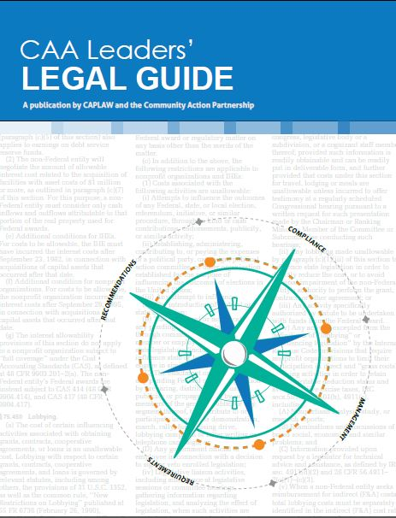
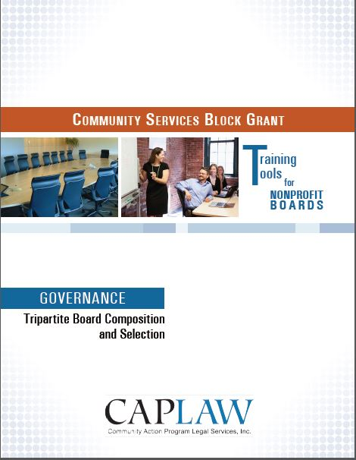
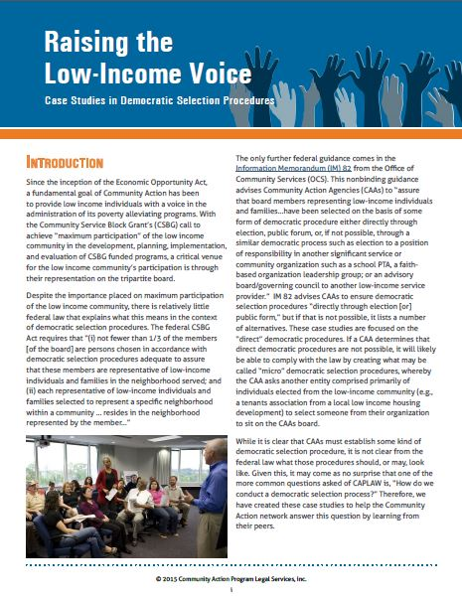
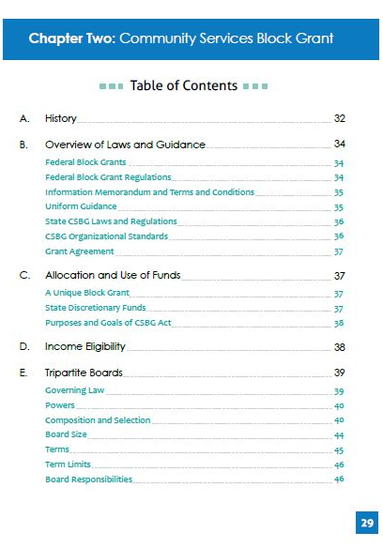
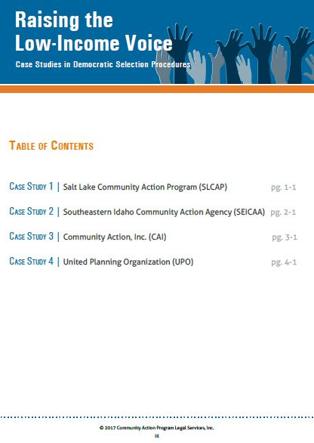
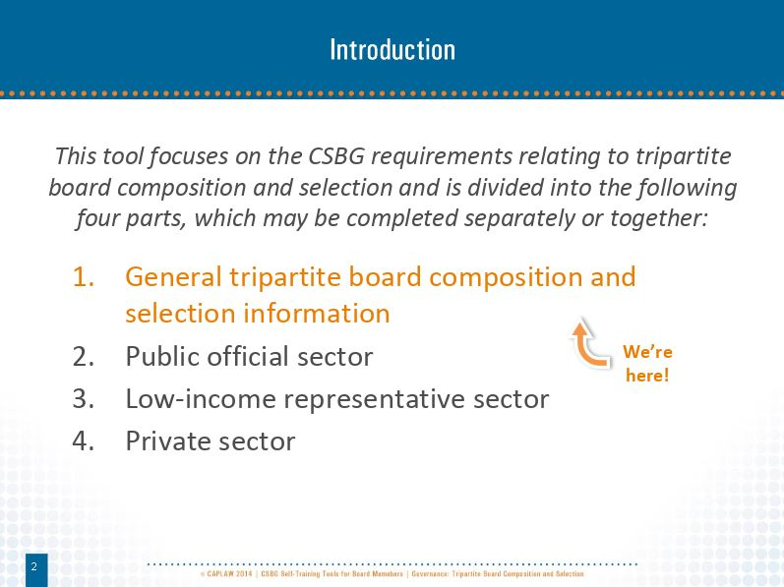
Tripartite Composition Resources
www.caplaw.org
Notes:
CAPLAW has a number of resources that tripartite boards may use to better understand the tripartite board composition requirements in the federal CSBG Act.
For those board members that retain information better from reading it, the CAA Leaders’ Legal Guide includes a chapter solely focused on the federal CSBG Act requirements applicable to tripartite boards, and in particular, the composition provisions in the Act.
For those boards that enjoy a more interactive approach to learning and reviewing information, the CSBG Training Tool for Nonprofit Boards walks through the federal CSBG Act requirements applicable to each of the three sectors. The Tool uses a facilitator’s guide, power point slides and exercises to help boards grasp the requirements.
Lastly, for boards that want to focus more on the democratic selection process requirement applicable to low-income sector representative seats, CAPLAW’s resource, Raising the Low-Income Voice: Case Studies in Democratic Selection Procedures, presents the selection procedures of four different CAAs and includes samples of the documents they use to facilitate their efforts.

Slide 10
HHS Block Grant Regulations
HHS block grant regulations establish that the federal government will generally defer to a state’s interpretation of the federal CSBG Act. True or False
Apply to all block grants issued by the U.S. Department of Health and Human Services (HHS)
45 C.F.R. Part 96
  Subpart I specifically applies to CSBG funding
Notes:
True. The HHS block grant regulations mainly establish that deference is to be given to the state with regards to the interpretation of the federal CSBG Act. Generally, the state’s interpretation of the Act will stand unless it is found to be “clearly erroneous”, i.e., in direct conflict with the federal CSBG Act. It is important for the board to understand the role of the state CSBG office in facilitating the CSBG program and how essential it is for the state CSBG office and CAA to work together to ensure that the CSBG program is successful.
While the HHS block grant regulations apply to all block grants issued by HHS, the regulations also include a few provisions specific to each grant. For CSBG, those specific provisions are found in Subpart I.

Slide 11
OCS Guidance
Guidance issued by the federal Office of Community Services (OCS) in the form of Information Memoranda (IMs) may create new legal requirements that are automatically binding on CAAs. True or False
OCS IM 82 provides guidance to tripartite boards regarding:
  Composition requirements
  Role and responsibilities
Notes:
False. Office of Community Services’ (OCS) Information Memoranda (IMs) are not binding on community action agencies (CAAs). Rather IMs are issued for state CSBG offices, as a state CSBG office is the direct grantee of CSBG funds from OCS. Generally, IMs are guidance and not binding on the state. Even though IMs are directed to the states, they offer CAAs insight into OCS’s interpretation of CSBG program requirements and can be very informative for CAAs.
One IM that is particularly relevant to tripartite boards is IM #82. This IM is the only guidance CAAs have from the federal government that speaks to the tripartite composition requirements and the directive that tripartite boards be fully engaged in the development, planning, implementation and evaluation of the CSBG program.

Slide 12
State CSBG Act and Regulations
CAAs must maintain compliance with state CSBG statutes and regulations, if they exist. True or False
May contain board requirements
  Example, terms and/or term limits, residency
CSBG Organizational Standards
  Standards from OCS IM #138
  Some standards specifically address board composition and responsibilities
Notes:
True. As previously discussed, deference is given to states with regards to the facilitation of CSBG programs. As a result, CAAs must maintain compliance with a state’s CSBG statutes and regulations.
Some states have passed CSBG statutes and regulations that mirror the federal CSBG Act, while others add additional requirements. Examples of additional requirements for boards may include:
Terms and/or term limits for board members. The federal CSBG Act does not address terms or terms limits. A state may impose such requirements and must do so in accordance with other applicable laws, e.g., the state nonprofit corporation act. If a state’s CSBG requirements do not address terms or term limits then it is up to the board to determine what approach works best for the CAA within the parameters, if any, set by the state’s nonprofit corporation act. The CAA’s approach should be reflected in its bylaws.
Residency requirements for board members. The federal CSBG Act does not impose a residency requirement on nonprofit tripartite boards. The federal Act only states that, if a low-income sector representative is selected to represent a specific neighborhood, the representative must live in that neighborhood. However, states may establish residency requirements for all or some of the sectors of the tripartite board.
To date, all states have adopted some form of the CSBG Organizational Standards set forth in the federal Office of Community Services (OCS’s) Information Memorandum (IM) #138. Unlike other IMs, Congress gave OCS the authority to require states to incorporate the Standards in the states’ CSBG statutes, regulations and/or policies. The Standards are one component of a larger performance management system. The purpose of the Standards is to strengthen the organizational capacity of CAAs to serve low-income communities and to increase accountability within the CSBG network.
The Standards are organized in the following three thematic groups comprising nine categories:
Maximum feasible participation, which speaks to the mandate of the CSBG Act to engage the communities being served by CAAs in their programs and decision-making to the furthest extent possible.
Vision and direction, which encompass organizational leadership, board governance and strategic planning.
Operations and accountability, which cover day-to-day operations and management of the CAA, including human resource management, financial operations and oversight and data and analysis.

Slide 13
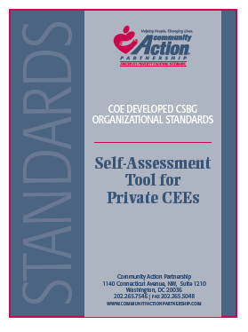
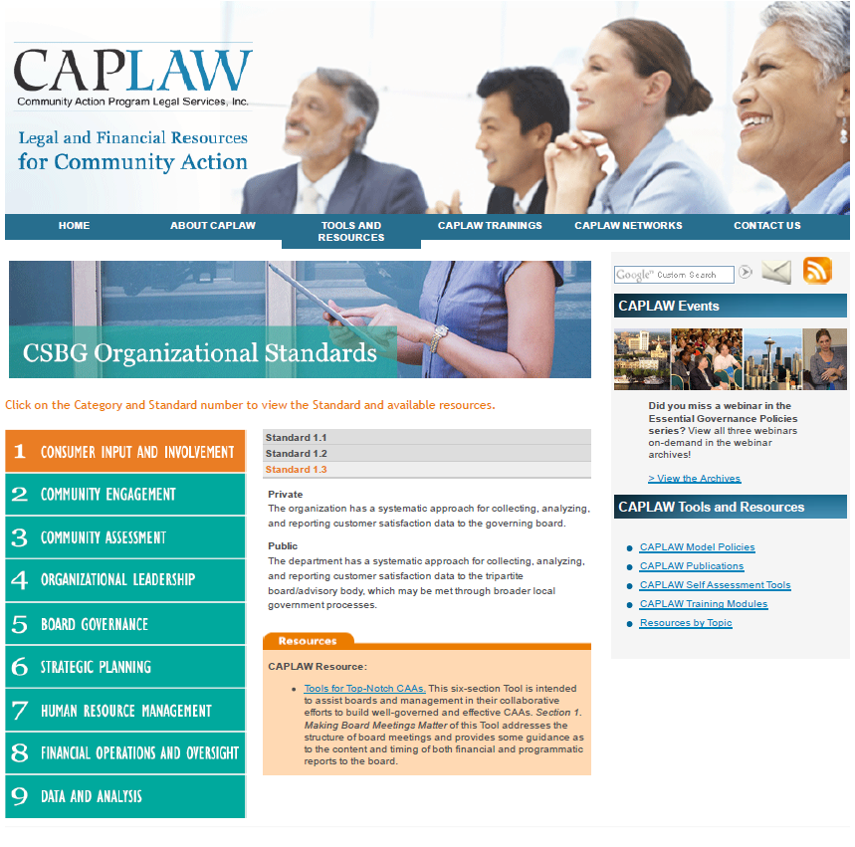
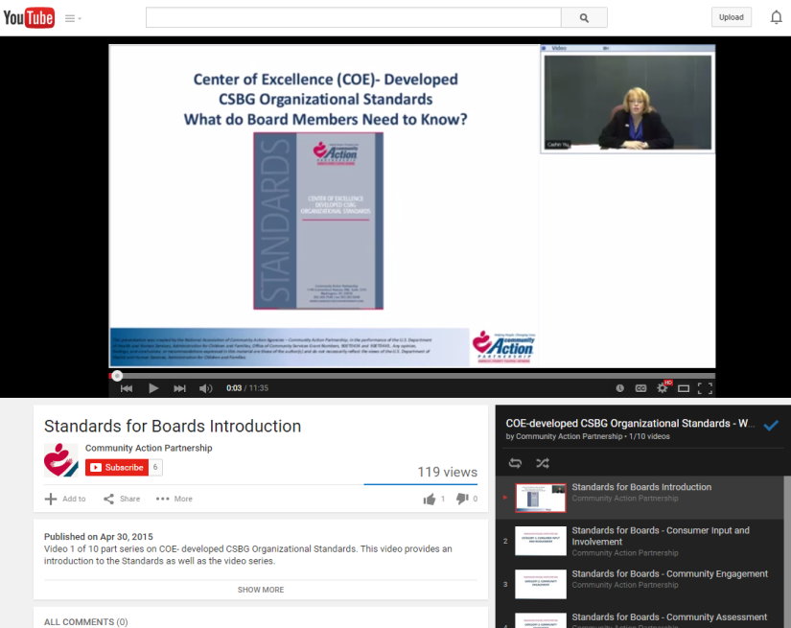
CSBG Organizational Standards Resources
www.communityactionpartnership.com and www.caplaw.org
Notes:
The National Community Action Partnership (Partnership) developed a whole series of technical assistance guides for each of the nine categories of the CSBG Organizational Standards. The guides provide CAAs with information on how to comply with each of the Standards.
The Partnership also created brief YouTube videos for board members to help them understand the Standards and what role the board specifically plays with regards to them.
CAPLAW also developed a resource that helps to connect CAAs with CAPLAW and some Partnership resources that provide guidance on what compliance with a particular Standard may entail.

Slide 14
CSBG Grant Agreement/Contract
CSBG grant agreements/contracts are usually non-negotiable. True or False
Contract/agreement should include citations or references to the state and federal CSBG requirements that apply to the board
  Example, tripartite composition requirement as set forth in the federal and, if exists, state CSBG laws
Notes:
False. A CSBG grant agreement/contract is like any other contract or grant agreement that a CAA enters into—it is subject to change based on negotiations. When the CAA receives its CSBG contract from the state, it should ensure that it fully understands all of its responsibilities under the contract and all of the federal and state laws it must follow. A CAA should have some process in place for reviewing the CSBG contract. The board of directors’ involvement in this process may range from authorizing the executive director to negotiate and sign the contract to reviewing the contract itself. Also, a state CSBG office may require a certain level of board involvement such as requiring the board chairperson to sign the contract.
A CSBG agreement/contract should reference the laws applicable to the CAA and the board and can serve as a helpful reference if confusion arises as to what CSBG requirements a CAA must follow. For example, CSBG agreements/contracts will reference the requirement for CAAs to have a tripartite board as set forth in the federal CSBG Act and the state’s CSBG laws, if they exist.

Slide 15
Other Funding Source Requirements
Federal CSBG Act governance requirements will override other federal funding source governance requirement if the two conflict. True or False
Examples of other funding sources with governance requirements:
  Head Start board composition, conflicts of interest and specific board responsibilities
  Community Housing Development Organization (CHDO) board composition
Notes:
False. The Federal CSBG Act’s governance requirements must be implemented alongside all other federal funding source governance requirements.
One example of another federal award’s governance requirements is the Head Start Act, which requires boards of Head Start grantees to have former or current Head Start parents serve on the board, as well as individuals with legal, financial and early education expertise serve or consult with the board. The Head Start Act also has very specific conflict of interest requirements such as a prohibition against financial conflicts of interests and against paying board members any compensation other than payments for reasonable expenses.
Another example of a federal funding source with a governance requirement that is sometimes difficult for a CAA to reconcile with the tripartite composition requirements is a Housing and Urban Development (HUD) Community Housing Development Organization (CHDO) requirement. The requirement limits the number of public officials or employees of a government entity that may serve on a board of any organization that receives CHDO funding. Because HUD broadly interprets “public officials or employees of a government entity” and only permits exactly 1/3 of the board to be comprised of such individuals, CAAs often struggle when individuals serving in the private sector fall within the definition of a “public official” under CHDO. Examples of individuals who may be considered “public officials” for CHDO purposes include a clerk in the water or sewer department of the local government, a public facility sanitation worker, or a professor of a public university.

