Slide 1

Board Roles & Responsibilities:
Public Community Action Agencies
PRESENTED BY:
[Trainer Name]
[Trainer Website or Email]
[Trainer Phone Number]
[Training]
[Date]
[Trainer Logo]
Notes:
Serving on the tripartite board of a public community action agency (CAA) is both rewarding and challenging. Even though a public CAA can exist in various forms, some of which are established under state and local laws, all public CAAs share the common thread of being controlled and managed by one or more local governments. This structure provides a tripartite board with the unique opportunity to internally influence local government involvement in improving the lives of those in the community who need it most. However, the board must do so within an established framework that adds a layer of operational complexity. Using scenarios and quizzes, this presentation focuses generally on how the tripartite board of a public CAA fulfills its role and meets its responsibility to be fully engaged in the development, planning, implementation and evaluation of the Community Services Block Grant (CSBG) program.
Note to Presenter: This presentation is basically a guide for those conducting trainings for tripartite boards and CAA staff that work with tripartite boards on the board’s roles and responsibilities. All the slides in the PowerPoint are annotated to provide the trainer with an understanding of the information that CAPLAW strives to convey when presenting on this topic. The intent is to support trainers in their own efforts to educate tripartite boards about the very vital role the board plays. We envision several ways that the Community Action network may use this presentation:
The presentation may be given in its entirety;
The slides may be presented in sections as noted on the webpage; and/or
The slides may be used to augment a presenter’s existing presentation.
The slides are not all-inclusive of the information that is important for tripartite boards to know. The slides are only intended to acknowledge the information that most tripartite boards will be tasked with overseeing. Every CAA is different and the way in which your CAA operates and the programs it runs will affect the information that has been included in this PowerPoint.
We recommend reading the brief introduction about this presentation for additional tips on using and printing this resource.

Slide 2
This training material was created in collaboration with Community Action Program Legal Services, Inc. (CAPLAW) and the Community Action Partnership (Partnership). The publication was created by National Association of Community Action Agencies - Community Action Partnership in the performance of the U.S. Department of Human Services, Administration for Children and Families, Office of Community Services Grant Number 90ET0465. Any opinion, findings, and conclusions, or recommendations expressed in this material are those of the authors and do not necessarily reflect the views of the U.S. Department of Health and Human Services, Administration for Children and Families.
Notes:
Note to Presenter: This is language we are required to include with this resource to acknowledge the funds that were used to pay for its creation. We ask that you include this slide in your presentation if you are presenting the PowerPoint or sections of the PowerPoint in its entirety and are not making any changes to the slides when doing so. However, if you make changes to the slides or incorporate a few slides into an existing presentation, rather than use an entire section, the language above is no longer applicable and it is not necessary to include it.

Slide 3
Legal Requirements Governing Tripartite Boards
Notes:
Multiple laws govern the way in which a tripartite board of a public CAA is composed and operates. In this section, I will provide a quick overview of how each of the applicable laws applies to a public CAA tripartite board and then walk through, very generally, the information that is important for tripartite boards to be aware of with respect to these laws.

Slide 4
Legal Requirements
State/local government laws
Other federal/state funding requirements
Bylaws/ governing document
CAA Boards
CSBG grant agreement/ contract with state
Federal CSBG Act, block grant regulation, guidance
State CSBG statute, regulations, policies
Notes:
State/local government laws: A public CAA is created under and generally governed by its local and state laws. While a public CAA is often a division or department of the local government, it may exist in other forms, such as a stand-alone entity formed pursuant to a local or state law and governed by two or more counties. All public CAAs share the common thread of being controlled and managed by one or more local governments. The local governing officials (e.g., the board of county commissioners, city council, board of selectmen, etc.) oversee the local government which includes the public CAA and its tripartite board.
Bylaws: Whether a public CAA tripartite board has a bylaws or some other form of governing document that establishes the framework for how the board will operate will depend on what the local laws require. Even if the local laws are silent, CAPLAW recommends that a public CAA adopt a form of bylaws or governing document that reflects the tripartite composition requirements, the authority of the board and how the board will operate (e.g., quorum and voting requirements, committee structure, officers, etc.)
Federal CSBG Act, block grant regulations, guidance: A public entity became a CAA when it applied for and received funds, initially under the Economic Opportunity Act, the precursor to the Community Service Block Grant (CSBG) Act. The U.S. Department of Health and Human Services (HHS) is the federal agency that oversees the CSBG program and passes rules (referred to as regulations) that apply to CSBG and other block grants. Additionally, the federal Office of Community Services (OCS) is a department in HHS’s Administration for Children and Families division that directly manages the CSBG program and issues mostly nonbinding program guidance in the form of Information Memorandum (IMs).
State CSBG statute, regulations and policies: Because CSBG is a block grant, states have primary authority to manage and facilitate the funding and, in an effort to do so, some states pass their own CSBG statutes, regulations and policies.
CSBG grant agreement/contract with state: To receive CSBG funding, all CAAs enter into grant agreements or contracts with the state CSBG office, which will typically incorporate other applicable federal and state laws. For many public CAAs, the grant agreement will be between the local government that oversees the CAA and the state CSBG office.
Other federal/state funding requirements: CAAs receive funding from other federal and state sources which may include governance requirements that apply to the CAA’s tripartite board.
Now, let’s turn to talking a little bit more about why each of these requirements is important for tripartite boards to know and how they affect the way in which a tripartite board governs the organization.
Note to presenter: the difference between a statute and a regulation: A federal “statute” is a law passed by U.S. Congress and a state “statute” is a law passed by the state legislature. Statutes will often include language in them that grant authority to a federal administrative agency (if it’s a federal statute) or state administrative agency (if it is state statute) to issue “regulations” that fill in the details of how to apply or implement a statute, and help flesh out compliance with the statute. For example, the federal CSBG Act authorizes the federal Department of Health and Human Services (HHS) to issue regulations to help flesh out the administration of block grants. Because of the nature of a block grant (i.e., that the state generally facilitates the funding), the HHS block grant regulations at 45 C.F.R. Part 96 are very bare bones and give deference to the states as the grantee and facilitator of the CSBG funding.

Slide 5
State/Local Government Laws
The authority of a tripartite board to take action on behalf of a public CAA is established by the federal CSBG Act. True or False
Authority of a public CAA tripartite board is often established by:
  Local governing officials of local gov’t where public CAA is a dept/division
  Local state/laws under which public CAA created
Notes:
False. The federal CSBG Act does not establish the authority of the tripartite board to act on behalf of a public CAA. Rather, the federal CSBG Act states that for a public CAA to receive CSBG funding, the CAAs tripartite board must actively participate in the development, planning, implementation and evaluation of the CSBG program. We will talk more about this requirement throughout the presentation.
The authority of the tripartite board is established typically in one of two ways: (i) by the local governing officials that oversee the local government in which the public CAA is a department/division or (ii) by the state/local law under which the public entity that receives CSBG funding was created. Some state/local laws that establish public entities are fairly detailed and specific. For example, the Tennessee Human Resources Agency law outlines the creation of a stand-alone public entity with a specific governance structure that requires the involvement of designated elected officials. Alternatively, the California Joint Powers of Authority law enables two or more local governments to create a stand-alone entity governed by local officials from each of the local governments.
Regardless of the form of a public CAA, local governing officials retain the ultimate authority to govern the entity and the tripartite board should work closely with the local governing officials to provide advice, make recommendations, and/or make decisions on behalf of the public CAA, all subject to the authority granted to the tripartite board.

Slide 6
Bylaws
While not always required, bylaws or a similar governing document serve as a useful operational guide for public CAA tripartite boards. True or False
Bylaws establish the ways the tripartite board will operate and may describe its authority to act
Bylaws typically reflect funding source requirements
  Ex., CSBG tripartite board composition and responsibilities; Head Start board composition, responsibilities and conflicts of interest requirements
Notes:
True. The local/state laws governing a public entity that receives CSBG funding will dictate whether the tripartite board is required to have bylaws or a similar governing document.
CAPLAW recommends that, regardless of what the local laws require, tripartite boards of public CAAs adopt bylaws or a similar governing document that establishes the framework within which the board operates. For a public CAA, the bylaws or similar governing document may delineate when the tripartite board has authority to act on behalf of the public CAA and describe different funding source requirements applicable to the board, such as the CSBG tripartite board requirement.
The bylaws, or similar governing document, should be provided to all board members and reviewed by them.

Slide 7
Federal CSBG Act
A public CAA may choose whether to use the tripartite structure as set forth in the federal CSBG Act for its board. True or False
1/3 elected or appointed public officials
At least 1/3 low-income reps
Remainder individual or group from private sector
Requires tripartite board to “actively participate” in the development, planning, implementation and evaluation.
42 U.S.C. § 9910(b)
Notes:
False. While there are many provisions in the federal CSBG Act that help establish the role and responsibilities of the board, there are two key sections in particular that are important for board members to know – the provisions establishing the tripartite board structure and the directive that the tripartite board must be fully engaged in the development, planning, implementation and evaluation of the CSBG program.
This question is a little more complex than it seems because the federal CSBG Act actually permits state CSBG offices, not individual public CAAs, to chose a “mechanism” other than the tripartite structure “to assure decision-making and participation by low-income individuals” on a public CAA tripartite board. This alternative is not available to nonprofit CAAs. CAPLAW is aware of a few states that permit certain types of public CAAs to use a variation of the tripartite structure.
If an alternative mechanism is not chosen by the state CSBG office, the federal CSBG Act requires a public CAA to maintain a tripartite board that consists of: (a) 1/3 of the board members being elected or appointed public officials, or their representatives who serve in the place of the elected or appointed official; (b) at least 1/3 of the board being democratically selected by the low-income community as representatives of that community; and (c) the remainder of the board being individuals or groups from the private sector, i.e., business, industry, labor, religious, law enforcement, or other major groups and interests in the community served.
We could spend an entire presentation discussing the tripartite composition; however the focus of this presentation is the board’s responsibilities. CAPLAW offers several other resources about the tripartite composition which I will discuss in just a moment.
The directive that the board be fully engaged in the development, planning, implementation and evaluation of the CSBG program is a statement that we will unpack in greater detail as we discuss board responsibilities in another part of this presentation.

Slide 8
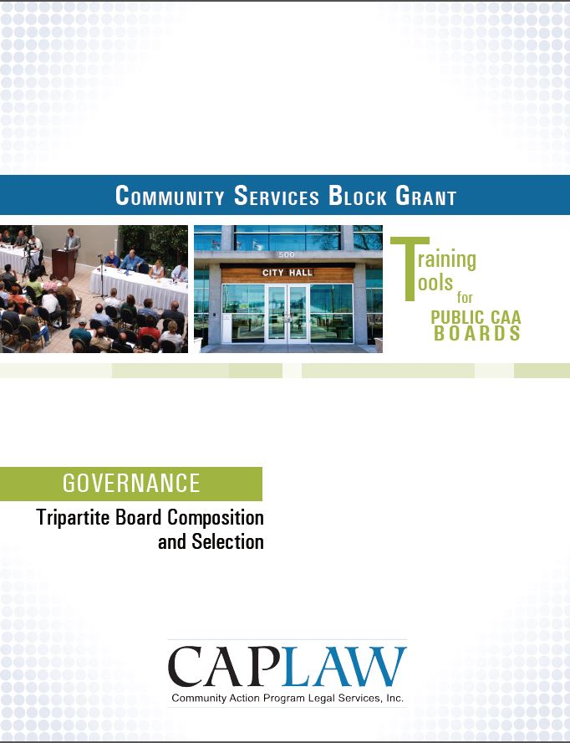
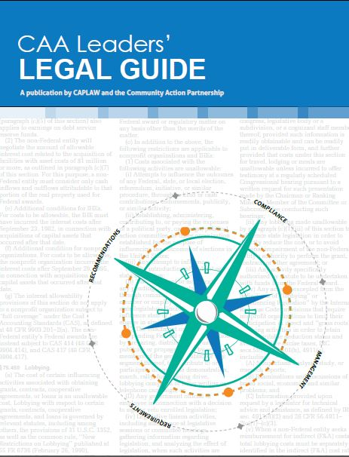
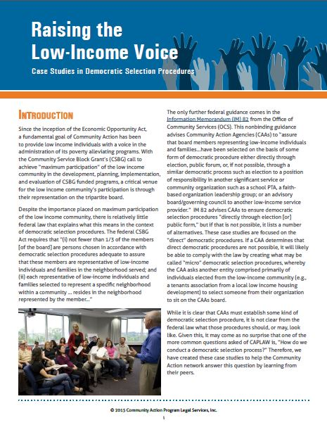
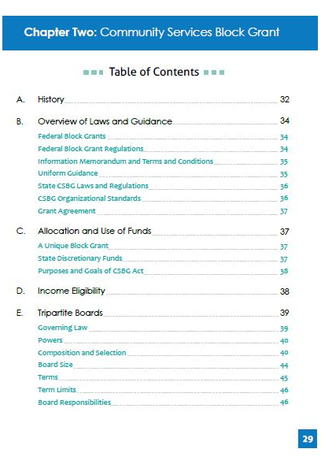
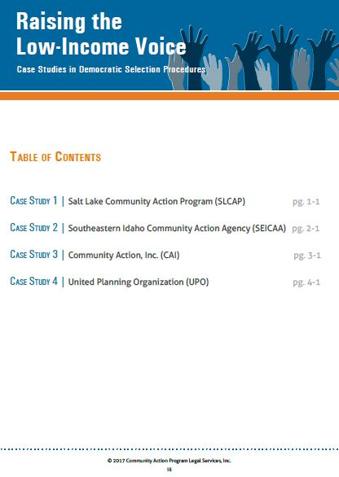
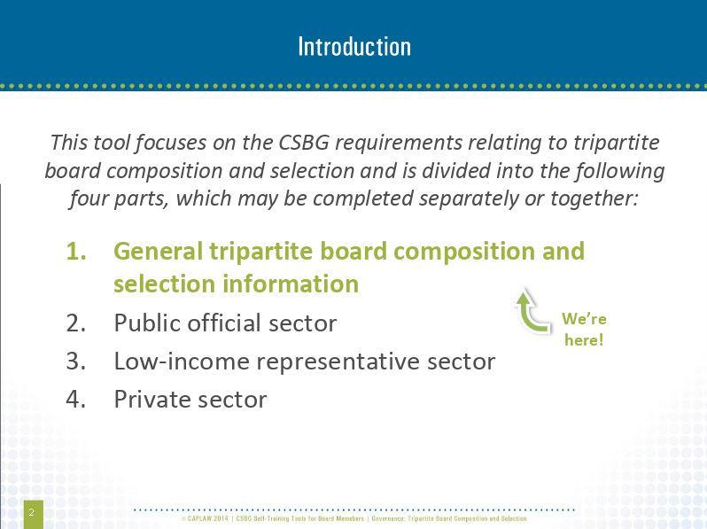
Tripartite Composition Resources
www.caplaw.org
Notes:
CAPLAW has a number of resources that tripartite boards may use to better understand the tripartite board composition requirements in the federal CSBG Act.
For board members who retain information better by reading the resource, the CAA Leaders’ Legal Guide includes a chapter solely focused on the federal CSBG Act requirements applicable to tripartite boards, and in particular, the composition provisions in the Act.
For boards who enjoy a more interactive approach to learning and reviewing information, the CSBG Training Tool for Public CAA Boards walks through the federal CSBG Act requirements applicable to each of the three sectors. The Tool uses a facilitator’s guide, power point slides and exercises to help tripartite boards grasp the requirements.
Lastly, for boards that want to focus more on the democratic selection process requirement applicable to low-income sector representative seats, CAPLAW’s resource, Raising the Low-Income Voice: Case Studies in Democratic Selection Procedures, presents the selection procedures of four different CAAs and includes samples of their CAA’s written democratic selection procedures.

Slide 9
HHS Block Grant Regulations
HHS block grant regulations establish that the federal government will generally defer to a state’s interpretation of the federal CSBG Act. True or False
Apply to all block grants issued by the U.S. Department of Health and Human Services (HHS)
45 C.F.R. Part 96
  Subpart I specifically applies to CSBG funding
Notes:
True. The HHS block grant regulations mainly establish that the federal government will defer to states in interpreting the federal CSBG Act. Generally, the state’s interpretation of the Act will stand unless it is found to be “clearly erroneous”, i.e., in direct conflict with the federal CSBG Act. It is important for the board to understand the role of the state CSBG office in facilitating the CSBG program and how essential it is for the state CSBG office and CAA to work together to ensure that the CSBG program is successful.
While the HHS block grant regulations apply to all block grants issued by HHS, the regulations also include a few provisions specific to each grant. For CSBG, those specific provisions are found in Subpart I.

Slide 10
OCS Guidance
Guidance issued by the federal Office of Community Services (OCS) in the form of Information Memoranda (IMs) are generally legally binding on CAAs. True or False
OCS IM #82 provides guidance to tripartite boards regarding:
  Composition requirements
  Role and responsibilities
Notes:
False. Office of Community Services’ (OCS) Information Memoranda (IMs) are generally not binding on community action agencies (CAAs). Rather IMs are issued for state CSBG offices, as a state CSBG office is the direct grantee of CSBG funds from OCS. Even though IMs are directed to the state and generally serve as guidance, they offer CAAs insight into OCS’s interpretation of CSBG program requirements and can be very informative for CAAs.
One IM that is particularly relevant to tripartite boards is IM #82. This IM is the only guidance CAAs have from the federal government that speaks to the tripartite composition requirements and the directive that tripartite boards be fully engaged in the development, planning, implementation and evaluation of the CSBG program.

Slide 11
State CSBG Act and Regulations
CAAs must maintain compliance with state CSBG statutes and regulations, if they exist. True or False
May contain board requirements
  Example, terms and/or term limits
CSBG Organizational Standards
  50 Standards for public CAAs from OCS IM #138
  Address board composition and responsibilities
  Application tailored to a public CAA to account for its unique structure
Notes:
True. As previously discussed, deference is given to states with regards to the facilitation of CSBG programs. As a result, all CAAs must maintain compliance with a state’s CSBG statutes and regulations.
Some states have passed CSBG statutes and regulations that mirror the federal CSBG Act, while others add additional requirements. An example of an additional requirement for tripartite boards includes terms and/or term limits for board members. The federal CSBG Act does not address terms or terms limits. A state may impose such requirements and must do so in accordance with other applicable state laws. If a state’s CSBG requirements do not address terms or term limits, then it is up to the board to determine what approach works best for the CAA. The board’s approach should be reflected in its bylaws or governing document.
To date, all states have adopted some form of the CSBG Organizational Standards set forth in the federal Office of Community Services (OCS’s) Information Memorandum (IM) #138. Unlike other IMs, Congress gave OCS the authority to require states to incorporate the Standards in the states’ CSBG statutes, regulations and/or policies. The Standards are one component of a larger performance management system. The purpose of the Standards is to strengthen the organizational capacity of CAAs to serve low-income communities and to increase accountability within the CSBG network.
The Standards are organized in the following three thematic groups comprising of nine categories:
Maximum feasible participation, which speaks to the mandate of the CSBG Act to engage the communities being served by CAAs in their programs and decision-making to the furthest extent possible.
Vision and direction, which encompass organizational leadership, board governance and strategic planning.
Operations and accountability, which cover day-to-day operations and management of the CAA, including human resource management, financial operations and oversight and data and analysis.
Even though one of the nine categories specifically focuses on board governance, the tripartite board’s responsibilities with respect to the Standards extends beyond this category. For example, with regards to the category addressing strategic planning, the tripartite board is required to receive an update on progress meeting the goals of the strategic plan or comparable document within the past 12 months.
The applicability of the Standards to a public CAA is tailored to account for the fact that local government entities oversee public CAAs and public CAAs must operate within the local government framework. This means that public CAAs, unlike nonprofit CAAs, must follow either (i) the local laws and requirements applicable to the local government or governments that oversee the public CAA and/or (ii) the state laws under which the public CAA was created. For example, a public CAA is not required to have an attorney review its bylaws or other governing document because a public CAA typically has access to the attorneys that work for the city or county that oversees the CAA.

Slide 12
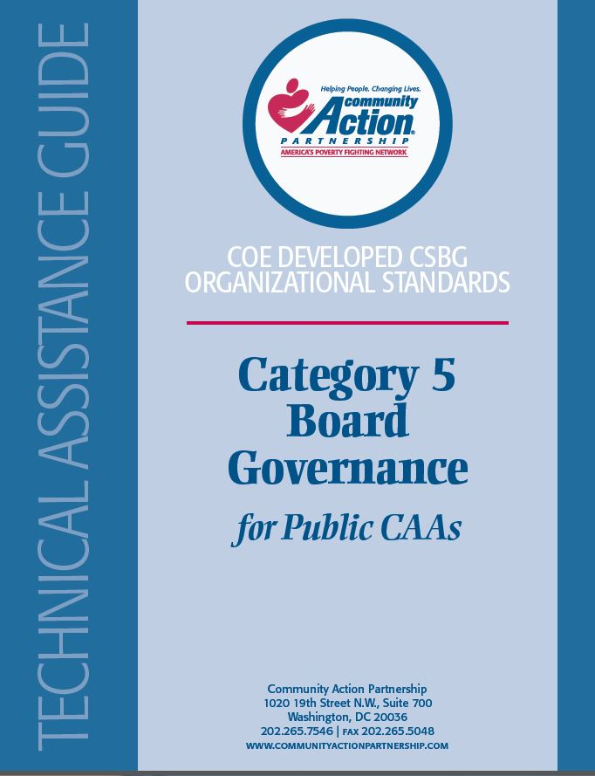
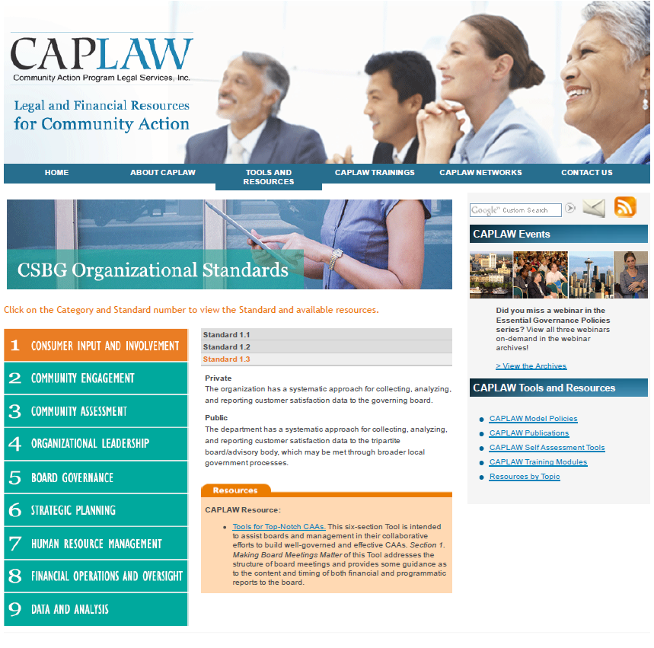
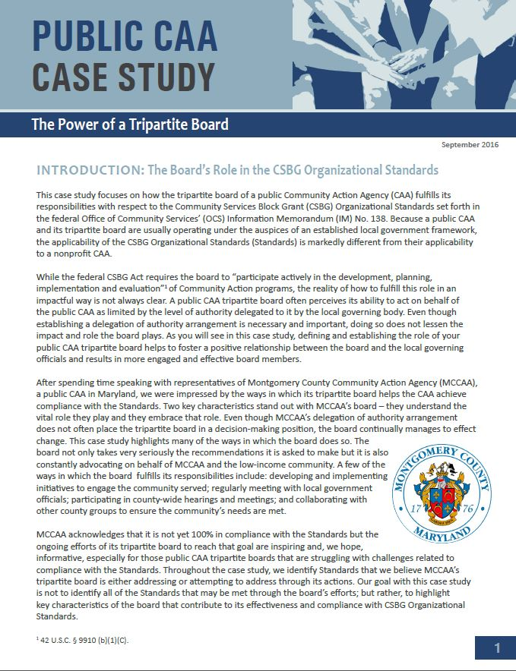
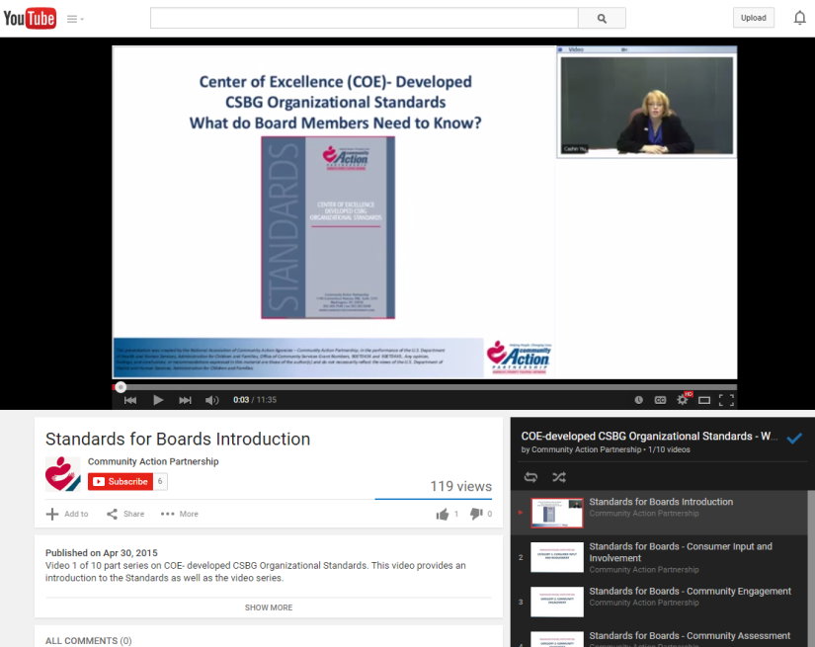
CSBG Organizational Standards Resources
www.communityactionpartnership.com and www.caplaw.org
Notes:
The National Community Action Partnership (Partnership) developed a whole series of technical assistance guides for each of the nine categories of the CSBG Organizational Standards. There are separate guides for nonprofit and public CAAs. The guides provide all CAAs with information on how to comply with each of the Standards.
The Partnership also created brief YouTube videos for board members to help them understand the Standards and the role the board specifically plays with respect to them.
CAPLAW developed a resource that compiles all CAPLAW (and some Partnership) resources that provide guidance on what compliance with a particular Standard may entail. This resource is available on CAPLAW’s website.
CAPLAW also developed a case study for public CAAs which focuses on how the tripartite board of a public CAA fulfills its responsibilities with respect to the Standards, especially when the tripartite board does not have authority to act on behalf of the public CAA. In this case study, the tripartite board makes recommendations to the local governing officials, which considers those recommendations when making decisions on behalf of the CAA. The case study focuses on how the tripartite board of the CAA, despite not having decision-making authority, continually manages to effect change within the CAA and help the CAA achieve compliance with the CSBG Organizational Standards.

Slide 13
CSBG Grant Agreement/Contract
CSBG grant agreements/contracts are usually non-negotiable. True or False
Contract/agreement should include citations or references to the state and federal CSBG requirements that apply to the board
  Example, tripartite composition requirement as set forth in the federal and, if exists, state CSBG laws
Notes:
False. A CSBG grant agreement/contract is like any other contract or grant agreement that the local government enters into to fund the public CAA — it is subject to change based on negotiations. When the public CAA receives its CSBG contract from the state, it should ensure that it fully understands all of its responsibilities under the contract and all of the federal and state laws it must follow. A CAA should have some process in place for reviewing the CSBG contract. The tripartite board’s involvement in this process may range from recommending to the local government that the head of the public CAA be authorized to negotiate the contract, to reviewing the contract itself. Also, a state CSBG office may require a certain level of board involvement, such as requiring the tripartite board chairperson to sign the contract.
A CSBG agreement/contract should reference the laws applicable to the CAA, and the board and can serve as a helpful reference if confusion arises as to what CSBG requirements a public CAA must follow. For example, CSBG agreements/contracts typically will reference the requirement for CAAs to have a tripartite board as set forth in the federal CSBG Act and the state’s CSBG laws, if they exist.

