Slide 1

Board Roles & Responsibilities:
Public Community Action Agencies
PRESENTED BY:
[Trainer Name]
[Trainer Website or Email]
[Trainer Phone Number]
[Training]
[Date]
[Trainer Logo]
Notes:
Serving on the tripartite board of a public community action agency (CAA) is both rewarding and challenging. Even though a public CAA can exist in various forms, some of which are established under state and local laws, all public CAAs share the common thread of being controlled and managed by one or more local governments. This structure provides a tripartite board with the unique opportunity to internally influence local government involvement in improving the lives of those in the community who need it most. However, the board must do so within an established framework that adds a layer of operational complexity. Using scenarios and quizzes, this presentation focuses generally on how the tripartite board of a public CAA fulfills its role and meets its responsibility to be fully engaged in the development, planning, implementation and evaluation of the Community Services Block Grant (CSBG) program.
Note to Presenter: This presentation is basically a guide for those conducting trainings for tripartite boards and CAA staff that work with tripartite boards on the board’s roles and responsibilities. All the slides in the PowerPoint are annotated to provide the trainer with an understanding of the information that CAPLAW strives to convey when presenting on this topic. The intent is to support trainers in their own efforts to educate tripartite boards about the very vital role the board plays. We envision several ways that the Community Action network may use this presentation:
The presentation may be given in its entirety;
The slides may be presented in sections as noted on the webpage; and/or
The slides may be used to augment a presenter’s existing presentation.
The slides are not all-inclusive of the information that is important for tripartite boards to know. The slides are only intended to acknowledge the information that most tripartite boards will be tasked with overseeing. Every CAA is different and the way in which your CAA operates and the programs it runs will affect the information that has been included in this PowerPoint.
We recommend reading the brief introduction about this presentation for additional tips on using and printing this resource.

Slide 2
This training material was created in collaboration with Community Action Program Legal Services, Inc. (CAPLAW) and the Community Action Partnership (Partnership). The publication was created by National Association of Community Action Agencies - Community Action Partnership in the performance of the U.S. Department of Human Services, Administration for Children and Families, Office of Community Services Grant Number 90ET0465. Any opinion, findings, and conclusions, or recommendations expressed in this material are those of the authors and do not necessarily reflect the views of the U.S. Department of Health and Human Services, Administration for Children and Families.
Notes:
Note to Presenter: This is language we are required to include with this resource to acknowledge the funds that were used to pay for its creation. We ask that you include this slide in your presentation if you are presenting the PowerPoint or sections of the PowerPoint in its entirety and are not making any changes to the slides when doing so. However, if you make changes to the slides or incorporate a few slides into an existing presentation, rather than use an entire section, the language above is no longer applicable and it is not necessary to include it.

Slide 3
Key Responsibilities of the Tripartite Board
Notes:
Unpacking what it means for tripartite board members to participate actively in the development, planning, implementation and evaluation of the CSBG program can seem daunting and overwhelming. The following section unpacks a board’s responsibilities by focusing on key responsibilities that encompass many of the actions board members must take to effectively fulfill their duties and obligations.

Slide 4
Key Board Responsibilities
Mission
Planning
Engagement
Maintain and Grow Funds
Performance
Accountability
Notes:
CAPLAW has identified 6 hallmarks of an effective tripartite board. Engaged boards acting and monitoring in these key areas are likely to be meeting and exceeding the governance requirements applicable to them. As we work through each of the six characteristics we will discuss how they tie in with the tripartite board’s responsibility to participate actively in the development, planning, implementation and evaluation of the CSBG program. We will also show how many of the CSBG Organizational Standards, especially those specific to a board’s responsibilities, are met through fulfilling these key responsibilities.

Slide 5
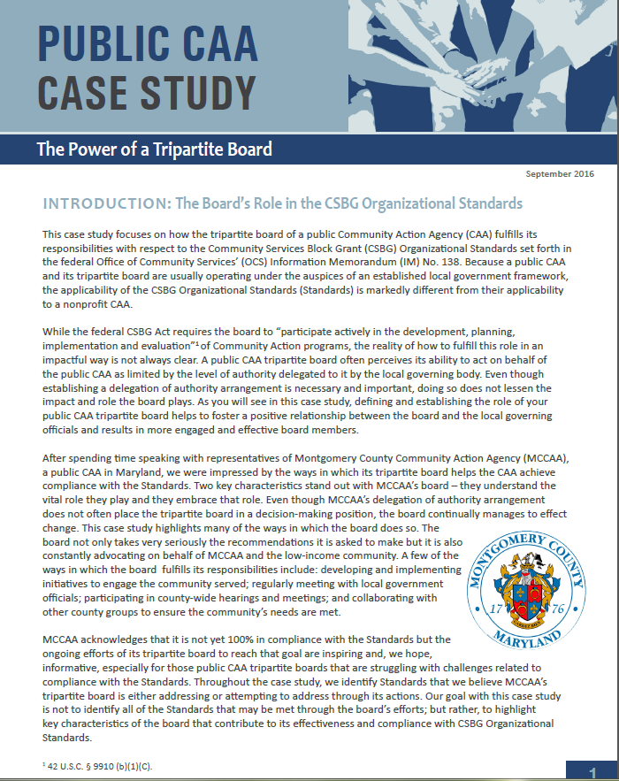
Public CAA Case Study:
Power of a Tripartite Board
Notes:
This case study focuses on how the tripartite board of a public CAA fulfills its responsibilities with respect to the CSBG Organizational Standards, which are referenced in the discussions of each of the key board responsibilities. Because a public CAA and its tripartite board are usually operating under the auspices of an established local government framework, the applicability of the Standards is markedly different from their applicability to a nonprofit CAA. After spending time speaking with representatives of Montgomery County Community Action Agency (MCCAA), a public CAA in Maryland, CAPLAW was impressed by the ways in which its tripartite board helps the CAA achieve compliance with the Standards; especially since the tripartite board does not have the authority to take action on behalf of the CAA. Rather the tripartite board submits recommendations to the local governing officials who carefully consider and often accept them.

Slide 6
Key Board Responsibility
Mission
Notes:
Our first focus is the mission of a public CAA. While a public CAA may rely on its local government’s mission, it still must feel confident that the mission reflects the purposes and goals of the CSBG program. A public CAA may decide that working with the tripartite board to develop a mission statement specific to the department or division is a more effective way to communicate the CAA’s purpose and direction as well as to inspire its stakeholders.

Slide 7
Know Your Mission Exercise
Write down your CAA's mission
  If you don’t know it exactly, write down the gist
Briefly describe 3 ways in which your tripartite board works with your CAA's mission
  For example, we discuss it in relation to new proposals or recite it at every meeting
Think about 1 way in which your tripartite board could better incorporate the CAA’s mission in its board meetings and activities
Notes:
Take a moment and write down your public CAA’s mission statement. If you don’t know it verbatim, don’t worry, write down the gist of it. After you have done that, either team up or work in a small group and describe three ways in which your tripartite board works with the mission statement. For example, your board recites the mission statement at the beginning of every board meeting or each board member is provided a copy of the mission statement when a new proposal is being reviewed and discussed. Lastly, after you’ve completed your discussions with your partner or group, take a moment and jot down one way your board could better incorporate the CAA’s mission statement in board meetings and/or activities.
Note to Presenter: you could ask for a few volunteers to report out or you could move forward with the presentation and, as you work through the remaining slides in this section, have participants revisit their exercise responses.

Slide 8
Why Mission Matters
Why mission matters:
  Provide clarity of purpose to stakeholders
  Guide major decisions
  Prevent “mission creep”
Why do you think mission matters?
Notes:
As previously mentioned, the mission statement serves as the driving force for your public CAA. The mission is thus very important for a number of reasons including:
A mission statement helps provide clarity to and unify stakeholders. Using a mission statement that is tailored to your public CAA can help both the local governing officials and your tripartite understand the importance of the work both bodies do on behalf of the CAA.
A mission statement guides all major decisions that the tripartite must make (especially which programs/projects to undertake, which to avoid, and which to stop doing).
The mission statement also ensures that a public CAA will resist “mission creep.” Having a clear mission that the board, staff and key stakeholders can come around helps the organization resist the temptation to expand into programs and services where it lacks appropriate skills and resources. There are many external and internal pressures that will cause mission creep in the absence of strong and intentional pushback.
Note to presenter: This slide is animated so you can ask workshop participants if they have anything to add with regards to why mission matters to a public CAA

Slide 9
Board Role and Mission
Review
Update
Use
Mission
Notes:
The tripartite board’s relationship with an organization's mission is multi-faceted and we will specifically talk about each of these facets. The board not only reviews the mission but may suggest updates, when necessary. The tripartite board is also regularly using the mission to guide its actions and fulfill its responsibilities.

Slide 10
Review Mission
A good mission statement:
  Is focused
  Solves unmet needs
  Leverages unique skills
  Inspires key stakeholders / is memorable
Notes:
A good, effective mission statement embodies several characteristics.
First, it is focused and specific. A mission statement should not be so broad and encompass so many activities that it is impossible to measure whether the public CAA is actually achieving any of its goals. If the mission statement is too long (e.g., half a page vs. a single sentence) and is difficult to remember, then it is not likely to be very memorable or effective.
Second, the mission should focus on needs that your public CAA believes is worth tackling. This communicates why your CAA exists and the motivation behind its activities.
Third, the mission statement should help your CAA leverage its unique skills. It is important for the statement to reflect the uniqueness of your CAA and the values that define it.
Finally, a mission statement should also inspire key stakeholders. Board members should be able to readily recite the mission. If very few stakeholders know and understand the mission of their organization, likely very few of them will feel any degree of passion or commitment toward it.

Slide 11
Update Mission
Producing an effective mission statement often involves:
  Commitment from the top
  Participation by a wide range of stakeholders
  A well defined revision process
  Determination of key components
  Careful crafting – active, concise, specific
CAPLAW Article
Mission Possible: Understanding & Developing an Effective Mission Statement
http://caplaw.org/resources/articlesbytopic/Governance/CAPLAW_EffectiveMissionStatement_Fall2010.pdf
Notes:
If a tripartite board feels that the local government’s mission statement is not addressing the purpose and goals of the public CAA, it should work to either revise the statement or update (or create if it doesn’t have one) its own statement. There are as many ways to update and rework a mission statement as there are mission statements. However, there are several constants in the process that help produce an effective mission statement. These constants are: (1) commitment from the top down and (2) participation from a wide range of stakeholders.
Defining the process by which the tripartite board will revise the public CAA’s mission statement helps in producing an effective one. One common, often fruitful method, is to conduct a retreat with a representative group of stakeholders, such as tripartite board members, local governing officials, community leaders and members, staff, and clients. The retreat may take the form of a part-day or full-day session in a conference room or an off-site gathering over a longer period of time. This approach demonstrates the commitment of top management to the mission statement development process and it gives many different stakeholders an opportunity to share their views of the public CAA’s mission. If not a retreat, then a series of meetings may suffice and ease the time commitment on the stakeholders. Additionally, surveys could be used to obtain the stakeholder input.
After defining the process, it is important to determine the key components of the mission statement. The goal is to generate a list of specific items that define your organization. At this stage it is critical to have a wide selection of stakeholders involved. Some questions to ask include: what does your CAA do on a daily basis?, how does your CAA achieve its mission?, who is impacted by your CAA?, where does your CAA operate?, does your CAA have specific values that set it apart from other organizations?
The responses to these questions could be elicited from the group in written survey form or as a group activity. The answers will form the building blocks for the next stage of the process in which the mission statement is drafted.
An effective mission statement also requires careful crafting. This mission statement must contain enough substance to appropriately convey the mission of the CAA but be concise enough so that the CAA’s stakeholders can easily memorize and recite it. There are no universally applicable rules here, but some helpful guidelines are: state the mission actively (for example, CAA [verb]); keep the mission statement short, but provide enough detail to be able to make decisions based on the mission statement (for example, if someone proposed a new program during a board meeting, could the mission statement provide guidance as to whether the suggested program would be consistent with the mission of the organization?); and stick to specifics.
For example, if a CAA were to decide that its mission components are (1) reducing the impact of poverty; (2) by granting funds to organizations focused on job training, housing assistance, and social services; (3) in Tremont County, then an effective mission statement could be: Tremont County Community Action Agency, Inc. is a division of the Tremont County government that, by mobilizing public and resources and coordinating a comprehensive network of educational, economic and social services in Tremont County, reduces poverty and enables low-income people in Tremont County to become self-sufficient.
Note to Presenter: While CAPLAW’s Mission Possible article referenced in the callout box on the slide is geared towards nonprofit CAAs, the article contains useful tips and approaches that may be adopted by public CAAs to help them guide the process for reviewing their mission statements.

Slide 12
Mission Revision Exercise
Your public CAA has died and at the memorial service for the organization with all of its stakeholders present, a spiritual leader states:
  Here lies [fill in the organization’s name]. It is an organization that was loved and will be missed. It will be remembered forever for:______________.
- Dr. Lisa McNary, NCSU
Notes:
Dr. Lisa McNary, a management consultant and instructor at North Carolina State University recalled her mentor, Dr. W. Edwards Deming, describing the following exercise as useful in developing a mission statement. Ask the top managers this:
Your organization has died and at the memorial service for the organization with all of its stakeholders present, a spiritual leader states, “Here lies [fill in the organization’s name]. It is an organization that was loved and will be missed. It will be remembered forever for:_____________________”
What goes in the blank is the essence of the organization’s mission.
Note to Presenter: Depending on the time, you could have the participants conduct this exercise either by themselves, with a partner or in a small group.

Slide 13
CSBG Organizational Standards
Mission
CSBG Org. Standard 4.1:
The tripartite board/advisory body has reviewed the department’s mission statement within the past 5 years and assured that: (1) The mission addresses poverty; and (2) The CAA’s programs and services are in alignment with the mission.
CSBG Org. Standard 3.1:
The tripartite board/advisory body formally accepts the completed community assessment.
The department conducted or was engaged in a community assessment and issued a report within the past 3 years, if no other report existed.
CSBG Org. Standard 3.5:
Notes:
Reviewing, updating and using the mission are board responsibilities reflected in the CSBG Organizational Standards. The Standards specifically direct board members to review the organization's mission within the past 5 years to make sure it feels confident that the statement addresses poverty and that the CAA’s programs are in alignment with the mission. We just discussed how a board reviews, updates (if necessary) and uses the mission statements – all of these actions show that the board is meeting this Organizational Standard.
Several other CSBG Organizational Standards that are related to the tripartite board’s role with respect to the public CAA’s mission include Standards 3.1 and 3.5. These Standards require the organization to conduct a community needs assessment, issue a report about the results, and have the board formally accept the completed assessment. The community needs assessment will help educate the board about the needs in the areas served by the public CAA and subsequently inform a CAA’s review of its mission.

Slide 14
Use Mission
Ways boards highlight and use the mission:
  Recite at board meetings
  Reference in meeting agenda
  Include on business cards
  Discuss in relation to all board actions
Notes:
Reviewing and updating the mission is only part of the tripartite board’s responsibility with regards to the mission. The most important role the board plays is to use the mission to guide the public CAA’s actions and make sure the executive director/department head is doing the same with staff. For example, understanding and using the mission might lead the public CAA’s staff to say “no” to attractive funding opportunities or compelling programs that are not aligned with their mission in order to say “yes” to going deeper in programs that do align with the mission.
There are multiple ways a tripartite board can ensure that it is regularly using and incorporating the mission into its activities. These include:
Reciting the mission at the beginning and/or ending of a board meeting. This will serve as a reminder to all board members of the important work they’ve been tasked with directing and overseeing.
Referencing the mission at the top of the meeting agenda. This is a great way to remind board members that the mission serves as the backbone for all actions to be taken by the board.
Including the mission statement on board member business cards. This helps board members remember and recite the mission when meeting with the community and stakeholders
Discussing the mission in relation to all board actions. Including the mission on the meeting agenda to serve as a reminder is even more effective if board members actually make a point of referencing the mission when discussing board actions.

Slide 15
Key Board Responsibility
Planning
Notes:
A significant responsibility of the tripartite board is to work with its local governing officials to set the direction for the public CAA. If the local government or division/department does not have a plan in place establishing the direction, then the tripartite board will take the lead on developing one. The planning required to do so involves, among other tasks, assessing needs, reviewing existing programs, forecasting future financial stability and growth, and making (sometimes tough, sometimes exciting) decisions about the future. Planning also requires constant assessing and revising. In this section, we will discuss the planning public CAAs engage in as a result of the CSBG funding they receive, and a few tools and resources the board may use to help frame and focus its planning efforts.

Slide 16
Planning Exercise
Name at least one of each of the following in relation to your CAA:
  Strength
  Weakness
  Opportunity
  Threat
Notes:
For those tripartite boards whose responsibilities involve planning (not just reviewing and accepting a plan), actually engaging in planning can be difficult to gasp as it is not as concrete as other board responsibilities. To better understand what engaging in planning might look like, ask workshop participants to participate in what is often referred to as the SWOT exercise. SWOT stands for Strength, Weakness, Opportunity and Threat. A SWOT analysis is used by boards to help build an organization’s strategy. Each workshop participant should take a moment to identify each of the following in relation to their organizations:
Strengths (e.g., sole provider of a service, passionate volunteers, loyal donors, clear vision and history). Questions to consider:
What does your organization do better than others?
What advantages does your organization have?
What do others see as your strengthens?
Weaknesses (e.g., small volunteer base, high staff turnover, lack of external communications). Questions to consider:
How could your organization improve?
What do others see as your weaknesses?
Opportunities (e.g., develop partnerships, expand volunteer and client base through robust communications, explore enhancement to or development of programs). Questions to consider:
What opportunities are you aware of?
What are new developments in the sector?
Threats (e.g., measuring success is difficult, cash flow, bad publicity). Questions to consider:
What obstacles does your organization face?
Could weakness threaten your organization’s sustainability?
Working through a SWOT analysis is one way for board members to develop a deeper understanding of their organization’s operations and efforts needed to further the mission. This understanding plays a crucial role in a board’s meeting its responsibility to think strategically about the organization’s future and planning accordingly.

Slide 17
Planning Under CSBG
Community Action Plan
3-Year Review
(Community needs assessment/CSBG-specific)
Strategic Plan
5-Year Review
(Organization-wide)
Notes:
The federal CSBG Act and CSBG Organizational Standards require that the tripartite board oversee two types of planning efforts by the public CAA. One is the preparation of the community action plan by staff, which is specific to CSBG-funded activities, and required by the federal CSBG Act. The plan involves the CAA conducting a community needs assessment to identify the population to be served and the assistance needed. These efforts often involve reviewing publicly available data such as the most recent census report, and engaging staff to develop surveys and conduct research to gather data from the community served. While the board is mainly tasked with voting to accept the needs assessment, a tripartite board may contribute to the data gathering process by convening community forums to solicit information on needs and suggestions for addressing those needs from those living in the area.
The community action plan informs a CAA’s strategic plan, which is the organization-wide document that establishes the direction and activities of the CAA. Under the CSBG Organizational Standards, a tripartite board is required within the past 5 years to review and accept its local government’s or department’s strategic plan. However, if no such plan exists, the tripartite board must develop a plan. While the board will likely organize a planning committee to work with the executive director/department head and staff to lead the planning efforts, the approach should focus on the “big picture” and include:
Thinking about mission and purpose;
Aligning strategic plan with overall mission;
Reviewing and adjusting (if necessary) all programs;
Identifying broad goals and priorities; and
Establishing and maintaining procedures for reporting on goals and results.

Slide 18
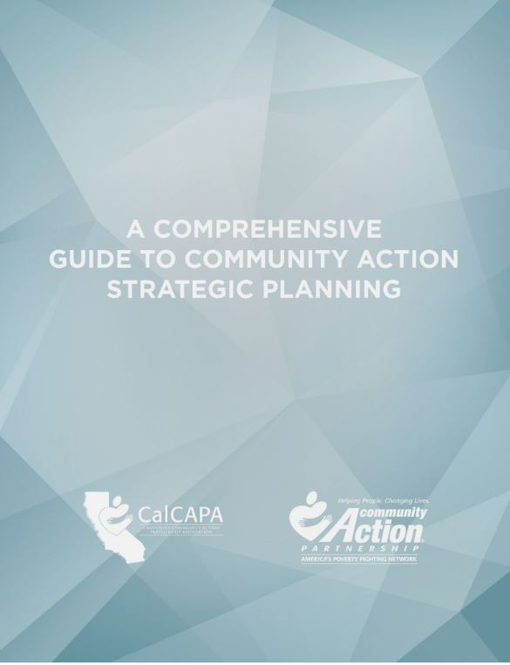
Development of Strategic Plan
Community Action Partnership & CalCAPA resource available at: https://communityactionpartnership.com/publication_toolkit/a-comprehensive-guide-to-community-action-strategic-planning-final-5/
Notes:
This guide developed by the California Community Action Association and the National Community Action Partnership was designed to help CAAs navigate the strategic planning process and successfully plan, develop, implement and evaluate strategic plans. As a comprehensive capacity building resource, the guide can also be used to refresh an existing plan, train program managers and agency leadership, or even develop a planning process for a community collaborative. The guide incorporates the CSBG Organizational Standards and walks through how both public and nonprofit CAAs maintain compliance with the Standards throughout the strategic planning process.

Slide 19
CSBG Organizational Standards
Planning
CSBG Org. Standard 6.1:
CSBG Org. Standard 3.1:
CSBG Org. Standard 3.5:
The department has a strategic plan, or comparable planning document, in place that has been reviewed and accepted by the tripartite board/advisory body within the past 5 years. If the department does not have a plan, the tripartite board/advisory body will develop the plan.
The department conducted or was engaged in a community assessment and issued a report within the past 3 years, if no other report exists.
The tripartite board/advisory body formally accepts the completed community assessment.
Notes:
The CSBG Organizational Standards require all CAAs to either review and accept or develop strategic plans as well as conduct a needs assessment that the board will formally accept. The Standard does not necessarily require a tripartite board to develop a new strategic plan every five years. Rather the Standard directs the board to review its existing strategic plan and ensure that it is truly reflective of community needs as reported in the community assessment, in line with the organization’s mission, and reflective of the organization’s goals. Organizational Standards 6.2 through 6.4 set forth information that the plan must address and contain. As previously noted, these Standards are addressed in the Comprehensive Guide to Community Action Strategic Planning developed by the National Community Action Partnership and the California state association, CalCAPA.

Slide 20
Engage in Planning
Approaches to help the tripartite board meet its planning and strategy development obligations:
  Form a planning/strategy committee
  Uses the strategic plan to frame board discussions
  Use a strategic agenda
Notes:
The strategic plan should be a living document that is regularly referred to and used. To encourage a commitment to planning, boards should consider implementing a planning/strategy committee. The committee could serve as the point of contact for staying on top of the board’s role in strategic planning, the goals set through that process, and the follow-up and reporting from those goals.
Another way to engage the board in strategic planning is for the board chair and executive director/department head to refer to and use the CAA’s strategic plan when developing meeting agendas and framing board discussions. A strategic agenda can help with these efforts as it encourages board discussions and actions to be taken in the context of the organization’s strategic efforts, rather than promoting an environment where board members are mainly listening to reports by committees and staff.

Slide 21
Strategic Agendas
Strike a balance between “routine” agenda items (e.g., contract approvals etc.) and strategy discussions
How will agenda items and information provided to board members help tripartite board:
  Connect with the CAA’s mission
  Enhance board functioning
  Provide oversight
  Identify and make decisions on key issues
Notes:
A strategic agenda requires the board chair and the executive director/department to carefully consider the strategic direction of the organization and the need for input on that direction while still attending to the routine items that must be addressed to support the organization’s operations. In developing a strategic agenda, the board chair should connect agenda item discussions with the public CAA’s mission and the board’s oversight role. Strategic agenda items should enable the board to function more efficiently and effectively by focusing the board’s energies on key issues.

Slide 22
Consent Agendas
Used for routine, procedural, informational, and self-explanatory non-controversial items
Helps streamline meetings
If using, be sure to educate board members on:
  Purpose , i.e., not used to force through decisions
  Process, i.e., allows for removal of item upon request
Notes:
A consent agenda is tool that boards may use with a strategic agenda to help focus efforts on strategy. A consent agenda groups together the routine, procedural, informational and self-explanatory, non-controversial items typically found in a meeting agenda. These items are typically presented to the board in a single motion for yay or nay vote after allowing for requests to move a specific item to the full agenda for individual attention. Consent agendas streamline meetings, reduce the amount of time spent approving motions that do not require further discussion, and allow the board to dedicate more time to focusing on substantive issues.
If a tripartite board adopts a consent agenda, it should provide information for the consent items prior to the board meeting so that board members have sufficient time to review the materials. Any item requiring discussion should be removed from the consent agenda and discussed and voted upon separately at the board meeting.
It is important to remember that consent agendas should not be used to force through decisions and board members should always have the option to move items from the agenda for discussion and debate. A simple and direct question about a consent item may not necessarily result in automatic removal; however, if further questions arise, removal is likely necessary.

Slide 23
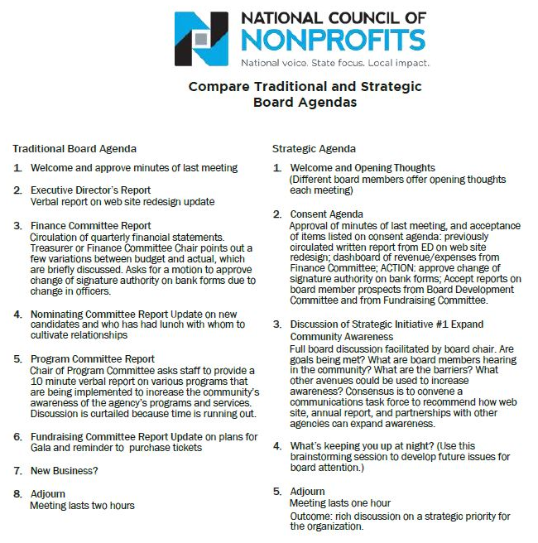
Notes:
Here is an example of a strategic agenda that includes a consent agenda. You can see how the focus of the strategic agenda shifts from committee reports and updates to discussions of strategic initiatives and concerns/thoughts for the future.
Tripartite boards hesitant to switch from an “old business/new business” format to a strategic agenda should consider alternating between the two agendas types. The board may find that it benefits more from a strategic agenda where they are tackling one or two items that relate directly to the mission, vision and organizational values and that require special attention. Switching between the two agendas is one way to help educate the board on the oversight value it brings to its public CAA as highlighted by the strategic agenda format.
Note to presenter: While this example is specific to boards of nonprofit organizations, it should give the tripartite board of a public CAA a better understanding of how it may adjust its agendas to achieve more effective meetings.

Slide 24
Strategic Dashboard
Financial Indicators
 |  | Target | This month | Last month | Last year end
Income Statement | Surplus/(deficit) YTD | $270,000 | $390,842 | $340,908 | ($570,240)
 | Surplus/(deficit) year-end forecast | $270,000 | $30,937 | $250,987 | ($570,240)
 | Earned income ratio | 11.5% | 10.3% | 11.8% | 13.0%
 | New grants success ratio | 50.0% | 35.0% | 33.0% | 50.0%
Balance Sheet | Days cash on hand (unrestricted) | 45 | 43 | 28 | 51
 | Reserve funds balance (1 month payroll) | $250,000 | $200,000 | $150,000 | $250,000
 | Current ratio | 2 to 1 | 5.8 | 4.2 | 6.2
 | AR aged over 90 days | 15.0% | 22.3% | 23.5% | 20.0%
Program Indicators
 |  | Target | This month | Last month | Last year end
 | Weatherization Contracts (monthly goal) | 20 | 21 | 22 | 15
 | Head Start enrollment | 100 | 60 | 58 | 109
 | Monthly job placements | 30 | 11 | 14 | 32
Notes:
Strategic dashboards are another way for an organization to focus its board on the critical issues. A dashboard is basically a brief snapshot of the public CAA at a fixed point in time – like a car dashboard that gives an instant update on many important factors (speed, gas left in the tank, engine temperature, whether the AC is on, etc.). A strategic dashboard is similar: it gives important information to decision makers such as executives and boards in a quick-read way.
Dashboards may be solely financial or programmatic or a combination of both. The example on this slide combines both. A dashboard should be comprehensive, but not so detailed as to hinder high-level, strategic questions. It will summarize data from many reports into one. Probably the trickiest and most time consuming aspect of dashboards is the analysis that goes into determining which metrics will most accurately portray the organization at this point in time. CAAs using dashboards should have explanations of the metrics, with context where necessary, and be flexible to the metrics changing and evolving so that they are as reflective as possible of the organization’s critical needs.

Slide 25
Agenda Exercise
Describe your CAA’s current board meeting agenda
List what items on the agenda may be suitable for a consent agenda
List the items that require the board to think strategically
Notes:
Note to Presenter: Developing a mock agenda could help workshop participants recognize ways in which they may improve their own approach to meeting agendas. This exercise may be done individually or in groups. Workshop participants should report their results and be encouraged to engage in a discussion about the reasons motivating the designation of items as consent versus strategic.

Slide 26
Key Board Responsibility
Engagement
Notes:
Being fully engaged means that tripartite board members are not only expected to make well-informed, reasonable decisions but also help the public CAA with its efforts to connect with the community it serves.

Slide 27
Engagement Scenario
Jack, a recently retired school superintendent, joined the tripartite board 10 years ago and continually gets re-elected to the private sector. He assumes he is on the board because the CAA operates an award-winning after school program. He is tired of attending community gatherings and interacting regularly with others – he did it for over 30 years with his school job. He likes his fellow board members and makes a real effort to attend the board meetings focused on education matters, but doesn’t worry if he can’t make other meetings.
Is Jack an engaged board member? Why or why not?
Notes:
Answer discussed on next slide.

Slide 28
Internal and External Responsibilities
With Board/ Local Governing Officials/CAA
With Stakeholders/ Community
Engagement
Notes:
You can think of board engagement as internal and external. The CSBG Organizational Standards explicitly require a CAA to engage with certain external stakeholders (e.g., social service providers, faith-based organizations, etc.). Board members contribute to these efforts through their community connections and willingness to advocate for the CAA and its programs. The CSBG Organizational Standards implicitly require board members to engage internally -- with the board (for example, by meeting composition requirements) as well as with the organization (for example, by participating in strategic planning efforts).
Jack is arguably not an engaged board member for two reasons. He is only concerned with one aspect of the CAA’s work, its award-wining after school program. Even though Jack brings a lot of experience to the board with respect to the after school program, he is essentially absent when it comes to the CAA’s other activities. Second, Jack has no interest in supporting the CAA’s efforts to educate the community about the vital role the CAA plays through the services it offers. Ultimately, however, it is up to the board to decide if the benefits Jack brings to the table outweigh his lack of engagement in certain areas.
In this section we will talk about ways in which the board can assess the type of board members that will be the best meet the needs of the public CAA and also help board members, like Jack, become more fully engaged.

Slide 29
Ways to Increase Engagement
Strategically Recruiting
Regularly Orienting & Training
Building Relationships
Conducting Assessments
Connecting with Community
Notes:
Boards can establish and increase both internal and external engagement of individual board members in a number of ways. We will discuss a few of these at a high level, which include:
how to think strategically about board member recruitment,
the importance of regularly orienting and training board members,
ways to build board member relationships,
the benefits of assessing individual and group perceptions, and
how board members can connect with the community served by the CAA.

Slide 30
Board Selection Procedure
Use board committee
Recruit smartly & strategically
Require applications
Follow selection procedures
Notes:
Developing an engaged board that can help the CAA further its mission can seem daunting, especially with the specific composition requirements that apply to tripartite boards. Thinking strategically about recruitment is the key. The following is a process may help with these efforts:
Use a committee (either governance or board development) to oversee the selection process. If you don’t have one, create one.
Recruit board members based on what you need: financial expertise, community connections, etc. The tripartite structure offers more flexibility than you may realize. For example, elected public officials often have skills beyond those of just being a politician. Try to tap into those elected public officials or representatives who can meet the needs of the CAA.
Require applications. Doing so can help educate interested applicants about what your CAA is looking for and also provide the CAA with the information it needs to select candidates who best fit the organization's current needs.
Follow selection procedures in the CAA’s bylaws or board operational guide. Many federal funding sources, including CSBG, have specific composition requirements for boards of entities that receive their funding. If procedures are not currently specified in your bylaws or board operational guide, add them or include them in separate governance policies approved by the board. Also, if changes to the procedures are needed to better position your CAA to attract the talent it is seeking, then take the opportunity to make those changes.

Slide 31
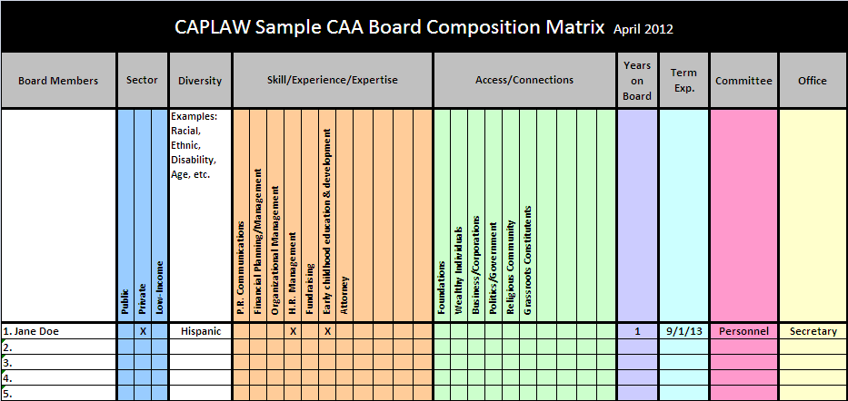
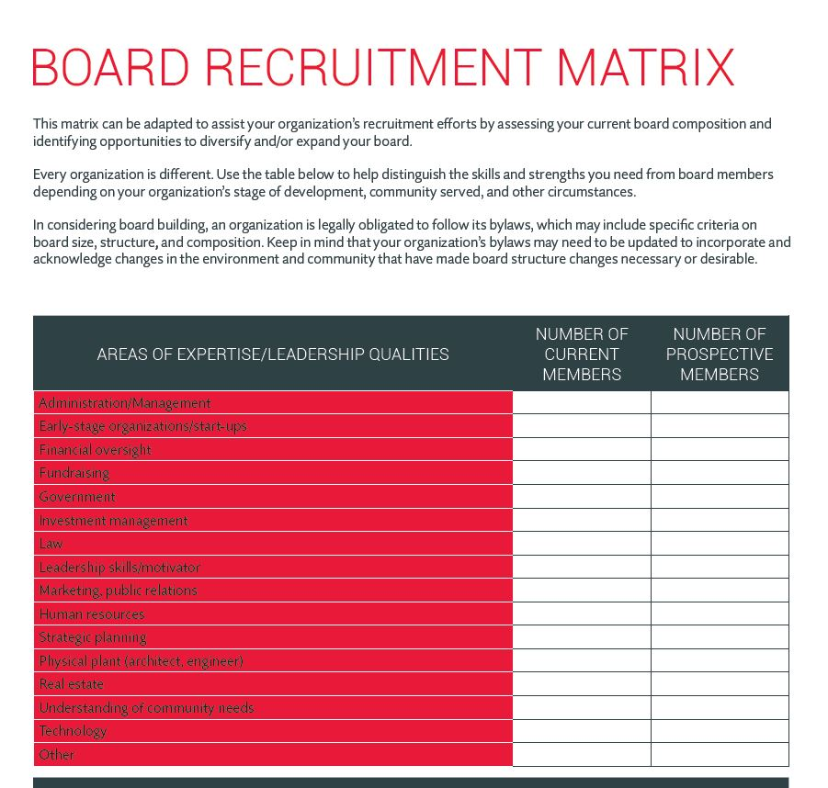
Recruitment Matrices
Board Source & CAPLAW
http://www.caplaw.org/resources/SelfAssessmentDocuments/CAPLAW_BoardComposition%20Matrix_April2012.xls
https://boardsource.org/board-recruitment-matrix/
Notes:
A composition or recruitment matrix is one way the tripartite board can take a step back and more fully understand who is currently serving on its board and what attributes the board should be seeking in its recruitment efforts. Board matrices can be customized to reflect specific organizational needs and help the board form a more strategic, targeted approach in seeking potential board members. However, it is important that your CAA does not solely rely on a matrix when making final decisions about board candidates. Someone who looks good on paper and checks off all of the boxes may not necessarily be a good fit for the board. In-person meetings often help convey information about potential candidates, such as their passion for your mission or ability to commitment to the organization, that is necessary for developing a successful and engaged board.

Slide 32
Training & Orientation Exercise
What Would You Do?
List the five most pressing topics for a board member orientation.
List the five topics that you think are essential to be covered in board trainings.
List three methods for providing training to the board.
Notes:
Note to Presenter: Workshop participants should take a moment either individually or in groups to discuss the topics they think should be covered in board orientations and trainings as well as the most effective methods for conducting such trainings. Doing so should help participants not only recognize the needs within their own organization, but also the role they individually play in helping all board members receive the information they need to meet their responsibilities.

Slide 33
Training & Orientation
Options
Use a governance committee to work with executive director and designated staff to:
  Develop a comprehensive approach
  Identify topics, e.g., financial oversight, board operations, etc.
  Establish methods , e.g., webinars, in-person, etc.
Notes:
33
Tripartite boards should consider establishing a governance committee to work with the executive director/department head and staff (as designated by the executive director/department head) to develop a comprehensive approach to training and orienting board members. The approach will likely be multifaceted and may include a mentorship program connecting more senior board members with new ones; a training schedule with specified times and days when training will occur throughout the year; and directives around attendance such as requiring all board members to attend some or all of the trainings.
As part of developing a comprehensive approach, the committee should consider topics essential to cover as part of an orientation, versus those that may necessitate more in-depth coverage and are thus better suited for a training. Some topics will be universal for all CAA boards such as board engagement, while other may be more specific to a particular CAA such as a board’s responsibilities with regards to a particular grant-funded program, like Head Start. Multiple options exist for how a board may identify the topics for both the orientation and training. Boards may: (1) survey their members either electronically or at meetings; (2) survey the executive director/department head and executive management who work with the board and its committees; (3) use board assessments that are conducted every two to three years; or (4) conduct meeting evaluations that include questions about board trainings. The same options used to identify topics could also be used to determine the best methods for conveying information. Different methods may be used to convey different types and amounts of information.
Sample orientation and training topics topics may include mission, history, programs, strategic direction, financial oversight, organizational structure, board composition, board roles and responsibilities, and board operation. Sample methods for convey the information for an orientation and trainings may include webinars, training modules, handbooks, mentoring, conference, retreats, one-on-one meetings, committee participation, on-site tours, staff presentations, and volunteering.

Slide 34
CSBG Organizational Standards
Board Orientation and Training
CSBG Org. Standard 5.7
The department has a process to provide a structured orientation for tripartite board/advisory body members within 6 months of being seated.
CSBG Org. Standard 5.8
Tripartite board/advisory body members have been provided with training on their duties and responsibilities within the past 2 years.
Notes:
Boards should also adopt a comprehensive approach to board orientation and trainings because the CAA will be monitored on these efforts pursuant to the CSBG Organizational Standards. The Standards specifically require CAAs to provide a structured orientation for governing boards within 6 months of new board members being seated and a training on their duties and responsibilities within the past two years. A board may show compliance with these Standards through a written orientation and training schedule and plan, board minutes reflecting the actual orientation and training and the board members who attended, sign-in sheets for the training and orientation, and a copy of the orientation and training materials.

Slide 35
Building Relationships
Executive Director/Dept. Head and Board Chair
Establish expectations
Frequency of check-ins
Priorities
Keep communication lines open
Regular communication
Identify and work to resolve differences in non-defensive ways
Issues to communicate
Communications style
Sounding board/feedback
Ways to support each other
Notes:
Another way to cultivate an engaged board is for the executive director/department head and board chair to develop a strong working relationship. The board chair is elected by the board to represent the individual board members and act as a conduit between the full board and the executive director/department head. The board chair presides over meetings, works with the executive director/department head to plan agendas, acts as the spokesperson for the board, and serves as a sounding board for the executive director/department head. Often times, the board gets the information it needs from the organization through the board chair, who communicates these needs to the executive director/department head. Thus, it is important that the executive director/department head and board chair are clear as to what they expect to receive and provide to each other.
Executive directors/department heads and board chairs should consider frequent check-ins where they can discuss issues and set priorities. They should educate each other regarding their preferred methods of communication, including the best way to serve as a sounding board and provide feedback. They should also discuss what type of support each is expecting and needs to fulfill the many responsibilities that each is tasked with. Keeping communications lines open and recognizing that differences will arise, while working collegially to resolve those differences, will likely result in the full board and the executive director/department head leading the public CAA in a well-informed and effective way.

Slide 36
Building Relationships
Board Members and Executive Director/Dept. Head
Meet one-on-one with board members
Periodic check-ins
Provide board members with opportunities to develop their skills as board members
Help board members get to know each other
Encourage board members to be actively engaged at board meetings
Notes:
While a strong working relationship between the board chair and the executive director/department head is necessary for a board to successfully function, there are also actions that the full board, in connection with the executive director/department head, can take to further deepen board member engagement. The executive director/department head, the board chair or governance committee chair or members should consider establishing one-on-one meetings with individual board members. These meetings could find out, among other things:
What motivates each to serve on the board?
How do they connect with the organization’s mission?
What do they hope to gain from board service?
What can they contribute?
What skills/knowledge do they need or want to develop to become a more effective board member?
What could make their experience more satisfying?
Also, periodically checking in with board members between meetings to see what support they may need or address concerns they may have helps to boost a board member’s interest and engagement. Educating board members about opportunities that align with their skills or can help them develop new skills will help them feel that they are contributing to the public CAA as well as growing from the experience of serving as a CAA board member. Helping board members get to know each other either by assigning new board members mentors and or inviting board members throughout the year to introduce themselves and tell their stories is another way to help board members feel invested in the board and the work they are tasked with. Another way to promote engagement is to assign specific tasks to board members, ask them to serve on committees, and conclude meetings with actions items that individual board members can take ownership of.

Slide 37
Building Relationships
Board Members and Local Governing Officials
Set regular meetings with governing officials
Provide governing officials with quarterly/ regular updates
Identify a liaison/point person between the two bodies
Involve local governing officials in tripartite board orientation and trainings
Notes:
Local governing officials and tripartite board members must work collaboratively for the public CAA to successfully further its mission and maintain its CSBG funding. It is thus essential that these two bodies regularly communicate with one another and are generally aligned in their efforts to oversee and support the CAA. Multiple ways exist for a tripartite board to develop and nurture its relationship with local governing officials. A few options include:
Setting regular meetings with governing officials. These meetings will likely involve a board committee and the tripartite board may decide to establish a standing committee that is solely focused on the tripartite board’s relationship with the local governing officials.
Providing governing officials with regular updates. The tripartite board should review the local governing officials’ annual meeting calendar, identify meetings that seem best suited for tripartite board updates and proactively request to be added as an agenda item for those meetings.
Identifying members of both bodies to serve as liaisons at the meetings of each. The tripartite board may consider creating an officer position whose responsibilities focus on ensuring that the two bodies are communicating and providing each other with the information needed for each to meet its responsibilities.
Involving local governing officials in board orientations and training. The tripartite board may also determine that conducting orientations and trainings specifically for local governing officials is an easier and more effective way to encourage and ensure participation by local governing officials. Such trainings and orientations may also occur as part of the local governing officials’ meetings.

Slide 38
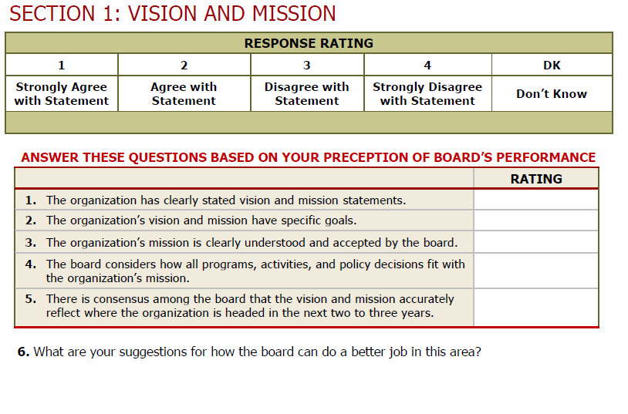
Board Assessment
Sample Excerpt
  http://www.virtualcap.com/downloads/MPI/IN-CAA-Board-Self-Assessment.pdf (developed by IN Community Action Assoc.)
Notes:
Conducting assessments that involve either the board members assessing the full board or their individual participation on the board is an opportunity for tripartite board members reflect on both their individual and shared responsibilities. Assessments are a vital governance tool that gives the board an opportunity to step back from its everyday business and address larger, more fundamental issues. Assessments can shake boards out of micromanaging the organization’s work and redirect their focus to governance issues. It can lead to a more engaged board—and a higher performing one. Assessments help board members identify varying perceptions, clarify and manage expectations and set priorities and goals. The result of a successful assessment could be to inspire the board to work more cohesively as a team to strengthen the organization.
On this slide is an excerpt from an assessment tool that was specifically created for CAAs by the Indiana Community Action Association. As you can see from this brief snippet, the assessment is basically giving the board and individual board members a chance to ask how they are doing. An assessment isn’t an opportunity to create another to-do list but is a chance for the board to fine-tune the way it operates in a targeted, effective way. An assessment should be viewed as an ongoing journey that leads to a healthy and productive discussion about the board’s strengths and weaknesses and results in an agreed-upon plan for building a stronger board and governance model.
An assessment may be too comprehensive a process to be carried out every year. Each board operates differently and will need to gauge what is the best time frame for them. Conducting an assessment every other year tends to be helpful for many boards. However, it doesn’t make sense to conduct an assessment if the organization is facing a crisis or some other pressing matter that is requiring everyone’s full attention. The process also isn’t effective when staff and board leadership are at odds with one another or when the organization or the board lack the capacity to enact the strategies that might grow out of the effort.

Slide 39
Board Assessment
Process
Get your full board on board!
Establish a group of board members to oversee the process
Administer the assessment tool
Tabulate responses
Discuss results – strengths, weaknesses
Establish a realistic action plan
Follow up and reassess!
Notes:
An assessment should be a team effort. A recommended approach is that either the governance committee or a few designated board members play an active role in the process and take some ownership for seeing that the results are used to effect change, when necessary. Once the assessment process is complete and responses tabulated, the board must take the time to discuss the results if the process is to be impactful. The governance committee, working with a staff person designated by the executive director/department head, may be charged with pulling together a report from the results to help facilitate the discussion and spearhead the development of an action plan. Most importantly, the board must make an effort to follow up, through meeting evaluations or board surveys, to determine if the plan addressed the results and what tweaks may be necessary.

Slide 40
Board Assessment
Resources
Decide on and use appropriate format/tool
  NH Center for Nonprofits, http://www.nhnonprofits.org/view/member-benefits/256
  National Council of Nonprofits, http://www.councilofnonprofits.org/resources/resources-topic/boards-governance/board-member-self-assessment
  VirtualCAP, http://www.virtualcap.com/downloads/MPI/IN-CAA-Board-Self-Assessment.pdf (tool developed by Indiana Community Action Association)
  The Nonprofit Association of Oregon, https://nonprofitoregon.org/helpline_resources/Board-Assessment-Tool
Notes:
Here are a few tools for conducting board assessments. While many of these assessments are tailored to nonprofit organizations, they serve as a good starting point from which a public CAA tripartite board can customize the tool to better reflect the way in which the board operates. No matter what tool a board uses, a good assessment needs to ask relevant and clear questions, collect systematic feedback from a variety of sources, and make use of the information for developmental purposes, rather than as a report card of board performance.

Slide 41
Connecting with Community Exercise
Fill in the Blank
Empowering the low-income community
  Ex., our tripartite board _______________________________
Effectively advocating for the CAA and its mission
  Ex., our tripartite board________________________________
Collecting and providing input on community needs
  Ex., our tripartite board________________________________
Developing and sustaining strategic partnerships and collaborations
  Ex., our tripartite board________________________________
Notes:
A public CAA garners the support it needs to survive and thrive if it is connecting with those individuals and families it serves as well as others in the community who can support the furtherance of the CAA’s efforts and mission. Connecting with the community embodies a hallmark of community action which is the “maximum feasible participation” of the low-income community served. The tripartite board serves as the face of the public CAA and must ask itself how it is engaging in activities like the ones listed above. Examples of how board members can connect with the community include:
Empowering the low-income community by spearheading a leadership development program for the CAA’s clients. A public CAA tripartite board developed a program that not only connected the board with the population the CAA serves but also helped to educate those who often feel voiceless as to how they can make their voices heard and produce results hopefully benefiting themselves and their community.
Advocating for the public CAA by speaking at community groups and participating in hearings on matters impacting the low-income community.
Collecting and providing input on community needs by holding forums seeking feedback from the community as to their needs and what assistance they believe will help them address those needs.
Developing and sustaining strategic partnerships and collaborations by working with other social service providers and groups who are serving the same community to determine what are the best ways they can individually and collaboratively help improve the lives of the low-income community served.
Now, it is your turn. Take a moment to fill in the blank for each of the bullets listed above with at least one way your tripartite board is connecting with the community. If you are not sure what your board might be doing to connect with the community, then make a proposal to take back to your board as an action item.

Slide 42
CSBG Organizational Standards
Community Engagement
CSBG Org. Standard 1.1
CSBG Org. Standard 2.1
CSBG Org. Standard 2.3
The department demonstrates low-income individuals’ participation in its activities.
The department has documented or demonstrated partnerships across the community, for specifically identified purposes; partnerships include other anti-poverty organizations in the area.
The department communicates its activities and its results to the community.
Notes:
Even though a tripartite board is not directly involved in complying with the CSBG Organizational Standards that require a CAA to engage the low-income community, collaborate with fellow providers and communicate results, the tripartite board’s efforts in these areas ultimately contribute to the success of the public CAA. There are actually a number of ways, as we just discussed, that a tripartite board can directly contribute to a CAA’s efforts to meet these Standards through deliberate efforts to connect with the community served.

Slide 43
Key Board Responsibility
Maintain and Grow
Funding
Notes:
Ensuring that the public CAA is maintaining, and when possible, growing its funding is not only a key board responsibility, it is a critical one. A public CAA is no different than a nonprofit CAA in that the survival of each is tied to having sufficient funds to operate. In this section, we will work through some questions to address the role of the board in overseeing and potentially growing the funds of a public CAA.

Slide 44
Funding Scenario
Darren has been a tripartite board member for 10 years and has become increasingly concerned about the public CAA’s financial standing. He hears rumblings about austerity measures in the county and fears that the board is not doing enough to help the CAA maintain its funding. Darren decides it is time for the board to take action but is not quite sure what actions the board can take since the public CAA is a division of the local government.
What advice do you have for Darren?
Notes:
A tripartite board plays an important role in helping a public CAA maintain not only its CSBG funding but also other financial supports that the CAA needs to operate within the local government framework. By regularly meeting with and educating the local governing officials about the CAAs needs and accomplishments, the board helps those who develop and decide the budget to make more informed decisions that will hopefully benefit the CAA. Further, as permitted by the local laws, board members should actively participate in local government hearings-- not only on the CAA’s budget--but also on the overall county budget.

Slide 45
Two Main Ways CAAs Generate Funds
Proposals
Writing grants
Preparing bid proposals
Putting on special events
Soliciting gifts
Fundraising
Capital campaigns
*
*
*
*
Executive director/dept. head and staff
Board, executive director/ dept. head and county counsel
Notes:
All CAAs typically receive funding in two main ways: (i) via proposals for grants from federal, state and private funding sources or (ii) via fundraising activities that target private donors. A public CAA typically relies on grants from government sources and must consult with its county counsel as to if and how it may engage other efforts to generate funds.
The federal grant rules that govern a CAA’s use of federal funds, the Uniform Guidance, allow for CAAs to pay for the costs that are associated with preparing both successful and unsuccessful bids, proposals, or applications on potential Federal and non-Federal awards or projects with federal funds as long as certain requirements are met as to how the costs are treated (i.e., as indirect) and when they are charged to the grant (i.e., during the accounting period in which they were incurred).
Cost associated with organized fundraising, which includes activities such as capital campaigns, special events, and solicitation of gifts and bequests, may not be paid for with federal funds without obtaining prior written approval from the federal awarding agency. To date, CAPLAW is not aware of any federal agency that has given fundraising approval.

Slide 46
Board’s Role in Generating Funds
Work with staff to develop plan
Oversee implementation of plan
Identify potential funders
Develop & nurture relationships
Consult with county counsel about fundraising options
Notes:
As previously noted, tripartite board members should consult with county counsel to determine ways that the board can engage in fundraising activities on behalf of the public CAA. One option, often of interest to public CAAs, is creating a nonprofit, tax-exempt subsidiary for the purpose of fundraising. The ability of public CAAs to pursue this option as well as other fundraising activities such as soliciting donations or conducting capital campaigns will be governed by state and local laws. If a public CAA is able to create a subsidiary for fundraising purposes, it should work closely with its county counsel to do so. Maintaining a subsidiary can be time consuming and administratively burdensome, so CAAs should carefully consider the benefits received from creating one compared to the effort expended to ensure that it is operating properly.
Even if the tripartite board is restricted by state and local laws in its ability to engage in certain fundraising activities, the board should consider taking other actions to support the CAA’s fiscal soundness. Such actions include:
Working directly with staff via a committee to develop a sustainability plan that focuses on ways in which the CAA is permitted to generate funds.
Overseeing the implementation of the plan with the executive director/department head.
Identifying potential funders. Board members could facilitate introductions between potential funders and staff.
Developing and nurturing relationships with funders and potential donors as well as those in the community so they recognize the value your CAA brings to the community. Board members could also accompany staff on funder and donor visits and offer to follow up with expressions of gratitude, when appropriate.

Slide 47
Key Board Responsibility
Strategic & Programmatic
Performance
Notes:
We now live in a data-driven society. Being able to show that a program is producing results is often the key to sustaining and attracting funding. In this section, we will talk about the role a tripartite board plays with respect to overseeing the performance of a CAA’s programs.
Note to Presenter: While this presentation does not refer to ROMA, this section of the presentation is where information about ROMA would likely be included. We encourage presenters with knowledge of the ROMA principles to include information about them as applicable.

Slide 48
Program Performance Exercise
List 3 reasons why a tripartite board should have a framework in place for reviewing the performance of the CAA’s programs.
The CSBG Organizational Standards require it.
ALL funders expect to receive information on how programs and services are making an impact.
It is the best way for the CAA to know what’s working and what’s not.
Notes:
Note to presenter: Ask workshop participants to take a moment to jot down three reasons why a tripartite board should have a framework in place for reviewing the performance of a CAA’s programs. This slide is animated so after asking for volunteers to report their answers, reveal the three reasons on the slide. It is likely that the workshop participants mentioned all three of the reasons listed.

Slide 49
Regular Strategic and Programmatic Reviews
Review at Every Board Meeting (Milestone / Programmatic)
Annual Review (Milestone / Programmatic/ Strategic)
5-Year Review (Strategic)
Notes:
A tripartite board oversees program performance by reviewing the goals it has set in comparison to the progress made in meeting those goals by the executive director/department head and his or her staff.
Reviewing programmatic goals and progress is not unique to CAAs and is usually required by non-federal funding sources as well. What is unique is that the CSBG Organizational Standards require CAAs to engage in organization-wide reviews, not just reviews of programs funded by CSBG. At every meeting, the board is tasked with receiving updates on the CAA’s programs. The board is not required to hear about every program at every meeting and they may decide what is the best, most effective way to receive the updates. For example, rather than having program directors or other members of the management team present detailed reports on CAA programs at each meeting, the board may have them prepare concise written reports that highlight recent developments. These reports can be included in the board packets sent to board members prior to the meeting. At the meeting, the executive director/department head can summarize the developments and issues outlined in the reports and board members can ask questions about the reports.
The focus of the annual review is to assess the progress the CAA has made towards meeting the goals set forth in its strategic plan.
The strategic review will be closely tied with the revision or further development of the CAA’s 5-year strategic plan. As with the annual review, programmatic and strategic goals and achievements will be assessed, and this information will be used by the board to inform its efforts in planning the future direction of the CAA.

Slide 50
CSBG Organizational Standards
Strategic and Program Performance
CSBG Org. Standard 6.5
CSBG Org. Standard 5.9
The tripartite board/advisory body has received an update(s) on progress meeting the goals of the strategic plan/comparable planning document within the past 12 months.
The department’s tripartite board/advisory body receives programmatic reports at each regular board/advisory meeting.
CSBG Org. Standard 6.1
The department has a strategic plan, or comparable planning document, in place that has been reviewed and accepted by the tripartite board/advisory body within the past 5 years. If the department does not have a plan, the tripartite board/advisory body will develop the plan.
Notes:
The CSBG Organization Standards establish the framework for a CAA’s program and strategy review. The board’s role is specifically outlined as one that approves plans, monitors progress, and receives updates.

Slide 51
Board’s Role in Programmatic & Strategic Performance
Establishing a culture of using data to make decisions
Performance management
How can we improve our . .
Outcomes?
Quality?
Cost effectiveness?
Notes:
In practical terms, a tripartite board’s role with regards to performance measurement involves establishing a culture of using data to make decisions. The graphic on this slide shows a somewhat simplistic view of what that means. A board that oversees the implementation of a constant feedback-and-response loop focused on improving program performance will strengthen its organization.

Slide 52
Board’s Role in Programmatic & Strategic Performance
Inquiring about relevancy of data received and the metrics used
Performance measurement
How will we know if we are meeting community needs prioritized?
What metrics matter?
What data will need to be captured?
Notes:
Part of developing a successful feedback-and-response loop requires inputting measures that assess the relevancy of the data received and the metrics used. The tripartite board is trying to answer the question, “How will we know if we are meeting the community needs we’ve prioritized?” and to properly do so it must work with the executive director/department head and staff to determine what data should be collected and what metrics will serve as the best guides for future decisions.

Slide 53
Key Board Responsibility
Accountability
Notes:
The tripartite board plays an instrumental role in ensuring that a CAA is accountable, i.e., fiscally strong, legally complaint and operationally sound. Maintaining accountability requires the implementation of systems, policies and procedures that the board oversees, reviews and approves. To gain and maintain public trust, a CAA must be able to show that it has a strong commitment to ethical principles, transparency and accountability.

Slide 54
Financial Oversight Quiz
Because a public CAA is often a division or department of the local government, the tripartite board has no real influence over the CAA’s budget. True or False
The tripartite board should work closely with local governing officials to ensure it receives the financial reports for the programs it oversees as permitted by local government procedures. True or False
Notes:
False. As we will discuss in greater detail in the following slides, there are a number of ways that a tripartite board of a public CAA that is a division or department of the local government may and should exercise influence over the local government budget, especially the sections relating to the programs the board oversees.
True. Again, we will discuss the tripartite board’s receipt of financial reports in greater detail in the following slides, however, it is important that the tripartite board work closely with the local governing officials so that the officials understand what the tripartite board needs to effectively fulfill its oversight responsibilities.

Slide 55
Oversee Financial Standing
1
  Receive financial reports at regular meetings
2
  Provide input on annual budget
3
  Develop dashboards
4
  Receive notification of audit and any CSBG findings
Notes:
The tripartite board, as permitted by the local government policies and procedures, oversees the CAA’s finances which includes reviewing how the CAA allocates its resources and protects its funds and resources from misuse or mismanagement. The board meets this responsibility by:
Reviewing financial statements
Providing feedback to the local governing officials on the annual budget.
Developing dashboards to focus the tripartite board on those financial indicators most relevant to the public CAA’s operations.
Receiving notification of the availability of the local government audit and any findings relating to CSBG

Slide 56
Financial Reports
An approach to financial reports may include:
  Preliminary review by finance committee
  Review by each board member
  Regular discussion
  Once-a-year discussions (e.g., annual budget, etc.)
  Question and answers
Notes:
As permitted by local government policies and procedures, the tripartite board may receive financial reports that provide information about the public CAA’s revenues and expenditures and a comparison of budget to actual. CAPLAW recommends a five-step approach to reviewing financial reports:
Step 1: Preliminary Review by the Finance Committee
Use a finance committee. One of the committee’s tasks should be to review the financial reports in advance of the board meeting and take the lead on discussing them at the meeting. If the CAA does not have a finance committee, someone should be designated to review the reports in advance of the meeting and lead the discussion. This person could be a board member or the CAA’s CFO or treasurer, depending on the CAA’s resources and circumstances. Even if a non-board member leads the discussion, CAPLAW recommends that the staff member review the reports ahead of time with a board member, such as the treasurer, so that at least one board member will have a more detailed understanding of the reports.
Step 2: Review by Every Board Member
Every board member should receive a packet of financial information at least one week in advance of the scheduled board meeting. The packet should include financial reports as permitted by the local government policy and procedures, and if possible, an analysis of the reports from the board’s finance committee or the CAA’s CFO or treasurer. Each board member—no matter how financially illiterate—should review the reports before the meeting.
Step 3: Regular Discussion of the Financial Statements
The meeting agenda should set aside sufficient time to permit a thorough discussion of the financial report. The discussion may include a review of:
Variances from budget—comparing what actually happened with the annual plan
Liquidity—the CAA’s ability to meet its obligations as they become due
Unrestricted net assets available for operations
Program-by-program analysis of revenue and expenses
Key financial metrics
Stability of the CAA’s grants and other revenue sources
Any other matters involving finances warranting discussion
Step 4: Once-a-Year Discussions
At least once a year, the tripartite board should discuss the following matters in detail: auditor’s annual report and management letter as it relates to CSBG findings; CAA’s annual budget; CAA’s compliance with the local government’s system of internal controls; CAA’s overall financial health, including its liquidity and unrestricted net assets; CAA’s long-term financial plans and needs. The board need not address all of these topics at the same meeting.
Step 5: Questions and Answers
Time should be set aside during each discussion of the CAA’s finances for a robust question and answer session. Questions should be encouraged.

Slide 57
Annual Budget
Provide input on CSBG budget process
Participate in hearings and meetings about budget
Monitor performance against budget during year
Help board members develop a high-level understanding of:
  Budget assumptions
  Cost centers
  Applicable grant requirements
Notes:
While a tripartite board may not have authority to develop the CAA’s annual budget, it should provide feedback on the CSBG budget process as permitted by local government policies and procedures. Tripartite board members should advocate for the CAA by attending hearings and meetings about the budget. The annual budget is also a useful tool for monitoring the CAA’s performance throughout the year. To facilitate use of the budget, the board should assist its members with developing a high-level understanding of the following aspects of a budget:
Assumptions: The annual operating budget represents the CAA’s best estimate or projection of income and expenses for the upcoming fiscal year. Sound budgeting requires systematic recording of the assumptions that are the basis of the projections. Clear documentation of assumptions will make it much easier to calculate the impact on the overall budget that will occur when assumptions change.
Cost centers. CAAs frequently operate multiple programs and in many instances, each program is supported through the use of resources from multiple sources. The use of a cost center budget structure facilitates describing how various programs will be supported and how various funding sources will be used in accordance with the requirements of specific funders. Budgets for all cost centers must be integrated into the comprehensive annual budget document. For example, a CAA with a Head Start, weatherization, and energy assistance programs will have budgets for each program as well as cost centers for general administration.
Grant requirements. Board members should have a high-level understanding of the goals of the financial requirements that apply to federal grants so they understand how the funding may be sued and the importance strong financial systems and processes.

Slide 58
CSBG Organizational Standards
Financial Oversight
CSBG Org. Standard 8.7
The tripartite board/advisory body receives financial reports at each regular meeting, for those program(s) the body advises, as allowed by local government procedure.
CSBG Org. Standard 8.9
The tripartite board/advisory body has input as allowed by local governmental procedure into the CSBG budget process.
Notes:
As previously noted, the CSBG Organizational Standards require that boards receive financial reports and provide input on the CSBG budget process as permitted by local government procedures.

Slide 59
CSBG Organizational Standards
Financial Oversight
CSBG Org. Standard 8.3
The department’s tripartite board/advisory body is notified of the availability of the local government audit.
CSBG Org. Standard 8.4
The department’s tripartite board/advisory body is notified of any findings relating to CSBG funding.
Notes:
As previously noted, the CSBG Organizational Standards require that boards are notified of the availability of the local government audit as well as of any findings relating to CSBG funding. The tripartite board will likely work closely with the local governing officials to help address and resolve any CSBG related findings.

