Slide 1

Board Roles & Responsibilities:
Public Community Action Agencies
PRESENTED BY:
[Trainer Name]
[Trainer Website or Email]
[Trainer Phone Number]
[Training]
[Date]
[Trainer Logo]
Notes:
Serving on the tripartite board of a public community action agency (CAA) is both rewarding and challenging. Even though a public CAA can exist in various forms, some of which are established under state and local laws, all public CAAs share the common thread of being controlled and managed by one or more local governments. This structure provides a tripartite board with the unique opportunity to internally influence local government involvement in improving the lives of those in the community who need it most. However, the board must do so within an established framework that adds a layer of operational complexity. Using scenarios and quizzes, this presentation focuses generally on how the tripartite board of a public CAA fulfills its role and meets its responsibility to be fully engaged in the development, planning, implementation and evaluation of the Community Services Block Grant (CSBG) program.
Note to Presenter: This presentation is basically a guide for those conducting trainings for tripartite boards and CAA staff that work with tripartite boards on the board’s roles and responsibilities. All the slides in the PowerPoint are annotated to provide the trainer with an understanding of the information that CAPLAW strives to convey when presenting on this topic. The intent is to support trainers in their own efforts to educate tripartite boards about the very vital role the board plays. We envision several ways that the Community Action network may use this presentation:
The presentation may be given in its entirety;
The slides may be presented in sections as noted on the webpage; and/or
The slides may be used to augment a presenter’s existing presentation.
The slides are not all-inclusive of the information that is important for tripartite boards to know. The slides are only intended to acknowledge the information that most tripartite boards will be tasked with overseeing. Every CAA is different and the way in which your CAA operates and the programs it runs will affect the information that has been included in this PowerPoint.
We recommend reading the brief introduction about this presentation for additional tips on using and printing this resource.

Slide 2
This training material was created in collaboration with Community Action Program Legal Services, Inc. (CAPLAW) and the Community Action Partnership (Partnership). The publication was created by National Association of Community Action Agencies - Community Action Partnership in the performance of the U.S. Department of Human Services, Administration for Children and Families, Office of Community Services Grant Number 90ET0465. Any opinion, findings, and conclusions, or recommendations expressed in this material are those of the authors and do not necessarily reflect the views of the U.S. Department of Health and Human Services, Administration for Children and Families.
Notes:
Note to Presenter: This is language we are required to include with this resource to acknowledge the funds that were used to pay for its creation. We ask that you include this slide in your presentation if you are presenting the PowerPoint or sections of the PowerPoint in its entirety and are not making any changes to the slides when doing so. However, if you make changes to the slides or incorporate a few slides into an existing presentation, rather than use an entire section, the language above is no longer applicable and it is not necessary to include it.

Slide 3
Key Responsibilities of the Tripartite Board
Notes:
Unpacking what it means for tripartite board members to participate actively in the development, planning, implementation and evaluation of the CSBG program can seem daunting and overwhelming. The following section unpacks a board’s responsibilities by focusing on key responsibilities that encompass many of the actions board members must take to effectively fulfill their duties and obligations.

Slide 4
Key Board Responsibilities
Mission
Planning
Engagement
Maintain and Grow Funds
Performance
Accountability
Notes:
CAPLAW has identified 6 hallmarks of an effective tripartite board. Engaged boards acting and monitoring in these key areas are likely to be meeting and exceeding the governance requirements applicable to them. As we work through each of the six characteristics we will discuss how they tie in with the tripartite board’s responsibility to participate actively in the development, planning, implementation and evaluation of the CSBG program. We will also show how many of the CSBG Organizational Standards, especially those specific to a board’s responsibilities, are met through fulfilling these key responsibilities.

Slide 5
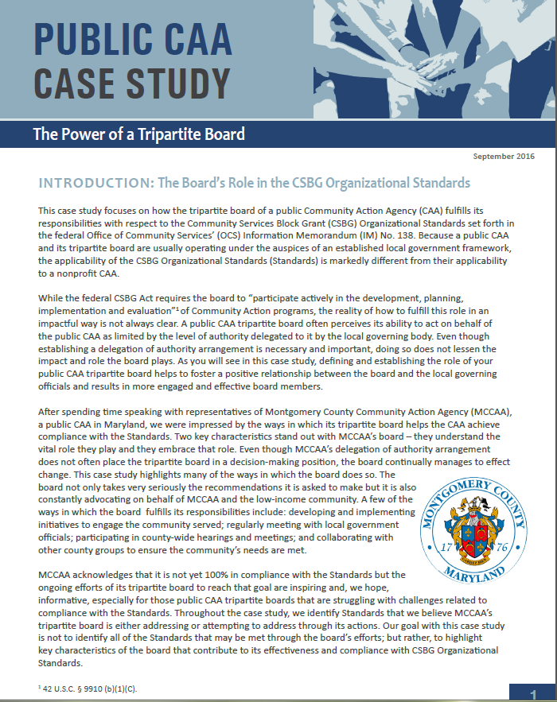
Public CAA Case Study:
Power of a Tripartite Board
Notes:
This case study focuses on how the tripartite board of a public CAA fulfills its responsibilities with respect to the CSBG Organizational Standards, which are referenced in the discussions of each of the key board responsibilities. Because a public CAA and its tripartite board are usually operating under the auspices of an established local government framework, the applicability of the Standards is markedly different from their applicability to a nonprofit CAA. After spending time speaking with representatives of Montgomery County Community Action Agency (MCCAA), a public CAA in Maryland, CAPLAW was impressed by the ways in which its tripartite board helps the CAA achieve compliance with the Standards; especially since the tripartite board does not have the authority to take action on behalf of the CAA. Rather the tripartite board submits recommendations to the local governing officials who carefully consider and often accept them.

Slide 6
Key Board Responsibility
Mission
Notes:
Our first focus is the mission of a public CAA. While a public CAA may rely on its local government’s mission, it still must feel confident that the mission reflects the purposes and goals of the CSBG program. A public CAA may decide that working with the tripartite board to develop a mission statement specific to the department or division is a more effective way to communicate the CAA’s purpose and direction as well as to inspire its stakeholders.

Slide 7
Know Your Mission Exercise
Write down your CAA's mission
  If you don’t know it exactly, write down the gist
Briefly describe 3 ways in which your tripartite board works with your CAA's mission
  For example, we discuss it in relation to new proposals or recite it at every meeting
Think about 1 way in which your tripartite board could better incorporate the CAA’s mission in its board meetings and activities
Notes:
Take a moment and write down your public CAA’s mission statement. If you don’t know it verbatim, don’t worry, write down the gist of it. After you have done that, either team up or work in a small group and describe three ways in which your tripartite board works with the mission statement. For example, your board recites the mission statement at the beginning of every board meeting or each board member is provided a copy of the mission statement when a new proposal is being reviewed and discussed. Lastly, after you’ve completed your discussions with your partner or group, take a moment and jot down one way your board could better incorporate the CAA’s mission statement in board meetings and/or activities.
Note to Presenter: you could ask for a few volunteers to report out or you could move forward with the presentation and, as you work through the remaining slides in this section, have participants revisit their exercise responses.

Slide 8
Why Mission Matters
Why mission matters:
  Provide clarity of purpose to stakeholders
  Guide major decisions
  Prevent “mission creep”
Why do you think mission matters?
Notes:
As previously mentioned, the mission statement serves as the driving force for your public CAA. The mission is thus very important for a number of reasons including:
A mission statement helps provide clarity to and unify stakeholders. Using a mission statement that is tailored to your public CAA can help both the local governing officials and your tripartite understand the importance of the work both bodies do on behalf of the CAA.
A mission statement guides all major decisions that the tripartite must make (especially which programs/projects to undertake, which to avoid, and which to stop doing).
The mission statement also ensures that a public CAA will resist “mission creep.” Having a clear mission that the board, staff and key stakeholders can come around helps the organization resist the temptation to expand into programs and services where it lacks appropriate skills and resources. There are many external and internal pressures that will cause mission creep in the absence of strong and intentional pushback.
Note to presenter: This slide is animated so you can ask workshop participants if they have anything to add with regards to why mission matters to a public CAA

Slide 9
Board Role and Mission
Review
Update
Use
Mission
Notes:
The tripartite board’s relationship with an organization's mission is multi-faceted and we will specifically talk about each of these facets. The board not only reviews the mission but may suggest updates, when necessary. The tripartite board is also regularly using the mission to guide its actions and fulfill its responsibilities.

Slide 10
Review Mission
A good mission statement:
  Is focused
  Solves unmet needs
  Leverages unique skills
  Inspires key stakeholders / is memorable
Notes:
A good, effective mission statement embodies several characteristics.
First, it is focused and specific. A mission statement should not be so broad and encompass so many activities that it is impossible to measure whether the public CAA is actually achieving any of its goals. If the mission statement is too long (e.g., half a page vs. a single sentence) and is difficult to remember, then it is not likely to be very memorable or effective.
Second, the mission should focus on needs that your public CAA believes is worth tackling. This communicates why your CAA exists and the motivation behind its activities.
Third, the mission statement should help your CAA leverage its unique skills. It is important for the statement to reflect the uniqueness of your CAA and the values that define it.
Finally, a mission statement should also inspire key stakeholders. Board members should be able to readily recite the mission. If very few stakeholders know and understand the mission of their organization, likely very few of them will feel any degree of passion or commitment toward it.

Slide 11
Update Mission
Producing an effective mission statement often involves:
  Commitment from the top
  Participation by a wide range of stakeholders
  A well defined revision process
  Determination of key components
  Careful crafting – active, concise, specific
CAPLAW Article
Mission Possible: Understanding & Developing an Effective Mission Statement
http://caplaw.org/resources/articlesbytopic/Governance/CAPLAW_EffectiveMissionStatement_Fall2010.pdf
Notes:
If a tripartite board feels that the local government’s mission statement is not addressing the purpose and goals of the public CAA, it should work to either revise the statement or update (or create if it doesn’t have one) its own statement. There are as many ways to update and rework a mission statement as there are mission statements. However, there are several constants in the process that help produce an effective mission statement. These constants are: (1) commitment from the top down and (2) participation from a wide range of stakeholders.
Defining the process by which the tripartite board will revise the public CAA’s mission statement helps in producing an effective one. One common, often fruitful method, is to conduct a retreat with a representative group of stakeholders, such as tripartite board members, local governing officials, community leaders and members, staff, and clients. The retreat may take the form of a part-day or full-day session in a conference room or an off-site gathering over a longer period of time. This approach demonstrates the commitment of top management to the mission statement development process and it gives many different stakeholders an opportunity to share their views of the public CAA’s mission. If not a retreat, then a series of meetings may suffice and ease the time commitment on the stakeholders. Additionally, surveys could be used to obtain the stakeholder input.
After defining the process, it is important to determine the key components of the mission statement. The goal is to generate a list of specific items that define your organization. At this stage it is critical to have a wide selection of stakeholders involved. Some questions to ask include: what does your CAA do on a daily basis?, how does your CAA achieve its mission?, who is impacted by your CAA?, where does your CAA operate?, does your CAA have specific values that set it apart from other organizations?
The responses to these questions could be elicited from the group in written survey form or as a group activity. The answers will form the building blocks for the next stage of the process in which the mission statement is drafted.
An effective mission statement also requires careful crafting. This mission statement must contain enough substance to appropriately convey the mission of the CAA but be concise enough so that the CAA’s stakeholders can easily memorize and recite it. There are no universally applicable rules here, but some helpful guidelines are: state the mission actively (for example, CAA [verb]); keep the mission statement short, but provide enough detail to be able to make decisions based on the mission statement (for example, if someone proposed a new program during a board meeting, could the mission statement provide guidance as to whether the suggested program would be consistent with the mission of the organization?); and stick to specifics.
For example, if a CAA were to decide that its mission components are (1) reducing the impact of poverty; (2) by granting funds to organizations focused on job training, housing assistance, and social services; (3) in Tremont County, then an effective mission statement could be: Tremont County Community Action Agency, Inc. is a division of the Tremont County government that, by mobilizing public and resources and coordinating a comprehensive network of educational, economic and social services in Tremont County, reduces poverty and enables low-income people in Tremont County to become self-sufficient.
Note to Presenter: While CAPLAW’s Mission Possible article referenced in the callout box on the slide is geared towards nonprofit CAAs, the article contains useful tips and approaches that may be adopted by public CAAs to help them guide the process for reviewing their mission statements.

Slide 12
Mission Revision Exercise
Your public CAA has died and at the memorial service for the organization with all of its stakeholders present, a spiritual leader states:
  Here lies [fill in the organization’s name]. It is an organization that was loved and will be missed. It will be remembered forever for:______________.
- Dr. Lisa McNary, NCSU
Notes:
Dr. Lisa McNary, a management consultant and instructor at North Carolina State University recalled her mentor, Dr. W. Edwards Deming, describing the following exercise as useful in developing a mission statement. Ask the top managers this:
Your organization has died and at the memorial service for the organization with all of its stakeholders present, a spiritual leader states, “Here lies [fill in the organization’s name]. It is an organization that was loved and will be missed. It will be remembered forever for:_____________________”
What goes in the blank is the essence of the organization’s mission.
Note to Presenter: Depending on the time, you could have the participants conduct this exercise either by themselves, with a partner or in a small group.

Slide 13
CSBG Organizational Standards
Mission
CSBG Org. Standard 4.1:
The tripartite board/advisory body has reviewed the department’s mission statement within the past 5 years and assured that: (1) The mission addresses poverty; and (2) The CAA’s programs and services are in alignment with the mission.
CSBG Org. Standard 3.1:
The tripartite board/advisory body formally accepts the completed community assessment.
The department conducted or was engaged in a community assessment and issued a report within the past 3 years, if no other report existed.
CSBG Org. Standard 3.5:
Notes:
Reviewing, updating and using the mission are board responsibilities reflected in the CSBG Organizational Standards. The Standards specifically direct board members to review the organization's mission within the past 5 years to make sure it feels confident that the statement addresses poverty and that the CAA’s programs are in alignment with the mission. We just discussed how a board reviews, updates (if necessary) and uses the mission statements – all of these actions show that the board is meeting this Organizational Standard.
Several other CSBG Organizational Standards that are related to the tripartite board’s role with respect to the public CAA’s mission include Standards 3.1 and 3.5. These Standards require the organization to conduct a community needs assessment, issue a report about the results, and have the board formally accept the completed assessment. The community needs assessment will help educate the board about the needs in the areas served by the public CAA and subsequently inform a CAA’s review of its mission.

Slide 14
Use Mission
Ways boards highlight and use the mission:
  Recite at board meetings
  Reference in meeting agenda
  Include on business cards
  Discuss in relation to all board actions
Notes:
Reviewing and updating the mission is only part of the tripartite board’s responsibility with regards to the mission. The most important role the board plays is to use the mission to guide the public CAA’s actions and make sure the executive director/department head is doing the same with staff. For example, understanding and using the mission might lead the public CAA’s staff to say “no” to attractive funding opportunities or compelling programs that are not aligned with their mission in order to say “yes” to going deeper in programs that do align with the mission.
There are multiple ways a tripartite board can ensure that it is regularly using and incorporating the mission into its activities. These include:
Reciting the mission at the beginning and/or ending of a board meeting. This will serve as a reminder to all board members of the important work they’ve been tasked with directing and overseeing.
Referencing the mission at the top of the meeting agenda. This is a great way to remind board members that the mission serves as the backbone for all actions to be taken by the board.
Including the mission statement on board member business cards. This helps board members remember and recite the mission when meeting with the community and stakeholders
Discussing the mission in relation to all board actions. Including the mission on the meeting agenda to serve as a reminder is even more effective if board members actually make a point of referencing the mission when discussing board actions.

