Slide 1

Board Roles & Responsibilities:
Nonprofit Community Action Agencies
PRESENTED BY:
[Trainer Name]
[Trainer Website or Email]
[Trainer Phone Number]
[Training]
[Date]
[Trainer Logo]
Notes:
Serving on a board of directors of a nonprofit organization is both rewarding and challenging. For a nonprofit community action agency (CAA), the federal funding that the organization receives adds another, unique layer to a board member’s responsibilities. Using scenarios and quizzes, this presentation focuses generally on the role and responsibilities of a nonprofit board and specifically on the board leadership for a nonprofit that is community action agency (CAA).
Note to Presenter: This presentation is basically a guide for those conducting trainings for tripartite boards and CAA staff that work with tripartite boards on the board’s roles and responsibilities. All the slides in the PowerPoint are annotated to provide the trainer with an understanding of the information that CAPLAW strives to convey when presenting on this topic. The intent is to support trainers in their own efforts to educate tripartite boards about the very vital role the board plays. We envision several ways that the Community Action network may use this presentation:
The presentation may be given in its entirety;
The slides may be presented in sections as noted on the webpage; and/or
The slides may be used to augment a presenter’s existing presentation.
The slides are not all-inclusive of the information that is important for tripartite boards to know. The slides are only intended to acknowledge the information that most tripartite boards will be tasked with overseeing. Every CAA is different and the way in which your CAA operates and the programs it runs will affect the information that has been included in this PowerPoint.
We recommend reading the brief introduction about this presentation for additional tips on using and printing this resource.

Slide 2
This training material was created in collaboration with Community Action Program Legal Services, Inc. (CAPLAW) and the Community Action Partnership (Partnership). The publication was created by National Association of Community Action Agencies - Community Action Partnership in the performance of the U.S. Department of Human Services, Administration for Children and Families, Office of Community Services Grant Number 90ET0465. Any opinion, findings, and conclusions, or recommendations expressed in this material are those of the authors and do not necessarily reflect the views of the U.S. Department of Health and Human Services, Administration for Children and Families.
Notes:
Note to Presenter: This is language we are required to include with this resource to acknowledge the funds that were used to pay for its creation. We ask that you include this slide in your presentation If you are presenting the PowerPoint or sections of the PowerPoint in its entirety and are not making any changes to the slides when doing so. However, if you make changes to the slides or incorporate a few slides into an existing presentation, rather than use an entire section, the language above is no longer applicable and it is not necessary to include it.

Slide 3
Key Responsibilities of the Tripartite Board
Notes:
Unpacking what it means for board members to manage all the affairs of a nonprofit corporation can seem daunting and overwhelming. For nonprofit CAAs, a board member’s responsibilities are often driven by the requirements of the state and federal funding they receive. For example, the federal CSBG Act requires board members to be fully engaged in the development, planning, implementation and evaluation of the CSBG program.
The following section unpacks a board’s responsibilities as managers of the corporation and pursuant to funding source directives by focusing on key responsibilities that encompass many of the actions board members must take to effectively fulfill their duties.

Slide 4
Key Board Responsibilities
Mission
Planning
Engagement
Generating Funds
Performance
Accountability
Notes:
CAPLAW has identified 6 hallmarks of an effective tripartite board. Engaged boards acting and monitoring in these key areas are likely to be meeting and exceeding the governance requirements applicable to them. As we work through each of the six characteristics we will discuss how they tie in with the tripartite board’s responsibility to be fully engaged in the development, planning, implementation and evaluation of the CSBG program. We will also show how many of the CSBG Organizational Standards, especially those specific to a board’s responsibilities, are met through fulfilling these key responsibilities.

Slide 5
Key Board Responsibility
Planning
Notes:
A significant responsibility of the tripartite board is to set the direction for the organization. The planning required to do so involves, among other tasks, assessing needs, reviewing existing programs, forecasting future financial stability and growth, and making (sometimes tough, sometimes exciting) decisions about the future. Planning also requires constant assessing and revising. In this section, we will discuss the planning CAAs are required to engage in because of the CSBG funding they receive and a few tools and resources a board may use to help frame and focus its planning efforts.

Slide 6
Planning Exercise
Name at least one of each of the following in relation to your CAA:
  Strength
  Weakness
  Opportunity
  Threat
Notes:
A board member’s responsibility to engage in planning is sometimes difficult to fully grasp because such efforts are not as concrete as other board responsibilities. To better understand what engaging in planning might look like, ask workshop participants to engage in what is often referred to as the SWOT exercise. SWOT stands for Strength, Weakness, Opportunity and Threat. A SWOT analysis is used by boards to help build an organization’s strategy. Each workshop participant should take a moment to identify each of the following in relation to their organizations:
Strengths (e.g., sole provider of a service, passionate volunteers, loyal donors, clear vision and history). Questions to consider:
What does your organization do better than others?
What advantages does your organization have?
What do others see as your strengthens?
Weaknesses (e.g., small volunteer base, high staff turnover, lack of external communications). Questions to consider:
How could your organization improve?
What do others see as your weaknesses?
Opportunities (e.g., develop partnerships, expand volunteer and client base through robust communications, increase number of loyal donors, explore enhancement to or development of programs). Questions to consider:
What opportunities are you aware of?
What are new developments in the sector?
Threats (e.g., measuring success is difficult, cash flow/external costs, bad publicity). Questions to consider:
What obstacles does your organization face?
Could weakness threaten your organization’s sustainability?
Working through a SWOT analysis is one way for board members to develop a deeper understanding of their organization’s operations and efforts needed to further the mission. This understanding plays a crucial role in a board’s meeting its responsibility to think strategically about the organization’s future and planning accordingly.

Slide 7
Planning Under CSBG
Community Action Plan
3-Year Review
(Community needs assessment/CSBG-specific)
Strategic Plan
5-Year Review
(Organization-wide)
Notes:
The federal CSBG Act and CSBG Organizational Standards require that the board oversee two types of planning efforts by the CAA. Preparing the community action plan, which is specific to CSBG-funded activities, is specifically required by the federal CSBG Act. The plan involves the CAA conducting a community needs assessment to identify the population to be served and the assistance needed. These efforts often involve reviewing publicly available data such as the most recent census report, and engaging staff to develop surveys and conduct research to gather data from the community served. While the board is mainly tasked with voting to accept the needs assessment, some CAA tripartite boards contribute to the data gathering process by convening community forums to solicit information on needs and suggestions for addressing those needs from those living in the area.
The community action plan informs a CAA’s strategic plan, which is an organization-wide document that establishes the direction and activities of the whole organization. Under the CSBG Organizational Standards, a CAA is required to engage in strategic planning every 5 years and the Board is required to approve the plan. While the board will likely organize a planning committee to work with the executive director and staff to lead the planning efforts, the approach should focus on the “big picture” and include:
Thinking about mission and purpose;
Aligning strategic plan with overall mission;
Reviewing and adjusting (if necessary) all programs;
Identifying broad goals and priorities; and
Establishing and maintaining procedures for reporting on goals and results.

Slide 8
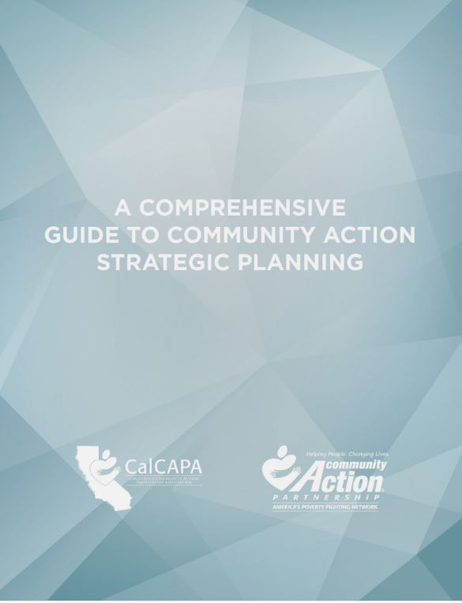
Development of Strategic Plan
Community Action Partnership & CalCAPA resource available at: https://communityactionpartnership.com/publication_toolkit/a-comprehensive-guide-to-community-action-strategic-planning-final-5/
Notes:
This guide developed by the California Community Action Association and the National Community Action Partnership was designed to help CAAs navigate the strategic planning process and successfully plan, develop, implement and evaluate strategic plans. As a comprehensive capacity building resource, the guide can also be used to refresh an existing plan, train program managers and agency leadership, or even develop a planning process for a community collaborative.

Slide 9

A Dual Bottom Line:
Mission Impact and Financial Return
Impact
High Mission Impact
Low Profitability
High Mission Impact
High Profitability
Keep it but contain costs
Invest & Grow
Profitability
Close or Give Away
Low Mission Impact
Low Profitability
Low Mission Impact
High Profitability
Water, Harvest, & Increase Impact
$
Source: Nonprofit Sustainability: Making Strategic Decisions for Financial Viability
Notes:
Another approach to strategic planning is offered by the book Nonprofit Sustainability: Making Strategic Decisions for Financial Viability. The book offers one way for a board to make decisions about programs and activities in its strategic planning sessions. The approach attempts to address concerns by board members and staff who may feel like they aren’t sufficiently familiar with all of the organization’s programs and activities. It also offers a challenge to many organizations who claim that “all of our programs are great” by requiring them to engage in a real discussion about which programs in fact have the greatest or most important impact.
The analysis is anchored in the development of a matrix for your organization using the template in the slide. The matrix map serves as a visual tool that plots all of the organization's activities and the financial and mission impact of each activity into a single image to generate strategic discussions. The focus is the dual bottom line: maximizing both programmatic impact and financial sustainability.
The matrix map requires an organization to identify all “lines of business” (e.g., Head Start, food pantry, affordable housing, Meals on Wheels, etc.) and place them in one of the four blue quadrants along the impact axis and profitability axis. A program that has high mission impact but doesn’t generate any funds (or costs a significant amount of money to operate) for the organization would, for example, be placed in the upper left hand quadrant. To assess the relative mission impact of each activity, an organization could: survey clients and staff members on how they assess the impact of the organization’s programs; conduct focus groups within the community; and host town halls or forums to discuss how effective the organization’s efforts are in meeting community needs. To asses the profitability of each activity an organization could look at how much an activity is contributing financially to an organization or how much the organization needs to subsidize the program with unrestricted funds.

Slide 10
Matrix Map Exercise
Keep it but contain costs
Impact
Invest & Grow
ESL
classes
4
Head Start preschool
U.S. citizenship classes
3
Annual street festival
Profitability
($60K)
($40K)
($20K)
$20K
$40K
$60K
2
Quit Smoking classes
Annual campaign
Close or Give Away
Water, Harvest, & Increase Impact
1
$
Notes:
Here is an example of a Matrix Map for a CAA:
Each circle represents a program or project, i.e., a “business line.”
You can see that circles higher on the map have higher impact than those lower on the map.
You can see the relative size of each activity, and which ones make money, which break even, and which require subsidy from the organization's unrestricted funds.
Ask workshop participants how they would make strategic decisions about each of these programs based on the matrix map. Here are some thoughts regarding each program:
Head Start preschool – market and try to grow; maintain government relations
ESL classes – limit attendance; try a partnership with the local community college
U.S. citizenship classes – increase class size and reduce number of classes
Annual street festival – raise corporate sponsorship fees; contain budget
Annual campaign – make a conscious effort to build a larger mailing list; use a campaign to educate people on the demographics of the community
Quit smoking classes – shut down, and refer people to other organizations providing classes

Slide 11
CSBG Organizational Standards
Planning
CSBG Org. Standard 6.1:
CSBG Org. Standard 3.1:
CSBG Org. Standard 3.5:
Organization has an agency-wide strategic plan in place that has been approved and accepted by the governing board within the past 5 years.
The organization conducted a community assessment and issued a report within the past 3 years.
The governing board formally accepts the completed community assessment.
Notes:
Even though a hallmark of a strong nonprofit is its ability to plan strategically, CAAs have an added incentive to engage in strategic planning activities. The CSBG Organizational Standards require them to do so and also direct a CAA to conduct a needs assessment that the board will formally accept. The Standard does not necessarily require a tripartite board to develop a new strategic plan every five years. Rather the Standard directs the board to review its existing strategic plan and ensure that it is truly reflective of community needs as reported in the community assessment, in line with the organization’s mission, and reflective of the organization’s goals.

Slide 12
Engage in Planning
Approaches to help a board meet its planning and strategy development obligations:
  Form a planning/strategy committee
  Uses the strategic plan to frame board discussions
  Use a strategic agenda
Notes:
The strategic plan should be a living document that is regularly referred to and used. Shifting the board’s focus to strategy, as opposed to solely the operational needs of an organization, can be challenging. To encourage a commitment to planning, boards should consider implementing a planning/strategy committee. The committee could serve as the point of contact for staying on top of the board’s role in strategic planning, the goals set through that process, and the follow-up and reporting from those goals.
Other ways to engage the board in strategic planning is for the board chair and executive director to refer to and use the CAA’s strategic plan when developing meeting agendas and framing board discussions. A strategic agenda can help with these efforts as it encourages board discussions and actions to be taken in the context of the organization’s strategic efforts, rather than promoting an environment where board members are mainly listening to reports by committees and staff.

Slide 13
Strategic Agendas
Strike a balance between “routine” agenda items (e.g., contract approvals etc.) and strategy discussions
How will agenda items and information provided to board members help board:
  Connect with the org’s mission
  Enhance board functioning
  Provide oversight
  Identify and make decisions on key issues
Notes:
A strategic agenda requires the board chair and the executive director to carefully consider the strategic direction of the organization and the need for input on that direction while still attending to the routine items that must be addressed to support the organization’s operations. In developing a strategic agenda, the board chair should connect agenda item discussions with the organization’s mission and the board’s oversight role. Strategic agenda items should enable the board to function more efficiently and effectively by focusing the board’s energies on key issues.

Slide 14
Consent Agendas
Used for routine, procedural, informational, and self-explanatory non-controversial items
Helps streamline meetings
If use, should educate board members on:
  Purpose , i.e., not used to ramrod decisions through
  Process, i.e., allows for removal of item upon request
Notes:
A consent agenda is tool that boards may use with a strategic agenda to help focus efforts on strategy. A consent agenda groups the routine, procedural, informational and self-explanatory non-controversial items typically found in an agenda. These items are typically presented to the board in a single motion for yay or nay vote after allowing for requests to move a specific item to the full agenda for individual attention. Consent agendas streamline meetings and allow the board to focus on substantive issues.
If an organization adopts a consent agenda, it must provide information for the consent items prior to the board meeting so that board members have sufficient time to review the materials and fulfill their duty of care. Any item requiring discussion should be removed from the consent agenda and discussed and voted upon separately at the board meeting.
It is important to remember that consent agendas must not be used to force through decisions and board members must always have the option to move items from the agenda for discussion and debate. A simple and direct question about a consent item may not necessarily result in automatic removal; however, if further questions arise, removal is likely necessary.

Slide 15
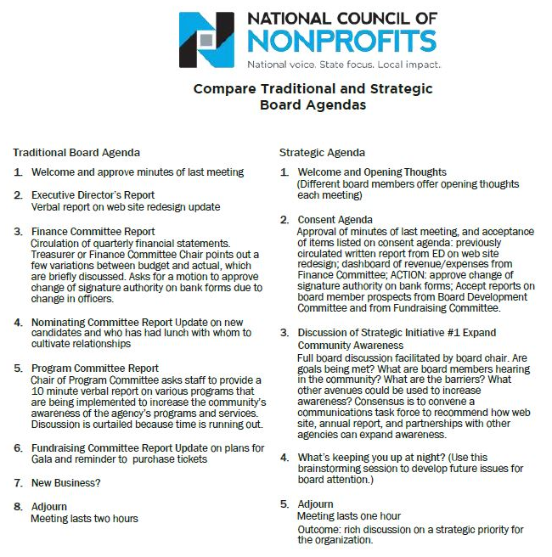
Notes:
Here is an example of a strategic agenda that includes a consent agenda. You can see how the focus shifts from committee reports and updates to discussions of strategic initiatives and concerns/thoughts for the future.
Organizations hesitant to switch from an “old business/new business” format to a strategic agenda should consider alternating between the two agendas types. The board may find that it benefits more from a strategic agenda where they are tackling one or two items that relate directly to the mission, vision and organizational values and that require special attention. Switching between to the two agendas is one way to help educate the board on the oversight value it brings to the organization as highlighted by the strategic agenda format.

Slide 16
Strategic Dashboard
Financial Indicators
 |  | Target | This month | Last month | Last year end
Income Statement | Surplus/(deficit) YTD | $270,000 | $390,842 | $340,908 | ($570,240)
 | Surplus/(deficit) year-end forecast | $270,000 | $30,937 | $250,987 | ($570,240)
 | Earned income ratio | 11.5% | 10.3% | 11.8% | 13.0%
 | New grants success ratio | 50.0% | 35.0% | 33.0% | 50.0%
Balance Sheet | Days cash on hand (unrestricted) | 45 | 43 | 28 | 51
 | Reserve funds balance (1 month payroll) | $250,000 | $200,000 | $150,000 | $250,000
 | Current ratio | 2 to 1 | 5.8 | 4.2 | 6.2
 | AR aged over 90 days | 15.0% | 22.3% | 23.5% | 20.0%
Program Indicators
 |  | Target | This month | Last month | Last year end
 | Weatherization Contracts (monthly goal) | 20 | 21 | 22 | 15
 | Head Start enrollment | 100 | 60 | 58 | 109
 | Monthly job placements | 30 | 11 | 14 | 32
21
Notes:
Strategic dashboards are another way for an organization to focus its board on the critical issues. A dashboard is basically a brief snapshot of the organization at a fixed point in time – like a car dashboard that gives an instant update on many important factors (speed, gas left in the tank, engine temperature, whether the AC is on, etc.). A nonprofit dashboard is similar: it gives important information to decision makers such as executives and boards in a quick-read way.
Dashboards may be solely financial or programmatic or a combination of both. The one on this slide combines both. A dashboard should be comprehensive, but not so detailed as to hinder high-level, strategic questions. It will summarize data from many reports into one. Probably the trickiest and most time consuming aspect of dashboards is the analysis that goes into determining which metrics will most accurately portray the organization. Those using dashboards should have explanations of the metrics, with context where necessary, and be flexible to the metrics changing and evolving so that they are as reflective as possible of the organization’s critical needs.

Slide 17
Agenda Exercise
Describe your CAA’s current board meeting agenda
List what items on the agenda may be suitable for a consent agenda
List the items that require the board to think strategically
Notes:
Developing a mock agenda could help workshop participants recognize ways in which they may approve their own approach to meeting agendas. This exercise may be done individually or in groups. Workshop participants should report their results and be encouraged to engage in a discussion about the reasons motivating the designation of items as consent versus strategic.

