Slide 1

Board Roles & Responsibilities:
Public Community Action Agencies
PRESENTED BY:
[Trainer Name]
[Trainer Website or Email]
[Trainer Phone Number]
[Training]
[Date]
[Trainer Logo]
Notes:
Serving on the tripartite board of a public community action agency (CAA) is both rewarding and challenging. Even though a public CAA can exist in various forms, some of which are established under state and local laws, all public CAAs share the common thread of being controlled and managed by one or more local governments. This structure provides a tripartite board with the unique opportunity to internally influence local government involvement in improving the lives of those in the community who need it most. However, the board must do so within an established framework that adds a layer of operational complexity. Using scenarios and quizzes, this presentation focuses generally on how the tripartite board of a public CAA fulfills its role and meets its responsibility to be fully engaged in the development, planning, implementation and evaluation of the Community Services Block Grant (CSBG) program.
Note to Presenter: This presentation is basically a guide for those conducting trainings for tripartite boards and CAA staff that work with tripartite boards on the board’s roles and responsibilities. All the slides in the PowerPoint are annotated to provide the trainer with an understanding of the information that CAPLAW strives to convey when presenting on this topic. The intent is to support trainers in their own efforts to educate tripartite boards about the very vital role the board plays. We envision several ways that the Community Action network may use this presentation:
The presentation may be given in its entirety;
The slides may be presented in sections as noted on the webpage; and/or
The slides may be used to augment a presenter’s existing presentation.
The slides are not all-inclusive of the information that is important for tripartite boards to know. The slides are only intended to acknowledge the information that most tripartite boards will be tasked with overseeing. Every CAA is different and the way in which your CAA operates and the programs it runs will affect the information that has been included in this PowerPoint.
We recommend reading the brief introduction about this presentation for additional tips on using and printing this resource.

Slide 2
This training material was created in collaboration with Community Action Program Legal Services, Inc. (CAPLAW) and the Community Action Partnership (Partnership). The publication was created by National Association of Community Action Agencies - Community Action Partnership in the performance of the U.S. Department of Human Services, Administration for Children and Families, Office of Community Services Grant Number 90ET0465. Any opinion, findings, and conclusions, or recommendations expressed in this material are those of the authors and do not necessarily reflect the views of the U.S. Department of Health and Human Services, Administration for Children and Families.
Notes:
Note to Presenter: This is language we are required to include with this resource to acknowledge the funds that were used to pay for its creation. We ask that you include this slide in your presentation if you are presenting the PowerPoint or sections of the PowerPoint in its entirety and are not making any changes to the slides when doing so. However, if you make changes to the slides or incorporate a few slides into an existing presentation, rather than use an entire section, the language above is no longer applicable and it is not necessary to include it.

Slide 3
Key Responsibilities of the Tripartite Board
Notes:
Unpacking what it means for tripartite board members to participate actively in the development, planning, implementation and evaluation of the CSBG program can seem daunting and overwhelming. The following section unpacks a board’s responsibilities by focusing on key responsibilities that encompass many of the actions board members must take to effectively fulfill their duties and obligations.

Slide 4
Key Board Responsibilities
Mission
Planning
Engagement
Maintain and Grow Funds
Performance
Accountability
Notes:
CAPLAW has identified 6 hallmarks of an effective tripartite board. Engaged boards acting and monitoring in these key areas are likely to be meeting and exceeding the governance requirements applicable to them. As we work through each of the six characteristics we will discuss how they tie in with the tripartite board’s responsibility to participate actively in the development, planning, implementation and evaluation of the CSBG program. We will also show how many of the CSBG Organizational Standards, especially those specific to a board’s responsibilities, are met through fulfilling these key responsibilities.

Slide 5
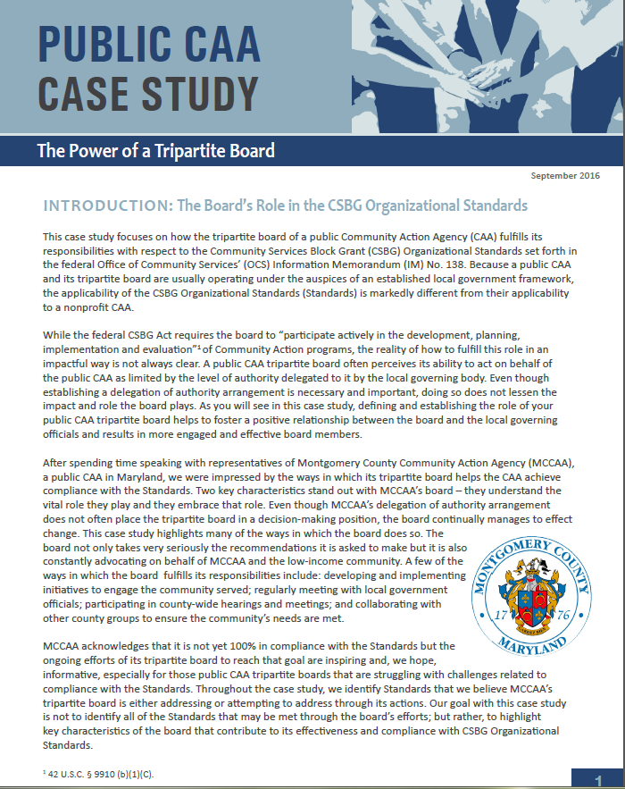
Public CAA Case Study:
Power of a Tripartite Board
Notes:
This case study focuses on how the tripartite board of a public CAA fulfills its responsibilities with respect to the CSBG Organizational Standards, which are referenced in the discussions of each of the key board responsibilities. Because a public CAA and its tripartite board are usually operating under the auspices of an established local government framework, the applicability of the Standards is markedly different from their applicability to a nonprofit CAA. After spending time speaking with representatives of Montgomery County Community Action Agency (MCCAA), a public CAA in Maryland, CAPLAW was impressed by the ways in which its tripartite board helps the CAA achieve compliance with the Standards; especially since the tripartite board does not have the authority to take action on behalf of the CAA. Rather the tripartite board submits recommendations to the local governing officials who carefully consider and often accept them.

Slide 6
Key Board Responsibility
Planning
Notes:
A significant responsibility of the tripartite board is to work with its local governing officials to set the direction for the public CAA. If the local government or division/department does not have a plan in place establishing the direction, then the tripartite board will take the lead on developing one. The planning required to do so involves, among other tasks, assessing needs, reviewing existing programs, forecasting future financial stability and growth, and making (sometimes tough, sometimes exciting) decisions about the future. Planning also requires constant assessing and revising. In this section, we will discuss the planning public CAAs engage in as a result of the CSBG funding they receive, and a few tools and resources the board may use to help frame and focus its planning efforts.

Slide 7
Planning Exercise
Name at least one of each of the following in relation to your CAA:
  Strength
  Weakness
  Opportunity
  Threat
Notes:
For those tripartite boards whose responsibilities involve planning (not just reviewing and accepting a plan), actually engaging in planning can be difficult to gasp as it is not as concrete as other board responsibilities. To better understand what engaging in planning might look like, ask workshop participants to participate in what is often referred to as the SWOT exercise. SWOT stands for Strength, Weakness, Opportunity and Threat. A SWOT analysis is used by boards to help build an organization’s strategy. Each workshop participant should take a moment to identify each of the following in relation to their organizations:
Strengths (e.g., sole provider of a service, passionate volunteers, loyal donors, clear vision and history). Questions to consider:
What does your organization do better than others?
What advantages does your organization have?
What do others see as your strengthens?
Weaknesses (e.g., small volunteer base, high staff turnover, lack of external communications). Questions to consider:
How could your organization improve?
What do others see as your weaknesses?
Opportunities (e.g., develop partnerships, expand volunteer and client base through robust communications, explore enhancement to or development of programs). Questions to consider:
What opportunities are you aware of?
What are new developments in the sector?
Threats (e.g., measuring success is difficult, cash flow, bad publicity). Questions to consider:
What obstacles does your organization face?
Could weakness threaten your organization’s sustainability?
Working through a SWOT analysis is one way for board members to develop a deeper understanding of their organization’s operations and efforts needed to further the mission. This understanding plays a crucial role in a board’s meeting its responsibility to think strategically about the organization’s future and planning accordingly.

Slide 8
Planning Under CSBG
Community Action Plan
3-Year Review
(Community needs assessment/CSBG-specific)
Strategic Plan
5-Year Review
(Organization-wide)
Notes:
The federal CSBG Act and CSBG Organizational Standards require that the tripartite board oversee two types of planning efforts by the public CAA. One is the preparation of the community action plan by staff, which is specific to CSBG-funded activities, and required by the federal CSBG Act. The plan involves the CAA conducting a community needs assessment to identify the population to be served and the assistance needed. These efforts often involve reviewing publicly available data such as the most recent census report, and engaging staff to develop surveys and conduct research to gather data from the community served. While the board is mainly tasked with voting to accept the needs assessment, a tripartite board may contribute to the data gathering process by convening community forums to solicit information on needs and suggestions for addressing those needs from those living in the area.
The community action plan informs a CAA’s strategic plan, which is the organization-wide document that establishes the direction and activities of the CAA. Under the CSBG Organizational Standards, a tripartite board is required within the past 5 years to review and accept its local government’s or department’s strategic plan. However, if no such plan exists, the tripartite board must develop a plan. While the board will likely organize a planning committee to work with the executive director/department head and staff to lead the planning efforts, the approach should focus on the “big picture” and include:
Thinking about mission and purpose;
Aligning strategic plan with overall mission;
Reviewing and adjusting (if necessary) all programs;
Identifying broad goals and priorities; and
Establishing and maintaining procedures for reporting on goals and results.

Slide 9
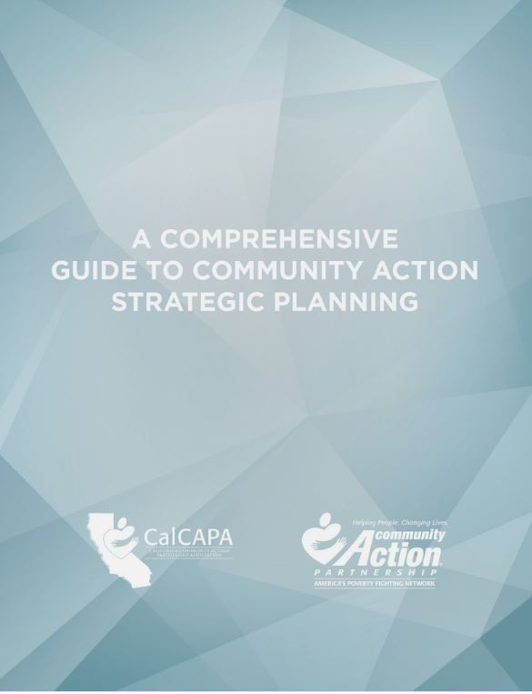
Development of Strategic Plan
Community Action Partnership & CalCAPA resource available at: https://communityactionpartnership.com/publication_toolkit/a-comprehensive-guide-to-community-action-strategic-planning-final-5/
Notes:
This guide developed by the California Community Action Association and the National Community Action Partnership was designed to help CAAs navigate the strategic planning process and successfully plan, develop, implement and evaluate strategic plans. As a comprehensive capacity building resource, the guide can also be used to refresh an existing plan, train program managers and agency leadership, or even develop a planning process for a community collaborative. The guide incorporates the CSBG Organizational Standards and walks through how both public and nonprofit CAAs maintain compliance with the Standards throughout the strategic planning process.

Slide 10
CSBG Organizational Standards
Planning
CSBG Org. Standard 6.1:
CSBG Org. Standard 3.1:
CSBG Org. Standard 3.5:
The department has a strategic plan, or comparable planning document, in place that has been reviewed and accepted by the tripartite board/advisory body within the past 5 years. If the department does not have a plan, the tripartite board/advisory body will develop the plan.
The department conducted or was engaged in a community assessment and issued a report within the past 3 years, if no other report exists.
The tripartite board/advisory body formally accepts the completed community assessment.
Notes:
The CSBG Organizational Standards require all CAAs to either review and accept or develop strategic plans as well as conduct a needs assessment that the board will formally accept. The Standard does not necessarily require a tripartite board to develop a new strategic plan every five years. Rather the Standard directs the board to review its existing strategic plan and ensure that it is truly reflective of community needs as reported in the community assessment, in line with the organization’s mission, and reflective of the organization’s goals. Organizational Standards 6.2 through 6.4 set forth information that the plan must address and contain. As previously noted, these Standards are addressed in the Comprehensive Guide to Community Action Strategic Planning developed by the National Community Action Partnership and the California state association, CalCAPA.

Slide 11
Engage in Planning
Approaches to help the tripartite board meet its planning and strategy development obligations:
  Form a planning/strategy committee
  Uses the strategic plan to frame board discussions
  Use a strategic agenda
Notes:
The strategic plan should be a living document that is regularly referred to and used. To encourage a commitment to planning, boards should consider implementing a planning/strategy committee. The committee could serve as the point of contact for staying on top of the board’s role in strategic planning, the goals set through that process, and the follow-up and reporting from those goals.
Another way to engage the board in strategic planning is for the board chair and executive director/department head to refer to and use the CAA’s strategic plan when developing meeting agendas and framing board discussions. A strategic agenda can help with these efforts as it encourages board discussions and actions to be taken in the context of the organization’s strategic efforts, rather than promoting an environment where board members are mainly listening to reports by committees and staff.

Slide 12
Strategic Agendas
Strike a balance between “routine” agenda items (e.g., contract approvals etc.) and strategy discussions
How will agenda items and information provided to board members help tripartite board:
  Connect with the CAA’s mission
  Enhance board functioning
  Provide oversight
  Identify and make decisions on key issues
Notes:
A strategic agenda requires the board chair and the executive director/department to carefully consider the strategic direction of the organization and the need for input on that direction while still attending to the routine items that must be addressed to support the organization’s operations. In developing a strategic agenda, the board chair should connect agenda item discussions with the public CAA’s mission and the board’s oversight role. Strategic agenda items should enable the board to function more efficiently and effectively by focusing the board’s energies on key issues.

Slide 13
Consent Agendas
Used for routine, procedural, informational, and self-explanatory non-controversial items
Helps streamline meetings
If using, be sure to educate board members on:
  Purpose , i.e., not used to force through decisions
  Process, i.e., allows for removal of item upon request
Notes:
A consent agenda is tool that boards may use with a strategic agenda to help focus efforts on strategy. A consent agenda groups together the routine, procedural, informational and self-explanatory, non-controversial items typically found in a meeting agenda. These items are typically presented to the board in a single motion for yay or nay vote after allowing for requests to move a specific item to the full agenda for individual attention. Consent agendas streamline meetings, reduce the amount of time spent approving motions that do not require further discussion, and allow the board to dedicate more time to focusing on substantive issues.
If a tripartite board adopts a consent agenda, it should provide information for the consent items prior to the board meeting so that board members have sufficient time to review the materials. Any item requiring discussion should be removed from the consent agenda and discussed and voted upon separately at the board meeting.
It is important to remember that consent agendas should not be used to force through decisions and board members should always have the option to move items from the agenda for discussion and debate. A simple and direct question about a consent item may not necessarily result in automatic removal; however, if further questions arise, removal is likely necessary.

Slide 14
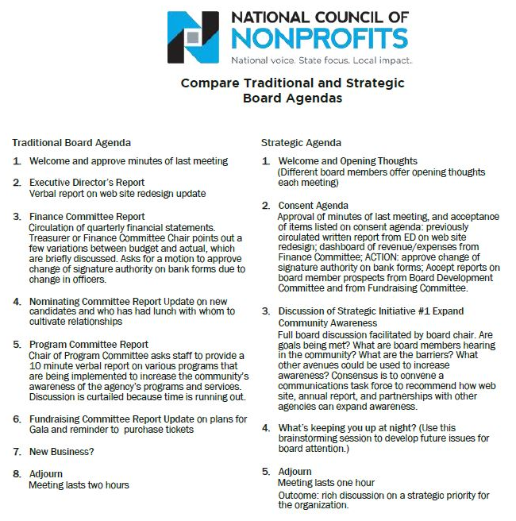
Notes:
Here is an example of a strategic agenda that includes a consent agenda. You can see how the focus of the strategic agenda shifts from committee reports and updates to discussions of strategic initiatives and concerns/thoughts for the future.
Tripartite boards hesitant to switch from an “old business/new business” format to a strategic agenda should consider alternating between the two agendas types. The board may find that it benefits more from a strategic agenda where they are tackling one or two items that relate directly to the mission, vision and organizational values and that require special attention. Switching between the two agendas is one way to help educate the board on the oversight value it brings to its public CAA as highlighted by the strategic agenda format.
Note to presenter: While this example is specific to boards of nonprofit organizations, it should give the tripartite board of a public CAA a better understanding of how it may adjust its agendas to achieve more effective meetings.

Slide 15
Strategic Dashboard
Financial Indicators
 |  | Target | This month | Last month | Last year end
Income Statement | Surplus/(deficit) YTD | $270,000 | $390,842 | $340,908 | ($570,240)
 | Surplus/(deficit) year-end forecast | $270,000 | $30,937 | $250,987 | ($570,240)
 | Earned income ratio | 11.5% | 10.3% | 11.8% | 13.0%
 | New grants success ratio | 50.0% | 35.0% | 33.0% | 50.0%
Balance Sheet | Days cash on hand (unrestricted) | 45 | 43 | 28 | 51
 | Reserve funds balance (1 month payroll) | $250,000 | $200,000 | $150,000 | $250,000
 | Current ratio | 2 to 1 | 5.8 | 4.2 | 6.2
 | AR aged over 90 days | 15.0% | 22.3% | 23.5% | 20.0%
Program Indicators
 |  | Target | This month | Last month | Last year end
 | Weatherization Contracts (monthly goal) | 20 | 21 | 22 | 15
 | Head Start enrollment | 100 | 60 | 58 | 109
 | Monthly job placements | 30 | 11 | 14 | 32
Notes:
Strategic dashboards are another way for an organization to focus its board on the critical issues. A dashboard is basically a brief snapshot of the public CAA at a fixed point in time – like a car dashboard that gives an instant update on many important factors (speed, gas left in the tank, engine temperature, whether the AC is on, etc.). A strategic dashboard is similar: it gives important information to decision makers such as executives and boards in a quick-read way.
Dashboards may be solely financial or programmatic or a combination of both. The example on this slide combines both. A dashboard should be comprehensive, but not so detailed as to hinder high-level, strategic questions. It will summarize data from many reports into one. Probably the trickiest and most time consuming aspect of dashboards is the analysis that goes into determining which metrics will most accurately portray the organization at this point in time. CAAs using dashboards should have explanations of the metrics, with context where necessary, and be flexible to the metrics changing and evolving so that they are as reflective as possible of the organization’s critical needs.

Slide 16
Agenda Exercise
Describe your CAA’s current board meeting agenda
List what items on the agenda may be suitable for a consent agenda
List the items that require the board to think strategically
Notes:
Note to Presenter: Developing a mock agenda could help workshop participants recognize ways in which they may improve their own approach to meeting agendas. This exercise may be done individually or in groups. Workshop participants should report their results and be encouraged to engage in a discussion about the reasons motivating the designation of items as consent versus strategic.

