Slide 1

Board Roles & Responsibilities:
Public Community Action Agencies
PRESENTED BY:
[Trainer Name]
[Trainer Website or Email]
[Trainer Phone Number]
[Training]
[Date]
[Trainer Logo]
Notes:
Serving on the tripartite board of a public community action agency (CAA) is both rewarding and challenging. Even though a public CAA can exist in various forms, some of which are established under state and local laws, all public CAAs share the common thread of being controlled and managed by one or more local governments. This structure provides a tripartite board with the unique opportunity to internally influence local government involvement in improving the lives of those in the community who need it most. However, the board must do so within an established framework that adds a layer of operational complexity. Using scenarios and quizzes, this presentation focuses generally on how the tripartite board of a public CAA fulfills its role and meets its responsibility to be fully engaged in the development, planning, implementation and evaluation of the Community Services Block Grant (CSBG) program.
Note to Presenter: This presentation is basically a guide for those conducting trainings for tripartite boards and CAA staff that work with tripartite boards on the board’s roles and responsibilities. All the slides in the PowerPoint are annotated to provide the trainer with an understanding of the information that CAPLAW strives to convey when presenting on this topic. The intent is to support trainers in their own efforts to educate tripartite boards about the very vital role the board plays. We envision several ways that the Community Action network may use this presentation:
The presentation may be given in its entirety;
The slides may be presented in sections as noted on the webpage; and/or
The slides may be used to augment a presenter’s existing presentation.
The slides are not all-inclusive of the information that is important for tripartite boards to know. The slides are only intended to acknowledge the information that most tripartite boards will be tasked with overseeing. Every CAA is different and the way in which your CAA operates and the programs it runs will affect the information that has been included in this PowerPoint.
We recommend reading the brief introduction about this presentation for additional tips on using and printing this resource.

Slide 2
This training material was created in collaboration with Community Action Program Legal Services, Inc. (CAPLAW) and the Community Action Partnership (Partnership). The publication was created by National Association of Community Action Agencies - Community Action Partnership in the performance of the U.S. Department of Human Services, Administration for Children and Families, Office of Community Services Grant Number 90ET0465. Any opinion, findings, and conclusions, or recommendations expressed in this material are those of the authors and do not necessarily reflect the views of the U.S. Department of Health and Human Services, Administration for Children and Families.
Notes:
Note to Presenter: This is language we are required to include with this resource to acknowledge the funds that were used to pay for its creation. We ask that you include this slide in your presentation if you are presenting the PowerPoint or sections of the PowerPoint in its entirety and are not making any changes to the slides when doing so. However, if you make changes to the slides or incorporate a few slides into an existing presentation, rather than use an entire section, the language above is no longer applicable and it is not necessary to include it.

Slide 3
Key Responsibilities of the Tripartite Board
Notes:
Unpacking what it means for tripartite board members to participate actively in the development, planning, implementation and evaluation of the CSBG program can seem daunting and overwhelming. The following section unpacks a board’s responsibilities by focusing on key responsibilities that encompass many of the actions board members must take to effectively fulfill their duties and obligations.

Slide 4
Key Board Responsibilities
Mission
Planning
Engagement
Maintain and Grow Funds
Performance
Accountability
Notes:
CAPLAW has identified 6 hallmarks of an effective tripartite board. Engaged boards acting and monitoring in these key areas are likely to be meeting and exceeding the governance requirements applicable to them. As we work through each of the six characteristics we will discuss how they tie in with the tripartite board’s responsibility to participate actively in the development, planning, implementation and evaluation of the CSBG program. We will also show how many of the CSBG Organizational Standards, especially those specific to a board’s responsibilities, are met through fulfilling these key responsibilities.

Slide 5
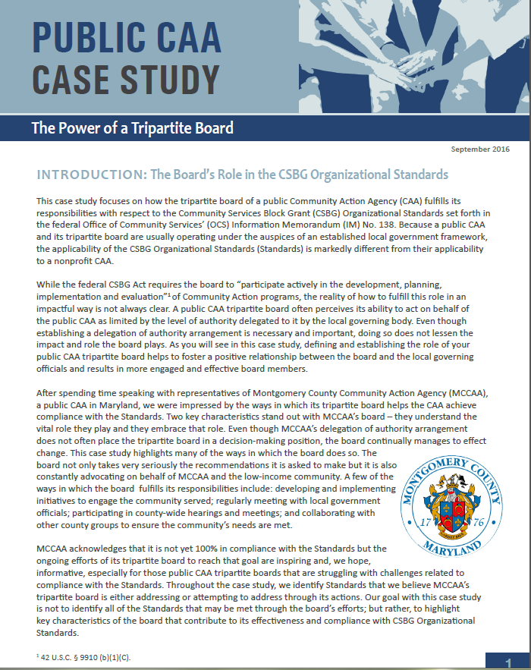
Public CAA Case Study:
Power of a Tripartite Board
Notes:
This case study focuses on how the tripartite board of a public CAA fulfills its responsibilities with respect to the CSBG Organizational Standards, which are referenced in the discussions of each of the key board responsibilities. Because a public CAA and its tripartite board are usually operating under the auspices of an established local government framework, the applicability of the Standards is markedly different from their applicability to a nonprofit CAA. After spending time speaking with representatives of Montgomery County Community Action Agency (MCCAA), a public CAA in Maryland, CAPLAW was impressed by the ways in which its tripartite board helps the CAA achieve compliance with the Standards; especially since the tripartite board does not have the authority to take action on behalf of the CAA. Rather the tripartite board submits recommendations to the local governing officials who carefully consider and often accept them.

Slide 6
Key Board Responsibility
Engagement
Notes:
Being fully engaged means that tripartite board members are not only expected to make well-informed, reasonable decisions but also help the public CAA with its efforts to connect with the community it serves.

Slide 7
Engagement Scenario
Jack, a recently retired school superintendent, joined the tripartite board 10 years ago and continually gets re-elected to the private sector. He assumes he is on the board because the CAA operates an award-winning after school program. He is tired of attending community gatherings and interacting regularly with others – he did it for over 30 years with his school job. He likes his fellow board members and makes a real effort to attend the board meetings focused on education matters, but doesn’t worry if he can’t make other meetings.
Is Jack an engaged board member? Why or why not?
Notes:
Answer discussed on next slide.

Slide 8
Internal and External Responsibilities
With Board/ Local Governing Officials/CAA
With Stakeholders/ Community
Engagement
Notes:
You can think of board engagement as internal and external. The CSBG Organizational Standards explicitly require a CAA to engage with certain external stakeholders (e.g., social service providers, faith-based organizations, etc.). Board members contribute to these efforts through their community connections and willingness to advocate for the CAA and its programs. The CSBG Organizational Standards implicitly require board members to engage internally -- with the board (for example, by meeting composition requirements) as well as with the organization (for example, by participating in strategic planning efforts).
Jack is arguably not an engaged board member for two reasons. He is only concerned with one aspect of the CAA’s work, its award-wining after school program. Even though Jack brings a lot of experience to the board with respect to the after school program, he is essentially absent when it comes to the CAA’s other activities. Second, Jack has no interest in supporting the CAA’s efforts to educate the community about the vital role the CAA plays through the services it offers. Ultimately, however, it is up to the board to decide if the benefits Jack brings to the table outweigh his lack of engagement in certain areas.
In this section we will talk about ways in which the board can assess the type of board members that will be the best meet the needs of the public CAA and also help board members, like Jack, become more fully engaged.

Slide 9
Ways to Increase Engagement
Strategically Recruiting
Regularly Orienting & Training
Building Relationships
Conducting Assessments
Connecting with Community
Notes:
Boards can establish and increase both internal and external engagement of individual board members in a number of ways. We will discuss a few of these at a high level, which include:
how to think strategically about board member recruitment,
the importance of regularly orienting and training board members,
ways to build board member relationships,
the benefits of assessing individual and group perceptions, and
how board members can connect with the community served by the CAA.

Slide 10
Board Selection Procedure
Use board committee
Recruit smartly & strategically
Require applications
Follow selection procedures
Notes:
Developing an engaged board that can help the CAA further its mission can seem daunting, especially with the specific composition requirements that apply to tripartite boards. Thinking strategically about recruitment is the key. The following is a process may help with these efforts:
Use a committee (either governance or board development) to oversee the selection process. If you don’t have one, create one.
Recruit board members based on what you need: financial expertise, community connections, etc. The tripartite structure offers more flexibility than you may realize. For example, elected public officials often have skills beyond those of just being a politician. Try to tap into those elected public officials or representatives who can meet the needs of the CAA.
Require applications. Doing so can help educate interested applicants about what your CAA is looking for and also provide the CAA with the information it needs to select candidates who best fit the organization's current needs.
Follow selection procedures in the CAA’s bylaws or board operational guide. Many federal funding sources, including CSBG, have specific composition requirements for boards of entities that receive their funding. If procedures are not currently specified in your bylaws or board operational guide, add them or include them in separate governance policies approved by the board. Also, if changes to the procedures are needed to better position your CAA to attract the talent it is seeking, then take the opportunity to make those changes.

Slide 11
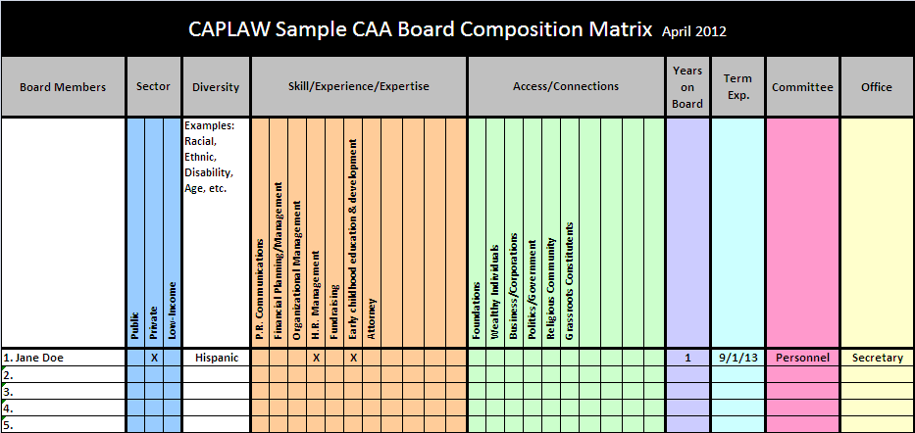
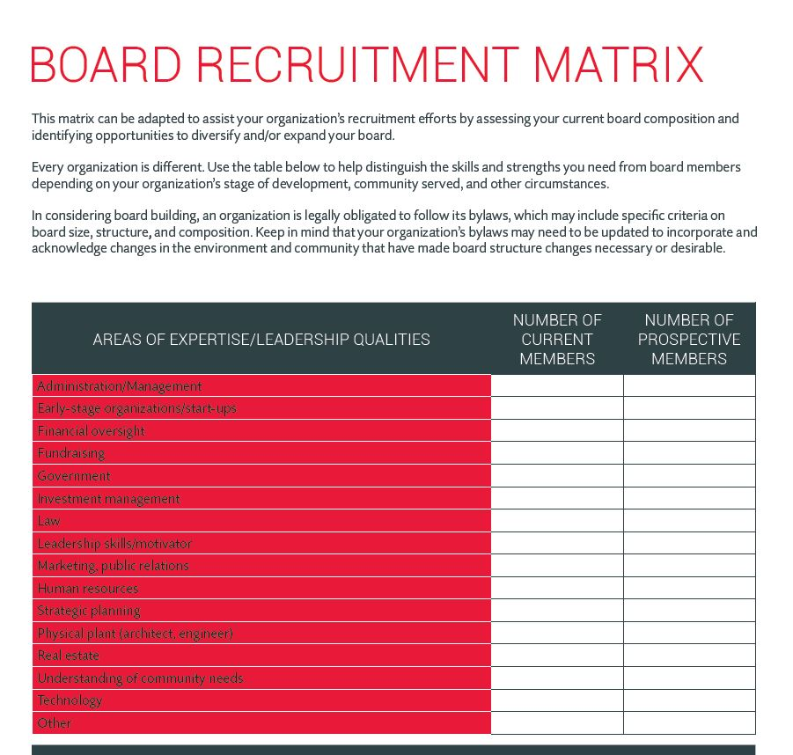
Recruitment Matrices
Board Source & CAPLAW
http://www.caplaw.org/resources/SelfAssessmentDocuments/CAPLAW_BoardComposition%20Matrix_April2012.xls
https://boardsource.org/board-recruitment-matrix/
Notes:
A composition or recruitment matrix is one way the tripartite board can take a step back and more fully understand who is currently serving on its board and what attributes the board should be seeking in its recruitment efforts. Board matrices can be customized to reflect specific organizational needs and help the board form a more strategic, targeted approach in seeking potential board members. However, it is important that your CAA does not solely rely on a matrix when making final decisions about board candidates. Someone who looks good on paper and checks off all of the boxes may not necessarily be a good fit for the board. In-person meetings often help convey information about potential candidates, such as their passion for your mission or ability to commitment to the organization, that is necessary for developing a successful and engaged board.

Slide 12
Training & Orientation Exercise
What Would You Do?
List the five most pressing topics for a board member orientation.
List the five topics that you think are essential to be covered in board trainings.
List three methods for providing training to the board.
Notes:
Note to Presenter: Workshop participants should take a moment either individually or in groups to discuss the topics they think should be covered in board orientations and trainings as well as the most effective methods for conducting such trainings. Doing so should help participants not only recognize the needs within their own organization, but also the role they individually play in helping all board members receive the information they need to meet their responsibilities.

Slide 13
Training & Orientation
Options
Use a governance committee to work with executive director and designated staff to:
  Develop a comprehensive approach
  Identify topics, e.g., financial oversight, board operations, etc.
  Establish methods , e.g., webinars, in-person, etc.
Notes:
13
Tripartite boards should consider establishing a governance committee to work with the executive director/department head and staff (as designated by the executive director/department head) to develop a comprehensive approach to training and orienting board members. The approach will likely be multifaceted and may include a mentorship program connecting more senior board members with new ones; a training schedule with specified times and days when training will occur throughout the year; and directives around attendance such as requiring all board members to attend some or all of the trainings.
As part of developing a comprehensive approach, the committee should consider topics essential to cover as part of an orientation, versus those that may necessitate more in-depth coverage and are thus better suited for a training. Some topics will be universal for all CAA boards such as board engagement, while other may be more specific to a particular CAA such as a board’s responsibilities with regards to a particular grant-funded program, like Head Start. Multiple options exist for how a board may identify the topics for both the orientation and training. Boards may: (1) survey their members either electronically or at meetings; (2) survey the executive director/department head and executive management who work with the board and its committees; (3) use board assessments that are conducted every two to three years; or (4) conduct meeting evaluations that include questions about board trainings. The same options used to identify topics could also be used to determine the best methods for conveying information. Different methods may be used to convey different types and amounts of information.
Sample orientation and training topics topics may include mission, history, programs, strategic direction, financial oversight, organizational structure, board composition, board roles and responsibilities, and board operation. Sample methods for convey the information for an orientation and trainings may include webinars, training modules, handbooks, mentoring, conference, retreats, one-on-one meetings, committee participation, on-site tours, staff presentations, and volunteering.

Slide 14
CSBG Organizational Standards
Board Orientation and Training
CSBG Org. Standard 5.7
The department has a process to provide a structured orientation for tripartite board/advisory body members within 6 months of being seated.
CSBG Org. Standard 5.8
Tripartite board/advisory body members have been provided with training on their duties and responsibilities within the past 2 years.
Notes:
Boards should also adopt a comprehensive approach to board orientation and trainings because the CAA will be monitored on these efforts pursuant to the CSBG Organizational Standards. The Standards specifically require CAAs to provide a structured orientation for governing boards within 6 months of new board members being seated and a training on their duties and responsibilities within the past two years. A board may show compliance with these Standards through a written orientation and training schedule and plan, board minutes reflecting the actual orientation and training and the board members who attended, sign-in sheets for the training and orientation, and a copy of the orientation and training materials.

Slide 15
Building Relationships
Executive Director/Dept. Head and Board Chair
Establish expectations
Frequency of check-ins
Priorities
Keep communication lines open
Regular communication
Identify and work to resolve differences in non-defensive ways
Issues to communicate
Communications style
Sounding board/feedback
Ways to support each other
Notes:
Another way to cultivate an engaged board is for the executive director/department head and board chair to develop a strong working relationship. The board chair is elected by the board to represent the individual board members and act as a conduit between the full board and the executive director/department head. The board chair presides over meetings, works with the executive director/department head to plan agendas, acts as the spokesperson for the board, and serves as a sounding board for the executive director/department head. Often times, the board gets the information it needs from the organization through the board chair, who communicates these needs to the executive director/department head. Thus, it is important that the executive director/department head and board chair are clear as to what they expect to receive and provide to each other.
Executive directors/department heads and board chairs should consider frequent check-ins where they can discuss issues and set priorities. They should educate each other regarding their preferred methods of communication, including the best way to serve as a sounding board and provide feedback. They should also discuss what type of support each is expecting and needs to fulfill the many responsibilities that each is tasked with. Keeping communications lines open and recognizing that differences will arise, while working collegially to resolve those differences, will likely result in the full board and the executive director/department head leading the public CAA in a well-informed and effective way.

Slide 16
Building Relationships
Board Members and Executive Director/Dept. Head
Meet one-on-one with board members
Periodic check-ins
Provide board members with opportunities to develop their skills as board members
Help board members get to know each other
Encourage board members to be actively engaged at board meetings
Notes:
While a strong working relationship between the board chair and the executive director/department head is necessary for a board to successfully function, there are also actions that the full board, in connection with the executive director/department head, can take to further deepen board member engagement. The executive director/department head, the board chair or governance committee chair or members should consider establishing one-on-one meetings with individual board members. These meetings could find out, among other things:
What motivates each to serve on the board?
How do they connect with the organization’s mission?
What do they hope to gain from board service?
What can they contribute?
What skills/knowledge do they need or want to develop to become a more effective board member?
What could make their experience more satisfying?
Also, periodically checking in with board members between meetings to see what support they may need or address concerns they may have helps to boost a board member’s interest and engagement. Educating board members about opportunities that align with their skills or can help them develop new skills will help them feel that they are contributing to the public CAA as well as growing from the experience of serving as a CAA board member. Helping board members get to know each other either by assigning new board members mentors and or inviting board members throughout the year to introduce themselves and tell their stories is another way to help board members feel invested in the board and the work they are tasked with. Another way to promote engagement is to assign specific tasks to board members, ask them to serve on committees, and conclude meetings with actions items that individual board members can take ownership of.

Slide 17
Building Relationships
Board Members and Local Governing Officials
Set regular meetings with governing officials
Provide governing officials with quarterly/ regular updates
Identify a liaison/point person between the two bodies
Involve local governing officials in tripartite board orientation and trainings
Notes:
Local governing officials and tripartite board members must work collaboratively for the public CAA to successfully further its mission and maintain its CSBG funding. It is thus essential that these two bodies regularly communicate with one another and are generally aligned in their efforts to oversee and support the CAA. Multiple ways exist for a tripartite board to develop and nurture its relationship with local governing officials. A few options include:
Setting regular meetings with governing officials. These meetings will likely involve a board committee and the tripartite board may decide to establish a standing committee that is solely focused on the tripartite board’s relationship with the local governing officials.
Providing governing officials with regular updates. The tripartite board should review the local governing officials’ annual meeting calendar, identify meetings that seem best suited for tripartite board updates and proactively request to be added as an agenda item for those meetings.
Identifying members of both bodies to serve as liaisons at the meetings of each. The tripartite board may consider creating an officer position whose responsibilities focus on ensuring that the two bodies are communicating and providing each other with the information needed for each to meet its responsibilities.
Involving local governing officials in board orientations and training. The tripartite board may also determine that conducting orientations and trainings specifically for local governing officials is an easier and more effective way to encourage and ensure participation by local governing officials. Such trainings and orientations may also occur as part of the local governing officials’ meetings.

Slide 18
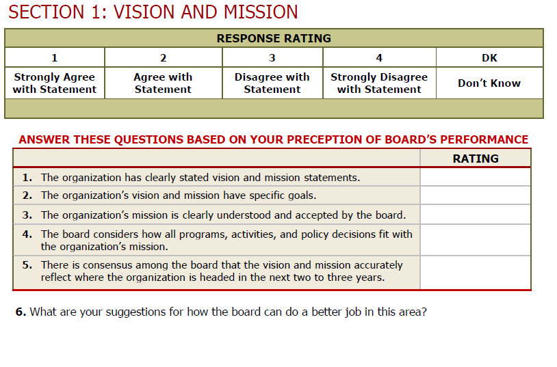
Board Assessment
Sample Excerpt
  http://www.virtualcap.com/downloads/MPI/IN-CAA-Board-Self-Assessment.pdf (developed by IN Community Action Assoc.)
Notes:
Conducting assessments that involve either the board members assessing the full board or their individual participation on the board is an opportunity for tripartite board members reflect on both their individual and shared responsibilities. Assessments are a vital governance tool that gives the board an opportunity to step back from its everyday business and address larger, more fundamental issues. Assessments can shake boards out of micromanaging the organization’s work and redirect their focus to governance issues. It can lead to a more engaged board—and a higher performing one. Assessments help board members identify varying perceptions, clarify and manage expectations and set priorities and goals. The result of a successful assessment could be to inspire the board to work more cohesively as a team to strengthen the organization.
On this slide is an excerpt from an assessment tool that was specifically created for CAAs by the Indiana Community Action Association. As you can see from this brief snippet, the assessment is basically giving the board and individual board members a chance to ask how they are doing. An assessment isn’t an opportunity to create another to-do list but is a chance for the board to fine-tune the way it operates in a targeted, effective way. An assessment should be viewed as an ongoing journey that leads to a healthy and productive discussion about the board’s strengths and weaknesses and results in an agreed-upon plan for building a stronger board and governance model.
An assessment may be too comprehensive a process to be carried out every year. Each board operates differently and will need to gauge what is the best time frame for them. Conducting an assessment every other year tends to be helpful for many boards. However, it doesn’t make sense to conduct an assessment if the organization is facing a crisis or some other pressing matter that is requiring everyone’s full attention. The process also isn’t effective when staff and board leadership are at odds with one another or when the organization or the board lack the capacity to enact the strategies that might grow out of the effort.

Slide 19
Board Assessment
Process
Get your full board on board!
Establish a group of board members to oversee the process
Administer the assessment tool
Tabulate responses
Discuss results – strengths, weaknesses
Establish a realistic action plan
Follow up and reassess!
Notes:
An assessment should be a team effort. A recommended approach is that either the governance committee or a few designated board members play an active role in the process and take some ownership for seeing that the results are used to effect change, when necessary. Once the assessment process is complete and responses tabulated, the board must take the time to discuss the results if the process is to be impactful. The governance committee, working with a staff person designated by the executive director/department head, may be charged with pulling together a report from the results to help facilitate the discussion and spearhead the development of an action plan. Most importantly, the board must make an effort to follow up, through meeting evaluations or board surveys, to determine if the plan addressed the results and what tweaks may be necessary.

Slide 20
Board Assessment
Resources
Decide on and use appropriate format/tool
  NH Center for Nonprofits, http://www.nhnonprofits.org/view/member-benefits/256
  National Council of Nonprofits, http://www.councilofnonprofits.org/resources/resources-topic/boards-governance/board-member-self-assessment
  VirtualCAP, http://www.virtualcap.com/downloads/MPI/IN-CAA-Board-Self-Assessment.pdf (tool developed by Indiana Community Action Association)
  The Nonprofit Association of Oregon, https://nonprofitoregon.org/helpline_resources/Board-Assessment-Tool
Notes:
Here are a few tools for conducting board assessments. While many of these assessments are tailored to nonprofit organizations, they serve as a good starting point from which a public CAA tripartite board can customize the tool to better reflect the way in which the board operates. No matter what tool a board uses, a good assessment needs to ask relevant and clear questions, collect systematic feedback from a variety of sources, and make use of the information for developmental purposes, rather than as a report card of board performance.

Slide 21
Connecting with Community Exercise
Fill in the Blank
Empowering the low-income community
  Ex., our tripartite board _______________________________
Effectively advocating for the CAA and its mission
  Ex., our tripartite board________________________________
Collecting and providing input on community needs
  Ex., our tripartite board________________________________
Developing and sustaining strategic partnerships and collaborations
  Ex., our tripartite board________________________________
Notes:
A public CAA garners the support it needs to survive and thrive if it is connecting with those individuals and families it serves as well as others in the community who can support the furtherance of the CAA’s efforts and mission. Connecting with the community embodies a hallmark of community action which is the “maximum feasible participation” of the low-income community served. The tripartite board serves as the face of the public CAA and must ask itself how it is engaging in activities like the ones listed above. Examples of how board members can connect with the community include:
Empowering the low-income community by spearheading a leadership development program for the CAA’s clients. A public CAA tripartite board developed a program that not only connected the board with the population the CAA serves but also helped to educate those who often feel voiceless as to how they can make their voices heard and produce results hopefully benefiting themselves and their community.
Advocating for the public CAA by speaking at community groups and participating in hearings on matters impacting the low-income community.
Collecting and providing input on community needs by holding forums seeking feedback from the community as to their needs and what assistance they believe will help them address those needs.
Developing and sustaining strategic partnerships and collaborations by working with other social service providers and groups who are serving the same community to determine what are the best ways they can individually and collaboratively help improve the lives of the low-income community served.
Now, it is your turn. Take a moment to fill in the blank for each of the bullets listed above with at least one way your tripartite board is connecting with the community. If you are not sure what your board might be doing to connect with the community, then make a proposal to take back to your board as an action item.

Slide 22
CSBG Organizational Standards
Community Engagement
CSBG Org. Standard 1.1
CSBG Org. Standard 2.1
CSBG Org. Standard 2.3
The department demonstrates low-income individuals’ participation in its activities.
The department has documented or demonstrated partnerships across the community, for specifically identified purposes; partnerships include other anti-poverty organizations in the area.
The department communicates its activities and its results to the community.
Notes:
Even though a tripartite board is not directly involved in complying with the CSBG Organizational Standards that require a CAA to engage the low-income community, collaborate with fellow providers and communicate results, the tripartite board’s efforts in these areas ultimately contribute to the success of the public CAA. There are actually a number of ways, as we just discussed, that a tripartite board can directly contribute to a CAA’s efforts to meet these Standards through deliberate efforts to connect with the community served.

