Slide 1

Board Roles & Responsibilities:
Public Community Action Agencies
PRESENTED BY:
[Trainer Name]
[Trainer Website or Email]
[Trainer Phone Number]
[Training]
[Date]
[Trainer Logo]
Notes:
Serving on the tripartite board of a public community action agency (CAA) is both rewarding and challenging. Even though a public CAA can exist in various forms, some of which are established under state and local laws, all public CAAs share the common thread of being controlled and managed by one or more local governments. This structure provides a tripartite board with the unique opportunity to internally influence local government involvement in improving the lives of those in the community who need it most. However, the board must do so within an established framework that adds a layer of operational complexity. Using scenarios and quizzes, this presentation focuses generally on how the tripartite board of a public CAA fulfills its role and meets its responsibility to be fully engaged in the development, planning, implementation and evaluation of the Community Services Block Grant (CSBG) program.
Note to Presenter: This presentation is basically a guide for those conducting trainings for tripartite boards and CAA staff that work with tripartite boards on the board’s roles and responsibilities. All the slides in the PowerPoint are annotated to provide the trainer with an understanding of the information that CAPLAW strives to convey when presenting on this topic. The intent is to support trainers in their own efforts to educate tripartite boards about the very vital role the board plays. We envision several ways that the Community Action network may use this presentation:
The presentation may be given in its entirety;
The slides may be presented in sections as noted on the webpage; and/or
The slides may be used to augment a presenter’s existing presentation.
The slides are not all-inclusive of the information that is important for tripartite boards to know. The slides are only intended to acknowledge the information that most tripartite boards will be tasked with overseeing. Every CAA is different and the way in which your CAA operates and the programs it runs will affect the information that has been included in this PowerPoint.
We recommend reading the brief introduction about this presentation for additional tips on using and printing this resource.

Slide 2
This training material was created in collaboration with Community Action Program Legal Services, Inc. (CAPLAW) and the Community Action Partnership (Partnership). The publication was created by National Association of Community Action Agencies - Community Action Partnership in the performance of the U.S. Department of Human Services, Administration for Children and Families, Office of Community Services Grant Number 90ET0465. Any opinion, findings, and conclusions, or recommendations expressed in this material are those of the authors and do not necessarily reflect the views of the U.S. Department of Health and Human Services, Administration for Children and Families.
Notes:
Note to Presenter: This is language we are required to include with this resource to acknowledge the funds that were used to pay for its creation. We ask that you include this slide in your presentation if you are presenting the PowerPoint or sections of the PowerPoint in its entirety and are not making any changes to the slides when doing so. However, if you make changes to the slides or incorporate a few slides into an existing presentation, rather than use an entire section, the language above is no longer applicable and it is not necessary to include it.

Slide 3
Key Responsibilities of the Tripartite Board
Notes:
Unpacking what it means for tripartite board members to participate actively in the development, planning, implementation and evaluation of the CSBG program can seem daunting and overwhelming. The following section unpacks a board’s responsibilities by focusing on key responsibilities that encompass many of the actions board members must take to effectively fulfill their duties and obligations.

Slide 4
Key Board Responsibilities
Mission
Planning
Engagement
Maintain and Grow Funds
Performance
Accountability
Notes:
CAPLAW has identified 6 hallmarks of an effective tripartite board. Engaged boards acting and monitoring in these key areas are likely to be meeting and exceeding the governance requirements applicable to them. As we work through each of the six characteristics we will discuss how they tie in with the tripartite board’s responsibility to participate actively in the development, planning, implementation and evaluation of the CSBG program. We will also show how many of the CSBG Organizational Standards, especially those specific to a board’s responsibilities, are met through fulfilling these key responsibilities.

Slide 5
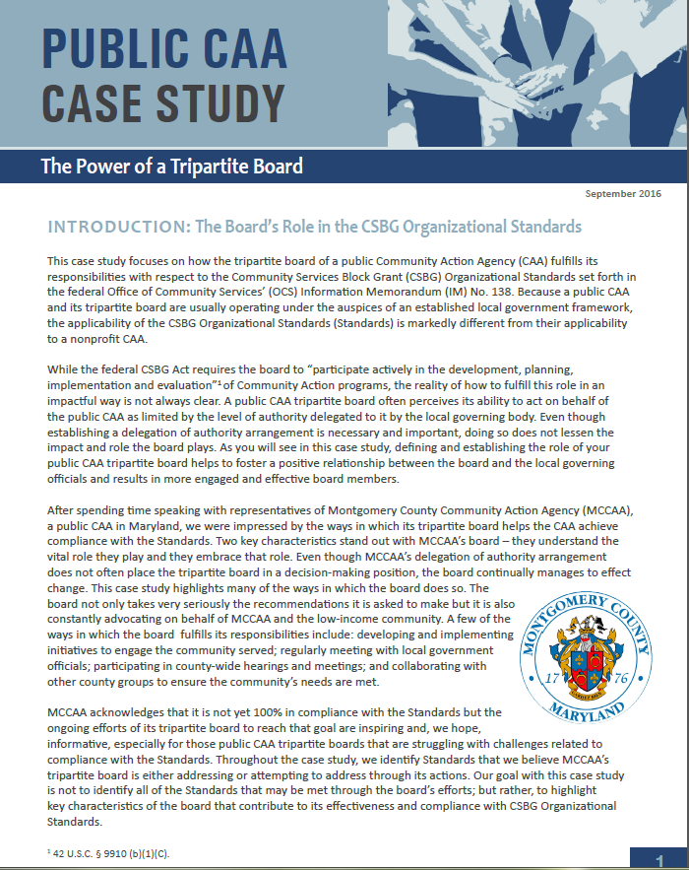
Public CAA Case Study:
Power of a Tripartite Board
Notes:
This case study focuses on how the tripartite board of a public CAA fulfills its responsibilities with respect to the CSBG Organizational Standards, which are referenced in the discussions of each of the key board responsibilities. Because a public CAA and its tripartite board are usually operating under the auspices of an established local government framework, the applicability of the Standards is markedly different from their applicability to a nonprofit CAA. After spending time speaking with representatives of Montgomery County Community Action Agency (MCCAA), a public CAA in Maryland, CAPLAW was impressed by the ways in which its tripartite board helps the CAA achieve compliance with the Standards; especially since the tripartite board does not have the authority to take action on behalf of the CAA. Rather the tripartite board submits recommendations to the local governing officials who carefully consider and often accept them.

Slide 6
Key Board Responsibility
Maintain and Grow
Funding
Notes:
Ensuring that the public CAA is maintaining, and when possible, growing its funding is not only a key board responsibility, it is a critical one. A public CAA is no different than a nonprofit CAA in that the survival of each is tied to having sufficient funds to operate. In this section, we will work through some questions to address the role of the board in overseeing and potentially growing the funds of a public CAA.

Slide 7
Funding Scenario
Darren has been a tripartite board member for 10 years and has become increasingly concerned about the public CAA’s financial standing. He hears rumblings about austerity measures in the county and fears that the board is not doing enough to help the CAA maintain its funding. Darren decides it is time for the board to take action but is not quite sure what actions the board can take since the public CAA is a division of the local government.
What advice do you have for Darren?
Notes:
A tripartite board plays an important role in helping a public CAA maintain not only its CSBG funding but also other financial supports that the CAA needs to operate within the local government framework. By regularly meeting with and educating the local governing officials about the CAAs needs and accomplishments, the board helps those who develop and decide the budget to make more informed decisions that will hopefully benefit the CAA. Further, as permitted by the local laws, board members should actively participate in local government hearings-- not only on the CAA’s budget--but also on the overall county budget.

Slide 8
Two Main Ways CAAs Generate Funds
Proposals
Writing grants
Preparing bid proposals
Putting on special events
Soliciting gifts
Fundraising
Capital campaigns
*
*
*
*
Executive director/dept. head and staff
Board, executive director/ dept. head and county counsel
Notes:
All CAAs typically receive funding in two main ways: (i) via proposals for grants from federal, state and private funding sources or (ii) via fundraising activities that target private donors. A public CAA typically relies on grants from government sources and must consult with its county counsel as to if and how it may engage other efforts to generate funds.
The federal grant rules that govern a CAA’s use of federal funds, the Uniform Guidance, allow for CAAs to pay for the costs that are associated with preparing both successful and unsuccessful bids, proposals, or applications on potential Federal and non-Federal awards or projects with federal funds as long as certain requirements are met as to how the costs are treated (i.e., as indirect) and when they are charged to the grant (i.e., during the accounting period in which they were incurred).
Cost associated with organized fundraising, which includes activities such as capital campaigns, special events, and solicitation of gifts and bequests, may not be paid for with federal funds without obtaining prior written approval from the federal awarding agency. To date, CAPLAW is not aware of any federal agency that has given fundraising approval.

Slide 9
Board’s Role in Generating Funds
Work with staff to develop plan
Oversee implementation of plan
Identify potential funders
Develop & nurture relationships
Consult with county counsel about fundraising options
Notes:
As previously noted, tripartite board members should consult with county counsel to determine ways that the board can engage in fundraising activities on behalf of the public CAA. One option, often of interest to public CAAs, is creating a nonprofit, tax-exempt subsidiary for the purpose of fundraising. The ability of public CAAs to pursue this option as well as other fundraising activities such as soliciting donations or conducting capital campaigns will be governed by state and local laws. If a public CAA is able to create a subsidiary for fundraising purposes, it should work closely with its county counsel to do so. Maintaining a subsidiary can be time consuming and administratively burdensome, so CAAs should carefully consider the benefits received from creating one compared to the effort expended to ensure that it is operating properly.
Even if the tripartite board is restricted by state and local laws in its ability to engage in certain fundraising activities, the board should consider taking other actions to support the CAA’s fiscal soundness. Such actions include:
Working directly with staff via a committee to develop a sustainability plan that focuses on ways in which the CAA is permitted to generate funds.
Overseeing the implementation of the plan with the executive director/department head.
Identifying potential funders. Board members could facilitate introductions between potential funders and staff.
Developing and nurturing relationships with funders and potential donors as well as those in the community so they recognize the value your CAA brings to the community. Board members could also accompany staff on funder and donor visits and offer to follow up with expressions of gratitude, when appropriate.

