Slide 1

Board Roles & Responsibilities:
Nonprofit Community Action Agencies
PRESENTED BY:
[Trainer Name]
[Trainer Website or Email]
[Trainer Phone Number]
[Training]
[Date]
[Trainer Logo]
Notes:
Serving on a board of directors of a nonprofit organization is both rewarding and challenging. For a nonprofit community action agency (CAA), the federal funding that the organization receives adds another, unique layer to a board member’s responsibilities. Using scenarios and quizzes, this presentation focuses generally on the role and responsibilities of a nonprofit board and specifically on the board leadership for a nonprofit that is community action agency (CAA).
Note to Presenter: This presentation is basically a guide for those conducting trainings for tripartite boards and CAA staff that work with tripartite boards on the board’s roles and responsibilities. All the slides in the PowerPoint are annotated to provide the trainer with an understanding of the information that CAPLAW strives to convey when presenting on this topic. The intent is to support trainers in their own efforts to educate tripartite boards about the very vital role the board plays. We envision several ways that the Community Action network may use this presentation:
The presentation may be given in its entirety;
The slides may be presented in sections as noted on the webpage; and/or
The slides may be used to augment a presenter’s existing presentation.
The slides are not all-inclusive of the information that is important for tripartite boards to know. The slides are only intended to acknowledge the information that most tripartite boards will be tasked with overseeing. Every CAA is different and the way in which your CAA operates and the programs it runs will affect the information that has been included in this PowerPoint.
We recommend reading the brief introduction about this presentation for additional tips on using and printing this resource.

Slide 2
This training material was created in collaboration with Community Action Program Legal Services, Inc. (CAPLAW) and the Community Action Partnership (Partnership). The publication was created by National Association of Community Action Agencies - Community Action Partnership in the performance of the U.S. Department of Human Services, Administration for Children and Families, Office of Community Services Grant Number 90ET0465. Any opinion, findings, and conclusions, or recommendations expressed in this material are those of the authors and do not necessarily reflect the views of the U.S. Department of Health and Human Services, Administration for Children and Families.
Notes:
Note to Presenter: This is language we are required to include with this resource to acknowledge the funds that were used to pay for its creation. We ask that you include this slide in your presentation If you are presenting the PowerPoint or sections of the PowerPoint in its entirety and are not making any changes to the slides when doing so. However, if you make changes to the slides or incorporate a few slides into an existing presentation, rather than use an entire section, the language above is no longer applicable and it is not necessary to include it.

Slide 3
Key Responsibilities of the Tripartite Board
Notes:
Unpacking what it means for board members to manage all the affairs of a nonprofit corporation can seem daunting and overwhelming. For nonprofit CAAs, a board member’s responsibilities are often driven by the requirements of the state and federal funding they receive. For example, the federal CSBG Act requires board members to be fully engaged in the development, planning, implementation and evaluation of the CSBG program.
The following section unpacks a board’s responsibilities as managers of the corporation and pursuant to funding source directives by focusing on key responsibilities that encompass many of the actions board members must take to effectively fulfill their duties.

Slide 4
Key Board Responsibilities
Mission
Planning
Engagement
Generating Funds
Performance
Accountability
Notes:
CAPLAW has identified 6 hallmarks of an effective tripartite board. Engaged boards acting and monitoring in these key areas are likely to be meeting and exceeding the governance requirements applicable to them. As we work through each of the six characteristics we will discuss how they tie in with the tripartite board’s responsibility to be fully engaged in the development, planning, implementation and evaluation of the CSBG program. We will also show how many of the CSBG Organizational Standards, especially those specific to a board’s responsibilities, are met through fulfilling these key responsibilities.

Slide 5
Key Board Responsibility
Accountability
Notes:
The tripartite board plays an instrumental role in ensuring that a CAA is accountable, i.e., fiscally strong, legally complaint and operationally sound. Maintaining accountability requires the implementation of systems, policies and procedures that the board oversees, reviews and approves. To gain and maintain public trust, a CAA must be able to show that it has a strong commitment to ethical principles, transparency and accountability.

Slide 6
Ensure Accountability
Financial
Operational
Legal
Notes:
When we talk about accountability, we will be looking at actions boards can take in three overlapping areas – legal, financial and operational – to support a CAA’s efforts to either maintain or grow into a high-performing organization.

Slide 7
Executive Director Oversight
Board of Directors
Sole employee of the board is the executive director
Executive Director
Staff
Staff
Notes:
As previously discussed, the executive director is the sole employee of the board and is authorized by the board to hire, fire and manage staff. Board members generally communicate with other staff about organizational business through its one employee, the executive director. A key board responsibility that is essential to maintaining an accountable organization is to effectively oversee, evaluate and compensate the executive director.

Slide 8
Manage Executive Director
Oversee
Regularly communicate
Provide assistance when needed
Evaluate
Use board committee
Decide on evaluation tool/ criteria
Request reports
Ask about goals & programs
Conduct annual review
Gather input
Set up in-person evaluation
Create written review
Notes:
Oversee
In a smoothly running organization, the board regularly communicates with the executive director via the board chair who will often meet or schedule regular calls with the executive director to discuss new or ongoing concerns. Meeting regularly establishes an opportunity for the board chair to let the executive director know what the board believes the executive director is doing well and provide appreciation for his or her daily efforts on behalf of the organization. At the same time, it is a way to spot problems between evaluations, before they become critical.
Being an executive director is a tremendously complex job with many pressures and expectations. If the executive director has been struggling with specific problems such as time management, lack of expertise, or feeling overwhelmed, the board should work to help him/her obtain the needed assistance. For most boards, the board chair will likely be the one to discuss such issues with the executive director and then work with either the full board or a board committee to identify possible solutions such as training in specific subjects, finding an external mentor or considering executive coaching.
Evaluate
The executive director is typically central to the success (or failure) of an organization. One of the board’s most critical roles is to perform an annual, written evaluation of the executive director. This evaluation will document both achievements and shortcomings so that the executive director’s performance can be improved to benefit the entire organization as well as his/her own personal growth.
The evaluation of the executive director actually begins when the board and the executive director agree upon goals and objectives for the coming year. Tying these goals to the strategic plan of the organization is a good way to structure a meaningful performance review for the executive director. The evaluation process often helps align and clarify the goals and expectations of the executive director and provides firm support for executive compensation decisions. While the size and complexity of the board and the organization will dictate what procedures and tools are appropriate for the evaluation, there are some general guidelines boards may find useful, which include:
Use a board committee that could be either a subgroup of the executive, governance or compensation committee (if applicable) or perhaps an ad hoc committee that will handle the logistics, research and written documentation.
Decide on an evaluation tool and the criteria for the review. Many types of evaluation tools are available, ranging from a checklist of skills and abilities that enable others to “rate” the executive director, to more open-ended tools that allow for individual comments. The executive director and the committee should meet to review the process and the tool.
Gather input from a variety of sources. Include board and staff members, and key partners of the CAA (consider clients, volunteers, donors, community members, etc.) as part of the evaluation. Obtaining input from non-board members may be difficult without anonymity so a board may consider using online surveys that protect confidentiality.
Set up a face-to-face evaluation meeting. Consider having either the board chair, or the chair and one other committee member, meet with the executive director to discuss the evaluation. Such a meeting would typically cover the executive director’s achievements, the areas where he/she might need improvement, and goals for the executive director to focus on in the coming year. It is also a good opportunity to discuss professional development goals for the executive director. If compensation is discussed, the committee should keep a record of that discussion.
Create a written review and summary. Documentation is important because it serves as a point of reference for the board and executive director with respect to those areas where the executive director has been successful, as well as those where he/she can improve performance.

Slide 9
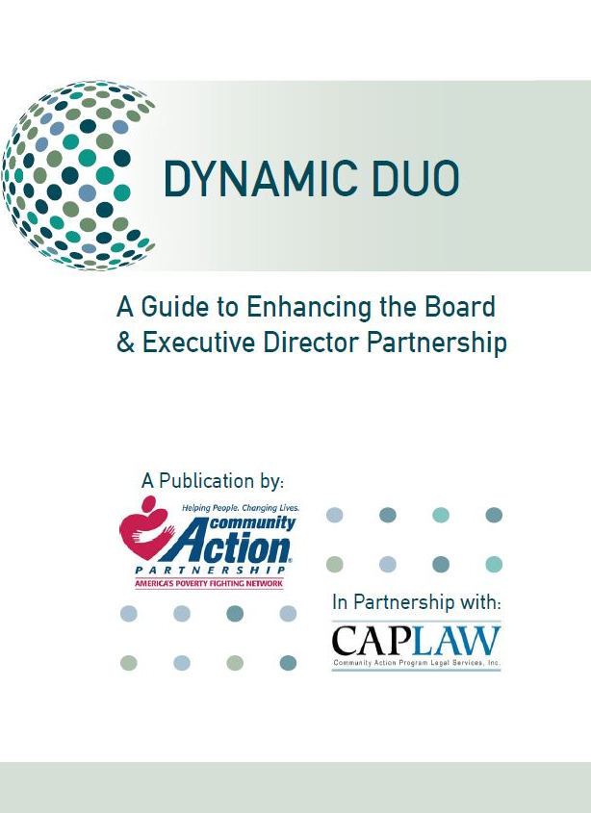
CSBG Organization Standards
Executive Director Oversight
CSBG Org. Standard 7.4
The governing board conducts a performance appraisal of the CEO/executive director within each calendar year
Notes:
While performing an annual review of the executive director is a standard practice for nonprofit organizations, CAAs are required to do so under the CSBG Organizational Standards. While the Standards require that the board conduct a performance appraisal of the executive director within each calendar year, they leave the specific process and procedures for doing so up to the board.
The CAPLAW publication, Dynamic Duo: A Guide to Enhancing the Board & Executive Director Partnership, offers further information and links to other resources that can help boards with conducting a performance appraisal of the executive director.

Slide 10
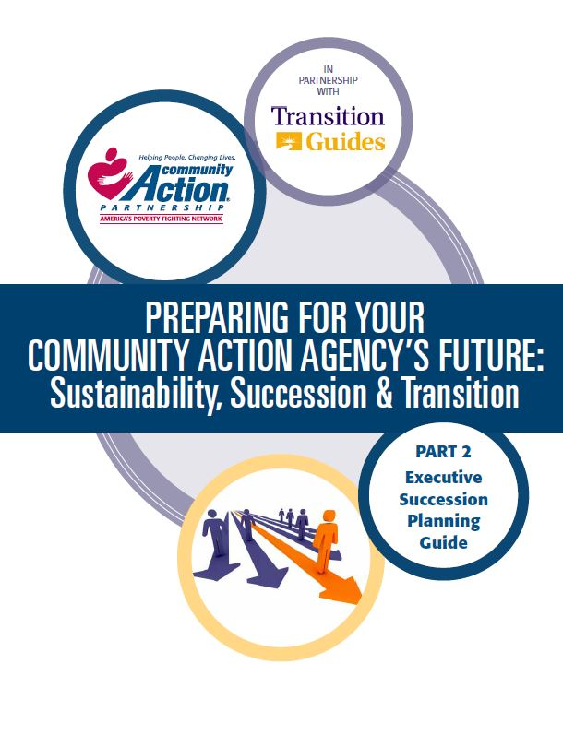
Executive Director Oversight
Succession Plan
CSBG Org. Standard 4.5
The organization has a written succession plan in place for the CEO/executive director, approved by the governing board, which contains procedures for covering an emergency/unplanned, short-term absence of 3 months or less, as well as outlines the process for filling a permanent vacancy.
Notes:
Succession planning is key to the sustainability of organizational leadership. The CSBG Organizational Standards specifically require nonprofit CAAs to have in place a written succession plan, approved by the board, for the executive director position. The plan must contain procedures for covering an emergency/unplanned departure and a short-term absence of three months or less, as well as the process for filling a permanent vacancy.
The national Community Action Partnership has developed a number of executive transition resources that are available on its website. The one referenced on this slide, Part 2: Executive Succession Planning Guide, specifically discusses ways a tripartite board may develop a plan that is right for its organization.

Slide 11
Organizational Policies Scenario
Ann, a program assistant who repeatedly spoke inappropriately to colleagues and clients, was terminated after her first year of working at CAA, Inc. Distraught by her termination, Ann sent a scathing email to the Executive Director and board member, Jackie, who is Ann’s sister-in-law. Ann exclaimed in the email that the CAA wrongfully terminated her, that her complaints about being sexually harassed by her co-worker Don were never addressed, and that the Program Director used program funds to pay vendors to provide personal services.
What organizational policies are implicated in this scenario? How?
Notes:
Boards oversee the implementation of policies by the CAA and there are a number implicated by this scenario that would have helped to protect this CAA. These polices include:
Personnel policies which would establish the process to follow before an employee is terminated. The policies would detail information about performance reviews, disciplinary measures and employee actions that may result in immediate terminations. The policies would also outline how staff handle employee complaints, especially ones of a serious nature like sexual harassment. The policies would establish the investigation and response required to effectively manage such claims.
A whistleblower policy would have instructed Ann on how to report her sexual harassment claims if they were not being properly addressed. Also, the policy would have provided Ann with one way to report her concerns about the Program Director paying CAA vendors for personal services using program funds.
A conflicts of interest policy is necessary to educate board members, like Jackie, about situations that may rise to the level of an apparent or real conflict of interest with the organization and how to manage that conflict. Funding sources impose conflict of interest governance requirements on grantees and, if this CAA has a Head Start program, then either Jackie would not be able to serve as a board member, or Ann would have to resign. The Head Start Act specifically prohibits the immediate family of board members from working for a Head Start grantee, even if the relative is not working for the Head Start program. Prior Head Start guidance indicates that “sister-in-law” is considered an immediate family member for purposes of compliance with the Head Start conflict of interest requirements.
Boards should remember that policies are most successful when those who are subject to them are trained on how to comply with them and understand what will result from noncompliance.

Slide 12
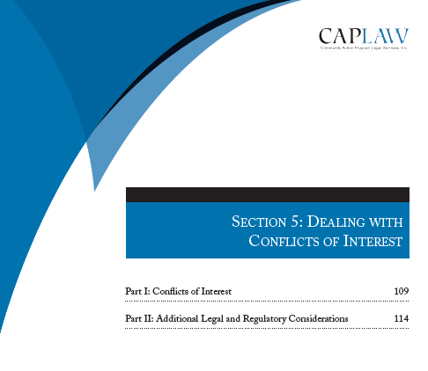
Policies
Conflict of Interest
CSBG Org. Standard 5.6
Each board member has signed a conflict of interest
policy within the past 2 years.
*
Sample policies and archived
webinar on CAPLAW’s website, www.caplaw.org
Notes:
Generally, a conflict of interest exists whenever an individual who has authority to make or influence decisions affecting the CAA, such as a board member or the person who makes procurement decisions, has a personal incentive (often financial) to influence the CAA to take or not take a particular action.
The prior scenario highlighted one reason board members are tasked with managing conflicts of interest -- funding sources require them to do so. In addition to the various Head Start conflict of interest requirements that apply to CAAs receiving Head Start funds, the CSBG Organizational Standards specifically require board members to sign a conflict of interest policy within the past two years. A robust conflict of interest policy can help protect the organization from losing its tax-exempt status (e.g., because assets or funding is used for the personal benefit of those who exercise influence over the organization) and from negative public perceptions that damage the CAA’s reputation in the community.
It is important to remember that not all conflicts of interest are objectionable. The goal is to develop a clear process to define conflicts, establish mechanisms to disclose potential conflicts and outline a process and criteria to determine whether a transaction involving a conflict is acceptable and permissible.
CAPLAW offers sample conflicts of interest policies for CAAs with and without Head Start programs, webinars discussing different conflicts of interest scenarios CAAs may face, and its resource, Tools for Top-Notch CAAs, which includes a section that specifically discusses how board members can deal with conflicts of interest.

Slide 13
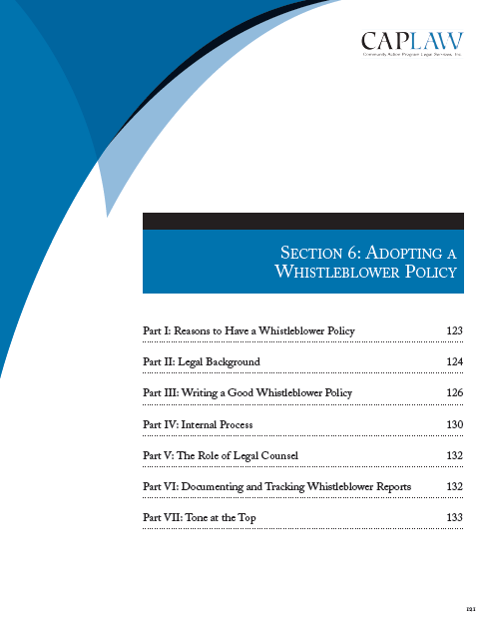
Policies
Whistleblower Policy
CSBG Org. Standard 7.7
The organization has a
whistleblower policy that has
been approved by the
governing board.
*
Sample policies and
archived webinar on
CAPLAW’s website. www.caplaw.org
Notes:
A whistleblower policy is one that encourages an organization’s employees, volunteers and other stakeholders to notify designated individuals within the CAA when they have concerns and suspicions regarding fraud, illegal activity and other wrongdoing, and in turn, protects the whistleblower from retaliation. The earlier scenario highlighted a situation where a whistleblower policy would have helped to protect the CAA. The CSBG Organizational Standards also makes clear that CAAs must have such a policy in place that has been approved by the board.
CAPLAW offers on its website a sample whistleblower policy for CAAs, webinars discussing different whistleblower scenarios CAAs may face, and its resource, Tools for Top-Notch CAAs, which includes a section that specifically discusses adopting a whistleblower policy.

Slide 14
Additional Policies
Adopt org. policies, ensure they are being followed, and review/update them periodically
CSBG Org. Standard 8.10
  The fiscal policies have been reviewed by staff within the past 2 years, updated as necessary, with changes approved by the governing board.
CSBG Org. Standard 7.1
  The organization has written personnel policies that have been reviewed by an attorney and approved by the governing board within the past 5 years.
CSBG Org. Standard 8.11
  A written procurement policy is in place and has been reviewed by the governing board within the past 5 years.
Notes:
The CSBG Organizational Standards also require the board to approve a number of other policies that support an organization’s operations. These policies include:
Fiscal polices that must be updated within the past two years with changes approved by the board;
Written personnel policies, which must be reviewed by an attorney and approved by the board within the past 5 years. Human resources is an area where CAAs face a fair amount of liability and where CAPLAW receives many questions. Also, the law in this area is constantly evolving, making it even more critical that the policies be up-to-date; and
A written procurement policy, which must be reviewed by the board within the past 5 years.
While the Standards only require the board to review and approve the policies, such policies are ineffective if staff are not be trained on them and are not following them.

Slide 15
Additional Filings
CSBG Org. Standard 8.8
CSBG Org. Standard 8.6
All required filings and payments related to payroll withholdings are completed on time.
The IRS Form 990 is completed annually and made available to the governing board for review.
Notes:
Boards should also be aware of other filings that the CAA is required to submit under the Uniform Guidance. Board members could face personal liability if payroll taxes are not paid, and thus boards should ensure these are being paid on a timely basis. Further, a CAA, as a tax-exempt organization, is required to report on its Form 990 that the board received a copy of the informational filing—this requirement is reflected in the CSBG Organizational Standards, which require that the CAA’s Form 990 be made available to the board for its review.

Slide 16
Oversee Financial Standing
1
  Review financial statements
2
  Approve and monitor annual budget
3
  Set and reassess CEO compensation
4
  Select and monitor auditor
Notes:
One of the board’s primary functions is to oversee a CAA’s finances, to determine how to allocate its resources and to protect its funds and resources from misuse or mismanagement. The board meets this responsibility by:
Regularly reviewing financial statements
Approving and monitoring the annual budget.
Setting and revisiting the executive director’s/CEO’s compensation and
Selecting and monitoring the auditor.
We will discuss in greater detail the board’s role with regards to each of these tasks in the following slides.

Slide 17
Financial Statement Scenario
CAA’s CFO, Ms. Moneypenny, decided that providing the board with a complete set of financial statements is a mistake. In Moneypenny’s view, the board should review a detailed schedule showing each program, the revenue associated with the program, and the related expenses. Moneypenny believes CAAs are unique because of their reliance on multiple revenue streams that must be used for specified purposes. In her view, entity-level financial statements make no sense because grant revenue from one program (e.g., CSBG) cannot be used to finance another program (e.g. Head Start).
Do you agree with Moneypenny’s approach? Why or why not?
Notes:
While Moneypenny is providing the board with useful information, she is ignoring the value of entity-level financial statements. External stakeholders often require financial information that reflects the entity as a whole. For example, if a CAA had a revolving line of credit to finance, the bank, in administering the loan, would look to the CAA as a whole. This means the board needs to also look at the entity as a whole to make sure that there is sufficient liquidity to satisfy the bank. In other words, the board should be looking at the CAA through the eyes of an external stakeholder. Moreover, not all assets are restricted to a particular program. CAAs may have unrestricted cash, receivables, and fixed assets (equipment and buildings). The board should be monitoring these on an ongoing basis. Finally, if the board wants to expand into new areas, it needs to understand the resources available for expansion.
Although Moneypenny may have legitimate reasons for disagreeing with the whole-entity approach, she should keep one fact squarely in mind: providing the board with a complete set of financial statements does not preclude her from supplementing the financial statements with schedules that show operations on a program-by-program basis. In fact, providing these supplemental schedules is an encouraged practice and enable the board to assess the financial health of individual programs.
Lesson: A board member who does not receive a complete set of financial statements, including the balance sheet, should demand them. Those who think board members won’t understand them or will be hopelessly confused are doing everyone a disservice, including themselves.

Slide 18
Financial Statements
Board’s approach to financial statements (balance sheet, income statement, cash flow statement) includes:
  Preliminary review by finance committee
  Review by every board member
  Regular discussion
  Once-a-year discussions (e.g., annual budget, etc.)
  Question and answers
Notes:
Every regular board meeting should include a review of the CAA’s financial statements, be they the year-end audited statements or interim statements. Typically the interim statements are less formal than the audited ones, but if the CAA’s accounting system is a good one, these statements should be relatively accurate. CAPLAW recommends a five-step approach to the periodic review:
Step 1: Preliminary Review by the Finance Committee
The CAA should have a finance committee. One of the committee’s tasks should be to review the financial statements in advance of the board meeting and report on the statements at the meeting. If the CAA does not have a finance committee, someone should be designated to review the statements in advance of the meeting and lead the discussion. This person could be a board member or the CAA’s CFO or treasurer, depending on the CAA’s resources and circumstances. Even if a non-board member leads the discussion, CAPLAW recommends that the staff member review the statements ahead of time with a board member, such as the treasurer, so that at least one board member will have a more detailed understanding of the statements.
Step 2: Review by Every Board Member
Every board member should receive a packet of financial information at least one week in advance of the scheduled board meeting. The packet should include a complete set of financial statements, and if possible, an analysis of the statements from the board’s finance committee or the CAA’s CFO or treasurer. Each board member—no matter how financially illiterate—should review the financial statements before the meeting.
Step 3: Regular Discussion of the Financial Statements
The meeting agenda should set aside sufficient time to permit a thorough discussion of the financial statements. The discussion should include a review of:
Variances from budget—comparing what actually happened with the annual plan
Liquidity—the CAA’s ability to meet its obligations as they become due
Unrestricted net assets available for operations
Program-by-program analysis of revenue and expenses
Key financial metrics
Stability of the CAA’s grants and other revenue sources
Any other matters involving finances warranting discussion
Step 4: Once-a-Year Discussions
At least once a year, the board should discuss the following matters in detail: auditor’s annual report and management letter; CAA’s annual organization-wide budget; CAA’s system of internal controls; CAA’s overall financial health, including its liquidity and unrestricted net assets; CAA’s long-term financial plans and needs. The board need not address all of these topics at the same meeting.
Step 5: Questions and Answers
Time should be set aside during each discussion of the CAA’s finances for a robust Q & A session. Questions should be encouraged.

Slide 19

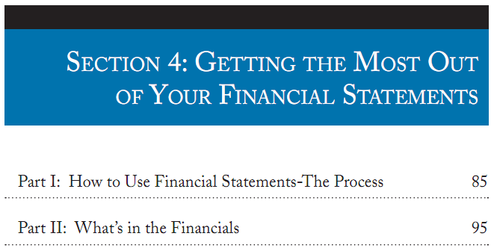
Notes:
If board members are struggling to read and understand the CAA’s financial statements, encourage them to review the section from CAPLAW’s Tools for Top-Notch CAAs, which walks through each of the financial statements and offers tips on what boards should be focusing on with regards to each of the statements.

Slide 20
CSBG Organizational Standards
Financial Statements
CSBG Org. Standard 8.7
The governing board receives financial reports at each regular meeting that include the following:
Balance sheet/statement of financial position.
Org.-wide report on revenue and expenditures that compares budget to actual, categorized by program; and
Notes:
As previously noted, the CSBG Organizational Standards require that boards receive financial statements at every meeting.

Slide 21
Annual Budget
Monitor performance against budget during year
Board members should develop a high-level understanding of:
  Overall budget goals and assumptions
  Cost centers
  Applicable grant requirements
Work with finance committee and fiscal staff to develop annual budget
Notes:
The annual budget is one of the most useful tools the board will use to monitor the CAA’s performance throughout the year. To ensure that the budget is effectively used, the board should assist its members with developing a high-level understanding of the following:
Budget Goals: Each board must determine its overall financial goals for the year covered by the annual operating budget. CAAs are encouraged to work toward long-term sustainability, which requires building both cash reserves and net assets (the nonprofit term for equity or net worth). To achieve these sustainability goals, the CAA must budget to have overall income exceed overall expenses in the annual budget. Unfortunately, many governmental funding agreements are structured on a “use it or lose it” cost reimbursement basis. Budgeting to generate income that is greater than expenses requires the CAA to develop additional strategies to overcome the limitations of cost reimbursement contracts.
Assumptions: The annual operating budget represents the CAA’s best estimate or projection of income and expenses for the upcoming fiscal year. Sound budgeting requires systematic recording of the assumptions that are the basis of the projections. Clear documentation of assumptions will make it much easier to calculate the impact on the overall budget that will occur when assumptions change.
Cost centers. CAAs frequently operate multiple programs and in many instances, each program is supported through the use of resources from multiple sources. The use of a cost center budget structure facilitates describing how various programs will be supported and how various funding sources will be used in accordance with the requirements of specific funders. Budgets for all cost centers must be integrated into the comprehensive annual budget document. For example, a CAA with a Head Start, weatherization, and energy assistance programs should develop budgets for each program. It should also develop cost centers for general administration and fundraising.
Grant requirements. Board members should have a high-level understanding of the goals of the financial requirements that apply to federal grants so they understand the need for strong financial systems and processes and are able to effectively oversee the CAA’s financial compliance.

Slide 22
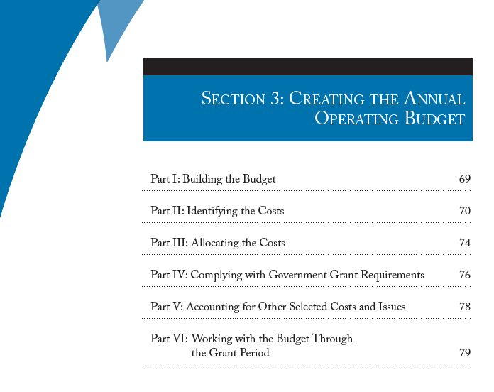
Notes:
This section from CAPLAW’s Tools for Top-Notch CAA’s will help tripartite boards understand how annual budgets are developed, the purpose they serve and the federal requirements that apply to the budgeting process.

Slide 23
CSBG Organizational Standards
Budget
CSBG Org. Standard 8.9
The governing board annually approves an organization-wide budget.
Notes:
The CSBG Organizational Standards require boards to approve an organization-wide budget on an annual basis.

Slide 24
CEO Compensation Scenario
Tonya has been the CEO of CAA, Inc. for the past 5 years and is concerned about her compensation. There is no formal or written compensation-setting process. The practice has been for the board chair to meet for coffee with the CEO once a year to discuss her performance and compensation for the following year. The chair then reports the meeting to the board and recommends a certain percentage increase. The board votes on the percentage increase, although the total compensation is not disclosed to the full board.
Do you think the way in which the board sets Tonya's compensation is appropriate? If yes or no, why?
Notes:
See answer in notes on next slide.

Slide 25
Executive Director Compensation
Understand IRS requirements, in particular, intermediate sanctions
Establish a presumption that compensation is reasonable:
  Use board committee
  Assure board independence
  Link pay to performance
  Rely on meaningful comparables
  Document the process
Recognize funding source requirements
Notes:
Another important responsibility of a board is to set the compensation it pays to the executive director. Nonprofit CAAs, as tax-exempt organizations, must comply with Internal Revenue Services (IRS) rules when setting an executive director’s compensation. The rules require the board to ensure that the compensation is reasonable and not excessive. The IRS has also established a process for setting executive compensation that, when followed, create a presumption that the compensation is reasonable. If the CAA had followed the IRS’s process, it would have shifted the burden to the IRS to prove that that the compensation paid was excessive and not reasonable.
The IRS requirements around executive director compensation are in place to prevent a tax-exempt organization, like a nonprofit CAA, from giving an executive director what may be viewed as excessive compensation. The IRS rules impose taxes on transactions where an individual with substantial influence over an organization receives an excessive economic benefit from the organization. If the compensation is not reasonable, the IRS will invoke “intermediate sanctions”, requiring the individual who received excessive compensation to return the unreasonable portion to the organization and to pay a penalty tax to the IRS. In addition, board members who approved the compensation knowing that it was excessive may also owe penalty taxes.
In an effort to establish the reasonableness of an executive director’s compensation, a boards should consider adopting the following approach:
Use a Board Committee: A committee of the board (such as the executive committee or the personnel committee) usually undertakes the responsibility to ensure that the proper compensation analysis is conducted, such as researching comparables, to show that salary ranges and compensations are reasonable.
Assure Board Independence: Any board members who have a conflict of interest with respect to the transaction should recuse themselves from discussions and voting on the matter.
Link Pay to Performance: Compensation levels and any bonuses should be linked to performance. Establishing compensation goes hand in hand with evaluating performance and setting goals. While cost-of-living increases and incentive compensation under a written plan may be permissible, boards should avoid increasing compensation levels based on non-performance related factors such as seniority. CAPLAW recommends caution when considering awarding bonuses and incentive compensation because IRS rules that apply to written plans for executive compensation are complex, and many organizations have had costs associated with such compensation disallowed under federal grant rules for either not having a plan or failing to follow their plan.
Rely on Meaningful Comparables: Use organizations for comparison that are similar to your CAA. To be considered comparable, an organization should conduct similar programs, be relatively equal in size, and have a similar workforce.
Document the Process. In setting the executive director’s compensation, the board should rely on a clearly-defined deliberative process that is documented. The board must adequately document the basis for its determination concurrently with making that determination.
When setting the executive director’s compensation, the board should be aware of funding source requirements that apply to the federal funds that may be used to pay the compensation. For example, typically the federal appropriations act which funds all of a CAA’s federal grants impose salary caps for an applicable year.

Slide 26
CSBG Organizational Standard
Executive Director Compensation
CSBG Org. Standard 7.5:
The governing board reviews and approves CEO/executive director compensation within each calendar year.
Notes:
The CSBG Organizational Standards require the board to review and approve the CEO/executive director’s salary on an annual basis. For more information about the board’s role in setting the compensation for the executive director and the applicable legal requirements, see CAPLAW’s Dynamic Duo: A Guide to Enhancing the Board & Executive Director Partnership.

Slide 27
Audit Exercise
The auditor prepares the CAA’s financial statements. True or False
An audit primarily certifies the fairness of financial statements. True or False
An audit is mostly for management’s benefit. True or False
A high-quality audit is a waste of money that could be better spent on mission. True or False
Notes:
False. The financial statements are management’s responsibility. The auditors are prohibited by professional standards from preparing the financial statements. During the course of an audit, the auditors may demand that the financial statements be adjusted because an accounting principle was incorrectly applied or because errors have been uncovered, but by and large, this is (and should be) the extent of the auditor’s involvement in the preparation of the financial statements.
True. Many think that an audit’s primary purpose is detecting fraud. However, the primary purpose of a financial statement audit is to certify the fairness of the financial statements. The professional standards applicable to financial statement audits require an auditor to consider the possibility of fraud to the extent it bears on the fairness of the financial statements, but detection of fraud is not the audit’s primary objective. Management is responsible for detecting and preventing fraud. Management discharges this responsibility by putting in place and continuously improving the CAA’s system of internal controls. Moreover, the audit cycle makes the detection of fraud less likely. Depending on the CAA’s size, the auditors conduct an audit over a several week or month period following the close of the CAA’s fiscal year. Even if the auditor shared responsibility for detecting fraud, the fraudster has ten or eleven months following the close of an audit to embezzle, steal, or otherwise defraud a CAA. That is more than enough time to do inflict significant harm.
False. Of course, management does benefit from an audit. The mere act of preparing for an audit requires the accounting staff to tie up loose ends and engage in a self-assessment. However, the board is the intended and primary beneficiary of an audit. The audit is an integral part of good internal control and oversight system. The board relies on the financial statements to allocate financial resources, evaluate management, and shape mission. The board looks to the auditor for assurance that it is prudent to rely on management’s financial statements.
False. There are two fallacies embedded in this statement. Mission and administration are inextricably linked. Any effort to distinguish between money spent on mission and money spent on administration is artificial. No entity can deliver goods or services without an administrative infrastructure. Without solid administration, money that is spent on mission will go to waste. The challenge is to strike the right balance between direct and indirect expenditures on mission.
An audit provides concrete benefits. The culminating step in the audit is the issuance of an audit opinion, also referred to as an audit report. Although that piece of paper may provide little or no insight into the audit or the CAA’s finances, a well-done audit nevertheless has great value to the CAA. As we will see, management and the board must be willing to work and communicate with the auditor to extract that value.

Slide 28
Board’s Role in Audit
Board retains auditor and should work with a board audit committee to:
  Oversee board’s relationship and interaction with outside auditors
  Monitor CAA’s system of internal controls
  Indentify and monitor financial related risks
  Conduct in-depth review (w/auditor present) of Single Audit compliance and prepare report to the board
Notes:
An audit is a multi-step process whose goal is to assess whether the financial statements prepared by management present an accurate and fair portrayal of the agency’s financial condition, cash flows and operating results. Since the primary purpose of the audit is to provide the board with comfort that management has produced financial statements that present the CAA’s financial results and position accurately in all material respects, the board, not management, should retain the auditor.
The audit committee should assess the auditor’s independence and communicate with the auditor. The auditor is required to communicate to the board: (i) the auditor’s responsibilities under Generally Accepted Accounting Standards (GAAS); (ii) an overview of the planned scope and timing of the audit; and (iii) significant findings from the audit. The auditing standards contemplate a formal communication process, specifying which communications are written or oral. Auditing standards require the auditor to communicate to the board significant control deficiencies and material weaknesses in the system of internal controls. The audit committee should have members capable of facilitating the committee’s role in the discussions. These members must understand the implications of the communications and be in a position to demand that management respond appropriately.
The audit committee receives the results of the audit from the auditor and must address any issues raised by the audit. To address these issues, the committee should review the auditor’s written communication regarding control deficiencies, engage in a discussion with management about the deficiencies and the need to make changes in systems, and require periodic progress reports from management. Auditors are required to start their auditing procedures the next year by examining whether previous deficiencies were resolved and how the board handled the audit findings
The audit committee will also work with the auditor to conduct the Single Audit review which is the review required by the federal government for organizations that expend a certain amount of federal dollars. The audit focuses on financial and program compliance.

Slide 29
CSBG Audit Requirements
Nonprofits
CSBG Org. Standard 8.2: Nonprofit
  All findings from the prior year’s annual audit have been assessed by the organization and addressed where the governing board has deemed it appropriate.
CSBG Org. Standard 8.3: Nonprofit
  The organization’s auditor presents the audit to the governing board.
CSBG Org. Standard 8.4: Nonprofit
  The governing board formally receives and accepts the audit.
CSBG Org. Standard 8.5: Nonprofit
  The organization has solicited bids for its audit within the past 5 years.
Notes:
The CSBG Organizational Standards require the board to be involved in the CAA’s audit by soliciting bids for its audit every five years, formally receiving and accepting the audit bid, receiving the audit from the auditor, and addressing all findings from the prior years audit when deemed appropriate.

Slide 30
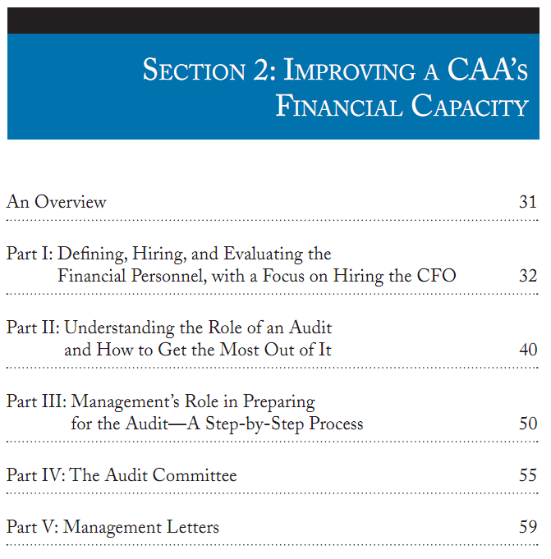
Notes:
For board members who are not familiar with audits, CAPLAW’s Tools for Top-Notch CAAs explains the role of the board versus management in the audit process as well as the duties of an audit committee and the purpose of management letters received at the conclusion of an audit.

Slide 31
Culture of Compliance Scenario
CAA’s Finance Manager compares receipts with expense reports and handles reimbursement requests. The Deputy Director and Program Manager submitted reimbursement requests for a training conference they both recently attended. The Program Manager kept her expenses very low by using the free hotel airport shuttle, eating all the meals included in the registration fee, and avoiding any unnecessary expenses. The Deputy Director used a taxi, ordered room service, consumed several mini-bar items, and sent clothes to the hotel laundry.
What, if anything, should the Finance Manager do?
Notes:
The tone at the top is the message about ethics and integrity that organization leaders send through their words and behaviors. Visible commitment by the organization’s board and senior management is essential to cultivating a culture of compliance and high ethical standards. The tone at the top needs to be one that emphasizes accountability, knowledge of procedures, compliance, and honesty.
Failure to reinforce these principles will be an open invitation to staff to cut corners for the sake of expediency, to avoid or never learn program requirements, and to be sloppy in their attention to details like reconciling accounts and documentation.
In this scenario, the finance manager may approach the deputy director’s supervisor, executive director, and express his/her concern with the deputy director’s reimbursement request. The CAA could also ensure that its expense reimbursement policy is clear and educate employ on compliance with it. The executive director may, pursuant to its personnel policies, decide to discipline the Deputy Director for failure to follow organizational policies, if such is found to be the case.

Slide 32
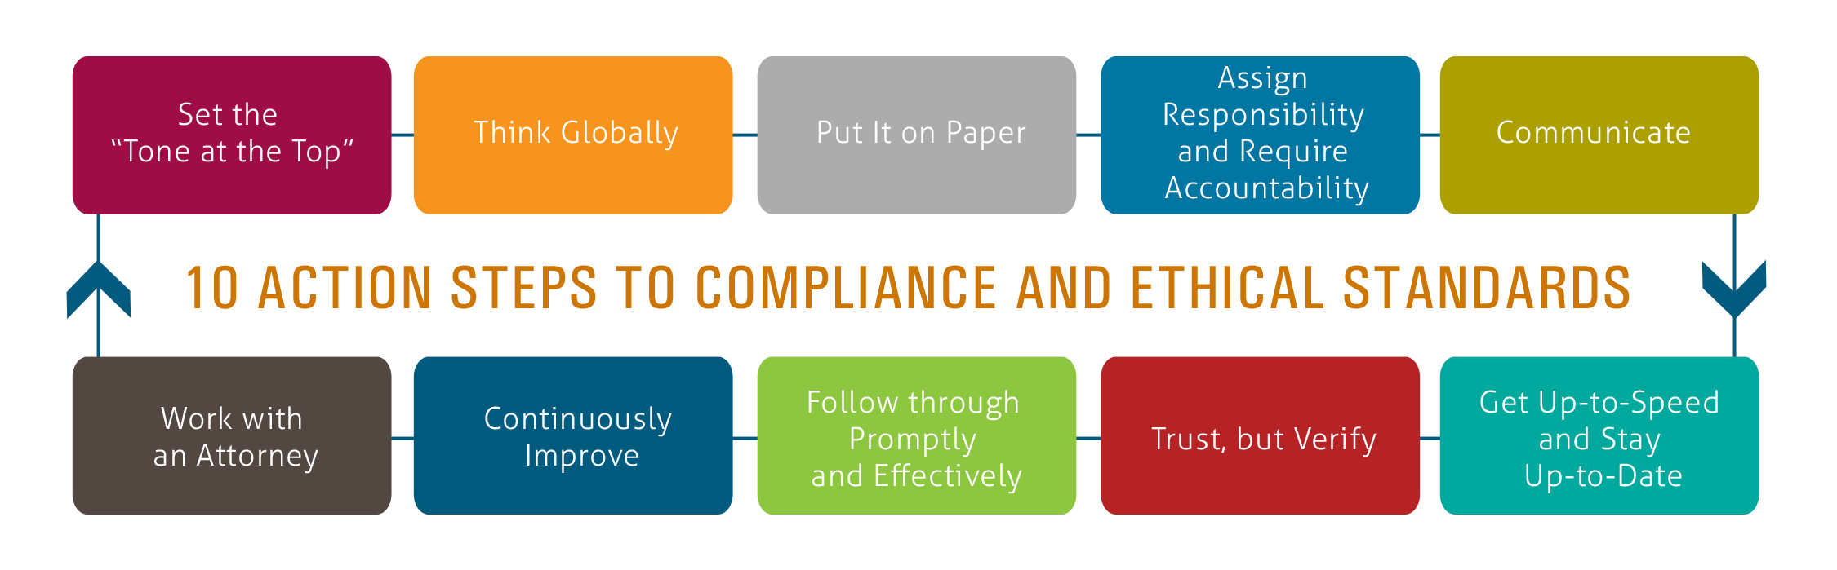
Developing a Culture of Compliance
Exemplary Legal Practices and Policies Guidebook, Part I: Do the Right Thing: How to Cultivate a Culture of Compliance and High Ethical Standards http://caplaw.org/resources/PublicationDocuments/DotheRightThing.html
Notes:
CAPLAW offers a resource, Exemplary Legal Practices and Policies Guidebook, Part I: Do the Right Thing: How to Cultivate a Culture of Compliance and High Ethical Standards that walks CAA leaders through ten steps to help them develop an approach to ensuring compliance and ethical behavior at the organization. The Guide includes specific examples of actions CAAs have taken to meet each of the steps listed above. The steps represent a continuous process that should be integrated into the CAA’s existing operations.

Slide 33
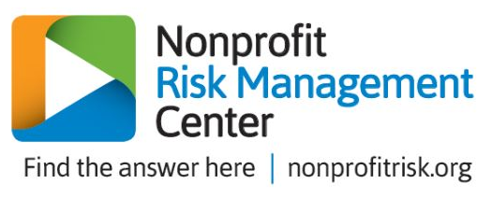
Risk Management
CSBG Org. Standard 4.6
An organization-wide, comprehensive risk assessment has been completed within the past 2 years and reported to the governing board.
Community Action Partnership Risk Management Portal:
https://communityactionpartnership.com/online_tools/risk-management-portal/
Notes:
The CSBG Organizational Standards requires that CAAs conduct a comprehensive risk assessment every 2 years. This risk assessment assists boards in developing a culture of compliance by requiring a comprehensive review of the organization’s systems and processes. The results of the assessment must be reported to the board. While receiving the report is all that is technically required by the Standards, boards may be involved in helping the CAA identify a tool for the assessment.
The National Community Action Partnership, in collaboration with the Nonprofit Risk Management Center, developed a risk management tool specifically for CAAs, the link to which is featured on the slide.
The assessment results should provide the board with feedback as to the effectiveness of the organization’s procedures and policies and where work needs to be done to improve the CAA’s accountability. A board should follow up on any findings from the risk assessment to ensure that the executive director and his/her staff are addressing identified weaknesses in the CAA’s operations.

