Slide 1

Board Roles & Responsibilities:
Public Community Action Agencies
PRESENTED BY:
[Trainer Name]
[Trainer Website or Email]
[Trainer Phone Number]
[Training]
[Date]
[Trainer Logo]
Notes:
Serving on the tripartite board of a public community action agency (CAA) is both rewarding and challenging. Even though a public CAA can exist in various forms, some of which are established under state and local laws, all public CAAs share the common thread of being controlled and managed by one or more local governments. This structure provides a tripartite board with the unique opportunity to internally influence local government involvement in improving the lives of those in the community who need it most. However, the board must do so within an established framework that adds a layer of operational complexity. Using scenarios and quizzes, this presentation focuses generally on how the tripartite board of a public CAA fulfills its role and meets its responsibility to be fully engaged in the development, planning, implementation and evaluation of the Community Services Block Grant (CSBG) program.
Note to Presenter: This presentation is basically a guide for those conducting trainings for tripartite boards and CAA staff that work with tripartite boards on the board’s roles and responsibilities. All the slides in the PowerPoint are annotated to provide the trainer with an understanding of the information that CAPLAW strives to convey when presenting on this topic. The intent is to support trainers in their own efforts to educate tripartite boards about the very vital role the board plays. We envision several ways that the Community Action network may use this presentation:
The presentation may be given in its entirety;
The slides may be presented in sections as noted on the webpage; and/or
The slides may be used to augment a presenter’s existing presentation.
The slides are not all-inclusive of the information that is important for tripartite boards to know. The slides are only intended to acknowledge the information that most tripartite boards will be tasked with overseeing. Every CAA is different and the way in which your CAA operates and the programs it runs will affect the information that has been included in this PowerPoint.
We recommend reading the brief introduction about this presentation for additional tips on using and printing this resource.

Slide 2
This training material was created in collaboration with Community Action Program Legal Services, Inc. (CAPLAW) and the Community Action Partnership (Partnership). The publication was created by National Association of Community Action Agencies - Community Action Partnership in the performance of the U.S. Department of Human Services, Administration for Children and Families, Office of Community Services Grant Number 90ET0465. Any opinion, findings, and conclusions, or recommendations expressed in this material are those of the authors and do not necessarily reflect the views of the U.S. Department of Health and Human Services, Administration for Children and Families.
Notes:
Note to Presenter: This is language we are required to include with this resource to acknowledge the funds that were used to pay for its creation. We ask that you include this slide in your presentation if you are presenting the PowerPoint or sections of the PowerPoint in its entirety and are not making any changes to the slides when doing so. However, if you make changes to the slides or incorporate a few slides into an existing presentation, rather than use an entire section, the language above is no longer applicable and it is not necessary to include it.

Slide 3
Key Responsibilities of the Tripartite Board
Notes:
Unpacking what it means for tripartite board members to participate actively in the development, planning, implementation and evaluation of the CSBG program can seem daunting and overwhelming. The following section unpacks a board’s responsibilities by focusing on key responsibilities that encompass many of the actions board members must take to effectively fulfill their duties and obligations.

Slide 4
Key Board Responsibilities
Mission
Planning
Engagement
Maintain and Grow Funds
Performance
Accountability
Notes:
CAPLAW has identified 6 hallmarks of an effective tripartite board. Engaged boards acting and monitoring in these key areas are likely to be meeting and exceeding the governance requirements applicable to them. As we work through each of the six characteristics we will discuss how they tie in with the tripartite board’s responsibility to participate actively in the development, planning, implementation and evaluation of the CSBG program. We will also show how many of the CSBG Organizational Standards, especially those specific to a board’s responsibilities, are met through fulfilling these key responsibilities.

Slide 5
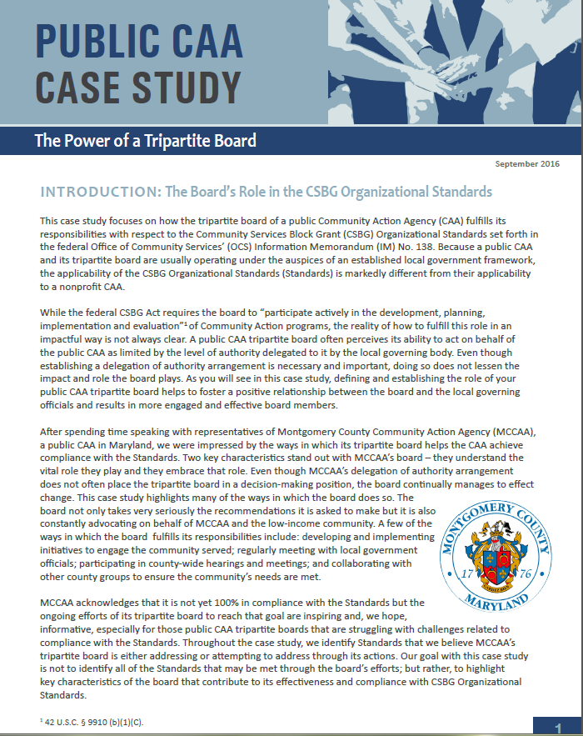
Public CAA Case Study:
Power of a Tripartite Board
Notes:
This case study focuses on how the tripartite board of a public CAA fulfills its responsibilities with respect to the CSBG Organizational Standards, which are referenced in the discussions of each of the key board responsibilities. Because a public CAA and its tripartite board are usually operating under the auspices of an established local government framework, the applicability of the Standards is markedly different from their applicability to a nonprofit CAA. After spending time speaking with representatives of Montgomery County Community Action Agency (MCCAA), a public CAA in Maryland, CAPLAW was impressed by the ways in which its tripartite board helps the CAA achieve compliance with the Standards; especially since the tripartite board does not have the authority to take action on behalf of the CAA. Rather the tripartite board submits recommendations to the local governing officials who carefully consider and often accept them.

Slide 6
Key Board Responsibility
Accountability
Notes:
The tripartite board plays an instrumental role in ensuring that a CAA is accountable, i.e., fiscally strong, legally complaint and operationally sound. Maintaining accountability requires the implementation of systems, policies and procedures that the board oversees, reviews and approves. To gain and maintain public trust, a CAA must be able to show that it has a strong commitment to ethical principles, transparency and accountability.

Slide 7
Financial Oversight Quiz
Because a public CAA is often a division or department of the local government, the tripartite board has no real influence over the CAA’s budget. True or False
The tripartite board should work closely with local governing officials to ensure it receives the financial reports for the programs it oversees as permitted by local government procedures. True or False
Notes:
False. As we will discuss in greater detail in the following slides, there are a number of ways that a tripartite board of a public CAA that is a division or department of the local government may and should exercise influence over the local government budget, especially the sections relating to the programs the board oversees.
True. Again, we will discuss the tripartite board’s receipt of financial reports in greater detail in the following slides, however, it is important that the tripartite board work closely with the local governing officials so that the officials understand what the tripartite board needs to effectively fulfill its oversight responsibilities.

Slide 8
Oversee Financial Standing
1
  Receive financial reports at regular meetings
2
  Provide input on annual budget
3
  Develop dashboards
4
  Receive notification of audit and any CSBG findings
Notes:
The tripartite board, as permitted by the local government policies and procedures, oversees the CAA’s finances which includes reviewing how the CAA allocates its resources and protects its funds and resources from misuse or mismanagement. The board meets this responsibility by:
Reviewing financial statements
Providing feedback to the local governing officials on the annual budget.
Developing dashboards to focus the tripartite board on those financial indicators most relevant to the public CAA’s operations.
Receiving notification of the availability of the local government audit and any findings relating to CSBG

Slide 9
Financial Reports
An approach to financial reports may include:
  Preliminary review by finance committee
  Review by each board member
  Regular discussion
  Once-a-year discussions (e.g., annual budget, etc.)
  Question and answers
Notes:
As permitted by local government policies and procedures, the tripartite board may receive financial reports that provide information about the public CAA’s revenues and expenditures and a comparison of budget to actual. CAPLAW recommends a five-step approach to reviewing financial reports:
Step 1: Preliminary Review by the Finance Committee
Use a finance committee. One of the committee’s tasks should be to review the financial reports in advance of the board meeting and take the lead on discussing them at the meeting. If the CAA does not have a finance committee, someone should be designated to review the reports in advance of the meeting and lead the discussion. This person could be a board member or the CAA’s CFO or treasurer, depending on the CAA’s resources and circumstances. Even if a non-board member leads the discussion, CAPLAW recommends that the staff member review the reports ahead of time with a board member, such as the treasurer, so that at least one board member will have a more detailed understanding of the reports.
Step 2: Review by Every Board Member
Every board member should receive a packet of financial information at least one week in advance of the scheduled board meeting. The packet should include financial reports as permitted by the local government policy and procedures, and if possible, an analysis of the reports from the board’s finance committee or the CAA’s CFO or treasurer. Each board member—no matter how financially illiterate—should review the reports before the meeting.
Step 3: Regular Discussion of the Financial Statements
The meeting agenda should set aside sufficient time to permit a thorough discussion of the financial report. The discussion may include a review of:
Variances from budget—comparing what actually happened with the annual plan
Liquidity—the CAA’s ability to meet its obligations as they become due
Unrestricted net assets available for operations
Program-by-program analysis of revenue and expenses
Key financial metrics
Stability of the CAA’s grants and other revenue sources
Any other matters involving finances warranting discussion
Step 4: Once-a-Year Discussions
At least once a year, the tripartite board should discuss the following matters in detail: auditor’s annual report and management letter as it relates to CSBG findings; CAA’s annual budget; CAA’s compliance with the local government’s system of internal controls; CAA’s overall financial health, including its liquidity and unrestricted net assets; CAA’s long-term financial plans and needs. The board need not address all of these topics at the same meeting.
Step 5: Questions and Answers
Time should be set aside during each discussion of the CAA’s finances for a robust question and answer session. Questions should be encouraged.

Slide 10
Annual Budget
Provide input on CSBG budget process
Participate in hearings and meetings about budget
Monitor performance against budget during year
Help board members develop a high-level understanding of:
  Budget assumptions
  Cost centers
  Applicable grant requirements
Notes:
While a tripartite board may not have authority to develop the CAA’s annual budget, it should provide feedback on the CSBG budget process as permitted by local government policies and procedures. Tripartite board members should advocate for the CAA by attending hearings and meetings about the budget. The annual budget is also a useful tool for monitoring the CAA’s performance throughout the year. To facilitate use of the budget, the board should assist its members with developing a high-level understanding of the following aspects of a budget:
Assumptions: The annual operating budget represents the CAA’s best estimate or projection of income and expenses for the upcoming fiscal year. Sound budgeting requires systematic recording of the assumptions that are the basis of the projections. Clear documentation of assumptions will make it much easier to calculate the impact on the overall budget that will occur when assumptions change.
Cost centers. CAAs frequently operate multiple programs and in many instances, each program is supported through the use of resources from multiple sources. The use of a cost center budget structure facilitates describing how various programs will be supported and how various funding sources will be used in accordance with the requirements of specific funders. Budgets for all cost centers must be integrated into the comprehensive annual budget document. For example, a CAA with a Head Start, weatherization, and energy assistance programs will have budgets for each program as well as cost centers for general administration.
Grant requirements. Board members should have a high-level understanding of the goals of the financial requirements that apply to federal grants so they understand how the funding may be sued and the importance strong financial systems and processes.

Slide 11
CSBG Organizational Standards
Financial Oversight
CSBG Org. Standard 8.7
The tripartite board/advisory body receives financial reports at each regular meeting, for those program(s) the body advises, as allowed by local government procedure.
CSBG Org. Standard 8.9
The tripartite board/advisory body has input as allowed by local governmental procedure into the CSBG budget process.
Notes:
As previously noted, the CSBG Organizational Standards require that boards receive financial reports and provide input on the CSBG budget process as permitted by local government procedures.

Slide 12
CSBG Organizational Standards
Financial Oversight
CSBG Org. Standard 8.3
The department’s tripartite board/advisory body is notified of the availability of the local government audit.
CSBG Org. Standard 8.4
The department’s tripartite board/advisory body is notified of any findings relating to CSBG funding.
Notes:
As previously noted, the CSBG Organizational Standards require that boards are notified of the availability of the local government audit as well as of any findings relating to CSBG funding. The tripartite board will likely work closely with the local governing officials to help address and resolve any CSBG related findings.

