Slide 1

Board Roles & Responsibilities:
Public Community Action Agencies
PRESENTED BY:
[Trainer Name]
[Trainer Website or Email]
[Trainer Phone Number]
[Training]
[Date]
[Trainer Logo]
Notes:
Serving on the tripartite board of a public community action agency (CAA) is both rewarding and challenging. Even though a public CAA can exist in various forms, some of which are established under state and local laws, all public CAAs share the common thread of being controlled and managed by one or more local governments. This structure provides a tripartite board with the unique opportunity to internally influence local government involvement in improving the lives of those in the community who need it most. However, the board must do so within an established framework that adds a layer of operational complexity. Using scenarios and quizzes, this presentation focuses generally on how the tripartite board of a public CAA fulfills its role and meets its responsibility to be fully engaged in the development, planning, implementation and evaluation of the Community Services Block Grant (CSBG) program.
Note to Presenter: This presentation is basically a guide for those conducting trainings for tripartite boards and CAA staff that work with tripartite boards on the board’s roles and responsibilities. All the slides in the PowerPoint are annotated to provide the trainer with an understanding of the information that CAPLAW strives to convey when presenting on this topic. The intent is to support trainers in their own efforts to educate tripartite boards about the very vital role the board plays. We envision several ways that the Community Action network may use this presentation:
The presentation may be given in its entirety;
The slides may be presented in sections as noted on the webpage; and/or
The slides may be used to augment a presenter’s existing presentation.
The slides are not all-inclusive of the information that is important for tripartite boards to know. The slides are only intended to acknowledge the information that most tripartite boards will be tasked with overseeing. Every CAA is different and the way in which your CAA operates and the programs it runs will affect the information that has been included in this PowerPoint.
We recommend reading the brief introduction about this presentation for additional tips on using and printing this resource.

Slide 2
This training material was created in collaboration with Community Action Program Legal Services, Inc. (CAPLAW) and the Community Action Partnership (Partnership). The publication was created by National Association of Community Action Agencies - Community Action Partnership in the performance of the U.S. Department of Human Services, Administration for Children and Families, Office of Community Services Grant Number 90ET0465. Any opinion, findings, and conclusions, or recommendations expressed in this material are those of the authors and do not necessarily reflect the views of the U.S. Department of Health and Human Services, Administration for Children and Families.
Notes:
Note to Presenter: This is language we are required to include with this resource to acknowledge the funds that were used to pay for its creation. We ask that you include this slide in your presentation if you are presenting the PowerPoint or sections of the PowerPoint in its entirety and are not making any changes to the slides when doing so. However, if you make changes to the slides or incorporate a few slides into an existing presentation, rather than use an entire section, the language above is no longer applicable and it is not necessary to include it.

Slide 3
Agenda
Brief Introductions
Legal Requirements Governing Tripartite Boards
A Few Points About Tripartite Board Operations
Role of the Tripartite Board
Key Responsibilities of the Tripartite Board
Notes:
An engaged and knowledgeable tripartite board is essential to the success of a public community action agency (CAA). This presentation provides an overview of the role and key responsibilities of the tripartite board. In discussing the important part the tripartite board plays in ensuring the effectiveness of a public CAA, we will touch on the legal requirements that establish the parameters within which the tripartite board functions. We will also address the distinctive way in which the tripartite board of a public CAA operates.
Note to presenter: The presentation is not intended to be all-inclusive of the many issues that affect tripartite boards. However, the presentation is intended to establish a basic framework that may be supplemented by individual CAAs, state associations or state CSBG offices. As is explained on the webpage, the presentation may be given in its entirety or in sections.

Slide 4
Brief Introductions
Notes:
To find out more about who we have with us today, let’s take a moment to walk through a few questions that will help us introduce ourselves to each other. Knowing more about each other, will hopefully encourage a level interactivity during today’s training and subsequently translate into peer sharing and support that extends beyond our time here today.
Note to Presenter: The questions in this section are intended to help the presenters think creatively about how to initially engage workshop participants and also create a comfortable learning environment. As a presenter, you may have other questions you’d like to ask so don’t hesitate to incorporate those into this section or you may have a different approach to asking the same or similar questions.
The way in which you ask the questions will likely be dictated by the number of participants present. If you have a large number of participants, you will likely ask for a show of hands and for a few volunteers to provide more specific answers. If you have a small number of participants, having each participant answer the questions individually may help encourage camaraderie and peer sharing.

Slide 5
Who do we have in the room with us today?
Board Member
Board Chair
Dept. Head/ Executive Director
Staff Board Liaison
State Association Staff
State CSBG Office Staff
Who Else???
Notes:
Note to presenter: This slide is animated, so each group that is listed above will appear one at a time and give the presenter a chance to ask additional questions of the individuals in that group.

Slide 6
Time Flies When You’re Having Fun! Right?!?
Board Members: How many years have you served on the board?
Staff: How many years have you worked in Community Action?
  0 to 3 years
  0 to 3 years
  3 to 5 years
  3 to 5 years
  5 to 10 years
  5 to 10 years
  10 to 15 years
  10 to 15 years
  15 to eternity . . .
  15 to eternity . . .
Notes:
Note to Presenter: This slide is animated with each span of years for both the board and staff appearing simultaneously. Both groups can therefore raise their hands for each time span. However, depending on the size of the workshop, you may decide to have the participants introduce themselves and answer this question when doing so.

Slide 7
Tells Us Why You are Here!
Board Members:
What motivated you to join a Community Action board?
Staff:
What motivated you to work for a Community Action Agency?
Notes:
Note to Presenter: This slide is animated so that the questions will appear one at a time. There are multiple ways to approach these questions. If it is a large group, ask the workshop participants to take a moment to answer the question and then ask for volunteers to report their answers to the group. If it is a small group, you may consider having each participant answer the question that pertains to him/her as part of his/her individual introduction.

Slide 8
Takeaways
What do you hope to learn?
At the end of the presentation, write down 3 action items to take back to your organization.
Notes:
Note to Presenter: These questions are animated and will appear on the slide one at a time. The approach to these questions will again depend on the size of the workshop. If it is a large group, ask the workshop participants to take a moment to answer the questions and then ask for volunteers to report their answers to the group. If it is a small group, you may consider having each participant answer the question.
The first question is intended to help the presenter address and set the expectations for workshop participants and should be asked before the presentation begins.
The second question should also be asked/presented before the presentation begins. At the end of the presentation, it is important to remind participants of the second question and have them take a moment to write down their three action items. You may decide to include this slide also at the end of the presentation to serve as a reminder. Time and workshop size permitting, either ask for volunteers to briefly state their action items or have each participant do so.

Slide 9
Legal Requirements Governing Tripartite Boards
Notes:
Multiple laws govern the way in which a tripartite board of a public CAA is composed and operates. In this section, I will provide a quick overview of how each of the applicable laws applies to a public CAA tripartite board and then walk through, very generally, the information that is important for tripartite boards to be aware of with respect to these laws.

Slide 10
Legal Requirements
State/local government laws
Other federal/state funding requirements
Bylaws/ governing document
CAA Boards
CSBG grant agreement/ contract with state
Federal CSBG Act, block grant regulation, guidance
State CSBG statute, regulations, policies
Notes:
State/local government laws: A public CAA is created under and generally governed by its local and state laws. While a public CAA is often a division or department of the local government, it may exist in other forms, such as a stand-alone entity formed pursuant to a local or state law and governed by two or more counties. All public CAAs share the common thread of being controlled and managed by one or more local governments. The local governing officials (e.g., the board of county commissioners, city council, board of selectmen, etc.) oversee the local government which includes the public CAA and its tripartite board.
Bylaws: Whether a public CAA tripartite board has a bylaws or some other form of governing document that establishes the framework for how the board will operate will depend on what the local laws require. Even if the local laws are silent, CAPLAW recommends that a public CAA adopt a form of bylaws or governing document that reflects the tripartite composition requirements, the authority of the board and how the board will operate (e.g., quorum and voting requirements, committee structure, officers, etc.)
Federal CSBG Act, block grant regulations, guidance: A public entity became a CAA when it applied for and received funds, initially under the Economic Opportunity Act, the precursor to the Community Service Block Grant (CSBG) Act. The U.S. Department of Health and Human Services (HHS) is the federal agency that oversees the CSBG program and passes rules (referred to as regulations) that apply to CSBG and other block grants. Additionally, the federal Office of Community Services (OCS) is a department in HHS’s Administration for Children and Families division that directly manages the CSBG program and issues mostly nonbinding program guidance in the form of Information Memorandum (IMs).
State CSBG statute, regulations and policies: Because CSBG is a block grant, states have primary authority to manage and facilitate the funding and, in an effort to do so, some states pass their own CSBG statutes, regulations and policies.
CSBG grant agreement/contract with state: To receive CSBG funding, all CAAs enter into grant agreements or contracts with the state CSBG office, which will typically incorporate other applicable federal and state laws. For many public CAAs, the grant agreement will be between the local government that oversees the CAA and the state CSBG office.
Other federal/state funding requirements: CAAs receive funding from other federal and state sources which may include governance requirements that apply to the CAA’s tripartite board.
Now, let’s turn to talking a little bit more about why each of these requirements is important for tripartite boards to know and how they affect the way in which a tripartite board governs the organization.
Note to presenter: the difference between a statute and a regulation: A federal “statute” is a law passed by U.S. Congress and a state “statute” is a law passed by the state legislature. Statutes will often include language in them that grant authority to a federal administrative agency (if it’s a federal statute) or state administrative agency (if it is state statute) to issue “regulations” that fill in the details of how to apply or implement a statute, and help flesh out compliance with the statute. For example, the federal CSBG Act authorizes the federal Department of Health and Human Services (HHS) to issue regulations to help flesh out the administration of block grants. Because of the nature of a block grant (i.e., that the state generally facilitates the funding), the HHS block grant regulations at 45 C.F.R. Part 96 are very bare bones and give deference to the states as the grantee and facilitator of the CSBG funding.

Slide 11
State/Local Government Laws
The authority of a tripartite board to take action on behalf of a public CAA is established by the federal CSBG Act. True or False
Authority of a public CAA tripartite board is often established by:
  Local governing officials of local gov’t where public CAA is a dept/division
  Local state/laws under which public CAA created
Notes:
False. The federal CSBG Act does not establish the authority of the tripartite board to act on behalf of a public CAA. Rather, the federal CSBG Act states that for a public CAA to receive CSBG funding, the CAAs tripartite board must actively participate in the development, planning, implementation and evaluation of the CSBG program. We will talk more about this requirement throughout the presentation.
The authority of the tripartite board is established typically in one of two ways: (i) by the local governing officials that oversee the local government in which the public CAA is a department/division or (ii) by the state/local law under which the public entity that receives CSBG funding was created. Some state/local laws that establish public entities are fairly detailed and specific. For example, the Tennessee Human Resources Agency law outlines the creation of a stand-alone public entity with a specific governance structure that requires the involvement of designated elected officials. Alternatively, the California Joint Powers of Authority law enables two or more local governments to create a stand-alone entity governed by local officials from each of the local governments.
Regardless of the form of a public CAA, local governing officials retain the ultimate authority to govern the entity and the tripartite board should work closely with the local governing officials to provide advice, make recommendations, and/or make decisions on behalf of the public CAA, all subject to the authority granted to the tripartite board.

Slide 12
Bylaws
While not always required, bylaws or a similar governing document serve as a useful operational guide for public CAA tripartite boards. True or False
Bylaws establish the ways the tripartite board will operate and may describe its authority to act
Bylaws typically reflect funding source requirements
  Ex., CSBG tripartite board composition and responsibilities; Head Start board composition, responsibilities and conflicts of interest requirements
Notes:
True. The local/state laws governing a public entity that receives CSBG funding will dictate whether the tripartite board is required to have bylaws or a similar governing document.
CAPLAW recommends that, regardless of what the local laws require, tripartite boards of public CAAs adopt bylaws or a similar governing document that establishes the framework within which the board operates. For a public CAA, the bylaws or similar governing document may delineate when the tripartite board has authority to act on behalf of the public CAA and describe different funding source requirements applicable to the board, such as the CSBG tripartite board requirement.
The bylaws, or similar governing document, should be provided to all board members and reviewed by them.

Slide 13
Federal CSBG Act
A public CAA may choose whether to use the tripartite structure as set forth in the federal CSBG Act for its board. True or False
1/3 elected or appointed public officials
At least 1/3 low-income reps
Remainder individual or group from private sector
Requires tripartite board to “actively participate” in the development, planning, implementation and evaluation.
42 U.S.C. § 9910(b)
Notes:
False. While there are many provisions in the federal CSBG Act that help establish the role and responsibilities of the board, there are two key sections in particular that are important for board members to know – the provisions establishing the tripartite board structure and the directive that the tripartite board must be fully engaged in the development, planning, implementation and evaluation of the CSBG program.
This question is a little more complex than it seems because the federal CSBG Act actually permits state CSBG offices, not individual public CAAs, to chose a “mechanism” other than the tripartite structure “to assure decision-making and participation by low-income individuals” on a public CAA tripartite board. This alternative is not available to nonprofit CAAs. CAPLAW is aware of a few states that permit certain types of public CAAs to use a variation of the tripartite structure.
If an alternative mechanism is not chosen by the state CSBG office, the federal CSBG Act requires a public CAA to maintain a tripartite board that consists of: (a) 1/3 of the board members being elected or appointed public officials, or their representatives who serve in the place of the elected or appointed official; (b) at least 1/3 of the board being democratically selected by the low-income community as representatives of that community; and (c) the remainder of the board being individuals or groups from the private sector, i.e., business, industry, labor, religious, law enforcement, or other major groups and interests in the community served.
We could spend an entire presentation discussing the tripartite composition; however the focus of this presentation is the board’s responsibilities. CAPLAW offers several other resources about the tripartite composition which I will discuss in just a moment.
The directive that the board be fully engaged in the development, planning, implementation and evaluation of the CSBG program is a statement that we will unpack in greater detail as we discuss board responsibilities in another part of this presentation.

Slide 14
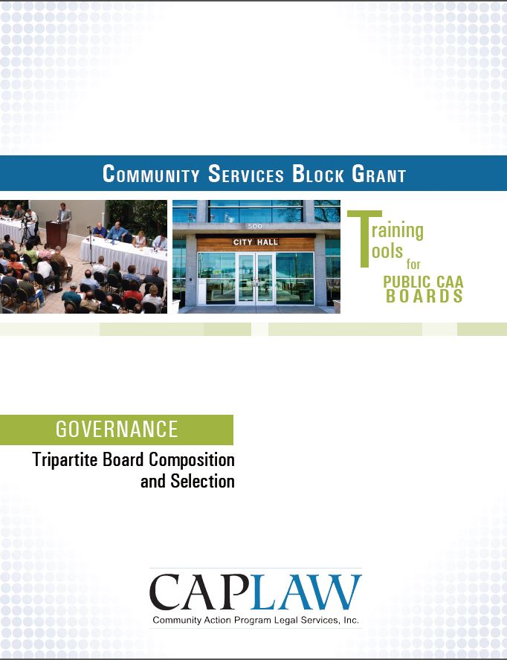
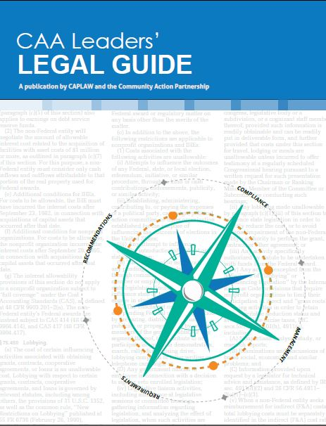
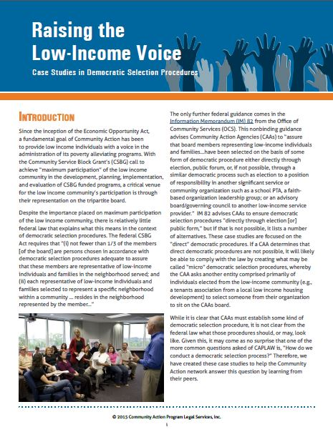
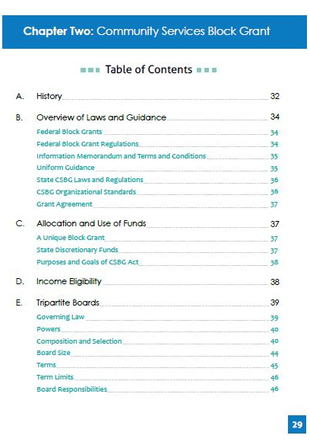
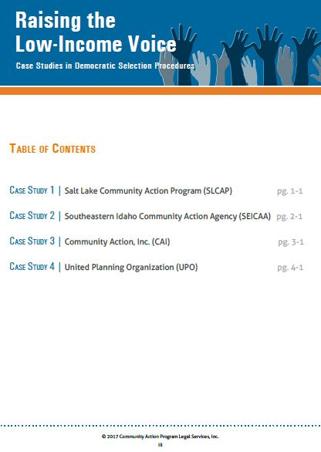
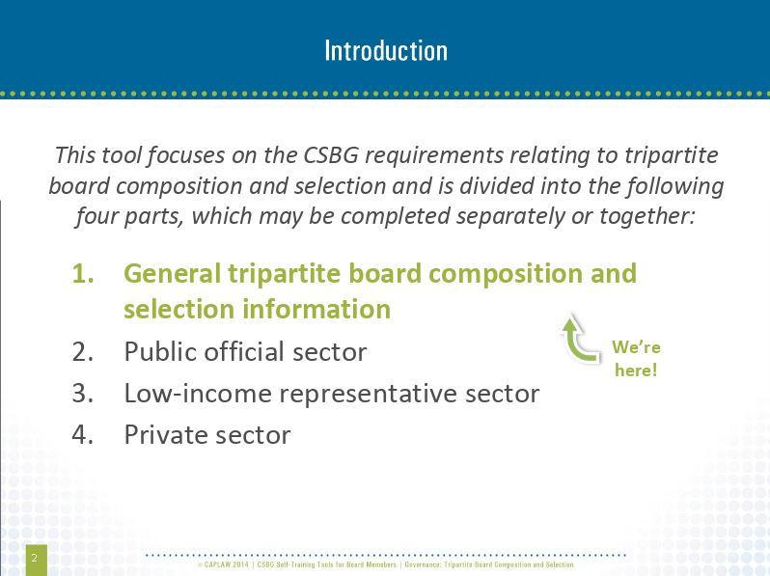
Tripartite Composition Resources
www.caplaw.org
Notes:
CAPLAW has a number of resources that tripartite boards may use to better understand the tripartite board composition requirements in the federal CSBG Act.
For board members who retain information better by reading the resource, the CAA Leaders’ Legal Guide includes a chapter solely focused on the federal CSBG Act requirements applicable to tripartite boards, and in particular, the composition provisions in the Act.
For boards who enjoy a more interactive approach to learning and reviewing information, the CSBG Training Tool for Public CAA Boards walks through the federal CSBG Act requirements applicable to each of the three sectors. The Tool uses a facilitator’s guide, power point slides and exercises to help tripartite boards grasp the requirements.
Lastly, for boards that want to focus more on the democratic selection process requirement applicable to low-income sector representative seats, CAPLAW’s resource, Raising the Low-Income Voice: Case Studies in Democratic Selection Procedures, presents the selection procedures of four different CAAs and includes samples of their CAA’s written democratic selection procedures.

Slide 15
HHS Block Grant Regulations
HHS block grant regulations establish that the federal government will generally defer to a state’s interpretation of the federal CSBG Act. True or False
Apply to all block grants issued by the U.S. Department of Health and Human Services (HHS)
45 C.F.R. Part 96
  Subpart I specifically applies to CSBG funding
Notes:
True. The HHS block grant regulations mainly establish that the federal government will defer to states in interpreting the federal CSBG Act. Generally, the state’s interpretation of the Act will stand unless it is found to be “clearly erroneous”, i.e., in direct conflict with the federal CSBG Act. It is important for the board to understand the role of the state CSBG office in facilitating the CSBG program and how essential it is for the state CSBG office and CAA to work together to ensure that the CSBG program is successful.
While the HHS block grant regulations apply to all block grants issued by HHS, the regulations also include a few provisions specific to each grant. For CSBG, those specific provisions are found in Subpart I.

Slide 16
OCS Guidance
Guidance issued by the federal Office of Community Services (OCS) in the form of Information Memoranda (IMs) are generally legally binding on CAAs. True or False
OCS IM #82 provides guidance to tripartite boards regarding:
  Composition requirements
  Role and responsibilities
Notes:
False. Office of Community Services’ (OCS) Information Memoranda (IMs) are generally not binding on community action agencies (CAAs). Rather IMs are issued for state CSBG offices, as a state CSBG office is the direct grantee of CSBG funds from OCS. Even though IMs are directed to the state and generally serve as guidance, they offer CAAs insight into OCS’s interpretation of CSBG program requirements and can be very informative for CAAs.
One IM that is particularly relevant to tripartite boards is IM #82. This IM is the only guidance CAAs have from the federal government that speaks to the tripartite composition requirements and the directive that tripartite boards be fully engaged in the development, planning, implementation and evaluation of the CSBG program.

Slide 17
State CSBG Act and Regulations
CAAs must maintain compliance with state CSBG statutes and regulations, if they exist. True or False
May contain board requirements
  Example, terms and/or term limits
CSBG Organizational Standards
  50 Standards for public CAAs from OCS IM #138
  Address board composition and responsibilities
  Application tailored to a public CAA to account for its unique structure
Notes:
True. As previously discussed, deference is given to states with regards to the facilitation of CSBG programs. As a result, all CAAs must maintain compliance with a state’s CSBG statutes and regulations.
Some states have passed CSBG statutes and regulations that mirror the federal CSBG Act, while others add additional requirements. An example of an additional requirement for tripartite boards includes terms and/or term limits for board members. The federal CSBG Act does not address terms or terms limits. A state may impose such requirements and must do so in accordance with other applicable state laws. If a state’s CSBG requirements do not address terms or term limits, then it is up to the board to determine what approach works best for the CAA. The board’s approach should be reflected in its bylaws or governing document.
To date, all states have adopted some form of the CSBG Organizational Standards set forth in the federal Office of Community Services (OCS’s) Information Memorandum (IM) #138. Unlike other IMs, Congress gave OCS the authority to require states to incorporate the Standards in the states’ CSBG statutes, regulations and/or policies. The Standards are one component of a larger performance management system. The purpose of the Standards is to strengthen the organizational capacity of CAAs to serve low-income communities and to increase accountability within the CSBG network.
The Standards are organized in the following three thematic groups comprising of nine categories:
Maximum feasible participation, which speaks to the mandate of the CSBG Act to engage the communities being served by CAAs in their programs and decision-making to the furthest extent possible.
Vision and direction, which encompass organizational leadership, board governance and strategic planning.
Operations and accountability, which cover day-to-day operations and management of the CAA, including human resource management, financial operations and oversight and data and analysis.
Even though one of the nine categories specifically focuses on board governance, the tripartite board’s responsibilities with respect to the Standards extends beyond this category. For example, with regards to the category addressing strategic planning, the tripartite board is required to receive an update on progress meeting the goals of the strategic plan or comparable document within the past 12 months.
The applicability of the Standards to a public CAA is tailored to account for the fact that local government entities oversee public CAAs and public CAAs must operate within the local government framework. This means that public CAAs, unlike nonprofit CAAs, must follow either (i) the local laws and requirements applicable to the local government or governments that oversee the public CAA and/or (ii) the state laws under which the public CAA was created. For example, a public CAA is not required to have an attorney review its bylaws or other governing document because a public CAA typically has access to the attorneys that work for the city or county that oversees the CAA.

Slide 18
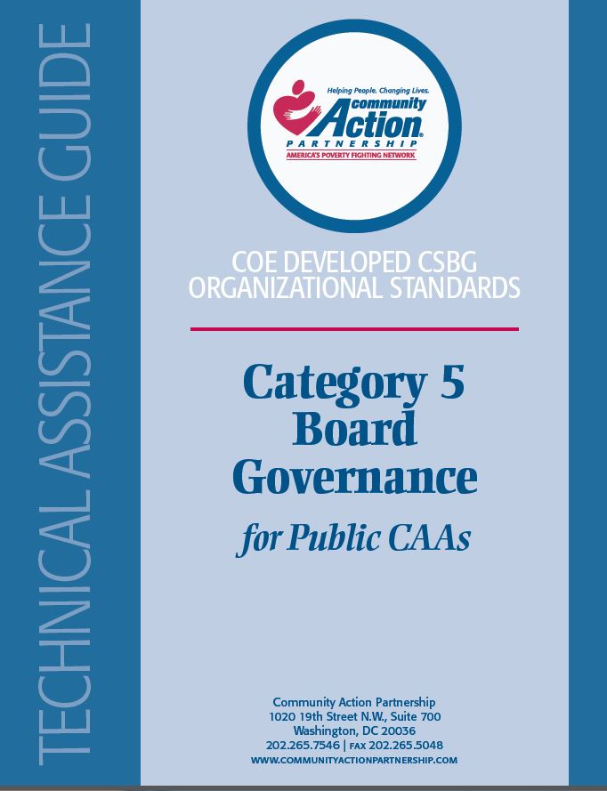
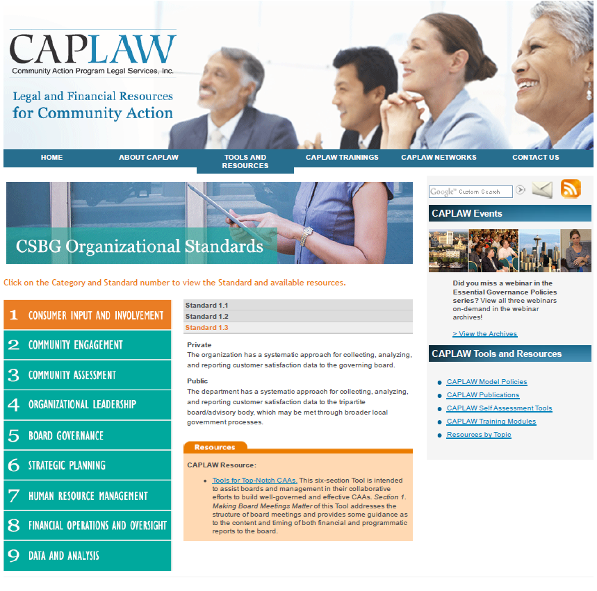
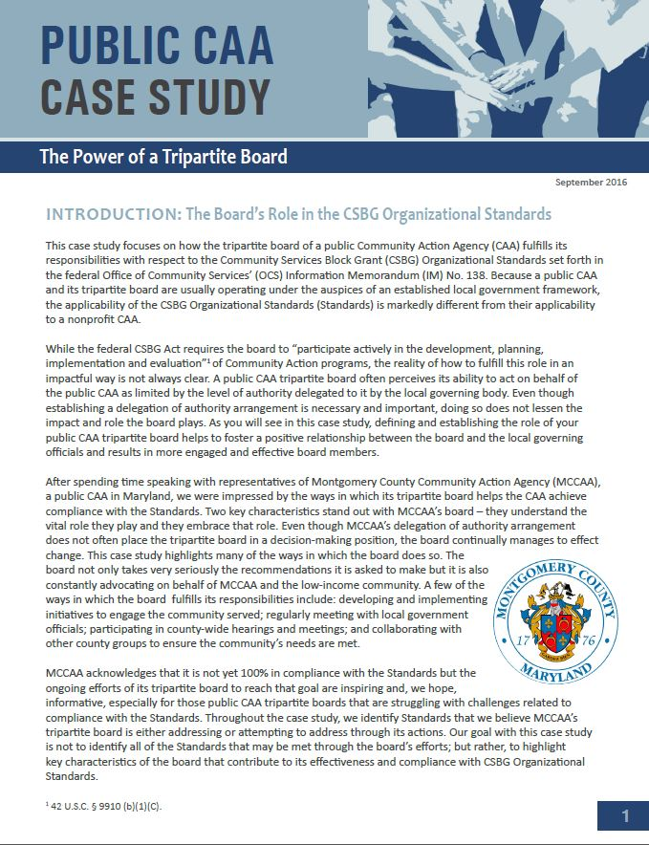
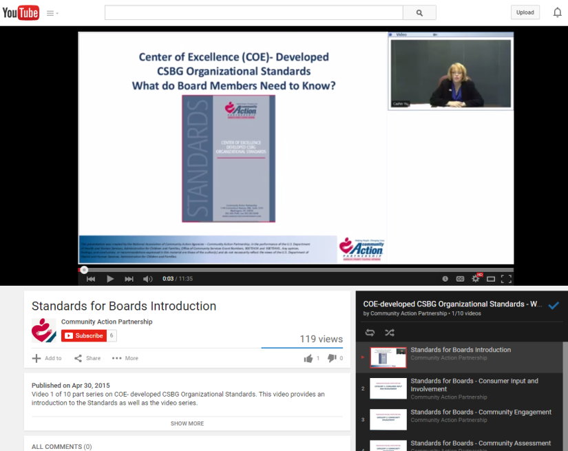
CSBG Organizational Standards Resources
www.communityactionpartnership.com and www.caplaw.org
Notes:
The National Community Action Partnership (Partnership) developed a whole series of technical assistance guides for each of the nine categories of the CSBG Organizational Standards. There are separate guides for nonprofit and public CAAs. The guides provide all CAAs with information on how to comply with each of the Standards.
The Partnership also created brief YouTube videos for board members to help them understand the Standards and the role the board specifically plays with respect to them.
CAPLAW developed a resource that compiles all CAPLAW (and some Partnership) resources that provide guidance on what compliance with a particular Standard may entail. This resource is available on CAPLAW’s website.
CAPLAW also developed a case study for public CAAs which focuses on how the tripartite board of a public CAA fulfills its responsibilities with respect to the Standards, especially when the tripartite board does not have authority to act on behalf of the public CAA. In this case study, the tripartite board makes recommendations to the local governing officials, which considers those recommendations when making decisions on behalf of the CAA. The case study focuses on how the tripartite board of the CAA, despite not having decision-making authority, continually manages to effect change within the CAA and help the CAA achieve compliance with the CSBG Organizational Standards.

Slide 19
CSBG Grant Agreement/Contract
CSBG grant agreements/contracts are usually non-negotiable. True or False
Contract/agreement should include citations or references to the state and federal CSBG requirements that apply to the board
  Example, tripartite composition requirement as set forth in the federal and, if exists, state CSBG laws
Notes:
False. A CSBG grant agreement/contract is like any other contract or grant agreement that the local government enters into to fund the public CAA — it is subject to change based on negotiations. When the public CAA receives its CSBG contract from the state, it should ensure that it fully understands all of its responsibilities under the contract and all of the federal and state laws it must follow. A CAA should have some process in place for reviewing the CSBG contract. The tripartite board’s involvement in this process may range from recommending to the local government that the head of the public CAA be authorized to negotiate the contract, to reviewing the contract itself. Also, a state CSBG office may require a certain level of board involvement, such as requiring the tripartite board chairperson to sign the contract.
A CSBG agreement/contract should reference the laws applicable to the CAA, and the board and can serve as a helpful reference if confusion arises as to what CSBG requirements a public CAA must follow. For example, CSBG agreements/contracts typically will reference the requirement for CAAs to have a tripartite board as set forth in the federal CSBG Act and the state’s CSBG laws, if they exist.

Slide 20
A Few Points About Tripartite Board Operations
Notes:
A few key points about how the tripartite board of a public CAA functions are helpful to cover with all board members to help set a strong foundation for and common understanding of how the board operates.

Slide 21
Board Operations Scenario One
Tonya is new to the tripartite board and really excited to start making a contribution. She previously served on nonprofit boards but never on a board for a government agency – she didn’t even know they existed!
She is confused by why the board is always voting to make recommendations to the city council, but not voting to take actions itself. She is wondering if the board is operating properly.
Any advice for Tonya?
Notes:
See next slide for the answer and explanation.

Slide 22
Operation Framework
Local governing officials establish authority of tripartite board
Delegation of authority established by:
  Ordinances
  Bylaws
  Delegation of Authority Agreement
Local Governing Officials
Tripartite Board
Dept. Head/ Executive Director
Staff
Notes:
Likely yes. Since a public CAA is typically either housed within a local government as a department or division of that local government or is the result of a collaboration between local governments, the local governing officials of the local government(s) have the authority to make decisions for the CAA, which includes the tripartite board.
The authority of a public CAA tripartite board may be established in a number of different ways. A local ordinance, a delegation of authorities agreement or the bylaws of the tripartite board are examples of a few of the documents in which the authority of the local governing officials and the tripartite board may be outlined.
While a tripartite board must, at the very least, make recommendations regarding the CSBG program to the local governing officials, the public CAA could also engage in non-CSBG work that falls outside of the purview of the tripartite board. For purposes of the Public CAA’s non-CSBG work, the local governing officials would have direct authority over the public CAA, likely through the chief county official, e.g., the mayor.

Slide 23
Operation Framework
REMEMBER: For the public CAA to receive CSBG funding:
  The tripartite board must “participate actively” in the development, planning, implementation and evaluation of the CSBG program.
42 U.S.C. § 9910(b)(1)(C)
Notes:
It is important to remember that the relationship between the tripartite board and local governing body must function properly for the CAA to continue to receive its funding. Even if a tripartite board is not permitted to take actions on behalf the public CAA, the tripartite board, at the very least, should be permitted to make recommendations regarding the CSBG program to the local governing officials. The local governing officials should consider those recommendations and address them when issuing decisions and taking action on behalf of the public CAA.

Slide 24
Board Operations Scenario Two
Even though tripartite board member Shelia is really proud of all the amazing work her public CAA does in the community, she recently became concerned about the CAA’s afterschool program.
After reading an article in the local newspaper raising questions about the effectiveness of program staff working at other social service providers in the community, Shelia contacted the CAA’s afterschool program manager and offered to help assess and improve, if necessary, the performance of CAA staff
Do you agree with Shelia’s approach? Why or why not?
Notes:
No. It is important that each board member understands his/her her oversight role and how that differs from the role of management. The tripartite board’s role with respect to operational activities such as matters involving employee performance is to ensure that department or organizational policies are in place to address such matters. In other words, the tripartite board helps to oversee the effectiveness of policies developed by the local government or the staff at the direction of the department head or executive director. To help prevent micromanaging by tripartite board members, a board member’s contact with CAA staff should be through the department head or executive director.
In some cases, the board may authorize a committee of the board to consider and make a recommendation to the full board about issues relating to personnel policies. When conducting a more in-depth analysis, board committees should not focus on specific employees. Further, board members rarely need to be provided access to individual employee data and, in those unusual instances in which they are given such data, the information should be shared only on a need to know basis in connection with official board business. Some types of sensitive employee information, such as health or financial information, may be protected by various confidentiality or privacy laws or exceptions to a state’s public records act requirements and may not generally be available to board members. Depending on the results of the review of the CAA’s policies, the full board may decide to advocate for change to the policies by meeting with and making recommendations to the local governing officials.
CAPLAW developed a resource several years ago to help board members better understand the role they play as Community Action board members and how they can best work with the executive director to fulfill that role. See CAPLAW’s Dynamic Duo: A Guide to Enhancing the Board & Executive Director Partnership.

Slide 25
Operation Framework
Local Governing Officials
The board acts only as a body
  Opportunity for group discussion and deliberation is important
Board contacts CAA via department head or executive director
Tripartite Board
Dept. Head/ Executive
Director
Staff
Notes:
The tripartite board acts as one body comprised of multiple individuals that must work together for the best interest of the public CAA. To successfully act as one, cohesive body, the board should provide for robust discussions and deliberations and often does so through meetings, agendas and retreats. The department head or executive director is the board’s contact to the CAA and facilitates the board’s work on behalf of the CAA by directing and running the CSBG programs at the direction of the local governing officials and the tripartite board. Board members generally should communicate with other staff about public CAA business through the department head, or executive director.

Slide 26
Operation Framework
Develop a Policy: Individual board members act on behalf of the board:
  When authorized by the full board to do so AND
    Officers, committees
  Typically, via the executive director
    Caveat: a few exceptions exist
Notes:
As previously explained, certain times exist when board members may act in their individual capacity as board members on behalf of the full board. Implementing a board/staff/3rd party communication policy is one way to educate all board members about the proper communication process and can serve as a point of reference if confusion arises.
The policy should reinforce that board members should only speak on behalf of the full board when authorized by the board of directors or executive director to do so. The policy should establish which officers of the board or committee have the authority to act on behalf of the board. While board members should typically speak with individual staff members via the department head or executive director, a policy would outline the situations when it would be appropriate for board members to consult directly with staff.

Slide 27
Board Member/ Staff Contact Examples
Board of Directors
Direct Contact
3. Seek staff input on ED evaluation
Via the ED
Executive Director
1. Coordinate board meeting logistics with staff admin
4. Reports of fraud, misuse of resources, discrimination or harassment involving the ED
2. Staff liaison assists with board committee business
Staff
Staff
Notes:
A board/staff/3rd party communication policy would outline the situations when it would be appropriate for tripartite board members to consult directly with staff. Examples of such situations would include:
board members communicating with an administrative staff person (sometimes referred to as a board liaison) who coordinates the logistics of board and committee meetings;
board committee members communicating with staff liaisons (for example, finance committee members communicating with the finance director) about committee business;
personnel committee members communicating with staff to gather input for the department head’s or executive director’s evaluation if the local governments evaluation process includes obtaining such input.
A complaint of suspected or potential fraud, misuse of resources or property, or discrimination or harassment involving the department head or executive director may be reported to the board or a designated board committee if the local government’s whistleblower policy requires this approach.
Such a policy on board-staff communication is intended to prevent the board from micro-managing the staff and circumventing the department head’s or executive director’s role in supervising and managing the public CAA’s staff.

Slide 28
Board Operations Scenario Three
Tony has been on the tripartite board for two years and L VES it! His fellow board members are very personable and friendly, but Tony is continually confused about the vote that is required to take actions as well as the number of meetings board members are required to attend.
What should Tony do?
Notes:
See next slide for the answer.

Slide 29
Board Operational Guide
Bylaws/ Governance Document
Article I
Thou shall read the bylaws.
See bylaws/governance document for information about:
  Board member composition
  Meeting frequency, notice
  Officers
  Committees
  Votes, quorum
  And more. . . .
Notes:
Even if not required by its local or state laws, a public CAA tripartite board should put in place bylaws to serve as an operations guidebook. The bylaws would include the information board members, like Tony, need to know to properly conduct meetings and take action. The public CAA will need to look to its local and state laws to determine what, if any, requirements govern the way in which the tripartite board operates.
The tripartite board should make its operational documents or bylaws available to all board members and educate board members about the information in them. Since Tony is new, he may not fully understand the importance of such documents and may contact the department head or executive director or the board chair for answers to his questions. The department head or executive director should work closely with the board chair to assist in educating board members about the bylaws and the ways in which the board operates.

Slide 30
Board Committees Exercise
It is a best practice for most board decisions to be made in a committee and reported to full board. True or False
Boards may use both standing and ad hoc committees. True or False
Committees that solely make recommendations do not need to take minutes or record meetings. True or False
Notes:
Tripartite boards will likely conduct board business with the help of board committees. For a public CAA tripartite board, the local laws will govern its use of committees to further board business. However, there are some general approaches that should help all board members understand how to properly use and work with committees. This exercise is intended to help board members identify what they do/don’t know about committee structures.
False. A board may task committees with researching and making recommendations, but the full board should review those recommendations and vote on them. As we will discuss in the next part of the presentation about the role of the tripartite board, while public CAA tripartite board members may not be required to fulfill fiduciary duties, the CSBG Act requires that the board “participate actively” in the CSBG program. The state CSBG office will thus likely monitor board participation and may use the nonprofit board fiduciary duties model as a guide for assessing the way in which the public CAA tripartite board operates.
True. Standing committees are designated in the bylaws or operational documents and typically consist of the following: financial/audit, personnel, governance and executive. Standing committees may also exist for larger programs run by the CAA, such as Head Start. Ad hoc committees are created as the need arises and the bylaws or operational documents would typically address the tripartite board’s ability to establish them. Examples of when ad hoc committees may be created include: to address an adverse monitoring report, research a project proposal, etc.
False. Minutes of committee meetings should be taken and maintained with board records, particularly for committees that exercise board authority. The way in which committees operate should be established in the bylaws and generally will reflect the way the full board operates especially with respect to meetings and minutes. The state CSBG office may ask to review these minutes as part of its monitoring of your public CAA. Also, local government laws may require committees to follow the same meeting procedures as the full board and, if such is the case, this should be reflected in the bylaws. Committees should have charters that establish their purpose, composition and methods of operation. Think of a committee charter as a mini-bylaws for a board committee.

Slide 31
Board Committees
Committee work is often essential to smooth and efficient operation of the tripartite board and CAA
Dept. head/executive director is not a board or committee member
Generally, board members may rely on information provided by committees
  But board members should have a reasonable basis for believing that committee is competent source of information
Regular review of committee structure is recommended
Notes:
A board often relies on committees to divide the work, build on the expertise of individual board members, and develop recommendations and solutions to problems. Some boards may decide to delegate decision-making authority to committees (assuming state and local laws permit such a delegation), but the recommended practice is to have committees report to the full board with background information and to make recommendations for board action.
Generally, department heads or executive directors of the public CAA do not also serve as board or committee members, but rather act as a resource for the board and its committees to ensure that each is receiving the information needed to successfully execute their duties. The federal funding that a CAA receives also makes it difficult for department heads or executive directors to serve as board or committee members. The federal CSBG Act tripartite board structure limits the eligible board seats for which a CAA’s executive director could fill—essentially only the private sector seats or as a public official representative. Moreover, except in very limited situations, the Head Start Act specifically prohibits board members from receiving compensation for providing services to the organization and also prohibits the organization from employing board members and their immediate family members.
The committee structure may be recognized in the public CAA’s local laws. However, even if it is not, generally board members may rely on information from committees so long as the board member has a reasonable basis for believing the committee is a reliable source of information. A committee charter describing the committee’s role and how it will operate should help establish the committee’s responsibilities.
A board should carefully consider and periodically review the committee structure and the powers delegated to committees. When reviewing its operational documents or bylaws, a CAA should revisit its committee structure to determine if reliance on committees is properly balanced with the engagement of the full board and what type of committees are useful to the organization. The operational documents or bylaws should include a brief description of the standing committees and each committee should be supported by a charter.

Slide 32
Role of the Tripartite Board
Notes:
The role of the tripartite board will be governed by the local laws that govern the public CAA and by the funding that the CAA receives. As noted earlier in the presentation, the federal CSBG Act requires the tripartite board to “participate actively” in the development, planning, implementation and evaluation of the CSBG program.

Slide 33
Duty of Care
Generally, not a requirement but serves as an informative guide
  Check local laws
Diligent –
  Acting with the care of a prudent person in similar circumstances
  Asking hard questions
  Reading materials
  Deliberating the decision
Notes:
The duty of care is a legal fiduciary duty established by the nonprofit laws in each state. While these laws do not apply to public entities, the standard serves as informative guidance for how tripartite board members of public CAAs can conduct themselves to achieve beneficial results for the CAA. A tripartite board of a public CAA must check its own local laws to determine what requirements it must comply with.
The duty of care is a standard of diligence. Board members are tasked with exercising diligence and deliberation – board decisions are made via a deliberative process. Assessing whether board members have fulfilled their duty of care involves asking questions such as – was a decision based on facts that were developed through an orderly process, or did the board just do what felt right at the time of the decision?
The duty of care is evaluated from a reasonable person standard – a board member exercises the care that an ordinarily prudent person would exercise under similar circumstances. Attending board meetings, reading board materials, asking hard questions are all factors that are considered when determining if a board member has met the duty of care.
Note to Presenter: In several states there are what we at CAPLAW would refer to as “hybrid CAAs”. These CAAs are often created under a state statute that gives the authority to two or more counties to create and oversee the entity. While the counties will maintain control over the CAA’s tripartite board, the CAA often functions independently. Some of these CAAs are incorporated as nonprofits under the state laws and have tax-exempt status under IRS rules. For these CAAs, it is not really clear how the duty of care under the state nonprofit laws would apply, and we recommend seeking the advice of the local government’s internal counsel. It is important to be aware of these types of entities because you may encounter one in a training.

Slide 34
Role of Tripartite Board Scenario
The tripartite board is considering whether CSBG funds should be used to start a college prep program. Board members Larry, Marsha, and Devon volunteer to review the staff’s preliminary research and report to the full board on the program’s potential impact and financial viability.
As a committee, they examine proposed budgets, a needs assessment, staffing and training requirements, and survey data from similar programs. They question staff and then prepare a 10-page report for the full board, recommending the program. At its next meeting, following a 90-minute discussion, the board unanimously votes to recommend that the local governing officials fund the program.
After a year, the program is well beyond budget and participation lower than expected. The local governing officials have no choice; the program is shut down.
Notes:
See next slide for question and answer.

Slide 35
Duty of Care Scenario
Would the tripartite board’s actions meet the duty of care? Why or why not?
  Board committee tasks
    Review mission
    Review needs assessment
    Examine proposed budgets
    Assess staffing and training requirements
    Collect data from others with similar programs
    Question staff
    Prepare report for the full board, with a recommendation
  Full board:
    Engage in discussion prior to vote
Notes:
Even though the tripartite board’s decision was a bad one in hindsight, the board likely satisfied its duty of care. It based its decision on an informed and thoughtful process. A board committee was formed to conduct the preliminary research for the program and prepared a 10-page report for the board after examining budgets, needs assessments, staffing/training and data from similar programs. The report included recommendations which the board considered as part of a 90 minute discussion. The board then voted unanimously to fund the program. This is a good example of how the duty of care works and how it could protect a board and its members even though their recommendations result in unsuccessful projects.

Slide 36
Duty of Loyalty
Generally, not a requirement but serves as an informative guide
  Check local laws
  Local government may require conflict of interest policies
Faithful to CAA –
  Act in good faith and in the best interests of CAA
  Disclose and avoid conflicts of interest
  Not engage in self-dealing
Notes:
As previously mentioned, the duty of loyalty is a legal fiduciary duty established by the nonprofit laws in each state. While these laws do not apply to public entities, the standard serves as informative guidance for how tripartite board members of public CAAs can conduct themselves to achieve beneficial results for the CAA. A tripartite board of a public CAA should check its own local laws to determine applicable requirements. The duty of loyalty is likely to take the form of a conflict of interest policy, which many local governments require.
The duty of loyalty is a standard of faithfulness – a board member gives undivided allegiance to the public CAA and its mission when making decisions affecting the CAA. This means that a board member should not use information obtained as a board member for personal gain (or self-dealing), but must act in the best interests of the public CAA. Board members should disclose and avoid conflicts of interest and recuse themselves from any decisions that might result in personal benefit.
Note to Presenter: As noted with respect to the duty of care, several states have what we at CAPLAW would refer to as “hybrid CAAs”. These CAAs are often created under a state statute that gives the authority to two or more counties to create and oversee the entity. While the counties will maintain control over the CAA’s tripartite board, the CAA often functions independently. Some of these CAAs are incorporated as nonprofits under the state laws and have tax-exempt status under IRS rules. For these CAAs, it is not really clear how the duty of loyalty under the state nonprofit laws would apply, and we recommend seeking the advice of the local government’s internal counsel. It is important to be aware of these types of entities because you may encounter one in a training.

Slide 37
Duty of Loyalty Scenarios
Do any of these board members have actual or perceived conflicts of interest? Why or why not?
  An elected public official board member votes to support only programs that benefit the constituents he represents, which make up 1/3 of the CAA’s service area.
  A private sector board member’s neighbor is a real estate agent and has offered to help the CAA find a building for its direct services for a reduced fee.
  A low-income representative sits on the board of another social service provider that sometimes competes for the same grants the CAA is seeking.
Notes:
Duty of loyalty dilemmas arise when a board member has an actual or perceived conflict of interest. Conflicts of interest exist whenever an individual who has authority to make or influence decisions affecting the CAA, such as a board member, has a personal incentive (often financial) to influence the CAA to take or not take a particular action.
Not all conflicts of interest are objectionable – the goal is to develop a clear process to define conflicts, establish mechanisms to disclose potential conflicts and outline a process and criteria to determine whether a transaction involving a conflict is acceptable.
This elected public official is arguably not meeting his duty of loyalty. An elected public official, like all of us, has multiple interests he/she is trying to further and promote. An elected public official’s divided interest are seemingly more obvious since he/she was specifically elected to serve constituents in his/her district. However, when an elected public official is in his/her role as a CAA board member, the duty of loyalty obligates him/her to put the needs and best interests of the CAA first. This does not mean that the elected public official cannot consider the interests of his/her constituents, especially those served by the CAA, but it does mean that decisions made by an elected public official as a CAA board member must encompass ALL of the CAA’s clients’ needs, which may not always be in line with the elected public official’s constituents’ needs.
If the CAA’s policies are followed, then the potential conflict of interest could be resolved. In rural areas it is often difficult for board members to maintain complete independence from those that the CAA may do business with. This does not mean that the CAA may not enter into a business arrangement with an individual who has a relationship with a board member. Rather processes and procedures must be put into place and followed to ensure that board members are fulfilling their duty of loyalty, i.e., acting in the best interest of the CAA, and not in his/her own best interest or in the interest of others with whom the board member has a close relationship. In this instance, the CAA should follow its conflicts of interest and procurement policies to ensure the private sector board member does not receive a personal benefit from the transaction and to establish that the arrangement meets the needs of the CAA. Likely, the board member would need to disclose the relationship with his/her neighbor and may need to recuse him/herself from deliberations and votes related to the transaction.
The CAA may resolve the potential conflict of interest by educating the board member on the duty of loyalty and the CAA’s policies. Like the elected public official, the low-income representative has potentially competing interests that he/she is managing. It is important for this (and all) board members to remember that when they are serving as the CAA board member they must wear their CAA board member hat and focus on the best interest of the CAA. The board member should follow the CAA’s conflict of interest policy to disclose actual or potential conflicts of interest and recuse oneself when necessary.

Slide 38
Duty of Loyalty
Conflicts of interest policy
  Protects CAA
Applicable requirements
  Funding source requirements
    Examples: CSBG Organizational Standard 5.6, Head Start Act prohibited financial conflict of interest, Office of Management and Budget (OMB) Uniform Guidance
Notes:
As discussed with the duty of loyalty scenarios, conflicts of interest policies protect public CAAs from a number of difficult, and sometimes troubling scenarios, such as: disallowances; negative public perceptions; diversion of public assets for private use; and potential loss of government funding.
Recognizing the importance of a board member fulfilling his/her duty of loyalty, many federal funding sources impose conflicts of interest requirements on grant recipients. For example, the CSBG Organizational Standards (Standard 5.6) requires each public CAA tripartite board/advisory body member to sign a conflict of interest policy, or comparable local government document, within the past 2 years.
About 50% of CAAs receive Head Start funding, which includes very specific provisions addressing when conflicts of interest arise and actions that the grantee must take when they do. CAPLAW’s sample conflict of interest policies offers guidance that grantees may find helpful when reviewing and updating their policies.
The Uniform Guidance is a set of federal grant rules governing the use of federal funds and the systems that must be in place to safeguard them. The Uniform Guidance includes a code of conduct requirement for procurement (i.e., the CAA’s purchase of goods and services) that directs board members and key employees who participate in the selection, award, or administration of a contract paid out of federal funds to refrain from doing so if he or she has a real or apparent conflict of interest.

Slide 39
Who Does What Around Here?
Fill in the Action
Role | Tripartite Board (w/ local governing officials) | Executive Director/ Dept. Head
Policy Action: establish, execute
Mission Action: accomplish, review
Performance Action: oversees, evaluates, executes, accountable for
Employees Action: Work with executive director, supervise staff
Establishes
Executes
Reviews
Accomplishes
Oversees, Evaluates
Executes, Accountable for
Work with executive director/dept. head
Supervise staff
Notes:
Confusion often arises when tripartite board members do not fully understanding their roles. Maintaining a fine balance between the board‘s role and the actions the board takes to fulfill that role versus the executive director’s/department head’s role and the actions he/she takes, can be tricky. This exercise encourages board members to recognize and discuss their understanding of a few of the different roles and actions each very important contributor to the organization plays.
Note that the column showing the tripartite board’s role represents the collective role of the tripartite board and the local governing officials, acting together. The tripartite board likely advises and makes recommendations to the local governing officials, and the local governing officials likely makes the decision.
The default is that the board is the “overseer and big picture thinker” whereas the executive director/department head is the “doer.” While in reality there is definitely overlap, keeping this default in mind will help boards and executive directors/department heads basically “stay in their lanes.” Generally the actions each party takes with regards to each role are:
Policy: The board establishes the organizational policies while the executive director/department head executes them. This often means that the board will recognize the need for a policy and assign a board committee to oversee the development of the policy by staff. On rare occasions, a board committee may fully develop the policy itself.
Mission: The tripartite board is the leader with regards to reviewing the CAA’s/department’s mission whereas the executive director/department head and his/her staff focus on achieving/accomplishing that mission. The executive director/department head also provides the tripartite board with the information it needs to guide its review.
Performance: The tripartite board of a public CAA regularly oversees and evaluates the organization’s programmatic. The tripartite board, at the very least, may recommend course corrections if the CAA is missing its targets. The executive director/department is guiding the CAA’s work to meet the targets set by the board and is also accountable for the performance of the organization. As part of that accountability, the executive director will likely engage in a level of evaluating and revising the work being done to meet the overarching goals and targets.
Employees: The board works with the executive director/department and should, at the very least, be providing the local governing officials with feedback regarding the executive director’s/department head’s performance. The executive director/department, not the tripartite board, manages and supervises the staff.
Note to presenter: As you will see, in the “Role” column, under each topic is a list of actions that may be taken to fulfill the role with respect to the topic. The workshop participants either individually or in groups should assign actions to the board and the executive director with regards to the topic listed. The table is animated, so once the workshop participants have completed the exercise and are ready to report out, the presenter can either ask for volunteers or assign individuals/groups to answer. Encourage workshop participants to explain their thoughts behind assigning actions to each party for a specific role.

Slide 40
Common Board Missteps
Disconnect with local governing officials
What board actions counter these missteps?
Not discussing critical issues
Too much deference to ED/dept. head
Board members acting as individuals
Micromanagement
Notes:
The CAA tripartite board’s task is to find the middle ground—not get too involved in day-to-day management, but be willing to ask questions about specific issues and concerns, to gather facts and data to support decisions, and to interact with senior management as needed. Along the way, the tripartite board must keep its focus on the overall mission and what policies and programs will support it. The primary—although not exclusive—venue for effective board oversight is the board meeting.
Micro-management. Thorough oversight should never be confused with board involvement in day-to-day management decisions. As a general rule, boards do not directly interact with frontline staff or operations. That is senior management’s role. The board member who decides to attend weatherization staff performance evaluations or the board member who offers classroom management suggestions to a Head Start teacher has crossed the line into micro-management.
Board members acting as individuals. It is important for individual board members to remember that they are part of a larger body and should act at the direction of the full board and not pursuant to individual motivations or concerns. If an individual board member is concerned about organizational matters, the board member should either contact the board chair or executive director with that concern. This should then result either in the full board or a committee of the board discussing the matter and making a determination that represents the full board and the best interests of the organization.
Too Much Deference to the Executive Director/Dept. Head. Some boards view their role as cheerleaders, with the board deferring to the executive director/department head in all matters. While this often happens when the executive director/department head has significant input into the selection of board members, some boards simply don’t understand their oversight role. The board should be supportive of the executive director/department head, sharing board’s insights and expertise, but there also needs to be some institutional tension between the tripartite board and the executive director/department head. The tripartite board should be contributing to the evaluation of the executive director’s performance and progress in accomplishing the mission. A board that becomes too deferential to the executive director inevitably will be deficient when it comes to discharging the specific functions assigned the board, namely participating actively in the development, planning, implementation and evaluation of the CSBG program. It is therefore incumbent upon the board and the executive director/department head who is faced with this situation to act intentionally to devise and implement strategies and processes to empower the board. This may be done, for example, through changes in bylaws, board size, committee structures, or review procedures. What may be most important, however, is setting the right tone and meeting structure to encourage questions and comments from board members.
Not discussing critical issues. Sometimes it is easier to sweat the small stuff rather than grapple with the big questions of the day. Tripartite boards must strike a fine balance between regularly reviewing operations while engaging in the strategic decisions that will sustain the organization. Boards can shift meetings to focus on the more critical issues by using committees to either help manage the more routine oversight functions or research and report back on more critical matters. Boards can streamline and rework their meeting agendas to focus on strategic discussions and send materials in advance of meetings so board members can arrived to meetings prepared and ready to think through the more pressing organizational matters.
Disconnect with local governing officials: Tripartite board member’s sometimes fail to recognize the interconnected relationship that the board has with the local governing officials. Often tripartite board’s only have the authority to make recommendations to the local governing officials. The local governing officials should be considering these recommendations and are more inclined to do so if the tripartite board members is regularly meeting with them and educating them about the public CAA’s programs and needs.
Note to presenter: As you will see this is an animated slide with each block falling down on the seesaw on at a time. After you work through each block, we encourage you to ask the workshop participants if they have any other examples of common board missteps and have the group discuss those. Also, note that with each discussion of a misstep we include action steps a board may take to counter the misstep.

Slide 41
Key Responsibilities of the Tripartite Board
Notes:
Unpacking what it means for tripartite board members to participate actively in the development, planning, implementation and evaluation of the CSBG program can seem daunting and overwhelming. The following section unpacks a board’s responsibilities by focusing on key responsibilities that encompass many of the actions board members must take to effectively fulfill their duties and obligations.

Slide 42
Key Board Responsibilities
Mission
Planning
Engagement
Maintain and Grow Funds
Performance
Accountability
Notes:
CAPLAW has identified 6 hallmarks of an effective tripartite board. Engaged boards acting and monitoring in these key areas are likely to be meeting and exceeding the governance requirements applicable to them. As we work through each of the six characteristics we will discuss how they tie in with the tripartite board’s responsibility to participate actively in the development, planning, implementation and evaluation of the CSBG program. We will also show how many of the CSBG Organizational Standards, especially those specific to a board’s responsibilities, are met through fulfilling these key responsibilities.

Slide 43
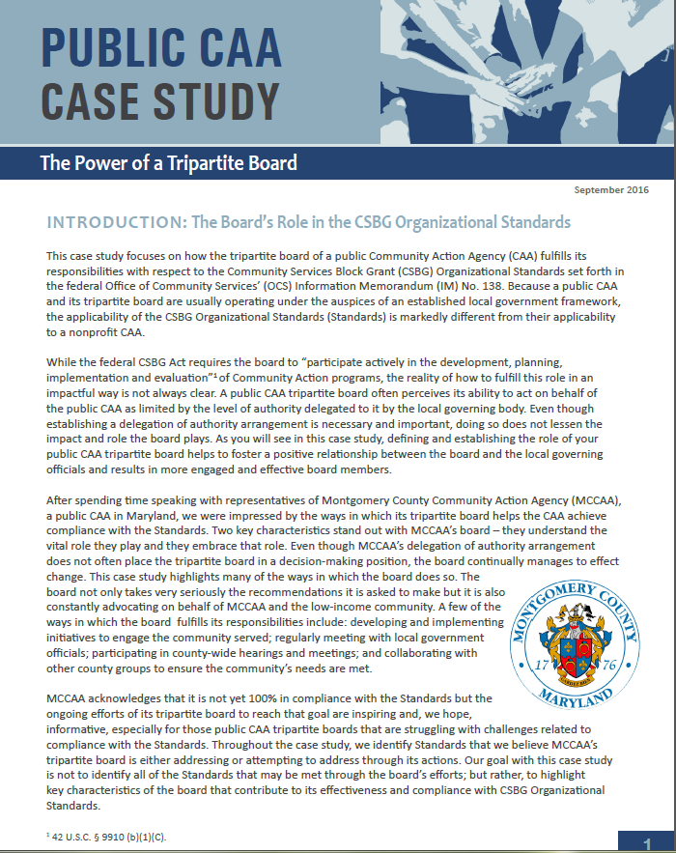
Public CAA Case Study:
Power of a Tripartite Board
Notes:
This case study focuses on how the tripartite board of a public CAA fulfills its responsibilities with respect to the CSBG Organizational Standards, which are referenced in the discussions of each of the key board responsibilities. Because a public CAA and its tripartite board are usually operating under the auspices of an established local government framework, the applicability of the Standards is markedly different from their applicability to a nonprofit CAA. After spending time speaking with representatives of Montgomery County Community Action Agency (MCCAA), a public CAA in Maryland, CAPLAW was impressed by the ways in which its tripartite board helps the CAA achieve compliance with the Standards; especially since the tripartite board does not have the authority to take action on behalf of the CAA. Rather the tripartite board submits recommendations to the local governing officials who carefully consider and often accept them.

Slide 44
Key Board Responsibility
Mission
Notes:
Our first focus is the mission of a public CAA. While a public CAA may rely on its local government’s mission, it still must feel confident that the mission reflects the purposes and goals of the CSBG program. A public CAA may decide that working with the tripartite board to develop a mission statement specific to the department or division is a more effective way to communicate the CAA’s purpose and direction as well as to inspire its stakeholders.

Slide 45
Know Your Mission Exercise
Write down your CAA's mission
  If you don’t know it exactly, write down the gist
Briefly describe 3 ways in which your tripartite board works with your CAA's mission
  For example, we discuss it in relation to new proposals or recite it at every meeting
Think about 1 way in which your tripartite board could better incorporate the CAA’s mission in its board meetings and activities
Notes:
Take a moment and write down your public CAA’s mission statement. If you don’t know it verbatim, don’t worry, write down the gist of it. After you have done that, either team up or work in a small group and describe three ways in which your tripartite board works with the mission statement. For example, your board recites the mission statement at the beginning of every board meeting or each board member is provided a copy of the mission statement when a new proposal is being reviewed and discussed. Lastly, after you’ve completed your discussions with your partner or group, take a moment and jot down one way your board could better incorporate the CAA’s mission statement in board meetings and/or activities.
Note to Presenter: you could ask for a few volunteers to report out or you could move forward with the presentation and, as you work through the remaining slides in this section, have participants revisit their exercise responses.

Slide 46
Why Mission Matters
Why mission matters:
  Provide clarity of purpose to stakeholders
  Guide major decisions
  Prevent “mission creep”
Why do you think mission matters?
Notes:
As previously mentioned, the mission statement serves as the driving force for your public CAA. The mission is thus very important for a number of reasons including:
A mission statement helps provide clarity to and unify stakeholders. Using a mission statement that is tailored to your public CAA can help both the local governing officials and your tripartite understand the importance of the work both bodies do on behalf of the CAA.
A mission statement guides all major decisions that the tripartite must make (especially which programs/projects to undertake, which to avoid, and which to stop doing).
The mission statement also ensures that a public CAA will resist “mission creep.” Having a clear mission that the board, staff and key stakeholders can come around helps the organization resist the temptation to expand into programs and services where it lacks appropriate skills and resources. There are many external and internal pressures that will cause mission creep in the absence of strong and intentional pushback.
Note to presenter: This slide is animated so you can ask workshop participants if they have anything to add with regards to why mission matters to a public CAA

Slide 47
Board Role and Mission
Review
Update
Use
Mission
Notes:
The tripartite board’s relationship with an organization's mission is multi-faceted and we will specifically talk about each of these facets. The board not only reviews the mission but may suggest updates, when necessary. The tripartite board is also regularly using the mission to guide its actions and fulfill its responsibilities.

Slide 48
Review Mission
A good mission statement:
  Is focused
  Solves unmet needs
  Leverages unique skills
  Inspires key stakeholders / is memorable
Notes:
A good, effective mission statement embodies several characteristics.
First, it is focused and specific. A mission statement should not be so broad and encompass so many activities that it is impossible to measure whether the public CAA is actually achieving any of its goals. If the mission statement is too long (e.g., half a page vs. a single sentence) and is difficult to remember, then it is not likely to be very memorable or effective.
Second, the mission should focus on needs that your public CAA believes is worth tackling. This communicates why your CAA exists and the motivation behind its activities.
Third, the mission statement should help your CAA leverage its unique skills. It is important for the statement to reflect the uniqueness of your CAA and the values that define it.
Finally, a mission statement should also inspire key stakeholders. Board members should be able to readily recite the mission. If very few stakeholders know and understand the mission of their organization, likely very few of them will feel any degree of passion or commitment toward it.

Slide 49
Update Mission
Producing an effective mission statement often involves:
  Commitment from the top
  Participation by a wide range of stakeholders
  A well defined revision process
  Determination of key components
  Careful crafting – active, concise, specific
CAPLAW Article
Mission Possible: Understanding & Developing an Effective Mission Statement
http://caplaw.org/resources/articlesbytopic/Governance/CAPLAW_EffectiveMissionStatement_Fall2010.pdf
Notes:
If a tripartite board feels that the local government’s mission statement is not addressing the purpose and goals of the public CAA, it should work to either revise the statement or update (or create if it doesn’t have one) its own statement. There are as many ways to update and rework a mission statement as there are mission statements. However, there are several constants in the process that help produce an effective mission statement. These constants are: (1) commitment from the top down and (2) participation from a wide range of stakeholders.
Defining the process by which the tripartite board will revise the public CAA’s mission statement helps in producing an effective one. One common, often fruitful method, is to conduct a retreat with a representative group of stakeholders, such as tripartite board members, local governing officials, community leaders and members, staff, and clients. The retreat may take the form of a part-day or full-day session in a conference room or an off-site gathering over a longer period of time. This approach demonstrates the commitment of top management to the mission statement development process and it gives many different stakeholders an opportunity to share their views of the public CAA’s mission. If not a retreat, then a series of meetings may suffice and ease the time commitment on the stakeholders. Additionally, surveys could be used to obtain the stakeholder input.
After defining the process, it is important to determine the key components of the mission statement. The goal is to generate a list of specific items that define your organization. At this stage it is critical to have a wide selection of stakeholders involved. Some questions to ask include: what does your CAA do on a daily basis?, how does your CAA achieve its mission?, who is impacted by your CAA?, where does your CAA operate?, does your CAA have specific values that set it apart from other organizations?
The responses to these questions could be elicited from the group in written survey form or as a group activity. The answers will form the building blocks for the next stage of the process in which the mission statement is drafted.
An effective mission statement also requires careful crafting. This mission statement must contain enough substance to appropriately convey the mission of the CAA but be concise enough so that the CAA’s stakeholders can easily memorize and recite it. There are no universally applicable rules here, but some helpful guidelines are: state the mission actively (for example, CAA [verb]); keep the mission statement short, but provide enough detail to be able to make decisions based on the mission statement (for example, if someone proposed a new program during a board meeting, could the mission statement provide guidance as to whether the suggested program would be consistent with the mission of the organization?); and stick to specifics.
For example, if a CAA were to decide that its mission components are (1) reducing the impact of poverty; (2) by granting funds to organizations focused on job training, housing assistance, and social services; (3) in Tremont County, then an effective mission statement could be: Tremont County Community Action Agency, Inc. is a division of the Tremont County government that, by mobilizing public and resources and coordinating a comprehensive network of educational, economic and social services in Tremont County, reduces poverty and enables low-income people in Tremont County to become self-sufficient.
Note to Presenter: While CAPLAW’s Mission Possible article referenced in the callout box on the slide is geared towards nonprofit CAAs, the article contains useful tips and approaches that may be adopted by public CAAs to help them guide the process for reviewing their mission statements.

Slide 50
Mission Revision Exercise
Your public CAA has died and at the memorial service for the organization with all of its stakeholders present, a spiritual leader states:
  Here lies [fill in the organization’s name]. It is an organization that was loved and will be missed. It will be remembered forever for:______________.
- Dr. Lisa McNary, NCSU
Notes:
Dr. Lisa McNary, a management consultant and instructor at North Carolina State University recalled her mentor, Dr. W. Edwards Deming, describing the following exercise as useful in developing a mission statement. Ask the top managers this:
Your organization has died and at the memorial service for the organization with all of its stakeholders present, a spiritual leader states, “Here lies [fill in the organization’s name]. It is an organization that was loved and will be missed. It will be remembered forever for:_____________________”
What goes in the blank is the essence of the organization’s mission.
Note to Presenter: Depending on the time, you could have the participants conduct this exercise either by themselves, with a partner or in a small group.

Slide 51
CSBG Organizational Standards
Mission
CSBG Org. Standard 4.1:
The tripartite board/advisory body has reviewed the department’s mission statement within the past 5 years and assured that: (1) The mission addresses poverty; and (2) The CAA’s programs and services are in alignment with the mission.
CSBG Org. Standard 3.1:
The tripartite board/advisory body formally accepts the completed community assessment.
The department conducted or was engaged in a community assessment and issued a report within the past 3 years, if no other report existed.
CSBG Org. Standard 3.5:
Notes:
Reviewing, updating and using the mission are board responsibilities reflected in the CSBG Organizational Standards. The Standards specifically direct board members to review the organization's mission within the past 5 years to make sure it feels confident that the statement addresses poverty and that the CAA’s programs are in alignment with the mission. We just discussed how a board reviews, updates (if necessary) and uses the mission statements – all of these actions show that the board is meeting this Organizational Standard.
Several other CSBG Organizational Standards that are related to the tripartite board’s role with respect to the public CAA’s mission include Standards 3.1 and 3.5. These Standards require the organization to conduct a community needs assessment, issue a report about the results, and have the board formally accept the completed assessment. The community needs assessment will help educate the board about the needs in the areas served by the public CAA and subsequently inform a CAA’s review of its mission.

Slide 52
Use Mission
Ways boards highlight and use the mission:
  Recite at board meetings
  Reference in meeting agenda
  Include on business cards
  Discuss in relation to all board actions
Notes:
Reviewing and updating the mission is only part of the tripartite board’s responsibility with regards to the mission. The most important role the board plays is to use the mission to guide the public CAA’s actions and make sure the executive director/department head is doing the same with staff. For example, understanding and using the mission might lead the public CAA’s staff to say “no” to attractive funding opportunities or compelling programs that are not aligned with their mission in order to say “yes” to going deeper in programs that do align with the mission.
There are multiple ways a tripartite board can ensure that it is regularly using and incorporating the mission into its activities. These include:
Reciting the mission at the beginning and/or ending of a board meeting. This will serve as a reminder to all board members of the important work they’ve been tasked with directing and overseeing.
Referencing the mission at the top of the meeting agenda. This is a great way to remind board members that the mission serves as the backbone for all actions to be taken by the board.
Including the mission statement on board member business cards. This helps board members remember and recite the mission when meeting with the community and stakeholders
Discussing the mission in relation to all board actions. Including the mission on the meeting agenda to serve as a reminder is even more effective if board members actually make a point of referencing the mission when discussing board actions.

Slide 53
Key Board Responsibility
Planning
Notes:
A significant responsibility of the tripartite board is to work with its local governing officials to set the direction for the public CAA. If the local government or division/department does not have a plan in place establishing the direction, then the tripartite board will take the lead on developing one. The planning required to do so involves, among other tasks, assessing needs, reviewing existing programs, forecasting future financial stability and growth, and making (sometimes tough, sometimes exciting) decisions about the future. Planning also requires constant assessing and revising. In this section, we will discuss the planning public CAAs engage in as a result of the CSBG funding they receive, and a few tools and resources the board may use to help frame and focus its planning efforts.

Slide 54
Planning Exercise
Name at least one of each of the following in relation to your CAA:
  Strength
  Weakness
  Opportunity
  Threat
Notes:
For those tripartite boards whose responsibilities involve planning (not just reviewing and accepting a plan), actually engaging in planning can be difficult to gasp as it is not as concrete as other board responsibilities. To better understand what engaging in planning might look like, ask workshop participants to participate in what is often referred to as the SWOT exercise. SWOT stands for Strength, Weakness, Opportunity and Threat. A SWOT analysis is used by boards to help build an organization’s strategy. Each workshop participant should take a moment to identify each of the following in relation to their organizations:
Strengths (e.g., sole provider of a service, passionate volunteers, loyal donors, clear vision and history). Questions to consider:
What does your organization do better than others?
What advantages does your organization have?
What do others see as your strengthens?
Weaknesses (e.g., small volunteer base, high staff turnover, lack of external communications). Questions to consider:
How could your organization improve?
What do others see as your weaknesses?
Opportunities (e.g., develop partnerships, expand volunteer and client base through robust communications, explore enhancement to or development of programs). Questions to consider:
What opportunities are you aware of?
What are new developments in the sector?
Threats (e.g., measuring success is difficult, cash flow, bad publicity). Questions to consider:
What obstacles does your organization face?
Could weakness threaten your organization’s sustainability?
Working through a SWOT analysis is one way for board members to develop a deeper understanding of their organization’s operations and efforts needed to further the mission. This understanding plays a crucial role in a board’s meeting its responsibility to think strategically about the organization’s future and planning accordingly.

Slide 55
Planning Under CSBG
Community Action Plan
3-Year Review
(Community needs assessment/CSBG-specific)
Strategic Plan
5-Year Review
(Organization-wide)
Notes:
The federal CSBG Act and CSBG Organizational Standards require that the tripartite board oversee two types of planning efforts by the public CAA. One is the preparation of the community action plan by staff, which is specific to CSBG-funded activities, and required by the federal CSBG Act. The plan involves the CAA conducting a community needs assessment to identify the population to be served and the assistance needed. These efforts often involve reviewing publicly available data such as the most recent census report, and engaging staff to develop surveys and conduct research to gather data from the community served. While the board is mainly tasked with voting to accept the needs assessment, a tripartite board may contribute to the data gathering process by convening community forums to solicit information on needs and suggestions for addressing those needs from those living in the area.
The community action plan informs a CAA’s strategic plan, which is the organization-wide document that establishes the direction and activities of the CAA. Under the CSBG Organizational Standards, a tripartite board is required within the past 5 years to review and accept its local government’s or department’s strategic plan. However, if no such plan exists, the tripartite board must develop a plan. While the board will likely organize a planning committee to work with the executive director/department head and staff to lead the planning efforts, the approach should focus on the “big picture” and include:
Thinking about mission and purpose;
Aligning strategic plan with overall mission;
Reviewing and adjusting (if necessary) all programs;
Identifying broad goals and priorities; and
Establishing and maintaining procedures for reporting on goals and results.

Slide 56
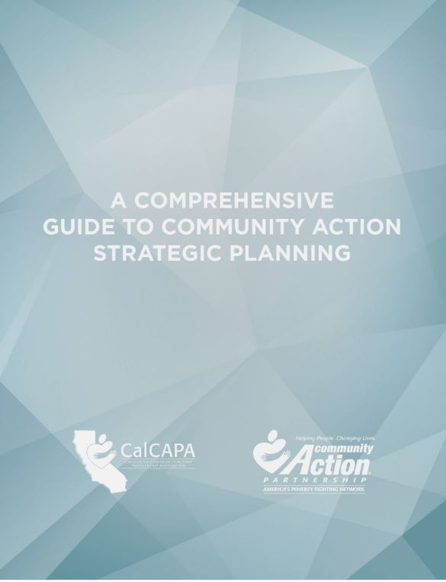
Development of Strategic Plan
Community Action Partnership & CalCAPA resource available at: https://communityactionpartnership.com/publication_toolkit/a-comprehensive-guide-to-community-action-strategic-planning-final-5/
Notes:
This guide developed by the California Community Action Association and the National Community Action Partnership was designed to help CAAs navigate the strategic planning process and successfully plan, develop, implement and evaluate strategic plans. As a comprehensive capacity building resource, the guide can also be used to refresh an existing plan, train program managers and agency leadership, or even develop a planning process for a community collaborative. The guide incorporates the CSBG Organizational Standards and walks through how both public and nonprofit CAAs maintain compliance with the Standards throughout the strategic planning process.

Slide 57
CSBG Organizational Standards
Planning
CSBG Org. Standard 6.1:
CSBG Org. Standard 3.1:
CSBG Org. Standard 3.5:
The department has a strategic plan, or comparable planning document, in place that has been reviewed and accepted by the tripartite board/advisory body within the past 5 years. If the department does not have a plan, the tripartite board/advisory body will develop the plan.
The department conducted or was engaged in a community assessment and issued a report within the past 3 years, if no other report exists.
The tripartite board/advisory body formally accepts the completed community assessment.
Notes:
The CSBG Organizational Standards require all CAAs to either review and accept or develop strategic plans as well as conduct a needs assessment that the board will formally accept. The Standard does not necessarily require a tripartite board to develop a new strategic plan every five years. Rather the Standard directs the board to review its existing strategic plan and ensure that it is truly reflective of community needs as reported in the community assessment, in line with the organization’s mission, and reflective of the organization’s goals. Organizational Standards 6.2 through 6.4 set forth information that the plan must address and contain. As previously noted, these Standards are addressed in the Comprehensive Guide to Community Action Strategic Planning developed by the National Community Action Partnership and the California state association, CalCAPA.

Slide 58
Engage in Planning
Approaches to help the tripartite board meet its planning and strategy development obligations:
  Form a planning/strategy committee
  Uses the strategic plan to frame board discussions
  Use a strategic agenda
Notes:
The strategic plan should be a living document that is regularly referred to and used. To encourage a commitment to planning, boards should consider implementing a planning/strategy committee. The committee could serve as the point of contact for staying on top of the board’s role in strategic planning, the goals set through that process, and the follow-up and reporting from those goals.
Another way to engage the board in strategic planning is for the board chair and executive director/department head to refer to and use the CAA’s strategic plan when developing meeting agendas and framing board discussions. A strategic agenda can help with these efforts as it encourages board discussions and actions to be taken in the context of the organization’s strategic efforts, rather than promoting an environment where board members are mainly listening to reports by committees and staff.

Slide 59
Strategic Agendas
Strike a balance between “routine” agenda items (e.g., contract approvals etc.) and strategy discussions
How will agenda items and information provided to board members help tripartite board:
  Connect with the CAA’s mission
  Enhance board functioning
  Provide oversight
  Identify and make decisions on key issues
Notes:
A strategic agenda requires the board chair and the executive director/department to carefully consider the strategic direction of the organization and the need for input on that direction while still attending to the routine items that must be addressed to support the organization’s operations. In developing a strategic agenda, the board chair should connect agenda item discussions with the public CAA’s mission and the board’s oversight role. Strategic agenda items should enable the board to function more efficiently and effectively by focusing the board’s energies on key issues.

Slide 60
Consent Agendas
Used for routine, procedural, informational, and self-explanatory non-controversial items
Helps streamline meetings
If using, be sure to educate board members on:
  Purpose , i.e., not used to force through decisions
  Process, i.e., allows for removal of item upon request
Notes:
A consent agenda is tool that boards may use with a strategic agenda to help focus efforts on strategy. A consent agenda groups together the routine, procedural, informational and self-explanatory, non-controversial items typically found in a meeting agenda. These items are typically presented to the board in a single motion for yay or nay vote after allowing for requests to move a specific item to the full agenda for individual attention. Consent agendas streamline meetings, reduce the amount of time spent approving motions that do not require further discussion, and allow the board to dedicate more time to focusing on substantive issues.
If a tripartite board adopts a consent agenda, it should provide information for the consent items prior to the board meeting so that board members have sufficient time to review the materials. Any item requiring discussion should be removed from the consent agenda and discussed and voted upon separately at the board meeting.
It is important to remember that consent agendas should not be used to force through decisions and board members should always have the option to move items from the agenda for discussion and debate. A simple and direct question about a consent item may not necessarily result in automatic removal; however, if further questions arise, removal is likely necessary.

Slide 61
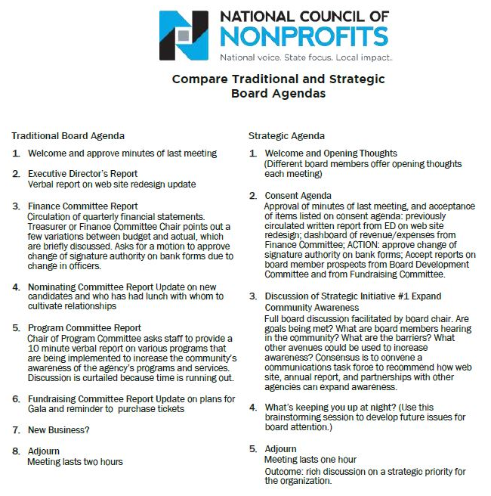
Notes:
Here is an example of a strategic agenda that includes a consent agenda. You can see how the focus of the strategic agenda shifts from committee reports and updates to discussions of strategic initiatives and concerns/thoughts for the future.
Tripartite boards hesitant to switch from an “old business/new business” format to a strategic agenda should consider alternating between the two agendas types. The board may find that it benefits more from a strategic agenda where they are tackling one or two items that relate directly to the mission, vision and organizational values and that require special attention. Switching between the two agendas is one way to help educate the board on the oversight value it brings to its public CAA as highlighted by the strategic agenda format.
Note to presenter: While this example is specific to boards of nonprofit organizations, it should give the tripartite board of a public CAA a better understanding of how it may adjust its agendas to achieve more effective meetings.

Slide 62
Strategic Dashboard
Financial Indicators
 |  | Target | This month | Last month | Last year end
Income Statement | Surplus/(deficit) YTD | $270,000 | $390,842 | $340,908 | ($570,240)
 | Surplus/(deficit) year-end forecast | $270,000 | $30,937 | $250,987 | ($570,240)
 | Earned income ratio | 11.5% | 10.3% | 11.8% | 13.0%
 | New grants success ratio | 50.0% | 35.0% | 33.0% | 50.0%
Balance Sheet | Days cash on hand (unrestricted) | 45 | 43 | 28 | 51
 | Reserve funds balance (1 month payroll) | $250,000 | $200,000 | $150,000 | $250,000
 | Current ratio | 2 to 1 | 5.8 | 4.2 | 6.2
 | AR aged over 90 days | 15.0% | 22.3% | 23.5% | 20.0%
Program Indicators
 |  | Target | This month | Last month | Last year end
 | Weatherization Contracts (monthly goal) | 20 | 21 | 22 | 15
 | Head Start enrollment | 100 | 60 | 58 | 109
 | Monthly job placements | 30 | 11 | 14 | 32
Notes:
Strategic dashboards are another way for an organization to focus its board on the critical issues. A dashboard is basically a brief snapshot of the public CAA at a fixed point in time – like a car dashboard that gives an instant update on many important factors (speed, gas left in the tank, engine temperature, whether the AC is on, etc.). A strategic dashboard is similar: it gives important information to decision makers such as executives and boards in a quick-read way.
Dashboards may be solely financial or programmatic or a combination of both. The example on this slide combines both. A dashboard should be comprehensive, but not so detailed as to hinder high-level, strategic questions. It will summarize data from many reports into one. Probably the trickiest and most time consuming aspect of dashboards is the analysis that goes into determining which metrics will most accurately portray the organization at this point in time. CAAs using dashboards should have explanations of the metrics, with context where necessary, and be flexible to the metrics changing and evolving so that they are as reflective as possible of the organization’s critical needs.

Slide 63
Agenda Exercise
Describe your CAA’s current board meeting agenda
List what items on the agenda may be suitable for a consent agenda
List the items that require the board to think strategically
Notes:
Note to Presenter: Developing a mock agenda could help workshop participants recognize ways in which they may improve their own approach to meeting agendas. This exercise may be done individually or in groups. Workshop participants should report their results and be encouraged to engage in a discussion about the reasons motivating the designation of items as consent versus strategic.

Slide 64
Key Board Responsibility
Engagement
Notes:
Being fully engaged means that tripartite board members are not only expected to make well-informed, reasonable decisions but also help the public CAA with its efforts to connect with the community it serves.

Slide 65
Engagement Scenario
Jack, a recently retired school superintendent, joined the tripartite board 10 years ago and continually gets re-elected to the private sector. He assumes he is on the board because the CAA operates an award-winning after school program. He is tired of attending community gatherings and interacting regularly with others – he did it for over 30 years with his school job. He likes his fellow board members and makes a real effort to attend the board meetings focused on education matters, but doesn’t worry if he can’t make other meetings.
Is Jack an engaged board member? Why or why not?
Notes:
Answer discussed on next slide.

Slide 66
Internal and External Responsibilities
With Board/ Local Governing Officials/CAA
With Stakeholders/ Community
Engagement
Notes:
You can think of board engagement as internal and external. The CSBG Organizational Standards explicitly require a CAA to engage with certain external stakeholders (e.g., social service providers, faith-based organizations, etc.). Board members contribute to these efforts through their community connections and willingness to advocate for the CAA and its programs. The CSBG Organizational Standards implicitly require board members to engage internally -- with the board (for example, by meeting composition requirements) as well as with the organization (for example, by participating in strategic planning efforts).
Jack is arguably not an engaged board member for two reasons. He is only concerned with one aspect of the CAA’s work, its award-wining after school program. Even though Jack brings a lot of experience to the board with respect to the after school program, he is essentially absent when it comes to the CAA’s other activities. Second, Jack has no interest in supporting the CAA’s efforts to educate the community about the vital role the CAA plays through the services it offers. Ultimately, however, it is up to the board to decide if the benefits Jack brings to the table outweigh his lack of engagement in certain areas.
In this section we will talk about ways in which the board can assess the type of board members that will be the best meet the needs of the public CAA and also help board members, like Jack, become more fully engaged.

Slide 67
Ways to Increase Engagement
Strategically Recruiting
Regularly Orienting & Training
Building Relationships
Conducting Assessments
Connecting with Community
Notes:
Boards can establish and increase both internal and external engagement of individual board members in a number of ways. We will discuss a few of these at a high level, which include:
how to think strategically about board member recruitment,
the importance of regularly orienting and training board members,
ways to build board member relationships,
the benefits of assessing individual and group perceptions, and
how board members can connect with the community served by the CAA.

Slide 68
Board Selection Procedure
Use board committee
Recruit smartly & strategically
Require applications
Follow selection procedures
Notes:
Developing an engaged board that can help the CAA further its mission can seem daunting, especially with the specific composition requirements that apply to tripartite boards. Thinking strategically about recruitment is the key. The following is a process may help with these efforts:
Use a committee (either governance or board development) to oversee the selection process. If you don’t have one, create one.
Recruit board members based on what you need: financial expertise, community connections, etc. The tripartite structure offers more flexibility than you may realize. For example, elected public officials often have skills beyond those of just being a politician. Try to tap into those elected public officials or representatives who can meet the needs of the CAA.
Require applications. Doing so can help educate interested applicants about what your CAA is looking for and also provide the CAA with the information it needs to select candidates who best fit the organization's current needs.
Follow selection procedures in the CAA’s bylaws or board operational guide. Many federal funding sources, including CSBG, have specific composition requirements for boards of entities that receive their funding. If procedures are not currently specified in your bylaws or board operational guide, add them or include them in separate governance policies approved by the board. Also, if changes to the procedures are needed to better position your CAA to attract the talent it is seeking, then take the opportunity to make those changes.

Slide 69
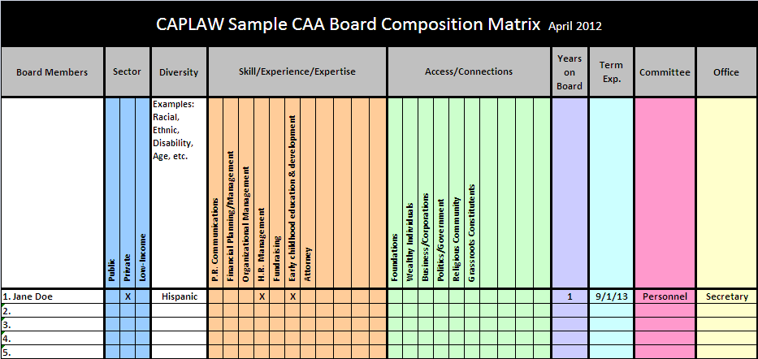
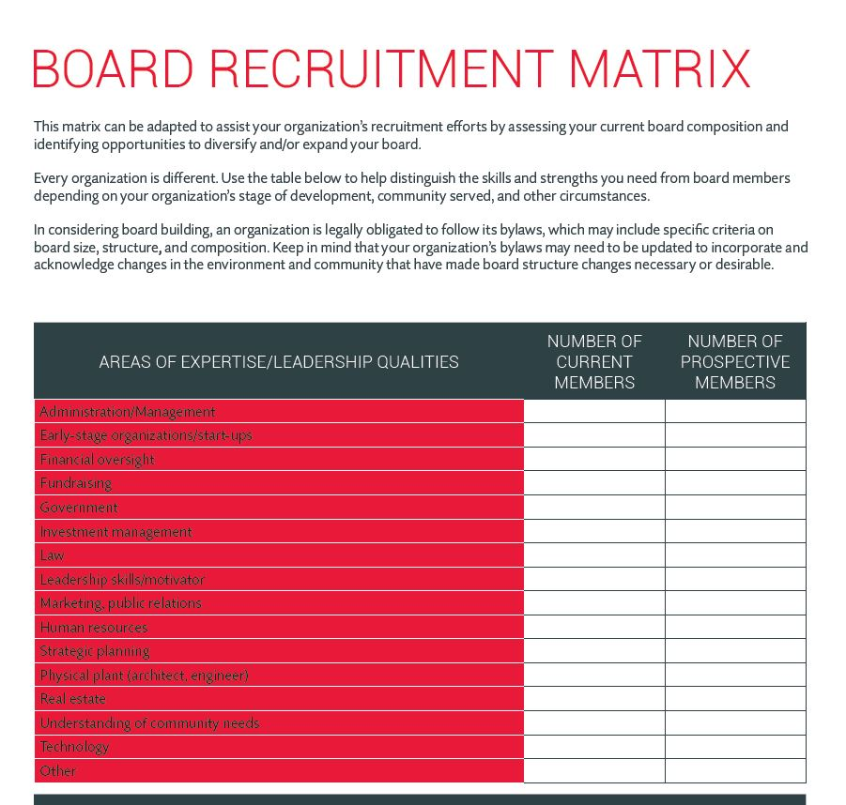
Recruitment Matrices
Board Source & CAPLAW
http://www.caplaw.org/resources/SelfAssessmentDocuments/CAPLAW_BoardComposition%20Matrix_April2012.xls
https://boardsource.org/board-recruitment-matrix/
Notes:
A composition or recruitment matrix is one way the tripartite board can take a step back and more fully understand who is currently serving on its board and what attributes the board should be seeking in its recruitment efforts. Board matrices can be customized to reflect specific organizational needs and help the board form a more strategic, targeted approach in seeking potential board members. However, it is important that your CAA does not solely rely on a matrix when making final decisions about board candidates. Someone who looks good on paper and checks off all of the boxes may not necessarily be a good fit for the board. In-person meetings often help convey information about potential candidates, such as their passion for your mission or ability to commitment to the organization, that is necessary for developing a successful and engaged board.

Slide 70
Training & Orientation Exercise
What Would You Do?
List the five most pressing topics for a board member orientation.
List the five topics that you think are essential to be covered in board trainings.
List three methods for providing training to the board.
Notes:
Note to Presenter: Workshop participants should take a moment either individually or in groups to discuss the topics they think should be covered in board orientations and trainings as well as the most effective methods for conducting such trainings. Doing so should help participants not only recognize the needs within their own organization, but also the role they individually play in helping all board members receive the information they need to meet their responsibilities.

Slide 71
Training & Orientation
Options
Use a governance committee to work with executive director and designated staff to:
  Develop a comprehensive approach
  Identify topics, e.g., financial oversight, board operations, etc.
  Establish methods , e.g., webinars, in-person, etc.
Notes:
71
Tripartite boards should consider establishing a governance committee to work with the executive director/department head and staff (as designated by the executive director/department head) to develop a comprehensive approach to training and orienting board members. The approach will likely be multifaceted and may include a mentorship program connecting more senior board members with new ones; a training schedule with specified times and days when training will occur throughout the year; and directives around attendance such as requiring all board members to attend some or all of the trainings.
As part of developing a comprehensive approach, the committee should consider topics essential to cover as part of an orientation, versus those that may necessitate more in-depth coverage and are thus better suited for a training. Some topics will be universal for all CAA boards such as board engagement, while other may be more specific to a particular CAA such as a board’s responsibilities with regards to a particular grant-funded program, like Head Start. Multiple options exist for how a board may identify the topics for both the orientation and training. Boards may: (1) survey their members either electronically or at meetings; (2) survey the executive director/department head and executive management who work with the board and its committees; (3) use board assessments that are conducted every two to three years; or (4) conduct meeting evaluations that include questions about board trainings. The same options used to identify topics could also be used to determine the best methods for conveying information. Different methods may be used to convey different types and amounts of information.
Sample orientation and training topics topics may include mission, history, programs, strategic direction, financial oversight, organizational structure, board composition, board roles and responsibilities, and board operation. Sample methods for convey the information for an orientation and trainings may include webinars, training modules, handbooks, mentoring, conference, retreats, one-on-one meetings, committee participation, on-site tours, staff presentations, and volunteering.

Slide 72
CSBG Organizational Standards
Board Orientation and Training
CSBG Org. Standard 5.7
The department has a process to provide a structured orientation for tripartite board/advisory body members within 6 months of being seated.
CSBG Org. Standard 5.8
Tripartite board/advisory body members have been provided with training on their duties and responsibilities within the past 2 years.
Notes:
Boards should also adopt a comprehensive approach to board orientation and trainings because the CAA will be monitored on these efforts pursuant to the CSBG Organizational Standards. The Standards specifically require CAAs to provide a structured orientation for governing boards within 6 months of new board members being seated and a training on their duties and responsibilities within the past two years. A board may show compliance with these Standards through a written orientation and training schedule and plan, board minutes reflecting the actual orientation and training and the board members who attended, sign-in sheets for the training and orientation, and a copy of the orientation and training materials.

Slide 73
Building Relationships
Executive Director/Dept. Head and Board Chair
Establish expectations
Frequency of check-ins
Priorities
Keep communication lines open
Regular communication
Identify and work to resolve differences in non-defensive ways
Issues to communicate
Communications style
Sounding board/feedback
Ways to support each other
Notes:
Another way to cultivate an engaged board is for the executive director/department head and board chair to develop a strong working relationship. The board chair is elected by the board to represent the individual board members and act as a conduit between the full board and the executive director/department head. The board chair presides over meetings, works with the executive director/department head to plan agendas, acts as the spokesperson for the board, and serves as a sounding board for the executive director/department head. Often times, the board gets the information it needs from the organization through the board chair, who communicates these needs to the executive director/department head. Thus, it is important that the executive director/department head and board chair are clear as to what they expect to receive and provide to each other.
Executive directors/department heads and board chairs should consider frequent check-ins where they can discuss issues and set priorities. They should educate each other regarding their preferred methods of communication, including the best way to serve as a sounding board and provide feedback. They should also discuss what type of support each is expecting and needs to fulfill the many responsibilities that each is tasked with. Keeping communications lines open and recognizing that differences will arise, while working collegially to resolve those differences, will likely result in the full board and the executive director/department head leading the public CAA in a well-informed and effective way.

Slide 74
Building Relationships
Board Members and Executive Director/Dept. Head
Meet one-on-one with board members
Periodic check-ins
Provide board members with opportunities to develop their skills as board members
Help board members get to know each other
Encourage board members to be actively engaged at board meetings
Notes:
While a strong working relationship between the board chair and the executive director/department head is necessary for a board to successfully function, there are also actions that the full board, in connection with the executive director/department head, can take to further deepen board member engagement. The executive director/department head, the board chair or governance committee chair or members should consider establishing one-on-one meetings with individual board members. These meetings could find out, among other things:
What motivates each to serve on the board?
How do they connect with the organization’s mission?
What do they hope to gain from board service?
What can they contribute?
What skills/knowledge do they need or want to develop to become a more effective board member?
What could make their experience more satisfying?
Also, periodically checking in with board members between meetings to see what support they may need or address concerns they may have helps to boost a board member’s interest and engagement. Educating board members about opportunities that align with their skills or can help them develop new skills will help them feel that they are contributing to the public CAA as well as growing from the experience of serving as a CAA board member. Helping board members get to know each other either by assigning new board members mentors and or inviting board members throughout the year to introduce themselves and tell their stories is another way to help board members feel invested in the board and the work they are tasked with. Another way to promote engagement is to assign specific tasks to board members, ask them to serve on committees, and conclude meetings with actions items that individual board members can take ownership of.

Slide 75
Building Relationships
Board Members and Local Governing Officials
Set regular meetings with governing officials
Provide governing officials with quarterly/ regular updates
Identify a liaison/point person between the two bodies
Involve local governing officials in tripartite board orientation and trainings
Notes:
Local governing officials and tripartite board members must work collaboratively for the public CAA to successfully further its mission and maintain its CSBG funding. It is thus essential that these two bodies regularly communicate with one another and are generally aligned in their efforts to oversee and support the CAA. Multiple ways exist for a tripartite board to develop and nurture its relationship with local governing officials. A few options include:
Setting regular meetings with governing officials. These meetings will likely involve a board committee and the tripartite board may decide to establish a standing committee that is solely focused on the tripartite board’s relationship with the local governing officials.
Providing governing officials with regular updates. The tripartite board should review the local governing officials’ annual meeting calendar, identify meetings that seem best suited for tripartite board updates and proactively request to be added as an agenda item for those meetings.
Identifying members of both bodies to serve as liaisons at the meetings of each. The tripartite board may consider creating an officer position whose responsibilities focus on ensuring that the two bodies are communicating and providing each other with the information needed for each to meet its responsibilities.
Involving local governing officials in board orientations and training. The tripartite board may also determine that conducting orientations and trainings specifically for local governing officials is an easier and more effective way to encourage and ensure participation by local governing officials. Such trainings and orientations may also occur as part of the local governing officials’ meetings.

Slide 76
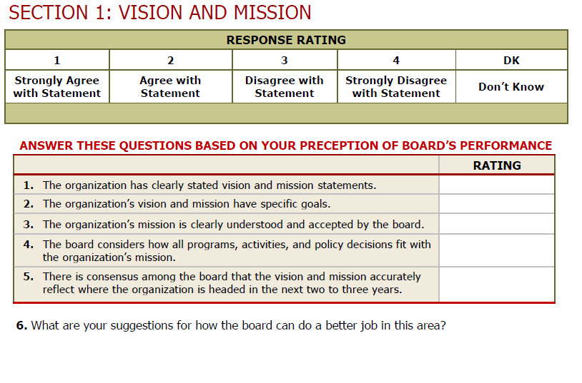
Board Assessment
Sample Excerpt
  http://www.virtualcap.com/downloads/MPI/IN-CAA-Board-Self-Assessment.pdf (developed by IN Community Action Assoc.)
Notes:
Conducting assessments that involve either the board members assessing the full board or their individual participation on the board is an opportunity for tripartite board members reflect on both their individual and shared responsibilities. Assessments are a vital governance tool that gives the board an opportunity to step back from its everyday business and address larger, more fundamental issues. Assessments can shake boards out of micromanaging the organization’s work and redirect their focus to governance issues. It can lead to a more engaged board—and a higher performing one. Assessments help board members identify varying perceptions, clarify and manage expectations and set priorities and goals. The result of a successful assessment could be to inspire the board to work more cohesively as a team to strengthen the organization.
On this slide is an excerpt from an assessment tool that was specifically created for CAAs by the Indiana Community Action Association. As you can see from this brief snippet, the assessment is basically giving the board and individual board members a chance to ask how they are doing. An assessment isn’t an opportunity to create another to-do list but is a chance for the board to fine-tune the way it operates in a targeted, effective way. An assessment should be viewed as an ongoing journey that leads to a healthy and productive discussion about the board’s strengths and weaknesses and results in an agreed-upon plan for building a stronger board and governance model.
An assessment may be too comprehensive a process to be carried out every year. Each board operates differently and will need to gauge what is the best time frame for them. Conducting an assessment every other year tends to be helpful for many boards. However, it doesn’t make sense to conduct an assessment if the organization is facing a crisis or some other pressing matter that is requiring everyone’s full attention. The process also isn’t effective when staff and board leadership are at odds with one another or when the organization or the board lack the capacity to enact the strategies that might grow out of the effort.

Slide 77
Board Assessment
Process
Get your full board on board!
Establish a group of board members to oversee the process
Administer the assessment tool
Tabulate responses
Discuss results – strengths, weaknesses
Establish a realistic action plan
Follow up and reassess!
Notes:
An assessment should be a team effort. A recommended approach is that either the governance committee or a few designated board members play an active role in the process and take some ownership for seeing that the results are used to effect change, when necessary. Once the assessment process is complete and responses tabulated, the board must take the time to discuss the results if the process is to be impactful. The governance committee, working with a staff person designated by the executive director/department head, may be charged with pulling together a report from the results to help facilitate the discussion and spearhead the development of an action plan. Most importantly, the board must make an effort to follow up, through meeting evaluations or board surveys, to determine if the plan addressed the results and what tweaks may be necessary.

Slide 78
Board Assessment
Resources
Decide on and use appropriate format/tool
  NH Center for Nonprofits, http://www.nhnonprofits.org/view/member-benefits/256
  National Council of Nonprofits, http://www.councilofnonprofits.org/resources/resources-topic/boards-governance/board-member-self-assessment
  VirtualCAP, http://www.virtualcap.com/downloads/MPI/IN-CAA-Board-Self-Assessment.pdf (tool developed by Indiana Community Action Association)
  The Nonprofit Association of Oregon, https://nonprofitoregon.org/helpline_resources/Board-Assessment-Tool
Notes:
Here are a few tools for conducting board assessments. While many of these assessments are tailored to nonprofit organizations, they serve as a good starting point from which a public CAA tripartite board can customize the tool to better reflect the way in which the board operates. No matter what tool a board uses, a good assessment needs to ask relevant and clear questions, collect systematic feedback from a variety of sources, and make use of the information for developmental purposes, rather than as a report card of board performance.

Slide 79
Connecting with Community Exercise
Fill in the Blank
Empowering the low-income community
  Ex., our tripartite board _______________________________
Effectively advocating for the CAA and its mission
  Ex., our tripartite board________________________________
Collecting and providing input on community needs
  Ex., our tripartite board________________________________
Developing and sustaining strategic partnerships and collaborations
  Ex., our tripartite board________________________________
Notes:
A public CAA garners the support it needs to survive and thrive if it is connecting with those individuals and families it serves as well as others in the community who can support the furtherance of the CAA’s efforts and mission. Connecting with the community embodies a hallmark of community action which is the “maximum feasible participation” of the low-income community served. The tripartite board serves as the face of the public CAA and must ask itself how it is engaging in activities like the ones listed above. Examples of how board members can connect with the community include:
Empowering the low-income community by spearheading a leadership development program for the CAA’s clients. A public CAA tripartite board developed a program that not only connected the board with the population the CAA serves but also helped to educate those who often feel voiceless as to how they can make their voices heard and produce results hopefully benefiting themselves and their community.
Advocating for the public CAA by speaking at community groups and participating in hearings on matters impacting the low-income community.
Collecting and providing input on community needs by holding forums seeking feedback from the community as to their needs and what assistance they believe will help them address those needs.
Developing and sustaining strategic partnerships and collaborations by working with other social service providers and groups who are serving the same community to determine what are the best ways they can individually and collaboratively help improve the lives of the low-income community served.
Now, it is your turn. Take a moment to fill in the blank for each of the bullets listed above with at least one way your tripartite board is connecting with the community. If you are not sure what your board might be doing to connect with the community, then make a proposal to take back to your board as an action item.

Slide 80
CSBG Organizational Standards
Community Engagement
CSBG Org. Standard 1.1
CSBG Org. Standard 2.1
CSBG Org. Standard 2.3
The department demonstrates low-income individuals’ participation in its activities.
The department has documented or demonstrated partnerships across the community, for specifically identified purposes; partnerships include other anti-poverty organizations in the area.
The department communicates its activities and its results to the community.
Notes:
Even though a tripartite board is not directly involved in complying with the CSBG Organizational Standards that require a CAA to engage the low-income community, collaborate with fellow providers and communicate results, the tripartite board’s efforts in these areas ultimately contribute to the success of the public CAA. There are actually a number of ways, as we just discussed, that a tripartite board can directly contribute to a CAA’s efforts to meet these Standards through deliberate efforts to connect with the community served.

Slide 81
Key Board Responsibility
Maintain and Grow
Funding
Notes:
Ensuring that the public CAA is maintaining, and when possible, growing its funding is not only a key board responsibility, it is a critical one. A public CAA is no different than a nonprofit CAA in that the survival of each is tied to having sufficient funds to operate. In this section, we will work through some questions to address the role of the board in overseeing and potentially growing the funds of a public CAA.

Slide 82
Funding Scenario
Darren has been a tripartite board member for 10 years and has become increasingly concerned about the public CAA’s financial standing. He hears rumblings about austerity measures in the county and fears that the board is not doing enough to help the CAA maintain its funding. Darren decides it is time for the board to take action but is not quite sure what actions the board can take since the public CAA is a division of the local government.
What advice do you have for Darren?
Notes:
A tripartite board plays an important role in helping a public CAA maintain not only its CSBG funding but also other financial supports that the CAA needs to operate within the local government framework. By regularly meeting with and educating the local governing officials about the CAAs needs and accomplishments, the board helps those who develop and decide the budget to make more informed decisions that will hopefully benefit the CAA. Further, as permitted by the local laws, board members should actively participate in local government hearings-- not only on the CAA’s budget--but also on the overall county budget.

Slide 83
Two Main Ways CAAs Generate Funds
Proposals
Writing grants
Preparing bid proposals
Putting on special events
Soliciting gifts
Fundraising
Capital campaigns
*
*
*
*
Executive director/dept. head and staff
Board, executive director/ dept. head and county counsel
Notes:
All CAAs typically receive funding in two main ways: (i) via proposals for grants from federal, state and private funding sources or (ii) via fundraising activities that target private donors. A public CAA typically relies on grants from government sources and must consult with its county counsel as to if and how it may engage other efforts to generate funds.
The federal grant rules that govern a CAA’s use of federal funds, the Uniform Guidance, allow for CAAs to pay for the costs that are associated with preparing both successful and unsuccessful bids, proposals, or applications on potential Federal and non-Federal awards or projects with federal funds as long as certain requirements are met as to how the costs are treated (i.e., as indirect) and when they are charged to the grant (i.e., during the accounting period in which they were incurred).
Cost associated with organized fundraising, which includes activities such as capital campaigns, special events, and solicitation of gifts and bequests, may not be paid for with federal funds without obtaining prior written approval from the federal awarding agency. To date, CAPLAW is not aware of any federal agency that has given fundraising approval.

Slide 84
Board’s Role in Generating Funds
Work with staff to develop plan
Oversee implementation of plan
Identify potential funders
Develop & nurture relationships
Consult with county counsel about fundraising options
Notes:
As previously noted, tripartite board members should consult with county counsel to determine ways that the board can engage in fundraising activities on behalf of the public CAA. One option, often of interest to public CAAs, is creating a nonprofit, tax-exempt subsidiary for the purpose of fundraising. The ability of public CAAs to pursue this option as well as other fundraising activities such as soliciting donations or conducting capital campaigns will be governed by state and local laws. If a public CAA is able to create a subsidiary for fundraising purposes, it should work closely with its county counsel to do so. Maintaining a subsidiary can be time consuming and administratively burdensome, so CAAs should carefully consider the benefits received from creating one compared to the effort expended to ensure that it is operating properly.
Even if the tripartite board is restricted by state and local laws in its ability to engage in certain fundraising activities, the board should consider taking other actions to support the CAA’s fiscal soundness. Such actions include:
Working directly with staff via a committee to develop a sustainability plan that focuses on ways in which the CAA is permitted to generate funds.
Overseeing the implementation of the plan with the executive director/department head.
Identifying potential funders. Board members could facilitate introductions between potential funders and staff.
Developing and nurturing relationships with funders and potential donors as well as those in the community so they recognize the value your CAA brings to the community. Board members could also accompany staff on funder and donor visits and offer to follow up with expressions of gratitude, when appropriate.

Slide 85
Key Board Responsibility
Strategic & Programmatic
Performance
Notes:
We now live in a data-driven society. Being able to show that a program is producing results is often the key to sustaining and attracting funding. In this section, we will talk about the role a tripartite board plays with respect to overseeing the performance of a CAA’s programs.
Note to Presenter: While this presentation does not refer to ROMA, this section of the presentation is where information about ROMA would likely be included. We encourage presenters with knowledge of the ROMA principles to include information about them as applicable.

Slide 86
Program Performance Exercise
List 3 reasons why a tripartite board should have a framework in place for reviewing the performance of the CAA’s programs.
The CSBG Organizational Standards require it.
ALL funders expect to receive information on how programs and services are making an impact.
It is the best way for the CAA to know what’s working and what’s not.
Notes:
Note to presenter: Ask workshop participants to take a moment to jot down three reasons why a tripartite board should have a framework in place for reviewing the performance of a CAA’s programs. This slide is animated so after asking for volunteers to report their answers, reveal the three reasons on the slide. It is likely that the workshop participants mentioned all three of the reasons listed.

Slide 87
Regular Strategic and Programmatic Reviews
Review at Every Board Meeting (Milestone / Programmatic)
Annual Review (Milestone / Programmatic/ Strategic)
5-Year Review (Strategic)
Notes:
A tripartite board oversees program performance by reviewing the goals it has set in comparison to the progress made in meeting those goals by the executive director/department head and his or her staff.
Reviewing programmatic goals and progress is not unique to CAAs and is usually required by non-federal funding sources as well. What is unique is that the CSBG Organizational Standards require CAAs to engage in organization-wide reviews, not just reviews of programs funded by CSBG. At every meeting, the board is tasked with receiving updates on the CAA’s programs. The board is not required to hear about every program at every meeting and they may decide what is the best, most effective way to receive the updates. For example, rather than having program directors or other members of the management team present detailed reports on CAA programs at each meeting, the board may have them prepare concise written reports that highlight recent developments. These reports can be included in the board packets sent to board members prior to the meeting. At the meeting, the executive director/department head can summarize the developments and issues outlined in the reports and board members can ask questions about the reports.
The focus of the annual review is to assess the progress the CAA has made towards meeting the goals set forth in its strategic plan.
The strategic review will be closely tied with the revision or further development of the CAA’s 5-year strategic plan. As with the annual review, programmatic and strategic goals and achievements will be assessed, and this information will be used by the board to inform its efforts in planning the future direction of the CAA.

Slide 88
CSBG Organizational Standards
Strategic and Program Performance
CSBG Org. Standard 6.5
CSBG Org. Standard 5.9
The tripartite board/advisory body has received an update(s) on progress meeting the goals of the strategic plan/comparable planning document within the past 12 months.
The department’s tripartite board/advisory body receives programmatic reports at each regular board/advisory meeting.
CSBG Org. Standard 6.1
The department has a strategic plan, or comparable planning document, in place that has been reviewed and accepted by the tripartite board/advisory body within the past 5 years. If the department does not have a plan, the tripartite board/advisory body will develop the plan.
Notes:
The CSBG Organization Standards establish the framework for a CAA’s program and strategy review. The board’s role is specifically outlined as one that approves plans, monitors progress, and receives updates.

Slide 89
Board’s Role in Programmatic & Strategic Performance
Establishing a culture of using data to make decisions
Performance management
How can we improve our . .
Outcomes?
Quality?
Cost effectiveness?
Notes:
In practical terms, a tripartite board’s role with regards to performance measurement involves establishing a culture of using data to make decisions. The graphic on this slide shows a somewhat simplistic view of what that means. A board that oversees the implementation of a constant feedback-and-response loop focused on improving program performance will strengthen its organization.

Slide 90
Board’s Role in Programmatic & Strategic Performance
Inquiring about relevancy of data received and the metrics used
Performance measurement
How will we know if we are meeting community needs prioritized?
What metrics matter?
What data will need to be captured?
Notes:
Part of developing a successful feedback-and-response loop requires inputting measures that assess the relevancy of the data received and the metrics used. The tripartite board is trying to answer the question, “How will we know if we are meeting the community needs we’ve prioritized?” and to properly do so it must work with the executive director/department head and staff to determine what data should be collected and what metrics will serve as the best guides for future decisions.

Slide 91
Key Board Responsibility
Accountability
Notes:
The tripartite board plays an instrumental role in ensuring that a CAA is accountable, i.e., fiscally strong, legally complaint and operationally sound. Maintaining accountability requires the implementation of systems, policies and procedures that the board oversees, reviews and approves. To gain and maintain public trust, a CAA must be able to show that it has a strong commitment to ethical principles, transparency and accountability.

Slide 92
Financial Oversight Quiz
Because a public CAA is often a division or department of the local government, the tripartite board has no real influence over the CAA’s budget. True or False
The tripartite board should work closely with local governing officials to ensure it receives the financial reports for the programs it oversees as permitted by local government procedures. True or False
Notes:
False. As we will discuss in greater detail in the following slides, there are a number of ways that a tripartite board of a public CAA that is a division or department of the local government may and should exercise influence over the local government budget, especially the sections relating to the programs the board oversees.
True. Again, we will discuss the tripartite board’s receipt of financial reports in greater detail in the following slides, however, it is important that the tripartite board work closely with the local governing officials so that the officials understand what the tripartite board needs to effectively fulfill its oversight responsibilities.

Slide 93
Oversee Financial Standing
1
  Receive financial reports at regular meetings
2
  Provide input on annual budget
3
  Develop dashboards
4
  Receive notification of audit and any CSBG findings
Notes:
The tripartite board, as permitted by the local government policies and procedures, oversees the CAA’s finances which includes reviewing how the CAA allocates its resources and protects its funds and resources from misuse or mismanagement. The board meets this responsibility by:
Reviewing financial statements
Providing feedback to the local governing officials on the annual budget.
Developing dashboards to focus the tripartite board on those financial indicators most relevant to the public CAA’s operations.
Receiving notification of the availability of the local government audit and any findings relating to CSBG

Slide 94
Financial Reports
An approach to financial reports may include:
  Preliminary review by finance committee
  Review by each board member
  Regular discussion
  Once-a-year discussions (e.g., annual budget, etc.)
  Question and answers
Notes:
As permitted by local government policies and procedures, the tripartite board may receive financial reports that provide information about the public CAA’s revenues and expenditures and a comparison of budget to actual. CAPLAW recommends a five-step approach to reviewing financial reports:
Step 1: Preliminary Review by the Finance Committee
Use a finance committee. One of the committee’s tasks should be to review the financial reports in advance of the board meeting and take the lead on discussing them at the meeting. If the CAA does not have a finance committee, someone should be designated to review the reports in advance of the meeting and lead the discussion. This person could be a board member or the CAA’s CFO or treasurer, depending on the CAA’s resources and circumstances. Even if a non-board member leads the discussion, CAPLAW recommends that the staff member review the reports ahead of time with a board member, such as the treasurer, so that at least one board member will have a more detailed understanding of the reports.
Step 2: Review by Every Board Member
Every board member should receive a packet of financial information at least one week in advance of the scheduled board meeting. The packet should include financial reports as permitted by the local government policy and procedures, and if possible, an analysis of the reports from the board’s finance committee or the CAA’s CFO or treasurer. Each board member—no matter how financially illiterate—should review the reports before the meeting.
Step 3: Regular Discussion of the Financial Statements
The meeting agenda should set aside sufficient time to permit a thorough discussion of the financial report. The discussion may include a review of:
Variances from budget—comparing what actually happened with the annual plan
Liquidity—the CAA’s ability to meet its obligations as they become due
Unrestricted net assets available for operations
Program-by-program analysis of revenue and expenses
Key financial metrics
Stability of the CAA’s grants and other revenue sources
Any other matters involving finances warranting discussion
Step 4: Once-a-Year Discussions
At least once a year, the tripartite board should discuss the following matters in detail: auditor’s annual report and management letter as it relates to CSBG findings; CAA’s annual budget; CAA’s compliance with the local government’s system of internal controls; CAA’s overall financial health, including its liquidity and unrestricted net assets; CAA’s long-term financial plans and needs. The board need not address all of these topics at the same meeting.
Step 5: Questions and Answers
Time should be set aside during each discussion of the CAA’s finances for a robust question and answer session. Questions should be encouraged.

Slide 95
Annual Budget
Provide input on CSBG budget process
Participate in hearings and meetings about budget
Monitor performance against budget during year
Help board members develop a high-level understanding of:
  Budget assumptions
  Cost centers
  Applicable grant requirements
Notes:
While a tripartite board may not have authority to develop the CAA’s annual budget, it should provide feedback on the CSBG budget process as permitted by local government policies and procedures. Tripartite board members should advocate for the CAA by attending hearings and meetings about the budget. The annual budget is also a useful tool for monitoring the CAA’s performance throughout the year. To facilitate use of the budget, the board should assist its members with developing a high-level understanding of the following aspects of a budget:
Assumptions: The annual operating budget represents the CAA’s best estimate or projection of income and expenses for the upcoming fiscal year. Sound budgeting requires systematic recording of the assumptions that are the basis of the projections. Clear documentation of assumptions will make it much easier to calculate the impact on the overall budget that will occur when assumptions change.
Cost centers. CAAs frequently operate multiple programs and in many instances, each program is supported through the use of resources from multiple sources. The use of a cost center budget structure facilitates describing how various programs will be supported and how various funding sources will be used in accordance with the requirements of specific funders. Budgets for all cost centers must be integrated into the comprehensive annual budget document. For example, a CAA with a Head Start, weatherization, and energy assistance programs will have budgets for each program as well as cost centers for general administration.
Grant requirements. Board members should have a high-level understanding of the goals of the financial requirements that apply to federal grants so they understand how the funding may be sued and the importance strong financial systems and processes.

Slide 96
CSBG Organizational Standards
Financial Oversight
CSBG Org. Standard 8.7
The tripartite board/advisory body receives financial reports at each regular meeting, for those program(s) the body advises, as allowed by local government procedure.
CSBG Org. Standard 8.9
The tripartite board/advisory body has input as allowed by local governmental procedure into the CSBG budget process.
Notes:
As previously noted, the CSBG Organizational Standards require that boards receive financial reports and provide input on the CSBG budget process as permitted by local government procedures.

Slide 97
CSBG Organizational Standards
Financial Oversight
CSBG Org. Standard 8.3
The department’s tripartite board/advisory body is notified of the availability of the local government audit.
CSBG Org. Standard 8.4
The department’s tripartite board/advisory body is notified of any findings relating to CSBG funding.
Notes:
As previously noted, the CSBG Organizational Standards require that boards are notified of the availability of the local government audit as well as of any findings relating to CSBG funding. The tripartite board will likely work closely with the local governing officials to help address and resolve any CSBG related findings.

