Slide 1

Board Roles & Responsibilities:
Nonprofit Community Action Agencies
PRESENTED BY:
[Trainer Name]
[Trainer Website or Email]
[Trainer Phone Number]
[Training]
[Date]
[Trainer Logo]
Notes:
Serving on a board of directors of a nonprofit organization is both rewarding and challenging. For a nonprofit community action agency (CAA), the federal funding that the organization receives adds another, unique layer to a board member’s responsibilities. Using scenarios and quizzes, this presentation focuses generally on the role and responsibilities of a nonprofit board and specifically on the board leadership for a nonprofit that is community action agency (CAA).
Note to Presenter: This presentation is basically a guide for those conducting trainings for tripartite boards and CAA staff that work with tripartite boards on the board’s roles and responsibilities. All the slides in the PowerPoint are annotated to provide the trainer with an understanding of the information that CAPLAW strives to convey when presenting on this topic. The intent is to support trainers in their own efforts to educate tripartite boards about the very vital role the board plays. We envision several ways that the Community Action network may use this presentation:
The presentation may be given in its entirety;
The slides may be presented in sections as noted on the webpage; and/or
The slides may be used to augment a presenter’s existing presentation.
The slides are not all-inclusive of the information that is important for tripartite boards to know. The slides are only intended to acknowledge the information that most tripartite boards will be tasked with overseeing. Every CAA is different and the way in which your CAA operates and the programs it runs will affect the information that has been included in this PowerPoint.
We recommend reading the brief introduction about this presentation for additional tips on using and printing this resource.

Slide 2
This training material was created in collaboration with Community Action Program Legal Services, Inc. (CAPLAW) and the Community Action Partnership (Partnership). The publication was created by National Association of Community Action Agencies - Community Action Partnership in the performance of the U.S. Department of Human Services, Administration for Children and Families, Office of Community Services Grant Number 90ET0465. Any opinion, findings, and conclusions, or recommendations expressed in this material are those of the authors and do not necessarily reflect the views of the U.S. Department of Health and Human Services, Administration for Children and Families.
Notes:
Note to Presenter: This is language we are required to include with this resource to acknowledge the funds that were used to pay for its creation. We ask that you include this slide in your presentation If you are presenting the PowerPoint or sections of the PowerPoint in its entirety and are not making any changes to the slides when doing so. However, if you make changes to the slides or incorporate a few slides into an existing presentation, rather than use an entire section, the language above is no longer applicable and it is not necessary to include it.

Slide 3
Agenda
Brief Introductions
Legal Requirements Governing Tripartite Boards
A Few Brief Points About How a Board of Directors Operates
Role of the Tripartite Board
Key Responsibilities of the Tripartite Board
Notes:
An engaged and knowledgeable board of directors is essential to the success of any nonprofit corporation. The tripartite board of a nonprofit community action agency (CAA) is no different. This presentation provides an overview of the role and key responsibilities of the tripartite board of a nonprofit CAA. In discussing the important part that the tripartite board plays in ensuring the sustainability and effectiveness of a CAA, we will touch on the legal requirements that establish the parameters within which tripartite boards operate as well as briefly address some key ways that all nonprofit boards, including tripartite boards, operate.
Note to presenter: The presentation is not intended to be all-inclusive of the many issues that affect tripartite boards. However, the presentation is intended to establish a basic framework that may be supplemented by individual CAAs, state associations or state CSBG offices. As is laid out on the webpage, the presentation may be given in its entirety or in sections.

Slide 4
Brief Introductions
Notes:
To find out more about who we have with us today, let’s take a moment to walk through a few questions that will help us introduce ourselves to each other. Knowing more about each other, will hopefully encourage a level interactivity during today’s training and subsequently translate into peer sharing and support that extends beyond this training .
Note to Presenter: The questions in this section are intended to help the presenters think creatively about how to initially engage workshop participants and also create a comfortable learning environment. As a presenter, you may have other questions you like to ask so don’t hesitate to incorporate those into this section or you may have a different approach to asking the same or similar questions.
The way in which you ask the questions will likely be dictated by the number of participants present. If you have a large number of participants, you will likely ask for a show of hands and for a few volunteers to provide more specific answers. If you have a small number of participants, having each participant answer the questions individually may help to encourage camaraderie and peer sharing.

Slide 5
Who do we have in the room with us today?
Board Member
Board Chair
Executive Director
Staff Board Liaison
State Association Staff
State CSBG Office Staff
Who Else???
Notes:
Note to presenter: This slide is animated, so each group that is listed above will appear one at a time and give the presenter a chance to ask additional questions of the individuals in that group.

Slide 6
Time Flies When You’re Having Fun! Right?!?
Board Members: How many years have you served on the board?
Staff: How many years have you worked in Community Action?
  0 to 3 years
  0 to 3 years
  3 to 5 years
  3 to 5 years
  5 to 10 years
  5 to 10 years
  10 to 15 years
  10 to 15 years
  15 to eternity . . .
  15 to eternity . . .
Notes:
Note to Presenter: This slide is animated with each separate span of years for both the board and staff appearing simultaneously. Both groups can therefore raise their hands for each time span. However, depending on the size of the workshop, you may decide to have the participants introduce themselves and answer this question when doing so.

Slide 7
Tells Us Why You are Here!
Board Members:
What motivated you to join a Community Action board?
Staff:
What motivated you to work for a Community Action Agency?
Notes:
Note to Presenter: This slide is animated so that the questions will appear one at a time. There are multiple ways to approach these questions. If it is a large group, ask the workshop participants to take a moment to answer the question and then ask for volunteers to report their answers to the group. If it is a small group, you may consider having each participant answer the question that pertains to him/her as part of their individual introductions.

Slide 8
Takeaways
What do you hope to learn?
At the end of the presentation, write down 3 action items to take back to your organization.
Notes:
Note to Presenter: These questions are animated and will appear on the slide one at a time. The approach to these questions will again depend on the size of the workshop. If it is a large group, ask the workshop participants to take a moment to answer the questions and then ask for volunteers to report their answers to the group. If it is a small group, you may consider having each participant answer the question.
The first question is intended to help the presenter address and set the expectations for workshop participants and should be asked before the presentation begins. The second question should also be asked/presented before the presentation begins. At the end of the presentation, it is important to remind participants of the second question and have them take a moment to write down their three action items. You may decide to include this slide also at the end of the presentation to serve as a reminder. Time and workshop size permitting, either ask for volunteers to briefly state their action items or have each participant do so.

Slide 9
Legal Requirements Governing Tripartite Boards
Notes:
Multiple laws govern the way in which a tripartite board of a nonprofit CAA is composed and operates. In this section, I will provide a quick overview of how each of the laws applies to CAAs and then walk through very generally the information that is important for boards to be aware of with respect to these laws.

Slide 10
Legal Requirements
State Nonprofit Corporation Act
Articles of incorporation & bylaws
Other federal/state funding requirements
CAA Boards
IRS tax-exempt org. requirements
CSBG grant agreement/ contract with state
Federal CSBG Act, block grant regulation, guidance
State CSBG statute, regulations, policies
Notes:
State Nonprofit Corporation Act and Articles of Incorporation & Bylaws: Your CAA began by being formed as a nonprofit corporation under the state’s nonprofit corporation act. As is required by the act, the organization filed articles of incorporation (or articles of organization) with the state and developed a set of bylaws to establish a framework for how the board will operate. Even though many CAAs were formed in the 1960s, the state’s nonprofit corporation act continues to apply and may have undergone amendment since then. Thus, it is important that your CAA understand the state nonprofit corporate act’s current requirements, or work with an attorney who has experience working with nonprofit organizations in your state.
Internal Revenue Services Tax-exempt Organization Requirements: Most nonprofit CAAs received their tax-exempt status under the federal Internal Revenue Code (IRC) around the same time they were formed as a nonprofit. The IRC basically exempts a nonprofit from paying federal taxes so long as the nonprofit is engaged in activities that further its charitable purposes. A nonprofit CAA’s mission typically reflects with greater specificity the CAA’s charitable purposes.
Federal CSBG Act, block grant regulations, guidance: The nonprofit corporation became a CAA when it applied for and received funds, initially under the Economic Opportunity Act, the precursor to the Community Service Block Grant (CSBG) Act. The U.S. Department of Health and Human Services (HHS) is the federal agency that oversees the CSBG program and passed rules (referred to as regulations) that apply to CSBG and other block grants. Additionally, the federal Office of Community Services (OCS) is a department in HHS’s Administration for Children and Families division that directly manages the CSBG program and issues mostly nonbinding program guidance in the form of Information Memorandum (IMs).
State CSBG statute, regulations and policies: Because CSBG is a block grant, states have primary authority to manage and facilitate the funding and, in an effort to do so, some states pass their own CSBG statutes, regulations (regs) and policies.
CSBG grant agreement/contract with state: To receive CSBG funding, CAAs enter into grant agreements or contracts with the state CSBG office, which will typically incorporate other applicable federal and state laws.
Other federal/state funding requirements: CAAs receive funding from other federal and state sources which may include governance requirements that apply to the CAA’s board.
Now, let’s turn to talking a little bit more about why each of these requirements is important for boards to know and how they affect the way in which a board governs the organization.
Note to presenter: the difference between a statute and a regulation: A federal statute is a law passed by U.S. Congress and a state statute is a law passed by the state legislature. Statutes will often include language in them that grants authority to a federal agency (if it’s a federal statute) or state agency (if it is state statute) to issue additional rules to help flesh out compliance. For example, the federal CSBG Act authorizes the federal Department of Health and Human Services (HHS) to issue regulations to help flesh out the administration of block grants. Because of the nature of a block grant, i.e., that the state generally facilitates the funding, the HHS block grant regulations at 45 C.F.R. Part 96 are very bare bones and give deference to the states as the grantee and facilitator of the CSBG funding.

Slide 11
State Nonprofit Corporation Act
Generally, sets minimum standards of compliance and “default rules.” True or False
  For example, may establish vote requirements for certain actions; removal provisions; committee composition requirements, etc.
Articles filed and bylaws created pursuant to the Act
  If provisions of articles or bylaws are not consistent with the Act, then they will have no legal effect
Notes:
True. The state nonprofit corporation act often sets minimum standards of compliance and defaults that will govern the way the organization can operate unless the bylaws and/or articles of incorporation provide otherwise.
Examples of such default and minimum standard provisions include:
Board size: If the board size is not set in the bylaws the default is usually that one to 3 board members are required;
Board action: Unless the articles or bylaws provide otherwise, the default is often that a majority vote of the directors then in office is required for actions to be taken
Removal: Automatic removal for missing a certain number of meetings is permitted if specific language to this effect is in the bylaws; and
Membership requirements for certain committees: For example, if a committee has the authority to act on behalf of the full board, the officers of the board may be required members of the committee
For this reason, it is important that a CAA develop bylaws that reflect the way the CAA operates. Generally, if the articles or bylaws are not consistent with the state’s nonprofit corporation act, the act will likely control.

Slide 12
Articles and Bylaws
Articles should contain as much, if not more, operational information as the bylaws. True or False
  If provisions in the bylaws and articles conflict, the articles will control so review together if amending them
Bylaws establish the ways in which the CAA will operate
Bylaws typically reflect funding source requirements
  Ex., CSBG tripartite board composition and responsibilities; Head Start board composition, responsibilities and conflicts of interest requirements
Notes:
False. The articles should only contain a minimal amount of information to avoid potential conflicts with the bylaws and because amending articles requires a fee and a filing with the state.
The board will likely only refer to the articles in limited situations such as when reviewing the bylaws to avoid any conflict with the articles, when updating its mission or when facing a dissolution. If provisions in the bylaws and articles conflict, the articles will control so the documents should always be reviewed simultaneously, especially if amending them.
The bylaws are the organization’s governing document and should be provided to all board members and reviewed by them. The bylaws inform the board of its operational obligations and framework. Different funding source requirements applicable to the board are often reflected in the bylaws, such as the CSBG tripartite board requirement and the Head Start board (i.e., governing body) composition requirements.

Slide 13
IRS Tax-Exempt Rules
To receive and maintain tax-exempt status, a nonprofit CAA must comply with a number of federal tax requirements. True or False
Tax-exempt rules requires that the tripartite board of a nonprofit CAA:
  Maintain a mission that furthers the CAA’s charitable purposes
  Abide by restrictions on activities
  Protect the use and disposition of the organization’s assets
Notes:
True. The IRS tax-exempt organization rules do more than simply provide for relief from federal taxes. In exchange for tax-exempt status, the federal government requires that a CAA comply with other requirements which require action from a nonprofit CAA and its tripartite board in a number of ways, including:
Informing the CAA’s mission, i.e., setting the parameters that require the CAA to establish a mission that furthers the CAA’s charitable purposes as established by the Internal Revenue Code (IRC)
Abiding by certain restrictions, i.e., for example, the tax-exempt rules that apply to CAAs are referred to as 501(c)(3) requirements and limit a CAA’s ability to lobby and participate in the political process
Dictating the use of assets, i.e., if a tax-exempt organization dissolves, its assets must continue to be used for charitable purposes.

Slide 14
Federal CSBG Act
The tripartite board composition is a suggested practice and not required by the federal CSBG Act. True or False
1/3 elected or appointed public officials
At least 1/3 low-income representative
Remainder individual or group from private sector
Requires tripartite board to be fully engaged in the development, planning, implementation and evaluation.
42 U.S.C. § 9910
Notes:
False. While there are many provisions in the federal CSBG Act that help establish the role and responsibilities of the board, there are two key sections in particular that are important for board members to know – the provisions establishing the tripartite board structure and the directive that the tripartite board must be fully engaged in the development, planning, implementation and evaluation of the CSBG program.
The federal CSBG Act requires a CAA to maintain a tripartite board which consists of: (a) 1/3 of the board members being elected or appointed public officials, or their representatives who serve in the place of the elected or appointed official; (b) at least 1/3 of the board being democratically selected by the low-income community as representatives of that community; and (c) the remainder of the board being individuals or groups from the private sector, i.e., business, industry, labor, religious, law enforcement, or other major groups and interests in the community served. We could spend an entire presentation discussing the tripartite composition; however the focus of this presentation is the board’s responsibilities. CAPLAW offers several other resources about the tripartite composition which I will discuss in just a moment.
The directive that the board be fully engaged in the development, planning, implementation and evaluation of the CSBG program is a statement that we will unpack in greater detail as we discuss board responsibilities in another part of this presentation.

Slide 15
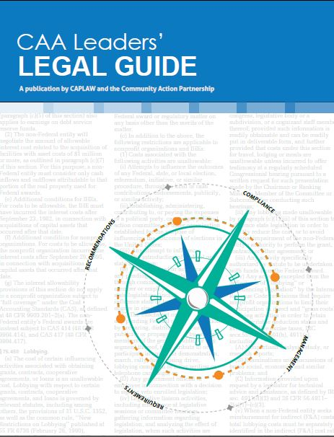
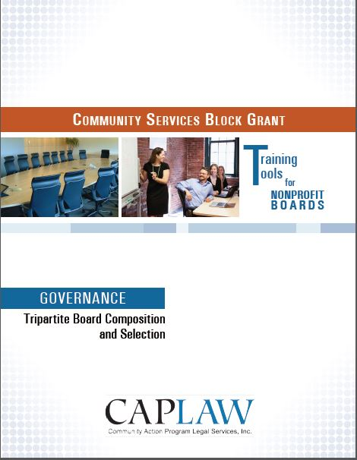
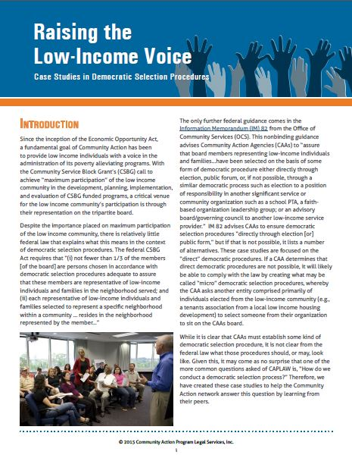
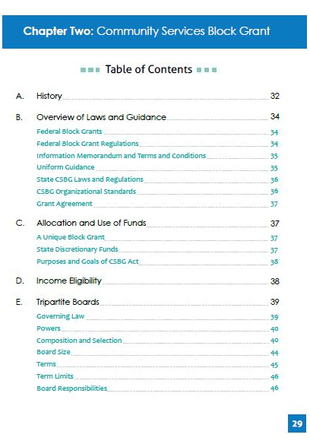
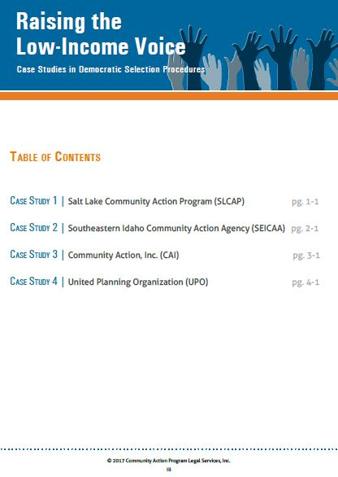
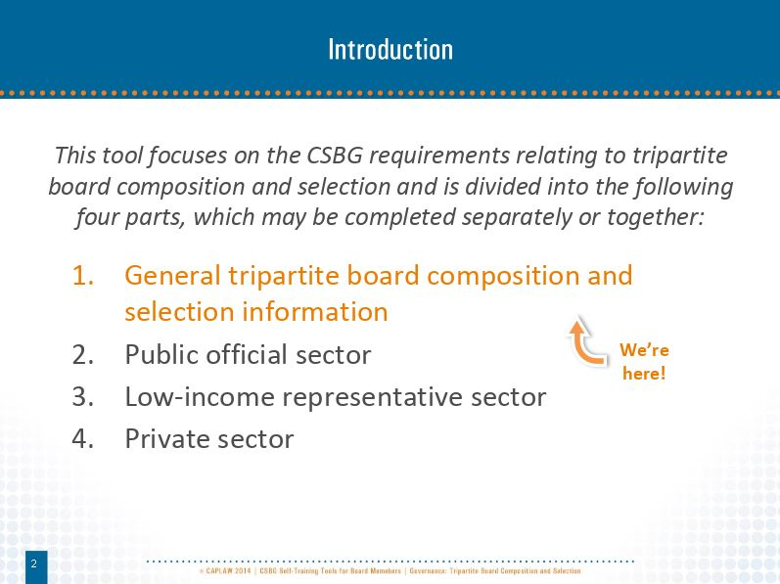
Tripartite Composition Resources
www.caplaw.org
Notes:
CAPLAW has a number of resources that tripartite boards may use to better understand the tripartite board composition requirements in the federal CSBG Act.
For those board members that retain information better from reading it, the CAA Leaders’ Legal Guide includes a chapter solely focused on the federal CSBG Act requirements applicable to tripartite boards, and in particular, the composition provisions in the Act.
For those boards that enjoy a more interactive approach to learning and reviewing information, the CSBG Training Tool for Nonprofit Boards walks through the federal CSBG Act requirements applicable to each of the three sectors. The Tool uses a facilitator’s guide, power point slides and exercises to help boards grasp the requirements.
Lastly, for boards that want to focus more on the democratic selection process requirement applicable to low-income sector representative seats, CAPLAW’s resource, Raising the Low-Income Voice: Case Studies in Democratic Selection Procedures, presents the selection procedures of four different CAAs and includes samples of the documents they use to facilitate their efforts.

Slide 16
HHS Block Grant Regulations
HHS block grant regulations establish that the federal government will generally defer to a state’s interpretation of the federal CSBG Act. True or False
Apply to all block grants issued by the U.S. Department of Health and Human Services (HHS)
45 C.F.R. Part 96
  Subpart I specifically applies to CSBG funding
Notes:
True. The HHS block grant regulations mainly establish that deference is to be given to the state with regards to the interpretation of the federal CSBG Act. Generally, the state’s interpretation of the Act will stand unless it is found to be “clearly erroneous”, i.e., in direct conflict with the federal CSBG Act. It is important for the board to understand the role of the state CSBG office in facilitating the CSBG program and how essential it is for the state CSBG office and CAA to work together to ensure that the CSBG program is successful.
While the HHS block grant regulations apply to all block grants issued by HHS, the regulations also include a few provisions specific to each grant. For CSBG, those specific provisions are found in Subpart I.

Slide 17
OCS Guidance
Guidance issued by the federal Office of Community Services (OCS) in the form of Information Memoranda (IMs) may create new legal requirements that are automatically binding on CAAs. True or False
OCS IM 82 provides guidance to tripartite boards regarding:
  Composition requirements
  Role and responsibilities
Notes:
False. Office of Community Services’ (OCS) Information Memoranda (IMs) are not binding on community action agencies (CAAs). Rather IMs are issued for state CSBG offices, as a state CSBG office is the direct grantee of CSBG funds from OCS. Generally, IMs are guidance and not binding on the state. Even though IMs are directed to the states, they offer CAAs insight into OCS’s interpretation of CSBG program requirements and can be very informative for CAAs.
One IM that is particularly relevant to tripartite boards is IM #82. This IM is the only guidance CAAs have from the federal government that speaks to the tripartite composition requirements and the directive that tripartite boards be fully engaged in the development, planning, implementation and evaluation of the CSBG program.

Slide 18
State CSBG Act and Regulations
CAAs must maintain compliance with state CSBG statutes and regulations, if they exist. True or False
May contain board requirements
  Example, terms and/or term limits, residency
CSBG Organizational Standards
  Standards from OCS IM #138
  Some standards specifically address board composition and responsibilities
Notes:
True. As previously discussed, deference is given to states with regards to the facilitation of CSBG programs. As a result, CAAs must maintain compliance with a state’s CSBG statutes and regulations.
Some states have passed CSBG statutes and regulations that mirror the federal CSBG Act, while others add additional requirements. Examples of additional requirements for boards may include:
Terms and/or term limits for board members. The federal CSBG Act does not address terms or terms limits. A state may impose such requirements and must do so in accordance with other applicable laws, e.g., the state nonprofit corporation act. If a state’s CSBG requirements do not address terms or term limits then it is up to the board to determine what approach works best for the CAA within the parameters, if any, set by the state’s nonprofit corporation act. The CAA’s approach should be reflected in its bylaws.
Residency requirements for board members. The federal CSBG Act does not impose a residency requirement on nonprofit tripartite boards. The federal Act only states that, if a low-income sector representative is selected to represent a specific neighborhood, the representative must live in that neighborhood. However, states may establish residency requirements for all or some of the sectors of the tripartite board.
To date, all states have adopted some form of the CSBG Organizational Standards set forth in the federal Office of Community Services (OCS’s) Information Memorandum (IM) #138. Unlike other IMs, Congress gave OCS the authority to require states to incorporate the Standards in the states’ CSBG statutes, regulations and/or policies. The Standards are one component of a larger performance management system. The purpose of the Standards is to strengthen the organizational capacity of CAAs to serve low-income communities and to increase accountability within the CSBG network.
The Standards are organized in the following three thematic groups comprising nine categories:
Maximum feasible participation, which speaks to the mandate of the CSBG Act to engage the communities being served by CAAs in their programs and decision-making to the furthest extent possible.
Vision and direction, which encompass organizational leadership, board governance and strategic planning.
Operations and accountability, which cover day-to-day operations and management of the CAA, including human resource management, financial operations and oversight and data and analysis.

Slide 19
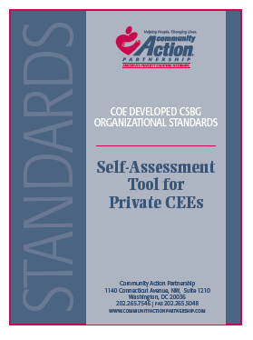
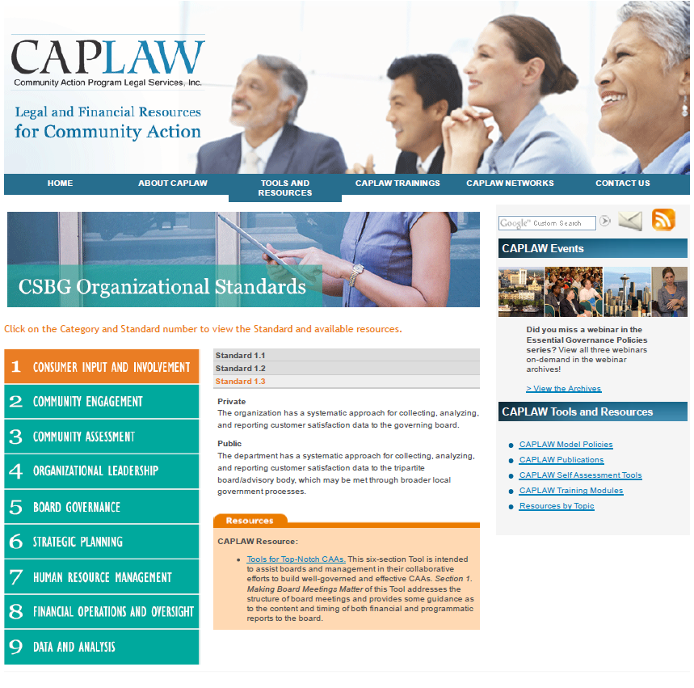
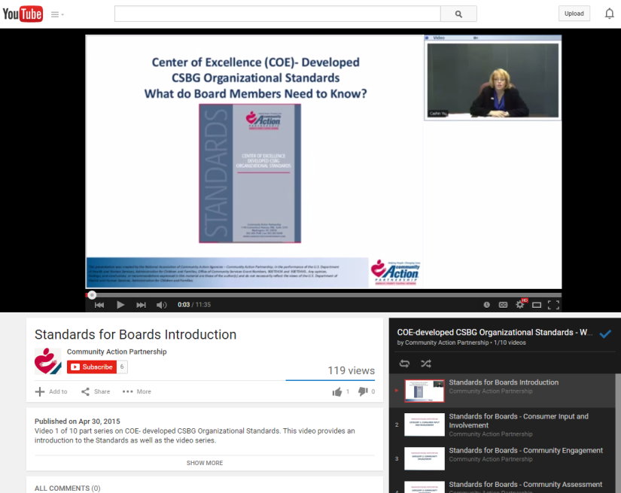
CSBG Organizational Standards Resources
www.communityactionpartnership.com and www.caplaw.org
Notes:
The National Community Action Partnership (Partnership) developed a whole series of technical assistance guides for each of the nine categories of the CSBG Organizational Standards. The guides provide CAAs with information on how to comply with each of the Standards.
The Partnership also created brief YouTube videos for board members to help them understand the Standards and what role the board specifically plays with regards to them.
CAPLAW also developed a resource that helps to connect CAAs with CAPLAW and some Partnership resources that provide guidance on what compliance with a particular Standard may entail.

Slide 20
CSBG Grant Agreement/Contract
CSBG grant agreements/contracts are usually non-negotiable. True or False
Contract/agreement should include citations or references to the state and federal CSBG requirements that apply to the board
  Example, tripartite composition requirement as set forth in the federal and, if exists, state CSBG laws
Notes:
False. A CSBG grant agreement/contract is like any other contract or grant agreement that a CAA enters into—it is subject to change based on negotiations. When the CAA receives its CSBG contract from the state, it should ensure that it fully understands all of its responsibilities under the contract and all of the federal and state laws it must follow. A CAA should have some process in place for reviewing the CSBG contract. The board of directors’ involvement in this process may range from authorizing the executive director to negotiate and sign the contract to reviewing the contract itself. Also, a state CSBG office may require a certain level of board involvement such as requiring the board chairperson to sign the contract.
A CSBG agreement/contract should reference the laws applicable to the CAA and the board and can serve as a helpful reference if confusion arises as to what CSBG requirements a CAA must follow. For example, CSBG agreements/contracts will reference the requirement for CAAs to have a tripartite board as set forth in the federal CSBG Act and the state’s CSBG laws, if they exist.

Slide 21
Other Funding Source Requirements
Federal CSBG Act governance requirements will override other federal funding source governance requirement if the two conflict. True or False
Examples of other funding sources with governance requirements:
  Head Start board composition, conflicts of interest and specific board responsibilities
  Community Housing Development Organization (CHDO) board composition
Notes:
False. The Federal CSBG Act’s governance requirements must be implemented alongside all other federal funding source governance requirements.
One example of another federal award’s governance requirements is the Head Start Act, which requires boards of Head Start grantees to have former or current Head Start parents serve on the board, as well as individuals with legal, financial and early education expertise serve or consult with the board. The Head Start Act also has very specific conflict of interest requirements such as a prohibition against financial conflicts of interests and against paying board members any compensation other than payments for reasonable expenses.
Another example of a federal funding source with a governance requirement that is sometimes difficult for a CAA to reconcile with the tripartite composition requirements is a Housing and Urban Development (HUD) Community Housing Development Organization (CHDO) requirement. The requirement limits the number of public officials or employees of a government entity that may serve on a board of any organization that receives CHDO funding. Because HUD broadly interprets “public officials or employees of a government entity” and only permits exactly 1/3 of the board to be comprised of such individuals, CAAs often struggle when individuals serving in the private sector fall within the definition of a “public official” under CHDO. Examples of individuals who may be considered “public officials” for CHDO purposes include a clerk in the water or sewer department of the local government, a public facility sanitation worker, or a professor of a public university.

Slide 22
A Few Brief Points About How a Board of Directors Operates
Notes:
We could have a whole training on how a nonprofit board operates. However, there are a few key points that are helpful to cover with all board members to ensure that a strong foundation for the board is set.

Slide 23
Board Operations Scenario One
Even though CAA board member Shelia is really proud of all the amazing work the CAA does in the community, she recently became concerned about employee wages at the CAA. After reading an article in the local newspaper about nonprofit employees facing the same financial challenges as the clients they serve, Shelia contacted the CAA’s Human Resources Coordinator and asked to see the salaries for all CAA employees.
Do you agree with Shelia’s approach? Why or Why not?
Notes:
No. It is important that each board member understands his/her her oversight role and how that differs from the role of management. The board’s role with respect to operational activities such as setting employee salaries (other than the executive director’s) or addressing other human resources (HR) matters involves overseeing the policies developed by the staff at the direction of the executive director and ensuring compliance with those policies. The board has one employee and that is the executive director. The board authorizes its one employee to help develop, manage and execute policies reviewed and overseen by the board.
In some cases, the board may authorize a committee of the board to consider and make a recommendation to the full board about issues relating to personnel policies, wage comparability studies, and organization-wide salary scales. When conducting a more in-depth analysis in each of these areas, board committees should focus on the position at issue and not on the specific employee that holds that position. Board members rarely need to be provided access to personal employee data and, in those unusual instances in which they are given such data, the information should be shared only on a need to know basis in connection with official board business. Some types of sensitive employee information, such as health or financial information, may be protected by various confidentiality or privacy laws and would not generally be available to board members.
CAPLAW developed a resource several years ago to help board members better understand the role they play as Community Action board members and how they can best work with the executive director to fulfill that role. See CAPLAW’s Dynamic Duo: A Guide to Enhancing the Board & Executive Director Partnership.

Slide 24
Operation Framework
Board of Directors
The board acts only as a body
  Opportunity for group discussion and deliberation is important
Sole employee of the board is the executive director
Executive Director
Staff
Staff
Notes:
The board of directors acts as one body comprised of multiple individuals that must work together for the best interest of the organization. To successfully act as one, cohesive body, the board must provide for robust discussions and deliberations and often does so through meetings, agendas and retreats. The executive director is the sole employee of the board and is authorized by the board to hire, fire and manage staff. Board members generally communicate with other staff about organizational business through the executive director.

Slide 25
Operation Framework
Individual board members only act on behalf of the board:
  When authorized by the full board to do so AND
    Officers, committees
  Typically, via the executive director
    Caveat: a few exceptions exist
Notes:
Certain times exist when board members may act in their individual capacity as board members on behalf of the full board. Implementing a board/staff/3rd party communication policy is one way to educate all board members about the proper communication process and can serve as a point of reference if confusion arises.
The policy should reinforce that board members should only speak on behalf of the full board when authorized by the board of directors or executive director to do so. Officers of the board or a committee often have the authority to act on behalf of the board or committee by nature of the office held. While board members should typically speak with individual staff members via the executive director, a policy would outline the limited situations when it would be appropriate for board members to consult directly with staff.

Slide 26
Board Member/ Staff Contact Examples
Board of Directors
Direct Contact
3. Seek staff input on ED evaluation
Via the ED
Executive Director
1. Coordinate board meeting logistics with staff admin
4. Reports of fraud, misuse of resources, discrimination or harassment involving the ED
2. Staff liaison assists with board committee business
Staff
Staff
Notes:
A board/staff/3rd party communication policy would outline the limited situations when it would be appropriate for board members to consult directly with staff. Examples of such situations would include:
board members communicating with an administrative staff person (sometimes referred to as a board liaison) who coordinates the logistics of board and committee meetings;
board committee members communicating with staff liaisons (for example, finance committee members communicating with the finance director) about committee business;
personnel committee members communicating with staff to gather input for the executive director’s evaluation if the board’s evaluation process includes obtaining such input.
A complaint of suspected or potential fraud, misuse of resources or property, or discrimination or harassment involving the executive director would be reported to the board or a designated board committee in accordance with the organization’s whistleblower policy. Procedures detailing the process for reporting such claims should be included in that policy.
Such a policy on board-staff communication is intended to prevent the board from micro-managing the staff and circumventing the executive director’s role in supervising the organization’s staff.

Slide 27
Board Operations Scenario Two
Tony has been on the board for two years and L VES it! His fellow board members are very personable and friendly but Tony is continually confused about the vote that is required to take actions as well as the number of meetings board members are required to attend.
What should Tony do?
What should the Executive Director do?
Notes:
See next slide for the answer.

Slide 28
Board Operational Guide
Bylaws serve as an organization’s operational guide
See bylaws for information about:
  Board member composition
  Meeting frequency, notice
  Officers
  Committees
  Votes, quorum
  And more. . . .
Bylaws
Article I
Thou shall read the bylaws.
Notes:
Tony has a number of options to figure out the appropriate way for the board to operate. The information Tony is seeking should be in the CAA’s bylaws. The bylaws serve as an operations guidebook for the organization and should include the information board members need to know to properly conduct meetings and take actions.
The board of directors should make the bylaws available to all board members and educate the board members about the information in them. Since Tony is new he may not fully understand the importance of the bylaws and may contact the executive director or the board chair for answers to his questions. The executive director should work closely with the board chair to assist in educating board members about the bylaws and the way in which the board operates.

Slide 29
Board Committees Exercise
An executive committee may have authority to act on behalf of the full board. True or False
Most board decisions may be made in the executive committee and reported to full board. True or False
Boards may use both standing and ad hoc committees. True or False
Committees that solely make recommendations do not need to take minutes or record meetings. True or False
Board approval is not required to seat either board members or non-members on committees. True or False
Notes:
Tripartite boards, like boards of other nonprofits, conduct board business with the help of board committees. Thus it is important that board members understand how to properly use and work with committees. This exercise is intended to help board members identify what they do/don’t know about committee structures.
True. The authority of a committee to act on behalf of the full board may be dictated by your state’s nonprofit corporation act and should be reflected in the bylaws. Often the state nonprofit corporation act specifies that certain actions may not be taken by a board committee (e.g., vote to dissolve the organization). A CAA’s bylaws should include those restrictions. Also some state CSBG laws impose composition requirements on committees that have the authority to act on behalf of the full board. An executive committee is typically the only committee given the authority to act on behalf of the full board.
False. A board may delegate some authority to an executive committee but the full board should review and vote on most decisions. As we discussed in the part of the presentation about the role of the tripartite board, all board members have fiduciary duties that require them to be actively engaged in decisions made by the board. An executive committee typically helps to move along routine matters that occur in between board meetings and can quickly convene for emergencies.
True. Standing committees are designated in the bylaws and typically consist of the following: financial/audit, personnel, governance and executive. Standing committees may also exist for larger programs run by the CAA, such as Head Start. Ad hoc committees are created as the need arises and the bylaws typically address a nonprofit’s ability to establish them. Examples of when ad hoc committees may be created include: to address an adverse monitoring report, develop a fundraising event, secure a facility for the CAA, etc.
False. Minutes of committee meetings should be taken and maintained with board records, particularly for committees that exercise board authority. The way in which committees operate should be established in the bylaws and generally will reflect the way the full board operates especially with respect to meetings and minutes. Also, the state nonprofit corporation act may require committees to follow the same meeting procedures as the full board and, if such is the case, this should be reflected in the bylaws. Committees should have charters that establish their purpose, composition and methods of operation. Think of a committee charter as a mini-bylaws for a board committee.
False. Typically, a state nonprofit corporation act will require the board to vote to create a committee and appoint committee member. This requirement should be reflected in the CAA’s bylaws. Even if the nonprofit corporation act does not speak to committee formations and/or selection of members, the board should develop a procedure for doing so and maintain control over who sits on committees. Usually, non-board members may sit on board committees so long as those members do not participate in actions that may be taken on behalf of the full board. For example, if the board is in the process of reviewing the CAA’s personnel policies and no current members have expertise in human resource (HR) matters, the board may ask an HR consultant or expert to participate in personnel committee meetings to help with the review of the policies and the recommendations that the committee will make to the full board.

Slide 30
Board Committees
Committee work is essential to smooth and efficient operation of board and CAA
  Executive directors are not committee members
Most state laws permit board members to rely on information provided by committees
  But board members must have a reasonable basis for believing that committee is competent source of information
Regular review of committee structure is recommended
Notes:
A board often relies on committees to divide the work, build on the expertise of individual board members, and develop recommendations and solutions to problems. Some boards may decide to delegate decision-making authority to committees (assuming state law permits such a delegation), but the recommended practice is to have committees report to the full board with background information and to make recommendations for board action.
Generally, executive directors of nonprofits do not also serve as board or committee members but rather act as a resource for the board and its committees to ensure that each is receiving the information needed to successfully execute their duties. The federal funding that a CAA receives also makes it difficult for executive directors to serve as board or committee members. The federal CSBG Act tripartite board structure limits the eligible board seats for which a CAA’s executive director could fill—essentially only the private sector seats or as a public official representative. Moreover, the Head Start Act specifically prohibits board members from receiving compensation for providing services to the organization and also prohibits the organization from employing board members and their immediate family members.
The committee structure is typically recognized in the state nonprofit corporation act. The act will often include language that enables board members to rely on information from committees so long as the board member has a reasonable basis for believing the committee is an accurate source. A committee charter describing the committee’s role and how it will operate should help establish the committee’s responsibilities.
A board should carefully consider and periodically review the committee structure and the powers delegated to committees. When reviewing its bylaws, a CAA should revisit its committee structure to determine if reliance on committees is properly balanced with the engagement of the full board and what type of committees are useful to the organization. The bylaws should include a brief description of the standing committees and each committee should be supported by a charter.

Slide 31
Role of Tripartite Board
Notes:
A nonprofit board generally has the authority under its state nonprofit corporation act to manage all of the affairs of the organization. Legally, this means that the tripartite board IS the organization. Thus, it is crucial that board members understand the legal obligations that arise from this very crucial role that they play.

Slide 32
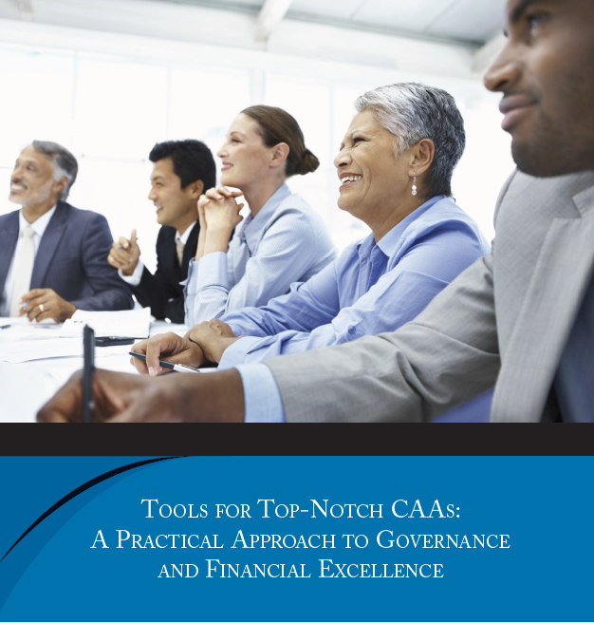
Fiduciary Duties
Nonprofit Board Members
Duty of Care – Diligent
  Acting with the care of a prudent person in similar circumstances
  Asking hard questions
  Reading materials
  Deliberating the decision
See page 9 of the Toolkit for more on fiduciary duties
Notes:
Under state law, every board member of a nonprofit CAA is a fiduciary of the organization and thus, owes a duty of care and a duty of loyalty to the organization.
The duty of care is a standard of diligence. Generally, board members are not subject to liability for decisions made as board members of an organization if the board has exercised the duty of care. The duty of care is a requirement to exercise diligence and deliberation – board decisions must be made via a deliberative process. Assessing whether board members have fulfilled their duty of care involves asking questions such as – was a decision based on facts that were developed through an orderly process, or did the board just do what felt right at the time of the decision?
The duty of care is evaluated from a reasonable person standard – a board member must exercise the care that an ordinarily prudent person would exercise under similar circumstances. Attending board meetings, reading board materials, asking hard questions are all factors that are considered when determining if a board member has met his/her duty of care.
Even if the board’s decision turns out to be a bad one, it has discharged its duty of care if the decision was the result of a deliberative process that involved a weighing of facts and alternatives.

Slide 33
Role of Tripartite Board Scenario
The board is considering whether to begin an afterschool college prep program. Its board chair asks board members, Larry, Marsha, and Devon to review the staff’s preliminary research and make a recommendation to the full board on the program’s potential impact and financial viability.
As a committee, they examine proposed budgets, a needs assessment, staffing and training requirements, and survey data from CAAs with similar programs. They question staff and then prepare a 10-page report for the full board, recommending the program. At its next meeting, following a 90-minute discussion, the board unanimously votes to fund the program.
Unfortunately, after a year, the program is much more expensive than the initial projections and youth participation lower than expected. The board has no choice; it must end the program.
Notes:
See next slide for question and answer.

Slide 34
Duty of Care Scenario
Did the board fulfill its duty of care? Why or why not?
  Board committee tasks
    Review mission
    Review needs assessment
    Examine proposed budgets
    Assess staffing and training requirements
    Collect data from others with similar programs
    Question staff
    Prepare report for the full board, with a recommendation
  Full board:
    Engage in discussion prior to vote
Notes:
Even though the board’s decision turned out to be a bad one in hindsight, the board likely satisfied its duty of care. It based its decision on an informed and thoughtful process. A board committee was formed to conduct the preliminary research for the program and prepared a 10-page report for the board after examining budgets, needs assessments, staffing/training and data from similar programs. The report included recommendations which the board considered as part of a 90 minute discussion. The board then voted unanimously to fund the program. This is a good example of how the duty of care can protect a board member from liability that may arise from decisions which result in unsuccessful projects.

Slide 35
Fiduciary Duties
Nonprofit Board Members
Duty of Loyalty – Faithful to CAA
  Act in good faith and in the best interests of CAA
  Disclose and avoid conflicts of interest
  Not engage in self-dealing
See page 9 of the Toolkit for more on fiduciary duties
Notes:
As previously mentioned, under state law, every member of a non-profit CAA tripartite board is a fiduciary of the organization and thus, owes a duty of care and a duty of loyalty to that CAA.
The duty of loyalty is a standard of faithfulness – a board member must give undivided allegiance to the CAA and its mission when making decisions affecting the agency. This means that a board member can never use information obtained as a board member for personal gain (or self-dealing), but must act in the best interests of the agency. Board members must disclose and avoid conflicts of interest and recuse themselves from any decisions that might result in personal benefit.

Slide 36
Duty of Loyalty Scenarios
Are any of the following a duty of loyalty dilemma? Why or why not?
  An elected public official board member votes only for programs that support the constituents he represents, which make up 1/3 of the CAA’s service area.
  A private sector board member’s neighbor is a real estate agent and has offered to help the CAA find a new facility for a reduced fee.
  A low-income representative sits on the board of another social service provider that sometimes competes for the same grants the CAA is seeking.
Notes:
Duty of loyalty dilemmas arise when a board member has an actual or perceived conflict of interest. Conflicts of interest exist whenever an individual who has authority to make or influence decisions affecting the CAA, such as a board member, has a personal incentive (often financial) to influence the CAA to take or not take a particular action.
Not all conflicts of interest are objectionable – the goal is to develop a clear process to define conflicts, establish mechanisms to disclose potential conflicts and outline a process and criteria to determine whether a transaction involving a conflict is acceptable.
This elected public official is arguably not meeting his duty of loyalty. An elected public official like all of us has multiple interests he/she is trying to further and promote. An elected public official’s divided interest are seemingly more obvious since he/she was specifically elected to serve constituents in his/her district. However, when an elected public official is in his/her role as a CAA board member, the duty of loyalty obligates him/her to put the needs and best interests of the CAA first. This does not mean that the elected public cannot consider the interests of his/her constituents, especially those served by the CAA, but it does mean that decisions made by an elected public official as a CAA board member must encompass ALL of the CAA’s clients’ needs, which may not always be in line with the elected public official’s constituents’ needs.
If policies are followed, then a duty of loyalty dilemma, if any, should be addressed. In rural areas it is often difficult for board members to maintain complete independence from those that the CAA may do business with. This does not mean that the CAA may not enter into a business arrangement with an individual who has a relationship with a board member. Rather processes and procedures must be put into place and followed to ensure that board members are fulfilling their duty of loyalty, i.e., acting in the best interest of the CAA, and not in his/her own best interest or in the interest of others with whom the board member has a close relationship. In this instance, the CAA should follow its conflicts of interest and procurement policies to guard against the private sector board member receiving a personal benefit from the transaction and to establish that the arrangement meets the needs of the CAA. Likely the board member would need to disclose the relationship with his/her neighbor and may need to recuse him/herself from deliberations and votes related to the transaction.
The CAA may resolve any duty of loyalty dilemma that may exist by educating the board member on the duty of loyalty and the CAA’s policies. Like the elected public official, the low-income representative has potentially competing interests that he/she is managing. It is important for this (and all) board members to remember that when they are serving as the CAA board member they must wear their CAA board member hat and focus on the best interest of the CAA. The board member should follow the CAA’s conflict of interest policy to disclose actual or potential conflicts of interest and recuse oneself when necessary.

Slide 37
Duty of Loyalty
Conflicts of interest policy
  Protects CAA
Applicable requirements
  Funding source requirements
    Example, CSBG Organizational Standard 5.6, Head Start Act prohibited financial conflict of interest, Office of Management and Budge (OMB) Uniform Guidance
  Form 990
Notes:
As discussed with the duty of loyalty scenarios, conflicts of interest policies protect CAAs from a number of difficult, and some times troubling scenarios, such as: disallowances; negative public perceptions; diversion of assets for public, charitable purposes to an insider for a private benefit (i.e., a benefit that enriches one individual or a small group); and potential loss of tax-exempt status and government funding.
Recognizing the importance of a board member fulfilling his/her duty of loyalty, many federal funding sources impose conflicts of interest requirements on grant recipients. Fore example, the Community Services Block Grant (CSBG) Organizational Standards (Standard 5.6) requires board members of nonprofit CAAs to sign a conflict of interest policy within the past 2 years.
About 50% of CAAs receive Head Start funding which includes very specific provisions addressing when conflicts of interest arise and actions that the grantee must take when they do. For example, an immediate family member of a board member may not be employed by a Head Start grantee and board members with a financial conflict of interest may not serve on the board. Head Start does not define what is a “prohibited financial conflict of interest”; however, CAPLAW’s sample conflict of interest policies offer guidance that grantees may find helpful when devising their own definition.
The Uniform Guidance is a set of federal grant rules governing the use of federal funds and the systems that must be in place to safeguard them. The Uniform Guidance includes a code of conduct requirement for procurement (i.e., purchase of goods and services) that requires board members and key employees who participate in the selection, award, or administration of a contract paid out of federal funds to disclose if he or she has a real or apparent conflict of interest.
Also, the Form 990 is the informational return that tax-exempt organizations must file with the Internal Revenue Service on a annual basis. The Form 990 requires CAAs to answer questions acknowledging whether board members and key employees sign annual disclosure forms and if the CAA regularly monitors and enforces its conflict of interest policy.

Slide 38
Who Does What Around Here?
Fill in the Action
Role | Board of Directors | Executive Director
Policy Action: establish, execute
Mission Action: set, accomplish, review, update
Performance Action: sets targets, evaluates, updates, executes, accountable for
Employees Action: supervise executive director, supervise staff
Establishes
Executes
Sets, Reviews, Updates
Accomplishes
Sets targets, Evaluates, Updates. Accountable for
Executes, Accountable for
Supervise executive director
Supervise staff
Notes:
Confusion often arises with board members not fully understanding their roles in the organization. Maintaining a fine balance between the board ‘s role and the actions the board takes to fulfill that role versus the executive director’s role and the actions he/she takes, can be tricky. This exercise encourages board members to recognize and discuss their understanding of a few of the different roles and actions each very important contributor to the organization plays.
The default for the board is that the board is the “overseer and big picture thinker” whereas the executive director is the “doer.” While in reality there is definitely overlap, keeping this default in mind will help boards and executive directors basically “stay in their lanes.” Generally the actions each party takes with regards to each role are:
Policy: The board establishes the organizational policies while the executive director executes them. This often means that the board will recognize the need for a policy and assign a board committee to oversee the development of the policy by staff. On rare occasions, a board committee may fully develop the policy itself.
Mission: The board is the leader with regards to establishing, reviewing and updating the mission whereas the executive director and his/her staff focus on achieving/accomplishing that mission. Even though the board takes the lead on mission development, the executive director plays a crucial role in the process by informing the board about the needs driving the work and guiding the development of that mission.
Performance: Performance is tricky because it encompasses both programmatic and operational performance. However, the actions that the board and executive director take to fulfill the roles for each is similar. For both programmatic and operational performance, the board is regularly evaluating how the organization is doing. The board sets overarching performance and operational targets that are updated based on evaluations and the board is ultimately accountable for the organization’s successes and challenges. The executive director is guiding the organization’s work to meet the targets set by the board and is also accountable for the performance of the organization. As part of that accountability, the executive director will likely engage in a level of evaluating and revising the work being done to meet the overarching goals and targets set by the board.
Employees: The board supervises and evaluates one employee, the executive director. The executive director is authorized by the board to manage and supervise the staff of the organization. As discussed in greater detail in the section of the presentation “A Few Brief Points about How the Board Operates,” there are a handful of instances when the board would work directly working with staff.
Note to presenter: As you will see, in the “Role” column, under each topic is a list of actions that may be taken to fulfill the role with respect to the topic. Note that for some roles actions may be applicable to both the board and the executive director. The workshop participants either individually or in groups should assign actions to the board and the executive director with regards to the topic listed. The table is animated, so once the workshop participants have completed the exercise and are ready to report out, the presenter can either ask for volunteers or assign individuals/groups to answer. Encourage workshop participants to explain their thoughts behind assigning actions to each party for a specific role.

Slide 39
Common Board Missteps
Other examples?????
What board actions counter these missteps?
Not discussing critical issues
Too much deference to executive director
Board members acting as individuals
Micromanagement
Notes:
The CAA board’s task is to find the middle ground—not get too involved in day-to-day management, but be willing to ask questions about specific issues and concerns, to gather facts and data to support decisions, and to interact with senior management as needed. Along the way, the board must keep its focus on the overall mission and what policies and programs will support it. The primary—although not exclusive—venue for effective board oversight is the board meeting.
Micro-management. Thorough oversight should never be confused with board involvement in day-to-day management decisions. As a general rule, boards do not directly interact with frontline staff or operations. That is senior management’s role. The board member who decides to attend weatherization staff performance evaluations or the board member who offers classroom management suggestions to a Head Start teacher has crossed the line into micro-management.
Board members acting as individuals. It is important for individual board members to remember that they are part of a larger body and that to properly fulfill one’s fiduciary duty of loyalty (i.e., obligation to act in the best interest of the organization) a board member should act at the direction of the full board and not pursuant to individual motivations or concerns. If an individual board member is concerned about organizational matters, the board member should either contact the board chair or executive director with that concern. This should then result either in the full board or a committee of the board discussing the matter and making a determination that represents the full board and the best interests of the organization.
Too Much Deference to the Executive Director. Some boards view their role as cheerleaders, with the board deferring to the executive director in all matters. While this often happens when the executive director has significant input into the selection of board members, some boards simply don’t understand their oversight role. The board should be supportive of the executive director, sharing board’s insights and expertise, but there also needs to be some institutional tension between the board and the executive director. The board’s primary function is to evaluate the executive director’s performance and progress in accomplishing the mission. A board that becomes too deferential to the executive director inevitably will be deficient when it comes to discharging the specific functions assigned the board, namely assessing the adequacy and utilization of the CAA’s financial and other resources, setting broad policy, and ensuring an adequate system of checks and balances is in place. It is therefore incumbent upon the board and the executive director who is faced with this situation to act intentionally to devise and implement strategies and processes to empower the board. This may be done, for example, through changes in bylaws, board size, committee structures, or review and approval procedures for policies and financial matters. What may be most important, however, is setting the right tone and meeting structure to encourage questions and comments from board members.
Not discussing critical issues. Sometimes it is easier to sweat the small stuff rather than grapple with the big questions of the day. Boards must strike a fine balance between regularly reviewing operations while engaging in the strategic decisions that will sustain the organization. Boards can shift meetings to focus on the more critical issues by using committees to either help manage the more routine oversight functions or research and report back on more critical matters. Boards can streamline and rework their meeting agendas to focus on strategic discussions and send materials in advance of meetings so board members can arrived to meetings prepared and ready to think through the more pressing organizational matters.
Note to presenter: As you will see this is an animated slide with each block falling down on the seesaw on at a time. After you work through each block, we encourage you to ask the workshop participants if they have any other examples of common board missteps and have the group discuss those. Also, note that with each discussion of a misstep we include action steps a board may take to counter the misstep.

Slide 40
Key Responsibilities of the Tripartite Board
Notes:
Unpacking what it means for board members to manage all the affairs of a nonprofit corporation can seem daunting and overwhelming. For nonprofit CAAs, a board member’s responsibilities are often driven by the requirements of the state and federal funding they receive. For example, the federal CSBG Act requires board members to be fully engaged in the development, planning, implementation and evaluation of the CSBG program.
The following section unpacks a board’s responsibilities as managers of the corporation and pursuant to funding source directives by focusing on key responsibilities that encompass many of the actions board members must take to effectively fulfill their duties.

Slide 41
Key Board Responsibilities
Mission
Planning
Engagement
Generating Funds
Performance
Accountability
Notes:
CAPLAW has identified 6 hallmarks of an effective tripartite board. Engaged boards acting and monitoring in these key areas are likely to be meeting and exceeding the governance requirements applicable to them. As we work through each of the six characteristics we will discuss how they tie in with the tripartite board’s responsibility to be fully engaged in the development, planning, implementation and evaluation of the CSBG program. We will also show how many of the CSBG Organizational Standards, especially those specific to a board’s responsibilities, are met through fulfilling these key responsibilities.

Slide 42
Key Board Responsibility
Mission
Notes:
Our first focus is the mission of an organization. The mission is the reason your organization exists and is therefore the most important statement your organization makes. A mission statement seems simple but is actually quite complex as it serves multiple purposes, which we will discuss in greater detail.

Slide 43
Know Your Mission Exercise
Write down your organization's mission
  If you don’t know it exactly, write down the gist
Briefly describe 3 ways in which your board works with your organization's mission
  For example, we discuss it in relation to new proposals or recite it at every meeting
Think about 1 way in which your board could better incorporate the CAA’s mission in its board meetings and activities
Notes:
Take a moment and write down your organization’s mission statement. If you don’t know it verbatim, don’t worry, write down the gist of it. After you have done that, either team up or work in a small group and describe three ways in which your board works with the organization’s mission statement. For example, your board recites the mission statement at the beginning of every board meeting or each board member is provided a copy of the mission statement when a new proposal is being reviewed and discussed. Lastly, after you’ve completed your discussions with your partner or group, take a moment and jot down one way your board could better incorporate the CAA’s mission statement in board meetings and/or activities.
Note to Presenter: you could ask for a few volunteers to report out or you could move forward with the presentation and, as you work through the remaining slides in this section, have participants revisit their exercise responses.

Slide 44
Why Mission Matters
Why mission matters:
  Provide clarity of purpose to stakeholders
  Guide major decisions
  Prevent “mission creep”
Why do you think mission matters?
Notes:
As previously mentioned, the mission statement serves as the driving force behind your organization. A CAA’s mission is thus very important for a number of reasons including:
A mission statement helps provide clarity to and unify stakeholders. Unlike for-profit corporations, whose purpose is generally to “maximize shareholder value,” nonprofit organizations lack inherent clarity of purpose. Further, nonprofits often have multiple stakeholders who have various and conflicting expectations.
A mission statement guides all major decisions that a nonprofit must make (especially which programs/projects to undertake, which to avoid, and which to stop doing).
The mission statement also ensures that an organization will resist “mission creep.” Having a clear mission that the board, staff and key stakeholders can come around helps the organization resist the temptation to expand into programs and services where it lacks appropriate skills and resources. There are many external and internal pressures that will cause mission creep in the absence of strong and intentional pushback. Mission creep can stretch an organization’s resources so thin and far that it can no longer effectively pursue its goals.
Note to presenter: This slide is animated so you can ask workshop participants if they have anything to add with regards to why mission matters to an organization.

Slide 45
Board Role and Mission
Review
Update
Use
Mission
Notes:
The board’s relationship with an organization's mission is multi-faceted and we will specifically talk about each of these facets. The board not only reviews and updates, when necessary, the mission, but it is also regularly using the mission to guide its actions and fulfill its responsibilities.

Slide 46
Review Mission
A good mission statement:
  Is focused
  Solves unmet needs
  Leverages unique skills
  Inspires key stakeholders / is memorable
Notes:
A good, effective mission statement embodies several characteristics.
First, it is focused and specific. A mission statement should not be so broad and encompass so many activities that it is impossible to measure whether the organization is actually achieving any of its goals. If the mission statement is too long (e.g., half a page vs. a single sentence) and is difficult to remember, then it is not likely to be very memorable or effective.
Second, the mission should focus on unmet needs that your organization believes is worth tackling. This communicates why your organization exists and the motivation behind its activities.
Third, the mission statement should help your organization leverage its unique skills. It is important for the statement to reflect the uniqueness of your organization and the values that define it.
Finally, a mission statement should also inspire key stakeholders. Board members should be able to readily recite the mission. If very few stakeholders know and understand the mission of their organization, likely very few of them will feel any degree of passion or commitment toward it.

Slide 47
Update Mission
Producing an effective mission statement often involves:
  Commitment from the top
  Participation by a wide range of stakeholders
  A well defined revision process
  Determination of key components
  Careful crafting – active, concise, specific
CAPLAW Article
Mission Possible: Understanding & Developing an Effective Mission Statement
http://caplaw.org/resources/articlesbytopic/Governance/CAPLAW_EffectiveMissionStatement_Fall2010.pdf
Notes:
There are as many ways to update and rework a mission statement as there are mission statements. However, there are several constants in the process that help produce an effective mission statement. These constants are: (1) commitment from the top down and (2) participation from a wide range of stakeholders.
Defining the process by which an organization will revise its mission statement helps in producing an effective one. Even though the exact process depends on a CAA’s specific needs, one common, often fruitful method, is to conduct a retreat with a representative group of stakeholders, such as board members, community leaders and members, staff, and clients. The retreat may take the form of a part-day or full-day session in a conference room or an off-site gathering over a longer period of time. This approach demonstrates the commitment of top management to the mission statement development process and it gives many different stakeholders an opportunity to share their views of the CAA’s mission. If not a retreat, then a series of meetings may suffice and ease the time commitment on the stakeholders. Additionally, surveys could be used to obtain the input of stakeholders.
After defining the process, it is important to determine the key components of the mission statement. The goal is to generate a list of specific items that define your organization. At this stage it is critical to have a wide selection of stakeholders involved. Some questions to ask include: what does your CAA do on a daily basis?, how does your CAA achieve its mission?, who is impacted by your CAA?, where does your CAA operate?, does your CAA have specific values that set it apart from other organizations?
The responses to these questions could be elicited from the group in written survey form or as a group activity. The answers will form the building blocks for the next stage of the process in which the mission statement is drafted.
An effective mission statement also requires careful crafting. This mission statement must contain enough substance to appropriately convey the mission of the CAA but be concise enough so that the CAA’s stakeholders can easily memorize and recite it. There are no universally applicable rules here, but some helpful guidelines are: state the mission actively (for example, CAA [verb]); keep the mission statement short, but provide enough detail to make decisions based on the mission statement (for example, if someone proposed a new program during a board meeting, could the mission statement provide guidance as to whether the suggested program would be consistent with the mission of the organization?); and stick to specifics.
For example, if a CAA were to decide that its mission components are (1) reducing the impact of poverty; (2) by offering job training, housing assistance, and social services; (3) in Tremont County, then an effective mission statement could be: Tremont County Community Action Agency, Inc. is a nonprofit, 501(c)(3) organization that, by mobilizing public and private resources and coordinating a comprehensive network of educational, economic and social services in Tremont County, reduces poverty and enables low-income people in Tremont County to become self-sufficient.

Slide 48
Mission Revision Exercise
Your organization has died and at the memorial service for the organization with all of its stakeholders present, a spiritual leader states:
  Here lies [fill in the organization’s name]. It is an organization that was loved and will be missed. It will be remembered forever for:______________.
- Dr. Lisa McNary, NCSU
Notes:
Dr. Lisa McNary, a management consultant and instructor at North Carolina State University recalled her mentor, Dr. W. Edwards Deming, describing the following exercise as useful in developing a mission statement. Ask the top managers this:
Your organization has died and at the memorial service for the organization with all of its stakeholders present, a spiritual leader states, “Here lies [fill in the organization’s name]. It is an organization that was loved and will be missed. It will be remembered forever for:_____________________”
What goes in the blank is the essence of the organization’s mission.
Note to Presenter: Depending on the time, you could have the participants conduct this exercise either by themselves, with a partner or in a small group.

Slide 49
Use Mission
Ways boards highlight and use the mission:
  Recite at board meetings
  Reference in meeting agenda
  Include on business cards
  Discuss in relation to all board actions
Notes:
Reviewing and updating the mission is only part of the board’s responsibility with regards to the organization’s mission. The most important role the board plays is to use the mission to guide all of the organization’s actions and make sure the executive director is doing the same with staff. For example, understanding and using the mission might lead the organization’s staff to say “no” to attractive funding opportunities or compelling programs that are not aligned with their mission in order to say “yes” to going deeper in programs that do align with the mission.
There are multiple ways a board can ensure that it is regularly using and incorporating the mission into its activities. These include:
Reciting the mission at the beginning and/or ending of a board meeting. This will serve as a reminder to all board members of the important work they’ve been tasked with directing and overseeing.
Referencing the mission at the top of the meeting agenda. This is a great way to remind board members that the mission serves as the backbone for all actions to be taken by the board.
Including the mission statement on board member business cards. This helps board members remember and recite the mission when meeting with the community and stakeholders
Discussing the mission in relation to all board actions. Including the mission on the meeting agenda to serve as a reminder is even more effective if board members actually make a point of referencing the mission when discussing board actions.

Slide 50
CSBG Organizational Standards
Mission
CSBG Org. Standard 4.1:
Governing board has reviewed the organization’s mission statement within the past 5 years and assured that: (1) The mission addresses poverty; and (2) The CAA’s programs and services are in alignment with the mission.
CSBG Org. Standard 3.1:
Governing board formally accepts the completed community assessment.
Organization has conducted a community assessment and issued a report within the past 3 years.
CSBG Org. Standard 3.5:
Notes:
Reviewing, updating and using the mission are board responsibilities reflected in the CSBG Organizational Standards. The Standards specifically direct board members to review the organization's mission every 5 years to ensure that it address poverty and that the CAA’s programs are in alignment with the mission. We just discussed how a board reviews, updates (if necessary) and uses the mission statements – all of these actions show that the board is meeting this Organizational Standard.
Several other CSBG Organizational Standards that are related to the board’s role with respect to the organization’s mission include Standards 3.1 and 3.5. These Standards require the organization to conduct a community needs assessment, issue a report about the results, and have the board formally accept the completed assessment. The community needs assessment will help educate the board about the needs in the areas served by the CAA and subsequently inform a CAA’s review of its mission.

Slide 51
Key Board Responsibility
Planning
Notes:
A significant responsibility of the tripartite board is to set the direction for the organization. The planning required to do so involves, among other tasks, assessing needs, reviewing existing programs, forecasting future financial stability and growth, and making (sometimes tough, sometimes exciting) decisions about the future. Planning also requires constant assessing and revising. In this section, we will discuss the planning CAAs are required to engage in because of the CSBG funding they receive and a few tools and resources a board may use to help frame and focus its planning efforts.

Slide 52
Planning Exercise
Name at least one of each of the following in relation to your CAA:
  Strength
  Weakness
  Opportunity
  Threat
Notes:
A board member’s responsibility to engage in planning is sometimes difficult to fully grasp because such efforts are not as concrete as other board responsibilities. To better understand what engaging in planning might look like, ask workshop participants to engage in what is often referred to as the SWOT exercise. SWOT stands for Strength, Weakness, Opportunity and Threat. A SWOT analysis is used by boards to help build an organization’s strategy. Each workshop participant should take a moment to identify each of the following in relation to their organizations:
Strengths (e.g., sole provider of a service, passionate volunteers, loyal donors, clear vision and history). Questions to consider:
What does your organization do better than others?
What advantages does your organization have?
What do others see as your strengthens?
Weaknesses (e.g., small volunteer base, high staff turnover, lack of external communications). Questions to consider:
How could your organization improve?
What do others see as your weaknesses?
Opportunities (e.g., develop partnerships, expand volunteer and client base through robust communications, increase number of loyal donors, explore enhancement to or development of programs). Questions to consider:
What opportunities are you aware of?
What are new developments in the sector?
Threats (e.g., measuring success is difficult, cash flow/external costs, bad publicity). Questions to consider:
What obstacles does your organization face?
Could weakness threaten your organization’s sustainability?
Working through a SWOT analysis is one way for board members to develop a deeper understanding of their organization’s operations and efforts needed to further the mission. This understanding plays a crucial role in a board’s meeting its responsibility to think strategically about the organization’s future and planning accordingly.

Slide 53
Planning Under CSBG
Community Action Plan
3-Year Review
(Community needs assessment/CSBG-specific)
Strategic Plan
5-Year Review
(Organization-wide)
Notes:
The federal CSBG Act and CSBG Organizational Standards require that the board oversee two types of planning efforts by the CAA. Preparing the community action plan, which is specific to CSBG-funded activities, is specifically required by the federal CSBG Act. The plan involves the CAA conducting a community needs assessment to identify the population to be served and the assistance needed. These efforts often involve reviewing publicly available data such as the most recent census report, and engaging staff to develop surveys and conduct research to gather data from the community served. While the board is mainly tasked with voting to accept the needs assessment, some CAA tripartite boards contribute to the data gathering process by convening community forums to solicit information on needs and suggestions for addressing those needs from those living in the area.
The community action plan informs a CAA’s strategic plan, which is an organization-wide document that establishes the direction and activities of the whole organization. Under the CSBG Organizational Standards, a CAA is required to engage in strategic planning every 5 years and the Board is required to approve the plan. While the board will likely organize a planning committee to work with the executive director and staff to lead the planning efforts, the approach should focus on the “big picture” and include:
Thinking about mission and purpose;
Aligning strategic plan with overall mission;
Reviewing and adjusting (if necessary) all programs;
Identifying broad goals and priorities; and
Establishing and maintaining procedures for reporting on goals and results.

Slide 54
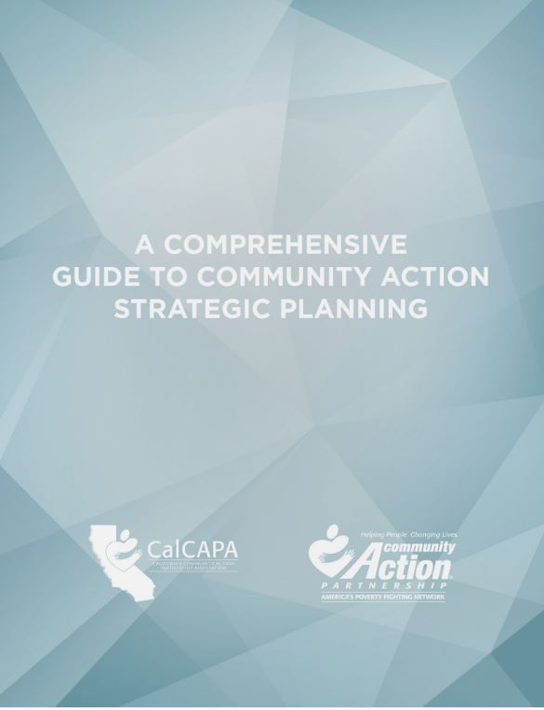
Development of Strategic Plan
Community Action Partnership & CalCAPA resource available at: https://communityactionpartnership.com/publication_toolkit/a-comprehensive-guide-to-community-action-strategic-planning-final-5/
Notes:
This guide developed by the California Community Action Association and the National Community Action Partnership was designed to help CAAs navigate the strategic planning process and successfully plan, develop, implement and evaluate strategic plans. As a comprehensive capacity building resource, the guide can also be used to refresh an existing plan, train program managers and agency leadership, or even develop a planning process for a community collaborative.

Slide 55

A Dual Bottom Line:
Mission Impact and Financial Return
Impact
High Mission Impact
Low Profitability
High Mission Impact
High Profitability
Keep it but contain costs
Invest & Grow
Profitability
Close or Give Away
Low Mission Impact
Low Profitability
Low Mission Impact
High Profitability
Water, Harvest, & Increase Impact
$
Source: Nonprofit Sustainability: Making Strategic Decisions for Financial Viability
Notes:
Another approach to strategic planning is offered by the book Nonprofit Sustainability: Making Strategic Decisions for Financial Viability. The book offers one way for a board to make decisions about programs and activities in its strategic planning sessions. The approach attempts to address concerns by board members and staff who may feel like they aren’t sufficiently familiar with all of the organization’s programs and activities. It also offers a challenge to many organizations who claim that “all of our programs are great” by requiring them to engage in a real discussion about which programs in fact have the greatest or most important impact.
The analysis is anchored in the development of a matrix for your organization using the template in the slide. The matrix map serves as a visual tool that plots all of the organization's activities and the financial and mission impact of each activity into a single image to generate strategic discussions. The focus is the dual bottom line: maximizing both programmatic impact and financial sustainability.
The matrix map requires an organization to identify all “lines of business” (e.g., Head Start, food pantry, affordable housing, Meals on Wheels, etc.) and place them in one of the four blue quadrants along the impact axis and profitability axis. A program that has high mission impact but doesn’t generate any funds (or costs a significant amount of money to operate) for the organization would, for example, be placed in the upper left hand quadrant. To assess the relative mission impact of each activity, an organization could: survey clients and staff members on how they assess the impact of the organization’s programs; conduct focus groups within the community; and host town halls or forums to discuss how effective the organization’s efforts are in meeting community needs. To asses the profitability of each activity an organization could look at how much an activity is contributing financially to an organization or how much the organization needs to subsidize the program with unrestricted funds.

Slide 56
Matrix Map Exercise
Keep it but contain costs
Impact
Invest & Grow
ESL
classes
4
Head Start preschool
U.S. citizenship classes
3
Annual street festival
Profitability
($60K)
($40K)
($20K)
$20K
$40K
$60K
2
Quit Smoking classes
Annual campaign
Close or Give Away
Water, Harvest, & Increase Impact
1
$
Notes:
Here is an example of a Matrix Map for a CAA:
Each circle represents a program or project, i.e., a “business line.”
You can see that circles higher on the map have higher impact than those lower on the map.
You can see the relative size of each activity, and which ones make money, which break even, and which require subsidy from the organization's unrestricted funds.
Ask workshop participants how they would make strategic decisions about each of these programs based on the matrix map. Here are some thoughts regarding each program:
Head Start preschool – market and try to grow; maintain government relations
ESL classes – limit attendance; try a partnership with the local community college
U.S. citizenship classes – increase class size and reduce number of classes
Annual street festival – raise corporate sponsorship fees; contain budget
Annual campaign – make a conscious effort to build a larger mailing list; use a campaign to educate people on the demographics of the community
Quit smoking classes – shut down, and refer people to other organizations providing classes

Slide 57
CSBG Organizational Standards
Planning
CSBG Org. Standard 6.1:
CSBG Org. Standard 3.1:
CSBG Org. Standard 3.5:
Organization has an agency-wide strategic plan in place that has been approved and accepted by the governing board within the past 5 years.
The organization conducted a community assessment and issued a report within the past 3 years.
The governing board formally accepts the completed community assessment.
Notes:
Even though a hallmark of a strong nonprofit is its ability to plan strategically, CAAs have an added incentive to engage in strategic planning activities. The CSBG Organizational Standards require them to do so and also direct a CAA to conduct a needs assessment that the board will formally accept. The Standard does not necessarily require a tripartite board to develop a new strategic plan every five years. Rather the Standard directs the board to review its existing strategic plan and ensure that it is truly reflective of community needs as reported in the community assessment, in line with the organization’s mission, and reflective of the organization’s goals.

Slide 58
Engage in Planning
Approaches to help a board meet its planning and strategy development obligations:
  Form a planning/strategy committee
  Uses the strategic plan to frame board discussions
  Use a strategic agenda
Notes:
The strategic plan should be a living document that is regularly referred to and used. Shifting the board’s focus to strategy, as opposed to solely the operational needs of an organization, can be challenging. To encourage a commitment to planning, boards should consider implementing a planning/strategy committee. The committee could serve as the point of contact for staying on top of the board’s role in strategic planning, the goals set through that process, and the follow-up and reporting from those goals.
Other ways to engage the board in strategic planning is for the board chair and executive director to refer to and use the CAA’s strategic plan when developing meeting agendas and framing board discussions. A strategic agenda can help with these efforts as it encourages board discussions and actions to be taken in the context of the organization’s strategic efforts, rather than promoting an environment where board members are mainly listening to reports by committees and staff.

Slide 59
Strategic Agendas
Strike a balance between “routine” agenda items (e.g., contract approvals etc.) and strategy discussions
How will agenda items and information provided to board members help board:
  Connect with the org’s mission
  Enhance board functioning
  Provide oversight
  Identify and make decisions on key issues
Notes:
A strategic agenda requires the board chair and the executive director to carefully consider the strategic direction of the organization and the need for input on that direction while still attending to the routine items that must be addressed to support the organization’s operations. In developing a strategic agenda, the board chair should connect agenda item discussions with the organization’s mission and the board’s oversight role. Strategic agenda items should enable the board to function more efficiently and effectively by focusing the board’s energies on key issues.

Slide 60
Consent Agendas
Used for routine, procedural, informational, and self-explanatory non-controversial items
Helps streamline meetings
If use, should educate board members on:
  Purpose , i.e., not used to ramrod decisions through
  Process, i.e., allows for removal of item upon request
Notes:
A consent agenda is tool that boards may use with a strategic agenda to help focus efforts on strategy. A consent agenda groups the routine, procedural, informational and self-explanatory non-controversial items typically found in an agenda. These items are typically presented to the board in a single motion for yay or nay vote after allowing for requests to move a specific item to the full agenda for individual attention. Consent agendas streamline meetings and allow the board to focus on substantive issues.
If an organization adopts a consent agenda, it must provide information for the consent items prior to the board meeting so that board members have sufficient time to review the materials and fulfill their duty of care. Any item requiring discussion should be removed from the consent agenda and discussed and voted upon separately at the board meeting.
It is important to remember that consent agendas must not be used to force through decisions and board members must always have the option to move items from the agenda for discussion and debate. A simple and direct question about a consent item may not necessarily result in automatic removal; however, if further questions arise, removal is likely necessary.

Slide 61
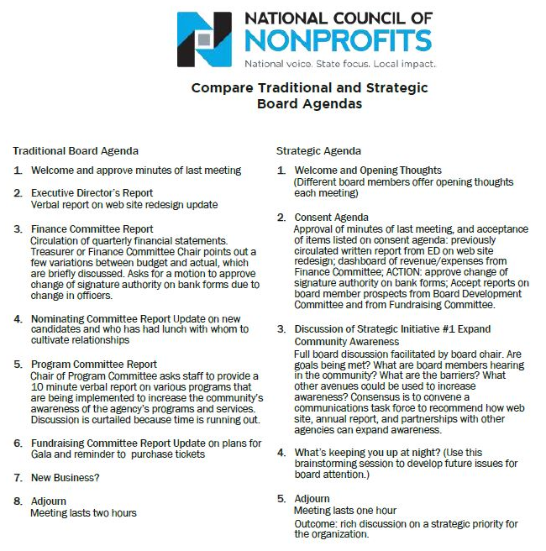
Notes:
Here is an example of a strategic agenda that includes a consent agenda. You can see how the focus shifts from committee reports and updates to discussions of strategic initiatives and concerns/thoughts for the future.
Organizations hesitant to switch from an “old business/new business” format to a strategic agenda should consider alternating between the two agendas types. The board may find that it benefits more from a strategic agenda where they are tackling one or two items that relate directly to the mission, vision and organizational values and that require special attention. Switching between to the two agendas is one way to help educate the board on the oversight value it brings to the organization as highlighted by the strategic agenda format.

Slide 62
Strategic Dashboard
Financial Indicators
 |  | Target | This month | Last month | Last year end
Income Statement | Surplus/(deficit) YTD | $270,000 | $390,842 | $340,908 | ($570,240)
 | Surplus/(deficit) year-end forecast | $270,000 | $30,937 | $250,987 | ($570,240)
 | Earned income ratio | 11.5% | 10.3% | 11.8% | 13.0%
 | New grants success ratio | 50.0% | 35.0% | 33.0% | 50.0%
Balance Sheet | Days cash on hand (unrestricted) | 45 | 43 | 28 | 51
 | Reserve funds balance (1 month payroll) | $250,000 | $200,000 | $150,000 | $250,000
 | Current ratio | 2 to 1 | 5.8 | 4.2 | 6.2
 | AR aged over 90 days | 15.0% | 22.3% | 23.5% | 20.0%
Program Indicators
 |  | Target | This month | Last month | Last year end
 | Weatherization Contracts (monthly goal) | 20 | 21 | 22 | 15
 | Head Start enrollment | 100 | 60 | 58 | 109
 | Monthly job placements | 30 | 11 | 14 | 32
21
Notes:
Strategic dashboards are another way for an organization to focus its board on the critical issues. A dashboard is basically a brief snapshot of the organization at a fixed point in time – like a car dashboard that gives an instant update on many important factors (speed, gas left in the tank, engine temperature, whether the AC is on, etc.). A nonprofit dashboard is similar: it gives important information to decision makers such as executives and boards in a quick-read way.
Dashboards may be solely financial or programmatic or a combination of both. The one on this slide combines both. A dashboard should be comprehensive, but not so detailed as to hinder high-level, strategic questions. It will summarize data from many reports into one. Probably the trickiest and most time consuming aspect of dashboards is the analysis that goes into determining which metrics will most accurately portray the organization. Those using dashboards should have explanations of the metrics, with context where necessary, and be flexible to the metrics changing and evolving so that they are as reflective as possible of the organization’s critical needs.

Slide 63
Agenda Exercise
Describe your CAA’s current board meeting agenda
List what items on the agenda may be suitable for a consent agenda
List the items that require the board to think strategically
Notes:
Developing a mock agenda could help workshop participants recognize ways in which they may approve their own approach to meeting agendas. This exercise may be done individually or in groups. Workshop participants should report their results and be encouraged to engage in a discussion about the reasons motivating the designation of items as consent versus strategic.

Slide 64
Key Board Responsibility
Engagement
Notes:
Being fully engaged in the organization means that board members not only meet their fiduciary duty of care to make well-informed, reasonable decisions but also help the organization with its efforts to connect with the community it serves.

Slide 65
Engagement Scenario
Jack, a recently retired school superintendent, joined the CAA board 10 years ago and continually gets re-elected to the private sector. He assumes he is on the board because the CAA operates a Head Start program. He is tired of attending community gatherings and interacting regularly with others – he did it for over 30 years with his school job. He likes his fellow board members and makes a real effort to attend board meetings focused on early education matters, but doesn’t worry if he can’t make other meetings.
Is Jack an engaged board member? Why or why not?
Notes:
Answer discussed on next slide.

Slide 66
Internal and External Responsibilities
With Board/ Organization
With Stakeholders/ Community
Engagement
Notes:
You can think of board engagement as internal and external. The CSBG Organizational Standards explicitly require a CAA to engage with certain, external stakeholders (e.g., other social service providers, government entities, etc.). Board members contribute to these efforts through their community connections and willingness to advocate for the CAA and its programs. The CSBG Organizational Standards implicitly require board members to engage internally -- with the board (for example, by meeting composition requirements) as well as with the organization (for example, by participating in strategic planning efforts).
Arguably Jack is not an engaged board member for two reasons. He is only concerned with one aspect of the CAA’s work, its Head Start program. Even though Jack brings a lot of experience to the board as to issues the CAA may face with its Head Start program, he is admittedly absent with regards to the CAA’s other activities and overall operations. Secondly, Jack has no interest in supporting the CAA’s efforts to educate the community about the vital role the CAA plays through the services it offers.
Ultimately, it is up to the board to decide if the benefits Jack brings to the table outweigh his deficits. Jack, though, should understand that under his state’s nonprofit corporation law, he has fiduciary duties that require him to make reasonably informed decisions and act in the best interest of the organization.
In this section we will talk about ways in which the board can assess the type of board members that will be the best fit for the organization and also help board members, like Jack, become more fully engaged.

Slide 67
Ways to Increase Engagement
Strategically Recruiting
Regularly Orienting & Training
Building Relationships
Conducting Assessments
Connecting with Community
Notes:
Boards can establish and increase both internal and external engagement of individual board members in a number of ways. We will discuss at a high level some of those which include:
how to think strategically about board member recruitment,
the importance of regularly orienting and training board members,
ways to build board member relationships,
the benefits of assessing individual and group perceptions, and
how board members can connect with the community served by the CAA.

Slide 68
Board Selection Procedure
Use board committee
Recruit smartly & strategically
Require applications
Follow selection procedures
Notes:
Developing an engaged board that can help the CAA further its mission can seem daunting, especially with the specific composition requirements that apply to tripartite boards. Thinking strategically about recruitment is the key. The following is a process may help with these efforts:
Use a committee (either governance or board development) to oversee the selection process. If you don’t have one, create one.
Recruit board members based on what you need: financial expertise, community connections, fundraising capabilities, etc. The tripartite structure offers more flexibility than you may realize. For example, elected public officials often have skills beyond those of just being a politician. Try to tap into those elected public official or representatives that can meet the needs of the CAA.
Require applications. Doing so can help educate interested applicants about what your CAA is looking for and also provide the CAA with the information it needs to select candidates who best fit the organization's current needs.
Follow selection procedures in the CAA’s bylaws. Many federal funding sources, including CSBG, have specific composition requirements for boards of entities that receive their funding. If procedures are not currently specified in your bylaws, add them or include them in separate governance policies approved by the board. Also, if changes to the procedures are needed to better position your CAA to attract the talent it is seeking, then take the opportunity to make those changes.

Slide 69
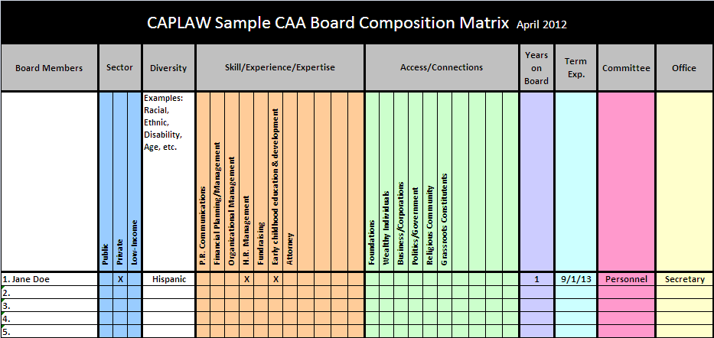
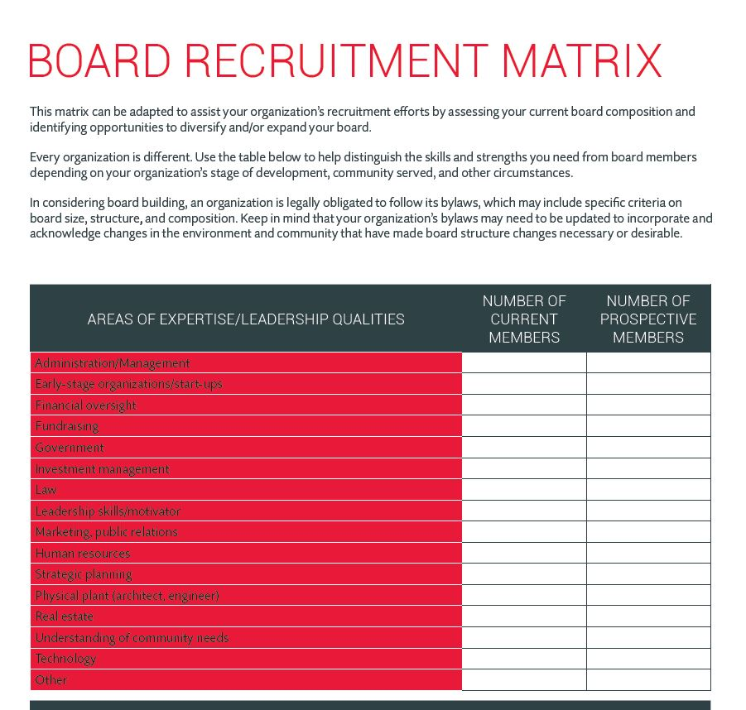
Recruitment Matrices
Board Source & CAPLAW
http://www.caplaw.org/resources/SelfAssessmentDocuments/CAPLAW_BoardComposition%20Matrix_April2012.xls
https://boardsource.org/board-recruitment-matrix/
Notes:
A composition or recruitment matrix is one way the board can take a step back and more fully understand who is currently serving on its board and what attributes the board should be seeking in its recruitment efforts. Board matrices can be customized to reflect a specific organization’s needs and help the board form a more strategic, targeted approach. However, it is important to not solely rely on a matrix when making final decisions about board candidates. Someone who looks good on paper and checks off all of the boxes may not necessarily be a good fit for the board. In-person meetings often help convey information about potential candidates, such as their passion for your mission or ability to commitment to the organization, that is necessary for developing a successful and engaged board.

Slide 70
Training & Orientation Exercise
What Would You Do?
List the five most pressing topics for a board member orientation.
List the five topics that you think are essential to be covered in board trainings.
List three methods for providing training to the board.
Notes:
Workshop participants should take a moment either individually or in groups to discuss the topics they think should be covered in board orientations and trainings as well as the most effective methods for conducting such trainings. Doing so should help participants not only recognize the needs within their own organization but also that they play a role in helping all board members receive the information they need to fulfill their duties.

Slide 71
Training & Orientation
Options
Use a governance committee to work with executive director and designated staff to:
  Develop a comprehensive approach
  Identify topics, e.g., financial oversight, board operations, etc.
  Establish methods , e.g., webinars, in-person, etc.
Notes:
71
Boards should consider establishing a governance committee to work with the executive director and staff (as designated by the executive director) to develop a comprehensive approach to training and orienting board members. The approach will likely be multifaceted and may include a mentorship program connecting more senior board members with new ones; a training schedule with specified times and days when training will occur throughout the year; and directives around attendance such as requiring all board members to attend some or all of the trainings.
As part of developing a comprehensive approach the committee should consider topics essential to cover as part of an orientation, versus those that may necessitate more in-depth coverage and are thus better suited for a training. Some topics will be universal for all CAA boards such as a board member’s fiduciary duties, while other may be more specific to a particular CAA such as a board’s responsibilities with regards to a particular grant-funded program, like Head Start. Multiple options exist for how a board may identify the topics for both the orientation and training. Boards may: (1) survey their members either electronically or at meetings; (2) survey the executive director and executive management who work with the board and its committees; (3) use board assessments that are conducted every two to three years; or (4) conduct meeting evaluations that include questions about board trainings. The same options used to identify topics could also be used to determine the best methods for conveying information. Different methods may be used to convey different types and amounts of information.
Sample orientation and training topics topics may include mission, history, programs, strategic direction, financial oversight, organizational structure, board composition, board roles and responsibilities, and board operation. Sample methods for convey the information for an orientation and trainings may include webinars, training modules, handbooks, mentoring, conference, retreats, one-on-one meetings, committee participation, on-site tours, staff presentations, and volunteering.

Slide 72
CSBG Organizational Standards
Board Orientation and Training
CSBG Org. Standard 5.7
Org. has a process to provide a structured orientation for governing board members within 6 months of being seated.
CSBG Org. Standard 5.8
Board members have been provided with training on their duties and responsibilities within the past 2 years.
Notes:
Another reason for board members to adopt a comprehensive approach to board orientation and trainings is because the CAA will be monitored on these efforts pursuant to the CSBG Organizational Standards. The Standards specifically require CAAs to provide a structured orientation for governing boards within 6 months of new board members being seated and a training on their duties and responsibilities within the past two years. A board may show compliance with these Standards through a written orientation and training schedule and plan, board minutes reflecting the actual orientation and training and the board members who attended, sign-in sheets for the training and orientation, and a copy of the orientation and training materials.

Slide 73
Building Relationships
Executive Director and Board Chair
Establish expectations
Frequency of check-ins
Priorities
Keep communication lines open
Regular communication
Identify and work to resolve differences in non-defensive ways
Issues to communicate
Communications style
Sounding board/feedback
Ways to support each other
Notes:
Another way to cultivate an engaged board is for the executive director and board chair to develop a strong working relationship. The board chair is elected by the board to represent them and act as a conduit between the full board and the executive director. The board chair presides over meetings, works with the executive director to plan agendas, acts as the spokesperson for the board, and serves as a sounding board for the executive director. Often times, the board gets the information it needs from the organization through the board chair, who communicates these needs to the executive directors. Thus, it is important that the executive director and board chair are clear as to what they expect to receive and provide to each other. Executive directors and board chairs should consider frequent check-ins where they can discuss issues and set priorities. They should educate each other regarding their preferred methods of communication, including the best way to serve as a sounding board and provide feedback. They should also discuss what type of support each is expecting and needs to fulfill the many responsibilities that each is tasked with. Keeping communications lines open and recognizing that differences will arise, while working collegially to resolve those differences, will likely result in the full board and the executive director leading the organization in a well-informed and effective way.

Slide 74
Building Relationships
Board Members/Executive Director
Meet one-on-one with board members
Periodic check-ins
Provide board members with opportunities to develop their skills as board members
Help board members get to know each other
Encourage board members to be actively engaged at board meetings
Notes:
While a strong working relationship between the board chair and the executive director is necessary for a board successfully function, there are also actions that the full board in connection with the executive director can take to further deepen board member engagement. The executive director, the board chair or governance committee chair or members should consider establishing one-on-one meetings with individual board members. These meetings could find out, among other things:
What motivates each to serve on the board?
How do they connect with the organization’s mission?
What do they hope to gain from board service?
What can they contribute?
What skills/knowledge do they need or want to develop to become a more effective board member?
What could make their experience more satisfying?
Also, periodically checking in with board members between meetings to see what support they may need or address concerns they may have helps to boost a board member’s interest and engagement. Educating board members about opportunities that align with their skills or can help them develop new skills will help them feel that they are contributing to the organization as well as growing from the experience of serving as a CAA board member. Helping board members get to know each other either by assigning new board members mentors and or inviting board members throughout the year to introduce themselves and tell their stories is another way to help board members feel invested in the board and the work they are tasked with. Another way to promote engagement is to assign specific tasks to board members, ask them to serve on committees and conclude meetings with actions items.

Slide 75
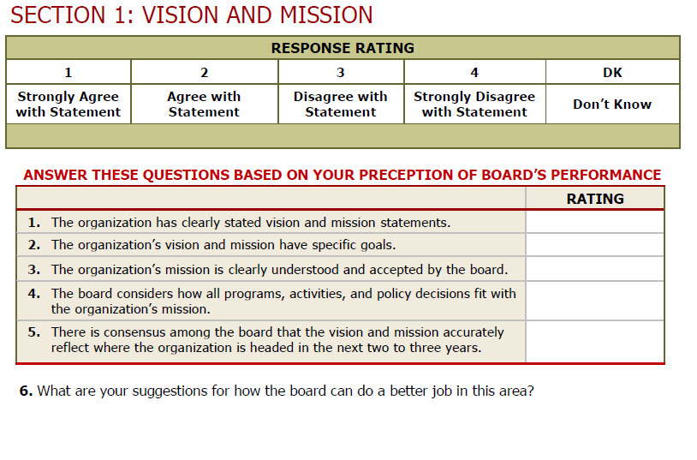
Board Assessment
Sample Excerpt
Notes:
Conducting assessments that involve either the board members assessing the full board or their individual participation on the board is an opportunity for board members reflect on both their individual and shared responsibilities. Assessments are a vital governance tool that gives the board an opportunity to step back from its everyday business and address larger, more fundamental issues. Assessments can shake boards out of micromanaging the organization’s work and redirect their focus to governance issues. It can lead to a more engaged board—and a higher performing one. Assessments help board members identify varying perceptions, clarify and manage expectations and set priorities and goals. The result of a successful assessment could be to inspire the board to work more cohesively as a team to strengthen the organization.
On this slide is an excerpt from an assessment tool that was specifically created for CAAs by the Indiana Community Action Association. As you can see from this brief snippet, the assessment is basically giving the board and individual board members a chance to ask how they are doing. An assessment isn’t an opportunity to create another “to do list” but is a chance for the board to fine-tune the way that it operates in a targeted and hopefully effective way. An assessment should be viewed as an ongoing journey that leads to a healthy and productive discussion about the board’s strengths and weaknesses and results in an agreed-upon plan for building a stronger board and governance model.
An assessment may be too comprehensive a process to be carried out every year. Each board operates differently and will need to gauge what is the best time frame for them. Conducting an assessment every other year tends to be helpful for many boards. It doesn’t make sense to conduct an assessment if the organization is facing a crisis or some other pressing matter that is requiring everyone’s full attention. The process also isn’t effective when staff and board leadership are at odds with one another or when the organization or the board lack the capacity to enact the strategies that might grow out of the effort.

Slide 76
Board Assessment
Process
Get your full board on board!
Establish a group of board members to oversee the process
Administer the assessment tool
Tabulate responses
Discuss results – strengths, weaknesses
Establish a realistic action plan
Follow up and reassess!
Notes:
An assessment should be a team effort. A recommended approach is that either the governance committee or a few designated board members play an active role in the process and take some ownership for seeing that the results are used to effect change, when necessary. Once the assessment process is complete and responses tabulated, the board must take the time to discuss the results if the process is to be impactful. The governance committee, working with a staff person designated by the executive director, may be charged with pulling together a report from the results to help facilitate the discussion and spearhead the development of an action plan. Most importantly, the board must make an effort to follow up, through meeting evaluations or board surveys, to determine if the plan addressed the results and what tweaks may be necessary.

Slide 77
Board Assessment
Resources
Decide on and use appropriate format/tool
  NH Center for Nonprofits, http://www.nhnonprofits.org/view/member-benefits/256
  National Council of Nonprofits, http://www.councilofnonprofits.org/resources/resources-topic/boards-governance/board-member-self-assessment
  VirtualCAP, http://www.virtualcap.com/downloads/MPI/IN-CAA-Board-Self-Assessment.pdf (tool developed by Indiana Community Action Association)
  The Nonprofit Association of Oregon, https://nonprofitoregon.org/helpline_resources/Board-Assessment-Tool
Notes:
Here are a few tools for conducting board assessments. No matter what tool a board uses, a good assessment needs to ask relevant and clear questions, collect systematic feedback from a variety of sources, and make use of the information for developmental purposes, rather than as a report card of board performance.

Slide 78
Connecting with Community Exercise
Fill in the Blank
Empowering the low-income community
  Ex., our tripartite board _______________________________
Effectively advocating for the organization and its mission
  Ex., our tripartite board________________________________
Collecting and providing input on community needs
  Ex., our tripartite board________________________________
Developing and sustaining strategic partnerships and collaborations
  Ex., our tripartite board________________________________
Notes:
A CAA garners the support it needs to survive and thrive if it is connecting with those individuals and families it serves as well as others in the community who can support the furtherance of the CAA’s efforts and mission. Connecting with the community embodies a hallmark of community action which is the “maximum feasible participation” of the low-income community served. The CAA board is the face of the organization and must ask itself how it is engaging in activities like the ones listed above. Examples of how board members can connect with the community include:
Empowering the low-income community by spearheading a leadership development program for the CAA’s clients. A tripartite board developed a program that not only connected the board with the population the CAA serves but also helped to educate those who often feel voiceless as to how they can make their voices heard and produce results hopefully benefiting themselves and their community.
Advocating for the organization by speaking at community groups and participating in hearings on matters impacting the low-income community.
Collecting and providing input on community needs by holding forums seeking feedback from the community as to their needs and what assistance they believe will help them address those needs.
Developing and sustaining strategic partnerships and collaborations by working with other social service providers and groups who are serving the same community to determine what are the best ways they can individually and collaboratively help improve the lives of the low-income community served.
Now, it is your turn. Take a moment to fill in the blank for each of the bullets listed above with at least one way your board is connecting with the community. If you are not sure what your board might be doing to connect with the community, then make a proposal to take back to your board as an action item.

Slide 79
CSBG Organizational Standards
Community Engagement
CSBG Org. Standard 1.1
CSBG Org. Standard 2.1
CSBG Org. Standard 2.3
Organization demonstrates low-income individuals’ participation in its activities.
Organization has documented or demonstrated partnerships across the community, for specifically identified purposes; partnerships include other anti-poverty orgs in the area.
Organization communicates its activities and its results to the community.
Notes:
Even though a board is not directly involved in complying with the CSBG Organizational Standards that require a CAA to engage the low-income community, collaborate with fellow providers and communicate results, the board is ultimately responsible for the success of the CAA. There are actually a number of ways, as we just discussed, that a board can directly contribute to a CAA’s efforts to meet these standards through deliberate efforts to connect with the community served.

Slide 80
Key Board Responsibility
Generating Funds
Notes:
Ensuring the fiscal soundness of a nonprofit CAA is not only a key board responsibility, it is a critical one. The tripartite board is ultimately responsible for a CAA’s survival and that survival is tied to having sufficient funds to operate and do so in compliance with the rules that govern the federal and state funds it receives. We will work through some questions to address the role of the board in generating the funds an organization needs to be sustainable.

Slide 81
Two Main Ways CAAs Generate Funds
Fundraising
Soliciting gifts
Putting on special events
Proposals
Writing grants
Preparing bid proposals
Capital campaigns
*
*
*
*
Board and executive director
Executive director and staff
Notes:
CAAs and many nonprofits generate funds in two main ways. The most common way is through writing grants and preparing bid proposals. The federal grant rules that govern a CAA’s use of federal funds, the Uniform Guidance, allow for CAAs to pay for the costs that are associated with preparing both successful and unsuccessful bids, proposals, or applications on potential Federal and non-Federal awards or projects with federal funds as long as certain requirements are met with regards to how the costs are treated (i.e., as indirect) and when they are charged to the grant (i.e., during the accounting period in which they were incurred). Most CAAs rely heavily on their federal and state grants and the executive director with staff often lead the effort to identify and apply for this type of funding.
Organized fundraising which includes capital campaigns, special events, and solicitation of gifts and bequests is another, less common way, that CAAs generally generate funds. However, fundraising is a common activity amongst must nonprofits who had the history with government fund that CAAs have had the fortune to have. Fundraising costs may not be paid for with federal funds unless the federal award agency gives prior written approval to use the funds for this activity. To date, CAPLAW is not aware of any federal agency that has given fundraising approval.

Slide 82
Generating Funds Quiz
A CAA cannot rely solely on its state and federal grants and should engage in efforts to generate unrestricted funds. True or False
Why?
  State and federal grants restrict use of funds
  Diversification of funding often essential for sustainability and flexibility
Notes:
True. Federal grant laws and funding source requirements impose restrictions on how funds may be used and often limit the funding to specific purposes. Diversification of funding is thus essential for a CAA to remain fiscally nimble and sustainable. Diversifying funding also helps protect a CAA from running afoul of federal requirements. For example, many CAAs are paid on a reimbursement basis and if they are slow to receive payment from one federal funding source they may not use funds from another federal funding source to carry those costs. Thus, unrestricted funds not only help CAAs correctly manage unanticipated shortfalls in the budget, they can also pay for activities that further the CAA’s mission but do not fall within federal grant purposes.

Slide 83
Generating Funds Quiz
Generating funds is mainly the executive director’s responsibility, not the board’s. True or False
Why?
  Joint effort – both bring different resources/skills
  If no unrestricted funds, board must spearhead fundraising efforts
Notes:
False. Typically, fundraising by nonprofits is a joint effort between the board of directors (often a fundraising committee) and the executive director. For example, board members are instrumental in:
helping to identify and meet with potential donors,
speaking on behalf of the organization,
generating interest in the organization’s efforts in the community,
volunteering for events and,
if possible, giving funds themselves to the organization.
The executive director or other designated staff will work with the board to develop a fundraising plan/approach and provide the support needed to execute the plan. The issue for community action agencies (CAAs) that often affects the roles that the board and the executive director play in fundraising is how to pay for staff time spent on fundraising efforts. As previously discussed, it is common for CAAs to receive mostly federal or state funds, which cannot be used to pay for fundraising costs (including staff time spent on fundraising). If a CAA does not have unrestricted funds to pay for an executive director’s or staff member’s time and/or contribute to organizational resources that may be used in fundraising efforts, then the board must take the lead to spearhead the efforts.

Slide 84
Generating Funds Quiz
Tripartite boards cannot require members to give financially to the CAA because low-income representatives may be low-income themselves. True or False
Why?
  No legal prohibition against soliciting funds from all board members
  Allow for varying levels of giving and non-financial ways to give
  Foundations often want to see 100% board giving
Notes:
False. There is no legal prohibition against soliciting funds from all board members. Even though a low-income representative on the tripartite board may have difficulty giving at the same levels of other board members because they are low-income, the board should think creatively about ways in which the board member may give financially to the organization. Foundations often want to see 100% board giving before they will allow organizations to apply for funding. The dollar amount of that giving is often not the issue, especially if funders are made aware of the governance composition requirements that apply to CAA boards and individual board members’ financial capacity to give to the organization. Thus, it may be that a low-income representative gives what he or she can, or that the representative individually fundraises for his/her contribution. Moreover, it is important that all board members feel equal with regards to their investment in the organization and requiring all board members to give, with the qualification that varying amounts may be given or generated in different ways, often fosters higher levels of engagement and commitment.

Slide 85
Getting Your Board Involved in Fundraising
Position your board to fundraise by:
  Considering fundraising experience/ability when selecting board members
  Communicating expectation of involvement in fundraising
  Establishing a board fundraising committee with mix of board members
  Forming an advisory committee comprised of non-board members with big hearts and deep pockets
Notes:
Developing a board that is comfortable with fundraising will be a process for many CAAs and will require deliberate and strategic efforts. A tripartite board could begin the process in a number of ways. One is to specifically recruit board members who have experience with fundraising. This is easiest when CAAs are recruiting to fill private sector seats or if they are choosing representatives to serve in place of elected or appointed public officials. Board fundraising, however, is more than just identifying one or two board members with the expertise and skill to jump start a program; it also involves developing a culture of philanthropy within the organization. The board should set an expectation that one of its key responsibilities is to generate funds for the organization and ensure its fiscal soundness. The board can do this by including fundraising as a responsibility in its board job descriptions, training board members on how they can contribute to these efforts, and establishing a fundraising committee made of board members from all sectors of the board. A board fundraising committee can keep tabs on the board’s efforts and work with the executive director and staff on the CAA’s approach. If recruiting board members with fundraising expertise and a willingness to give is difficult, boards may also consider forming an advisory committee made up of non-board members who can lead the fundraising charge as well as contribute financially to the organization.

Slide 86
Board’s Role in Fundraising
Work with staff to develop plan
Oversee implementation of plan
Identify potential funders
Develop & nurture relationships
Organize & participate in special events
Notes:
Giving actual dollars is one major way that individual board members contribute to a CAA’s fundraising efforts. There are also a variety of other actions individual board members may take to support these efforts. Such actions include:
Overseeing the implementation of a plan to generate funds (with input from the executive director).
Working directly with staff to develop a fundraising plan. Staff would likely work with members of the fundraising committee.
Identifying potential donors. Board members could begin by asking peers or relatives to donate and expand their asks to other relationships. Board members could also offer to facilitate introductions between potential donors and staff.
Helping to organize and participating in fundraising events.
Developing and nurturing relationships with donors as well as those in the community so they recognize the value your CAA brings to the community. Board members could also accompany staff on donor visits and offer to follow up with expressions of gratitude, when appropriate.

Slide 87
Some Resources
Board’s Role in Fundraising
Grantspace: What is the board’s role in fundraising: https://grantspace.org/resources/knowledge-base/boards-and-fundraising/
GIFT – Grassroots Institute for Fundraising Training: http://www.grassrootsfundraising.org/
Board Source: books and other resources on nonprofit boards – including involving the board in fundraising, https://boardsource.org/fundamental-topics-of-nonprofit-board-service/fundraising/
Notes:
If board members are struggling with embracing the role they play in your CAA’s fundraising efforts, we recommend directing them to these resources. All of the organizations listed above focus on providing resources to board members to help them better understand the vital part they play in a nonprofit’s financial survival.

Slide 88
Fundraising Rules Takeaway
Work with local counsel to ensure compliance with applicable laws
More notable requirements applicable to fundraising activities by CAAs:
  Federal grant law restrictions
  Internal Revenue Service (IRS) rules
  Fair Labor Standards Act (Wage and Hour)
  State charitable solicitation and gaming rules
Notes:
While there are legal rules that apply to a nonprofit tax-exempt organization’s fundraising activities, these rules are in no way intended to discourage organizations from engaging in fundraising. The legal takeaway for boards is that organizations must approach fundraising like any other new program or project they begin – get acquainted with the legal framework and parameters and work with legal counsel to develop policies and procedures that will assist with compliance.
One of the more notable legal requirements that applies to fundraising activities by CAAs includes one that we have already discussed. This is the federal grant law restrictions which generally require a federal grantee to obtain prior written approval from its federal agency before using federal funds to fundraise. Another set of requirements apply to nonprofit CAAs as tax-exempt organizations – these are Internal Revenue Service (IRS) rules that generally require donor acknowledgements and disclosures. The rules also may impose a tax on the organization depending on the type of fundraising activity the organization engages in. The federal Fair Labor Standards Act (wage and hour laws) mostly apply when employers seek to have non-exempt employees “volunteer” for fundraising activities. Non-exempt employees must be paid for all hours worked and overtime if they work over 40 hours a week. An employer must show the existence of certain factors for a non-exempt employee to be viewed under the law as a “volunteer.” Lastly, every state imposes its own requirements around charitable solicitations and gaming activities. These requirements usually involve organizations submitting filings, paying fees and/or obtaining licenses to operate such activities, even if they are for charitable purposes.

Slide 89
Key Board Responsibility
Strategic & Programmatic
Performance
Notes:
We now live in a data-driven society. Being able to show that a program is producing results is often the key to sustaining and attracting funding. In this section, we will talk about the role a tripartite board plays with respect to overseeing the performance of a CAA’s programs.
Note to Presenter: While this presentation does not refer to ROMA, this section of the presentation is where information about ROMA would likely be included. We encourage presenters with knowledge of the ROMA principles to include information about them as applicable.

Slide 90
Program Performance Exercise
List 3 reasons why a tripartite board should have a framework in place for reviewing the performance of the CAA’s programs.
Community Services Block Grant organizational standards require it.
ALL funders expect organizations to demonstrate how programs and services are making an impact.
It is the best way for the organization to know what’s working and what’s not.
Notes:
Note to presenter: Ask workshop participants to take a moment to jot down three reasons why a tripartite board should have a framework in place for reviewing the performance of a CAA’s programs. This slide is animated so after asking for volunteers to report their answers, reveal the three reasons on the slide. It is likely that the workshop participants mentioned all three of the reasons listed.

Slide 91
Regular Strategic and Programmatic Reviews
5-Year Review (Strategic)
Annual Review (Milestone / Programmatic/ Strategic)
Review at Every Board Meeting (Milestone / Programmatic)
Notes:
A board oversees program performance by reviewing the goals it has set in comparison to the progress made in meeting those goals by the executive director and his or her staff. Reviewing programmatic goals and progress is not unique to CAAs and is usually required by non-federal funding sources as well. What is unique is that the CSBG Organizational Standards require CAAs to engage in organization-wide reviews, not just reviews of programs funded by CSBG. At every meeting, the board is tasked with receiving updates on the CAA’s programs. The board is not required to hear about every program at every meeting and they may decide what is the best, most effective way to receive the updates. For example, rather than having program directors or other members of the management team present detailed reports on CAA programs at each meeting, the board may have them prepare concise written reports that highlight recent developments. These reports can be included in the board packets sent to directors prior to the meeting. At the meeting, the executive director can summarize the developments and issues outlined in the reports and board members can ask questions about the reports.
The annual review will also involve assessments of certain programs, and in particular, those programs for which decisions regarding the operations supporting the programs need to be made. Nevertheless, the focus of the annual review is to assess the progress the CAA has made towards meeting the goals set forth in its strategic plan.
The strategic review will be closely tied with the revision or further development of the CAA’s 5-year strategic plan. As with the annual review, programmatic and strategic goals and achievements will be assessed, and this information will be used by the board to inform its efforts in planning the future direction of the CAA.

Slide 92
CSBG Organizational Standards
Strategic and Program Performance
CSBG Org. Standard 6.5
CSBG Org. Standard 5.9
Governing board has received update(s) on progress meeting the goals of the strategic plan within the past 12 months.
Organization’s governing board receives programmatic reports at each regular board meeting.
CSBG Org. Standard 6.1
Organization has an agency-wide strategic plan in place that has been approved and accepted by the governing board within the past 5 years.
Notes:
The CSBG Organization Standards establish the framework for a CAA’s program and strategy review. The board’s role is specifically outlined as one that approves plans, monitors progress, and receives updates.

Slide 93
Board’s Role in Programmatic & Strategic Performance
Establishing a culture of using data to make decisions
Performance management
How can we improve our . .
Outcomes?
Quality?
Cost effectiveness?
Notes:
In practical terms, a board’s role with regards to performance measurement involves establishing a culture of using data to make decisions. The graphic on this slide shows a somewhat simplistic view of what that means. A board that oversees the implementation of a constant feedback and response loop focused on improving program performance will strengthen its organization.

Slide 94
Board’s Role in Programmatic & Strategic Performance
Inquiring about relevancy of data received and the metrics used
Performance measurement
How will we know if we are meeting community needs prioritized?
What metrics matter?
What data will need to be captured
Notes:
Part of developing a successful feedback and response loop requires inputting measures that assess the relevancy of the data received and the metrics used. The board is trying to answer the question, “How will we know if we are meeting the community needs we’ve prioritized?” and to properly do so it must work with the executive director and staff to determine what data should be collected and what metrics will serve as the best guides for future decisions.

Slide 95
Key Board Responsibility
Accountability
Notes:
The tripartite board plays an instrumental role in ensuring that a CAA is accountable, i.e., fiscally strong, legally complaint and operationally sound. Maintaining accountability requires the implementation of systems, policies and procedures that the board oversees, reviews and approves. To gain and maintain public trust, a CAA must be able to show that it has a strong commitment to ethical principles, transparency and accountability.

Slide 96
Ensure Accountability
Financial
Operational
Legal
Notes:
When we talk about accountability, we will be looking at actions boards can take in three overlapping areas – legal, financial and operational – to support a CAA’s efforts to either maintain or grow into a high-performing organization.

Slide 97
Executive Director Oversight
Board of Directors
Sole employee of the board is the executive director
Executive Director
Staff
Staff
Notes:
As previously discussed, the executive director is the sole employee of the board and is authorized by the board to hire, fire and manage staff. Board members generally communicate with other staff about organizational business through its one employee, the executive director. A key board responsibility that is essential to maintaining an accountable organization is to effectively oversee, evaluate and compensate the executive director.

Slide 98
Manage Executive Director
Oversee
Regularly communicate
Provide assistance when needed
Evaluate
Use board committee
Decide on evaluation tool/ criteria
Request reports
Ask about goals & programs
Conduct annual review
Gather input
Set up in-person evaluation
Create written review
Notes:
Oversee
In a smoothly running organization, the board regularly communicates with the executive director via the board chair who will often meet or schedule regular calls with the executive director to discuss new or ongoing concerns. Meeting regularly establishes an opportunity for the board chair to let the executive director know what the board believes the executive director is doing well and provide appreciation for his or her daily efforts on behalf of the organization. At the same time, it is a way to spot problems between evaluations, before they become critical.
Being an executive director is a tremendously complex job with many pressures and expectations. If the executive director has been struggling with specific problems such as time management, lack of expertise, or feeling overwhelmed, the board should work to help him/her obtain the needed assistance. For most boards, the board chair will likely be the one to discuss such issues with the executive director and then work with either the full board or a board committee to identify possible solutions such as training in specific subjects, finding an external mentor or considering executive coaching.
Evaluate
The executive director is typically central to the success (or failure) of an organization. One of the board’s most critical roles is to perform an annual, written evaluation of the executive director. This evaluation will document both achievements and shortcomings so that the executive director’s performance can be improved to benefit the entire organization as well as his/her own personal growth.
The evaluation of the executive director actually begins when the board and the executive director agree upon goals and objectives for the coming year. Tying these goals to the strategic plan of the organization is a good way to structure a meaningful performance review for the executive director. The evaluation process often helps align and clarify the goals and expectations of the executive director and provides firm support for executive compensation decisions. While the size and complexity of the board and the organization will dictate what procedures and tools are appropriate for the evaluation, there are some general guidelines boards may find useful, which include:
Use a board committee that could be either a subgroup of the executive, governance or compensation committee (if applicable) or perhaps an ad hoc committee that will handle the logistics, research and written documentation.
Decide on an evaluation tool and the criteria for the review. Many types of evaluation tools are available, ranging from a checklist of skills and abilities that enable others to “rate” the executive director, to more open-ended tools that allow for individual comments. The executive director and the committee should meet to review the process and the tool.
Gather input from a variety of sources. Include board and staff members, and key partners of the CAA (consider clients, volunteers, donors, community members, etc.) as part of the evaluation. Obtaining input from non-board members may be difficult without anonymity so a board may consider using online surveys that protect confidentiality.
Set up a face-to-face evaluation meeting. Consider having either the board chair, or the chair and one other committee member, meet with the executive director to discuss the evaluation. Such a meeting would typically cover the executive director’s achievements, the areas where he/she might need improvement, and goals for the executive director to focus on in the coming year. It is also a good opportunity to discuss professional development goals for the executive director. If compensation is discussed, the committee should keep a record of that discussion.
Create a written review and summary. Documentation is important because it serves as a point of reference for the board and executive director with respect to those areas where the executive director has been successful, as well as those where he/she can improve performance.

Slide 99
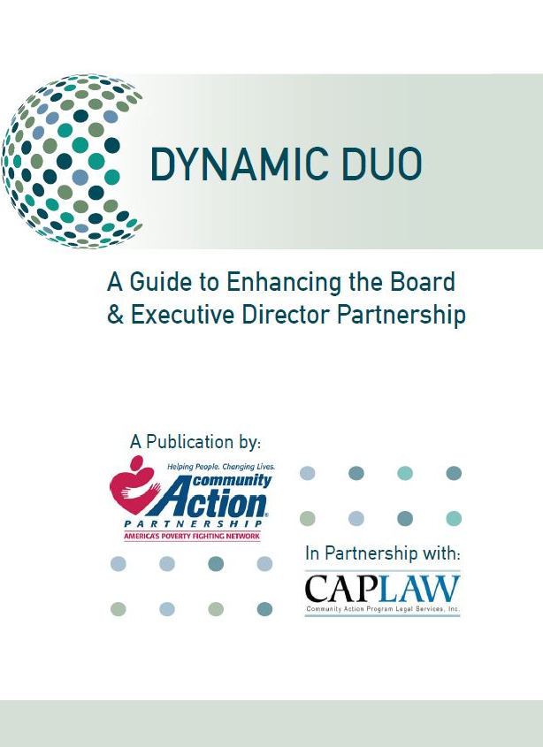
CSBG Organization Standards
Executive Director Oversight
CSBG Org. Standard 7.4
The governing board conducts a performance appraisal of the CEO/executive director within each calendar year
Notes:
While performing an annual review of the executive director is a standard practice for nonprofit organizations, CAAs are required to do so under the CSBG Organizational Standards. While the Standards require that the board conduct a performance appraisal of the executive director within each calendar year, they leave the specific process and procedures for doing so up to the board.
The CAPLAW publication, Dynamic Duo: A Guide to Enhancing the Board & Executive Director Partnership, offers further information and links to other resources that can help boards with conducting a performance appraisal of the executive director.

Slide 100
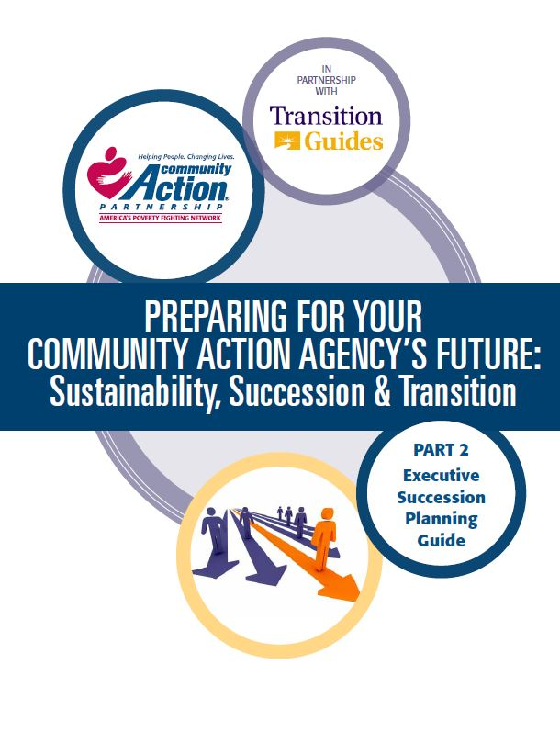
Executive Director Oversight
Succession Plan
CSBG Org. Standard 4.5
The organization has a written succession plan in place for the CEO/executive director, approved by the governing board, which contains procedures for covering an emergency/unplanned, short-term absence of 3 months or less, as well as outlines the process for filling a permanent vacancy.
Notes:
Succession planning is key to the sustainability of organizational leadership. The CSBG Organizational Standards specifically require nonprofit CAAs to have in place a written succession plan, approved by the board, for the executive director position. The plan must contain procedures for covering an emergency/unplanned departure and a short-term absence of three months or less, as well as the process for filling a permanent vacancy.
The national Community Action Partnership has developed a number of executive transition resources that are available on its website. The one referenced on this slide, Part 2: Executive Succession Planning Guide, specifically discusses ways a tripartite board may develop a plan that is right for its organization.

Slide 101
Organizational Policies Scenario
Ann, a program assistant who repeatedly spoke inappropriately to colleagues and clients, was terminated after her first year of working at CAA, Inc. Distraught by her termination, Ann sent a scathing email to the Executive Director and board member, Jackie, who is Ann’s sister-in-law. Ann exclaimed in the email that the CAA wrongfully terminated her, that her complaints about being sexually harassed by her co-worker Don were never addressed, and that the Program Director used program funds to pay vendors to provide personal services.
What organizational policies are implicated in this scenario? How?
Notes:
Boards oversee the implementation of policies by the CAA and there are a number implicated by this scenario that would have helped to protect this CAA. These polices include:
Personnel policies which would establish the process to follow before an employee is terminated. The policies would detail information about performance reviews, disciplinary measures and employee actions that may result in immediate terminations. The policies would also outline how staff handle employee complaints, especially ones of a serious nature like sexual harassment. The policies would establish the investigation and response required to effectively manage such claims.
A whistleblower policy would have instructed Ann on how to report her sexual harassment claims if they were not being properly addressed. Also, the policy would have provided Ann with one way to report her concerns about the Program Director paying CAA vendors for personal services using program funds.
A conflicts of interest policy is necessary to educate board members, like Jackie, about situations that may rise to the level of an apparent or real conflict of interest with the organization and how to manage that conflict. Funding sources impose conflict of interest governance requirements on grantees and, if this CAA has a Head Start program, then either Jackie would not be able to serve as a board member, or Ann would have to resign. The Head Start Act specifically prohibits the immediate family of board members from working for a Head Start grantee, even if the relative is not working for the Head Start program. Prior Head Start guidance indicates that “sister-in-law” is considered an immediate family member for purposes of compliance with the Head Start conflict of interest requirements.
Boards should remember that policies are most successful when those who are subject to them are trained on how to comply with them and understand what will result from noncompliance.

Slide 102
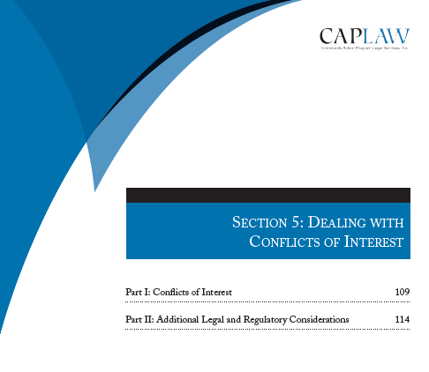
Policies
Conflict of Interest
CSBG Org. Standard 5.6
Each board member has signed a conflict of interest
policy within the past 2 years.
*
Sample policies and archived
webinar on CAPLAW’s website, www.caplaw.org
Notes:
Generally, a conflict of interest exists whenever an individual who has authority to make or influence decisions affecting the CAA, such as a board member or the person who makes procurement decisions, has a personal incentive (often financial) to influence the CAA to take or not take a particular action.
The prior scenario highlighted one reason board members are tasked with managing conflicts of interest -- funding sources require them to do so. In addition to the various Head Start conflict of interest requirements that apply to CAAs receiving Head Start funds, the CSBG Organizational Standards specifically require board members to sign a conflict of interest policy within the past two years. A robust conflict of interest policy can help protect the organization from losing its tax-exempt status (e.g., because assets or funding is used for the personal benefit of those who exercise influence over the organization) and from negative public perceptions that damage the CAA’s reputation in the community.
It is important to remember that not all conflicts of interest are objectionable. The goal is to develop a clear process to define conflicts, establish mechanisms to disclose potential conflicts and outline a process and criteria to determine whether a transaction involving a conflict is acceptable and permissible.
CAPLAW offers sample conflicts of interest policies for CAAs with and without Head Start programs, webinars discussing different conflicts of interest scenarios CAAs may face, and its resource, Tools for Top-Notch CAAs, which includes a section that specifically discusses how board members can deal with conflicts of interest.

Slide 103
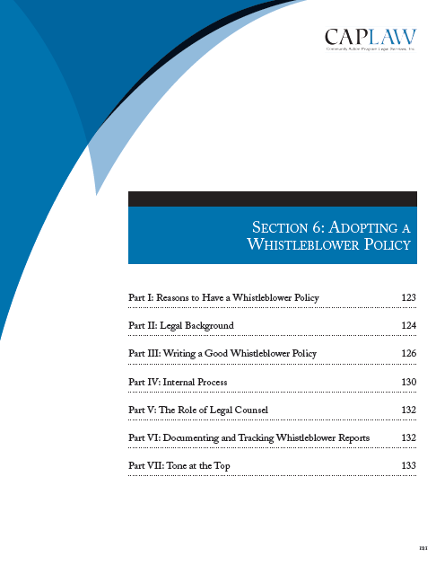
Policies
Whistleblower Policy
CSBG Org. Standard 7.7
The organization has a
whistleblower policy that has
been approved by the
governing board.
*
Sample policies and
archived webinar on
CAPLAW’s website. www.caplaw.org
Notes:
A whistleblower policy is one that encourages an organization’s employees, volunteers and other stakeholders to notify designated individuals within the CAA when they have concerns and suspicions regarding fraud, illegal activity and other wrongdoing, and in turn, protects the whistleblower from retaliation. The earlier scenario highlighted a situation where a whistleblower policy would have helped to protect the CAA. The CSBG Organizational Standards also makes clear that CAAs must have such a policy in place that has been approved by the board.
CAPLAW offers on its website a sample whistleblower policy for CAAs, webinars discussing different whistleblower scenarios CAAs may face, and its resource, Tools for Top-Notch CAAs, which includes a section that specifically discusses adopting a whistleblower policy.

Slide 104
Additional Policies
Adopt org. policies, ensure they are being followed, and review/update them periodically
CSBG Org. Standard 8.10
  The fiscal policies have been reviewed by staff within the past 2 years, updated as necessary, with changes approved by the governing board.
CSBG Org. Standard 7.1
  The organization has written personnel policies that have been reviewed by an attorney and approved by the governing board within the past 5 years.
CSBG Org. Standard 8.11
  A written procurement policy is in place and has been reviewed by the governing board within the past 5 years.
Notes:
The CSBG Organizational Standards also require the board to approve a number of other policies that support an organization’s operations. These policies include:
Fiscal polices that must be updated within the past two years with changes approved by the board;
Written personnel policies, which must be reviewed by an attorney and approved by the board within the past 5 years. Human resources is an area where CAAs face a fair amount of liability and where CAPLAW receives many questions. Also, the law in this area is constantly evolving, making it even more critical that the policies be up-to-date; and
A written procurement policy, which must be reviewed by the board within the past 5 years.
While the Standards only require the board to review and approve the policies, such policies are ineffective if staff are not be trained on them and are not following them.

Slide 105
Additional Filings
CSBG Org. Standard 8.8
CSBG Org. Standard 8.6
All required filings and payments related to payroll withholdings are completed on time.
The IRS Form 990 is completed annually and made available to the governing board for review.
Notes:
Boards should also be aware of other filings that the CAA is required to submit under the Uniform Guidance. Board members could face personal liability if payroll taxes are not paid, and thus boards should ensure these are being paid on a timely basis. Further, a CAA, as a tax-exempt organization, is required to report on its Form 990 that the board received a copy of the informational filing—this requirement is reflected in the CSBG Organizational Standards, which require that the CAA’s Form 990 be made available to the board for its review.

Slide 106
Oversee Financial Standing
1
  Review financial statements
2
  Approve and monitor annual budget
3
  Set and reassess CEO compensation
4
  Select and monitor auditor
Notes:
One of the board’s primary functions is to oversee a CAA’s finances, to determine how to allocate its resources and to protect its funds and resources from misuse or mismanagement. The board meets this responsibility by:
Regularly reviewing financial statements
Approving and monitoring the annual budget.
Setting and revisiting the executive director’s/CEO’s compensation and
Selecting and monitoring the auditor.
We will discuss in greater detail the board’s role with regards to each of these tasks in the following slides.

Slide 107
Financial Statement Scenario
CAA’s CFO, Ms. Moneypenny, decided that providing the board with a complete set of financial statements is a mistake. In Moneypenny’s view, the board should review a detailed schedule showing each program, the revenue associated with the program, and the related expenses. Moneypenny believes CAAs are unique because of their reliance on multiple revenue streams that must be used for specified purposes. In her view, entity-level financial statements make no sense because grant revenue from one program (e.g., CSBG) cannot be used to finance another program (e.g. Head Start).
Do you agree with Moneypenny’s approach? Why or why not?
Notes:
While Moneypenny is providing the board with useful information, she is ignoring the value of entity-level financial statements. External stakeholders often require financial information that reflects the entity as a whole. For example, if a CAA had a revolving line of credit to finance, the bank, in administering the loan, would look to the CAA as a whole. This means the board needs to also look at the entity as a whole to make sure that there is sufficient liquidity to satisfy the bank. In other words, the board should be looking at the CAA through the eyes of an external stakeholder. Moreover, not all assets are restricted to a particular program. CAAs may have unrestricted cash, receivables, and fixed assets (equipment and buildings). The board should be monitoring these on an ongoing basis. Finally, if the board wants to expand into new areas, it needs to understand the resources available for expansion.
Although Moneypenny may have legitimate reasons for disagreeing with the whole-entity approach, she should keep one fact squarely in mind: providing the board with a complete set of financial statements does not preclude her from supplementing the financial statements with schedules that show operations on a program-by-program basis. In fact, providing these supplemental schedules is an encouraged practice and enable the board to assess the financial health of individual programs.
Lesson: A board member who does not receive a complete set of financial statements, including the balance sheet, should demand them. Those who think board members won’t understand them or will be hopelessly confused are doing everyone a disservice, including themselves.

Slide 108
Financial Statements
Board’s approach to financial statements (balance sheet, income statement, cash flow statement) includes:
  Preliminary review by finance committee
  Review by every board member
  Regular discussion
  Once-a-year discussions (e.g., annual budget, etc.)
  Question and answers
Notes:
Every regular board meeting should include a review of the CAA’s financial statements, be they the year-end audited statements or interim statements. Typically the interim statements are less formal than the audited ones, but if the CAA’s accounting system is a good one, these statements should be relatively accurate. CAPLAW recommends a five-step approach to the periodic review:
Step 1: Preliminary Review by the Finance Committee
The CAA should have a finance committee. One of the committee’s tasks should be to review the financial statements in advance of the board meeting and report on the statements at the meeting. If the CAA does not have a finance committee, someone should be designated to review the statements in advance of the meeting and lead the discussion. This person could be a board member or the CAA’s CFO or treasurer, depending on the CAA’s resources and circumstances. Even if a non-board member leads the discussion, CAPLAW recommends that the staff member review the statements ahead of time with a board member, such as the treasurer, so that at least one board member will have a more detailed understanding of the statements.
Step 2: Review by Every Board Member
Every board member should receive a packet of financial information at least one week in advance of the scheduled board meeting. The packet should include a complete set of financial statements, and if possible, an analysis of the statements from the board’s finance committee or the CAA’s CFO or treasurer. Each board member—no matter how financially illiterate—should review the financial statements before the meeting.
Step 3: Regular Discussion of the Financial Statements
The meeting agenda should set aside sufficient time to permit a thorough discussion of the financial statements. The discussion should include a review of:
Variances from budget—comparing what actually happened with the annual plan
Liquidity—the CAA’s ability to meet its obligations as they become due
Unrestricted net assets available for operations
Program-by-program analysis of revenue and expenses
Key financial metrics
Stability of the CAA’s grants and other revenue sources
Any other matters involving finances warranting discussion
Step 4: Once-a-Year Discussions
At least once a year, the board should discuss the following matters in detail: auditor’s annual report and management letter; CAA’s annual organization-wide budget; CAA’s system of internal controls; CAA’s overall financial health, including its liquidity and unrestricted net assets; CAA’s long-term financial plans and needs. The board need not address all of these topics at the same meeting.
Step 5: Questions and Answers
Time should be set aside during each discussion of the CAA’s finances for a robust Q & A session. Questions should be encouraged.

Slide 109

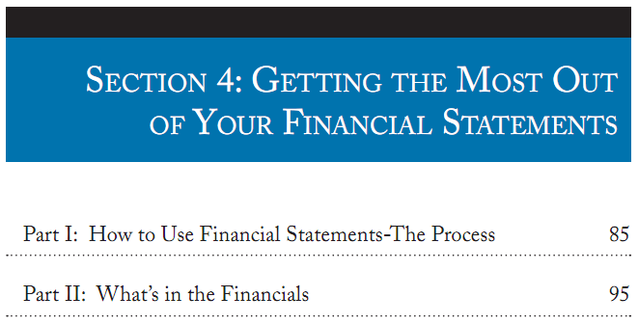
Notes:
If board members are struggling to read and understand the CAA’s financial statements, encourage them to review the section from CAPLAW’s Tools for Top-Notch CAAs, which walks through each of the financial statements and offers tips on what boards should be focusing on with regards to each of the statements.

Slide 110
CSBG Organizational Standards
Financial Statements
CSBG Org. Standard 8.7
The governing board receives financial reports at each regular meeting that include the following:
Balance sheet/statement of financial position.
Org.-wide report on revenue and expenditures that compares budget to actual, categorized by program; and
Notes:
As previously noted, the CSBG Organizational Standards require that boards receive financial statements at every meeting.

Slide 111
Annual Budget
Monitor performance against budget during year
Board members should develop a high-level understanding of:
  Overall budget goals and assumptions
  Cost centers
  Applicable grant requirements
Work with finance committee and fiscal staff to develop annual budget
Notes:
The annual budget is one of the most useful tools the board will use to monitor the CAA’s performance throughout the year. To ensure that the budget is effectively used, the board should assist its members with developing a high-level understanding of the following:
Budget Goals: Each board must determine its overall financial goals for the year covered by the annual operating budget. CAAs are encouraged to work toward long-term sustainability, which requires building both cash reserves and net assets (the nonprofit term for equity or net worth). To achieve these sustainability goals, the CAA must budget to have overall income exceed overall expenses in the annual budget. Unfortunately, many governmental funding agreements are structured on a “use it or lose it” cost reimbursement basis. Budgeting to generate income that is greater than expenses requires the CAA to develop additional strategies to overcome the limitations of cost reimbursement contracts.
Assumptions: The annual operating budget represents the CAA’s best estimate or projection of income and expenses for the upcoming fiscal year. Sound budgeting requires systematic recording of the assumptions that are the basis of the projections. Clear documentation of assumptions will make it much easier to calculate the impact on the overall budget that will occur when assumptions change.
Cost centers. CAAs frequently operate multiple programs and in many instances, each program is supported through the use of resources from multiple sources. The use of a cost center budget structure facilitates describing how various programs will be supported and how various funding sources will be used in accordance with the requirements of specific funders. Budgets for all cost centers must be integrated into the comprehensive annual budget document. For example, a CAA with a Head Start, weatherization, and energy assistance programs should develop budgets for each program. It should also develop cost centers for general administration and fundraising.
Grant requirements. Board members should have a high-level understanding of the goals of the financial requirements that apply to federal grants so they understand the need for strong financial systems and processes and are able to effectively oversee the CAA’s financial compliance.

Slide 112
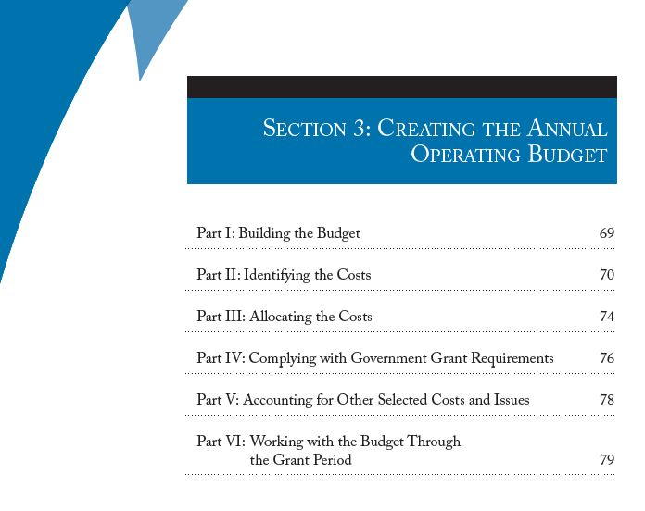
Notes:
This section from CAPLAW’s Tools for Top-Notch CAA’s will help tripartite boards understand how annual budgets are developed, the purpose they serve and the federal requirements that apply to the budgeting process.

Slide 113
CSBG Organizational Standards
Budget
CSBG Org. Standard 8.9
The governing board annually approves an organization-wide budget.
Notes:
The CSBG Organizational Standards require boards to approve an organization-wide budget on an annual basis.

Slide 114
CEO Compensation Scenario
Tonya has been the CEO of CAA, Inc. for the past 5 years and is concerned about her compensation. There is no formal or written compensation-setting process. The practice has been for the board chair to meet for coffee with the CEO once a year to discuss her performance and compensation for the following year. The chair then reports the meeting to the board and recommends a certain percentage increase. The board votes on the percentage increase, although the total compensation is not disclosed to the full board.
Do you think the way in which the board sets Tonya's compensation is appropriate? If yes or no, why?
Notes:
See answer in notes on next slide.

Slide 115
Executive Director Compensation
Understand IRS requirements, in particular, intermediate sanctions
Establish a presumption that compensation is reasonable:
  Use board committee
  Assure board independence
  Link pay to performance
  Rely on meaningful comparables
  Document the process
Recognize funding source requirements
Notes:
Another important responsibility of a board is to set the compensation it pays to the executive director. Nonprofit CAAs, as tax-exempt organizations, must comply with Internal Revenue Services (IRS) rules when setting an executive director’s compensation. The rules require the board to ensure that the compensation is reasonable and not excessive. The IRS has also established a process for setting executive compensation that, when followed, create a presumption that the compensation is reasonable. If the CAA had followed the IRS’s process, it would have shifted the burden to the IRS to prove that that the compensation paid was excessive and not reasonable.
The IRS requirements around executive director compensation are in place to prevent a tax-exempt organization, like a nonprofit CAA, from giving an executive director what may be viewed as excessive compensation. The IRS rules impose taxes on transactions where an individual with substantial influence over an organization receives an excessive economic benefit from the organization. If the compensation is not reasonable, the IRS will invoke “intermediate sanctions”, requiring the individual who received excessive compensation to return the unreasonable portion to the organization and to pay a penalty tax to the IRS. In addition, board members who approved the compensation knowing that it was excessive may also owe penalty taxes.
In an effort to establish the reasonableness of an executive director’s compensation, a boards should consider adopting the following approach:
Use a Board Committee: A committee of the board (such as the executive committee or the personnel committee) usually undertakes the responsibility to ensure that the proper compensation analysis is conducted, such as researching comparables, to show that salary ranges and compensations are reasonable.
Assure Board Independence: Any board members who have a conflict of interest with respect to the transaction should recuse themselves from discussions and voting on the matter.
Link Pay to Performance: Compensation levels and any bonuses should be linked to performance. Establishing compensation goes hand in hand with evaluating performance and setting goals. While cost-of-living increases and incentive compensation under a written plan may be permissible, boards should avoid increasing compensation levels based on non-performance related factors such as seniority. CAPLAW recommends caution when considering awarding bonuses and incentive compensation because IRS rules that apply to written plans for executive compensation are complex, and many organizations have had costs associated with such compensation disallowed under federal grant rules for either not having a plan or failing to follow their plan.
Rely on Meaningful Comparables: Use organizations for comparison that are similar to your CAA. To be considered comparable, an organization should conduct similar programs, be relatively equal in size, and have a similar workforce.
Document the Process. In setting the executive director’s compensation, the board should rely on a clearly-defined deliberative process that is documented. The board must adequately document the basis for its determination concurrently with making that determination.
When setting the executive director’s compensation, the board should be aware of funding source requirements that apply to the federal funds that may be used to pay the compensation. For example, typically the federal appropriations act which funds all of a CAA’s federal grants impose salary caps for an applicable year.

Slide 116
CSBG Organizational Standard
Executive Director Compensation
CSBG Org. Standard 7.5:
The governing board reviews and approves CEO/executive director compensation within each calendar year.
Notes:
The CSBG Organizational Standards require the board to review and approve the CEO/executive director’s salary on an annual basis. For more information about the board’s role in setting the compensation for the executive director and the applicable legal requirements, see CAPLAW’s Dynamic Duo: A Guide to Enhancing the Board & Executive Director Partnership.

Slide 117
Audit Exercise
The auditor prepares the CAA’s financial statements. True or False
An audit primarily certifies the fairness of financial statements. True or False
An audit is mostly for management’s benefit. True or False
A high-quality audit is a waste of money that could be better spent on mission. True or False
Notes:
False. The financial statements are management’s responsibility. The auditors are prohibited by professional standards from preparing the financial statements. During the course of an audit, the auditors may demand that the financial statements be adjusted because an accounting principle was incorrectly applied or because errors have been uncovered, but by and large, this is (and should be) the extent of the auditor’s involvement in the preparation of the financial statements.
True. Many think that an audit’s primary purpose is detecting fraud. However, the primary purpose of a financial statement audit is to certify the fairness of the financial statements. The professional standards applicable to financial statement audits require an auditor to consider the possibility of fraud to the extent it bears on the fairness of the financial statements, but detection of fraud is not the audit’s primary objective. Management is responsible for detecting and preventing fraud. Management discharges this responsibility by putting in place and continuously improving the CAA’s system of internal controls. Moreover, the audit cycle makes the detection of fraud less likely. Depending on the CAA’s size, the auditors conduct an audit over a several week or month period following the close of the CAA’s fiscal year. Even if the auditor shared responsibility for detecting fraud, the fraudster has ten or eleven months following the close of an audit to embezzle, steal, or otherwise defraud a CAA. That is more than enough time to do inflict significant harm.
False. Of course, management does benefit from an audit. The mere act of preparing for an audit requires the accounting staff to tie up loose ends and engage in a self-assessment. However, the board is the intended and primary beneficiary of an audit. The audit is an integral part of good internal control and oversight system. The board relies on the financial statements to allocate financial resources, evaluate management, and shape mission. The board looks to the auditor for assurance that it is prudent to rely on management’s financial statements.
False. There are two fallacies embedded in this statement. Mission and administration are inextricably linked. Any effort to distinguish between money spent on mission and money spent on administration is artificial. No entity can deliver goods or services without an administrative infrastructure. Without solid administration, money that is spent on mission will go to waste. The challenge is to strike the right balance between direct and indirect expenditures on mission.
An audit provides concrete benefits. The culminating step in the audit is the issuance of an audit opinion, also referred to as an audit report. Although that piece of paper may provide little or no insight into the audit or the CAA’s finances, a well-done audit nevertheless has great value to the CAA. As we will see, management and the board must be willing to work and communicate with the auditor to extract that value.

Slide 118
Board’s Role in Audit
Board retains auditor and should work with a board audit committee to:
  Oversee board’s relationship and interaction with outside auditors
  Monitor CAA’s system of internal controls
  Indentify and monitor financial related risks
  Conduct in-depth review (w/auditor present) of Single Audit compliance and prepare report to the board
Notes:
An audit is a multi-step process whose goal is to assess whether the financial statements prepared by management present an accurate and fair portrayal of the agency’s financial condition, cash flows and operating results. Since the primary purpose of the audit is to provide the board with comfort that management has produced financial statements that present the CAA’s financial results and position accurately in all material respects, the board, not management, should retain the auditor.
The audit committee should assess the auditor’s independence and communicate with the auditor. The auditor is required to communicate to the board: (i) the auditor’s responsibilities under Generally Accepted Accounting Standards (GAAS); (ii) an overview of the planned scope and timing of the audit; and (iii) significant findings from the audit. The auditing standards contemplate a formal communication process, specifying which communications are written or oral. Auditing standards require the auditor to communicate to the board significant control deficiencies and material weaknesses in the system of internal controls. The audit committee should have members capable of facilitating the committee’s role in the discussions. These members must understand the implications of the communications and be in a position to demand that management respond appropriately.
The audit committee receives the results of the audit from the auditor and must address any issues raised by the audit. To address these issues, the committee should review the auditor’s written communication regarding control deficiencies, engage in a discussion with management about the deficiencies and the need to make changes in systems, and require periodic progress reports from management. Auditors are required to start their auditing procedures the next year by examining whether previous deficiencies were resolved and how the board handled the audit findings
The audit committee will also work with the auditor to conduct the Single Audit review which is the review required by the federal government for organizations that expend a certain amount of federal dollars. The audit focuses on financial and program compliance.

Slide 119
CSBG Audit Requirements
Nonprofits
CSBG Org. Standard 8.2: Nonprofit
  All findings from the prior year’s annual audit have been assessed by the organization and addressed where the governing board has deemed it appropriate.
CSBG Org. Standard 8.3: Nonprofit
  The organization’s auditor presents the audit to the governing board.
CSBG Org. Standard 8.4: Nonprofit
  The governing board formally receives and accepts the audit.
CSBG Org. Standard 8.5: Nonprofit
  The organization has solicited bids for its audit within the past 5 years.
Notes:
The CSBG Organizational Standards require the board to be involved in the CAA’s audit by soliciting bids for its audit every five years, formally receiving and accepting the audit bid, receiving the audit from the auditor, and addressing all findings from the prior years audit when deemed appropriate.

Slide 120
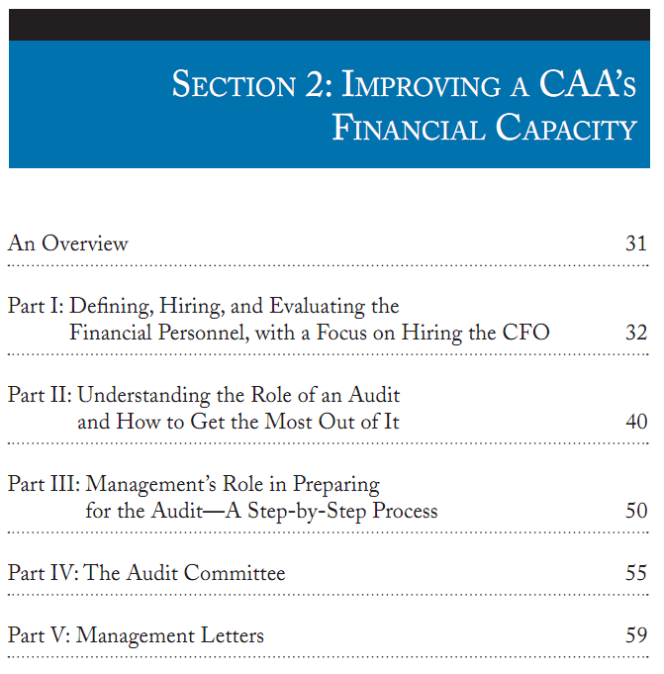
Notes:
For board members who are not familiar with audits, CAPLAW’s Tools for Top-Notch CAAs explains the role of the board versus management in the audit process as well as the duties of an audit committee and the purpose of management letters received at the conclusion of an audit.

Slide 121
Culture of Compliance Scenario
CAA’s Finance Manager compares receipts with expense reports and handles reimbursement requests. The Deputy Director and Program Manager submitted reimbursement requests for a training conference they both recently attended. The Program Manager kept her expenses very low by using the free hotel airport shuttle, eating all the meals included in the registration fee, and avoiding any unnecessary expenses. The Deputy Director used a taxi, ordered room service, consumed several mini-bar items, and sent clothes to the hotel laundry.
What, if anything, should the Finance Manager do?
Notes:
The tone at the top is the message about ethics and integrity that organization leaders send through their words and behaviors. Visible commitment by the organization’s board and senior management is essential to cultivating a culture of compliance and high ethical standards. The tone at the top needs to be one that emphasizes accountability, knowledge of procedures, compliance, and honesty.
Failure to reinforce these principles will be an open invitation to staff to cut corners for the sake of expediency, to avoid or never learn program requirements, and to be sloppy in their attention to details like reconciling accounts and documentation.
In this scenario, the finance manager may approach the deputy director’s supervisor, executive director, and express his/her concern with the deputy director’s reimbursement request. The CAA could also ensure that its expense reimbursement policy is clear and educate employ on compliance with it. The executive director may, pursuant to its personnel policies, decide to discipline the Deputy Director for failure to follow organizational policies, if such is found to be the case.

Slide 122
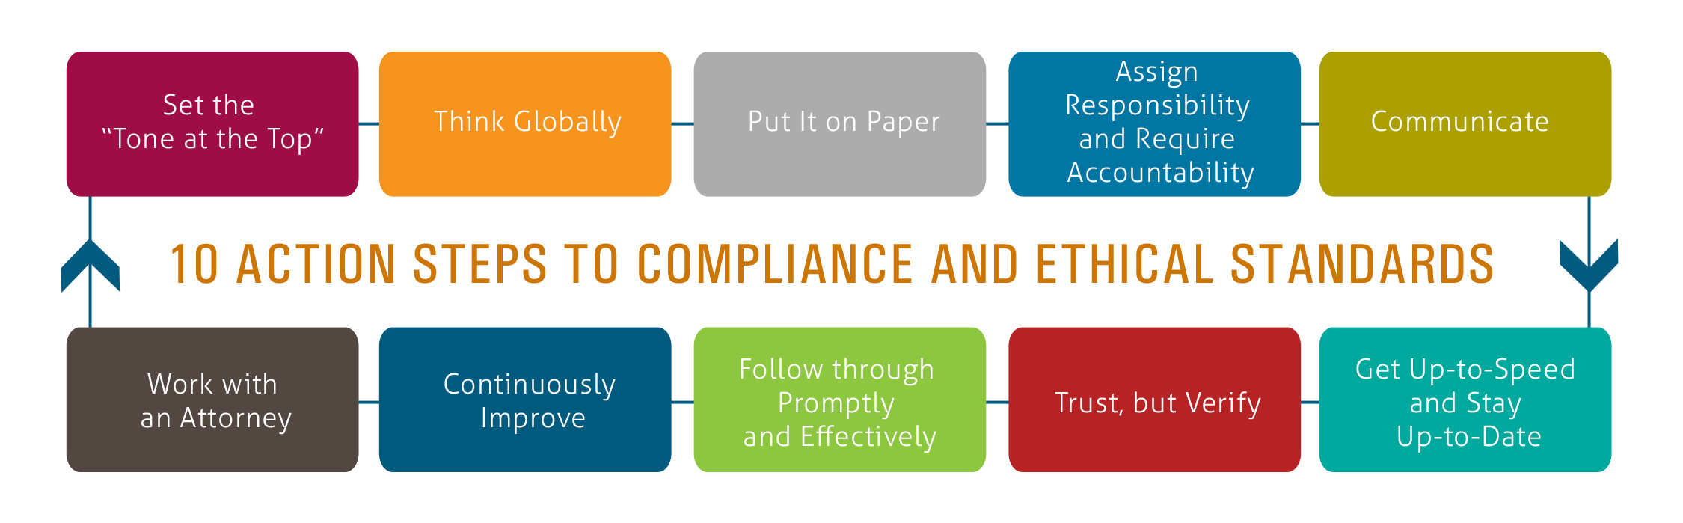
Developing a Culture of Compliance
Exemplary Legal Practices and Policies Guidebook, Part I: Do the Right Thing: How to Cultivate a Culture of Compliance and High Ethical Standards http://caplaw.org/resources/PublicationDocuments/DotheRightThing.html
Notes:
CAPLAW offers a resource, Exemplary Legal Practices and Policies Guidebook, Part I: Do the Right Thing: How to Cultivate a Culture of Compliance and High Ethical Standards that walks CAA leaders through ten steps to help them develop an approach to ensuring compliance and ethical behavior at the organization. The Guide includes specific examples of actions CAAs have taken to meet each of the steps listed above. The steps represent a continuous process that should be integrated into the CAA’s existing operations.

Slide 123
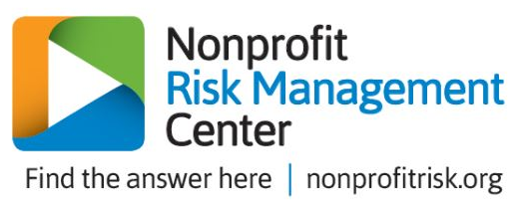
Risk Management
CSBG Org. Standard 4.6
An organization-wide, comprehensive risk assessment has been completed within the past 2 years and reported to the governing board.
Community Action Partnership Risk Management Portal:
https://communityactionpartnership.com/online_tools/risk-management-portal/
Notes:
The CSBG Organizational Standards requires that CAAs conduct a comprehensive risk assessment every 2 years. This risk assessment assists boards in developing a culture of compliance by requiring a comprehensive review of the organization’s systems and processes. The results of the assessment must be reported to the board. While receiving the report is all that is technically required by the Standards, boards may be involved in helping the CAA identify a tool for the assessment.
The National Community Action Partnership, in collaboration with the Nonprofit Risk Management Center, developed a risk management tool specifically for CAAs, the link to which is featured on the slide.
The assessment results should provide the board with feedback as to the effectiveness of the organization’s procedures and policies and where work needs to be done to improve the CAA’s accountability. A board should follow up on any findings from the risk assessment to ensure that the executive director and his/her staff are addressing identified weaknesses in the CAA’s operations.

